Slide 1
How To Study
Workshop
Katia Marion
13/19 March, 2022

Slide 2
Table Of Contents
Part I – Setting Goals
Part II – Achieving Goals
Part III – Sharing Time

Slide 3
Setting goals

Slide 4
Goals
To develop our character and pass our SL test = be faithful Know the character of God How to love our neighbour Unlearn, deconstruct to re-learn | How to create a note system, develop a structure Time management: allocation of time and resources Tools : eSword; websites, charts, newsletter | How to correctly connect all the information How to trace our journey | How to take a study and place it on a line and which line How to break down a study | How to separate noise from truth Separate good article from non-beneficial
How to read Bible, SOP, articles | How to give a reason for the faith we have To Understand and explain with back up truth | How to simplify and explain a subject from a complex perspective Come to unity with each other so we can all teach the same thing | Learn how to teach | Coordination, different materials Personal responsibility

Slide 5
Part ii – Achieving Goals

Slide 6
The Development Of Our Character
When you remember that Christ has paid the price of His own blood for your redemption and for the redemption of others, you will be moved to catch the bright rays of His righteousness, that you may shed them upon the pathway of those around you. OFC 302.2
To understand the plan of redemption, God chose the reform lines so we can navigate through this process.
The purpose of the reform lines is to save us and restore us to God's image by bringing us through an experience that will transform us and change our mindset. This will occur as the message develops, and we are tested upon it (particularly at the formalization).
The message impacts us directly when we have to make a big decision. This is an individual choice but a life and death decision. It will require of us to unlearn and deconstruct lifelong biases to give space to a new education. Faith and a good methodology will help us achieve this goal.
Restored to the tree of life in the long-lost Eden, the redeemed will “grow up” to the full stature of the race in its primeval glory. The last lingering trace of the curse of sin will be removed, and Christ’s faithful ones will appear “in the beauty of the Lord our God;” in mind and soul and body reflecting the perfect image of their Lord. Oh, wonderful redemption! long talked of, long hoped for, contemplated with eager expectation, but never fully understood. {SW March 14, 1905, par. 15}

Slide 7
How To Take Notes
Listen to the presentation and take a maximum of notes (verbatim if possible).
Listen to the presentation a second time in increments of 20 minutes. It would help fill the gaps and ensure all the study concepts have been grasped.
Add quotes, read referenced articles, and watch referenced videos. If a concept is not understood or new, do your research ( e.g. what is lateral reading). It might take you about an hour or more to complete 20 mins of a presentation.
Highlight information that could relate to a particular subject, e.g., blue for methodology; green for the nature of man; red for Millerites history; purple for Sunday Law, etc.
Create different folders for those specific subjects. Copy-paste the information highlighted during the presentation in the related folder.

Slide 8
How To Take Notes, Continues
In a separate folder, make a summary of the presentations. They will serve as a quick reference and a tool to see the progression of our message during the year and ultimately trace our journey.
If time is lacking, use the following websites for transcriptions, charts, newsletters. You can also ask the presenter for their notes.
https://www.themidnightcry.co.uk/
http://repairersofthebreach7.com/bible-studies.html
https://sacramentofellowship.weebly.com/sabbath-fellowship.html
https://en.fin1844.info/index.php/adventnews
https://shop-english.fin1844.info/charts/
http://www.little-book.org/

Slide 9
The Connecting Link – Tracing our Journey
It may not seem easy to connect our journey. We need to pay attention to the "clues" elders Tess and Parminder will provide during their presentations.
They will make the connections for us. Sometimes, it will be said in a nutshell. Sometimes, they will reference a previous presentation. Sometimes, they will spend a whole study showing us the links.
To not miss them, listen to their studies in small increments and ask yourself why they reference 2019, for example, why they want us to understand the Apis Bull or the 14th Amendment, what is the link with their last presentations as they build on one another.

Slide 10
The Connecting Link, An Example
In her first presentation of the year, elder Tess read from the book FLB 306.2 to show us that there was a third group who received the light but doesn't appreciate it. Since she taught feminism and gender in 2019, we see that group developing. Who is she pointing out?
The answer - the connecting link - is given during the vespers she hosted on TMW on March 11, 2022. As she develops, comparing and contrasting the Left Wing with the Right Wing and the conflict between equality and freedom, elder Tess points out the German International Camp Meeting.
Since Feminism and Gender are taught, people misheard her words. She speaks for equality, and they hear freedom, unrestricted freedom because of their right Wing mindset. From there, constant clash going on with the leadership, over makeup or women to have the right to choose dowry, or men who abuse their wives, to have the right to be viewed as the victim, to name a few examples. If they claim to believe in equality, they don't have freedom. They are the socially Liberals; they are that third group and this is the link!
Now we can look back at our history and see how God led us. Moreover, it will strengthen our faith to see there is no mistakes in the lines/messages.
Elder Tess in 2020 made a presentation called you don’t have the freedom. Elder Parminder presented in Uganda a study called, law or good advice.
All these studies help us to trace link after link the chain of truth!

Slide 11
1989
IK
F
2d Adv.
2001
SL
COP
2019
2021
144K
Morally Conservatives
Republicans
Leave the mvt
Socially Liberals
Demorats
Believe in equality
Morally Liberals
Republicans
Confuse freedom with equality
Do not appreciate the light

Slide 12
How To Study – Place on the Line
In the movement, we privilege to follow of a structured methodology/Parable teaching. Spending 90% of our time in the context and structure and 10% in the application is the best way to study.
When doing this exercise, place everything on a line. It will guide you through your study and allow you to see if you haven’t miss anything.

Slide 13
90% History,context, structure of the Text
Look at the Internal context (who/ where is the author? why is he writing? to whom does he speak? what is going on in the church? etc.) and the external context ( history, political, social, economic context, etc.) and compare and contrast the internal with the external.
Look at the structure of the text ( meaning of the words ( Strongs, Dictionary, etc.); the first mention of the word to have its proper bearing. Look at the verses and chapters before and after; look at the author's writing style ( does he compare and contrast, use a chiasm, repeat and enlarge, literal vs,spiritual, juxtaposition, cause and effect, etc.?). Define the words according to the context. E.g., A woman = a church. Look at any cause-to-effect relationship. Keep the theme in mind.
10% Application
Compare and contrast with the Alpha and Omega histories. Apply the text to our period according to social, cultural, judicial, and religious developments.

Slide 14
Additionally in SOP, Look at:
Publishing Date
Historical context ( internal and external)
Title
First sentence and the most important word
First paragraph
Conclusion
Do not gather bunch of quotes at once. This is not parable teaching!

Slide 15
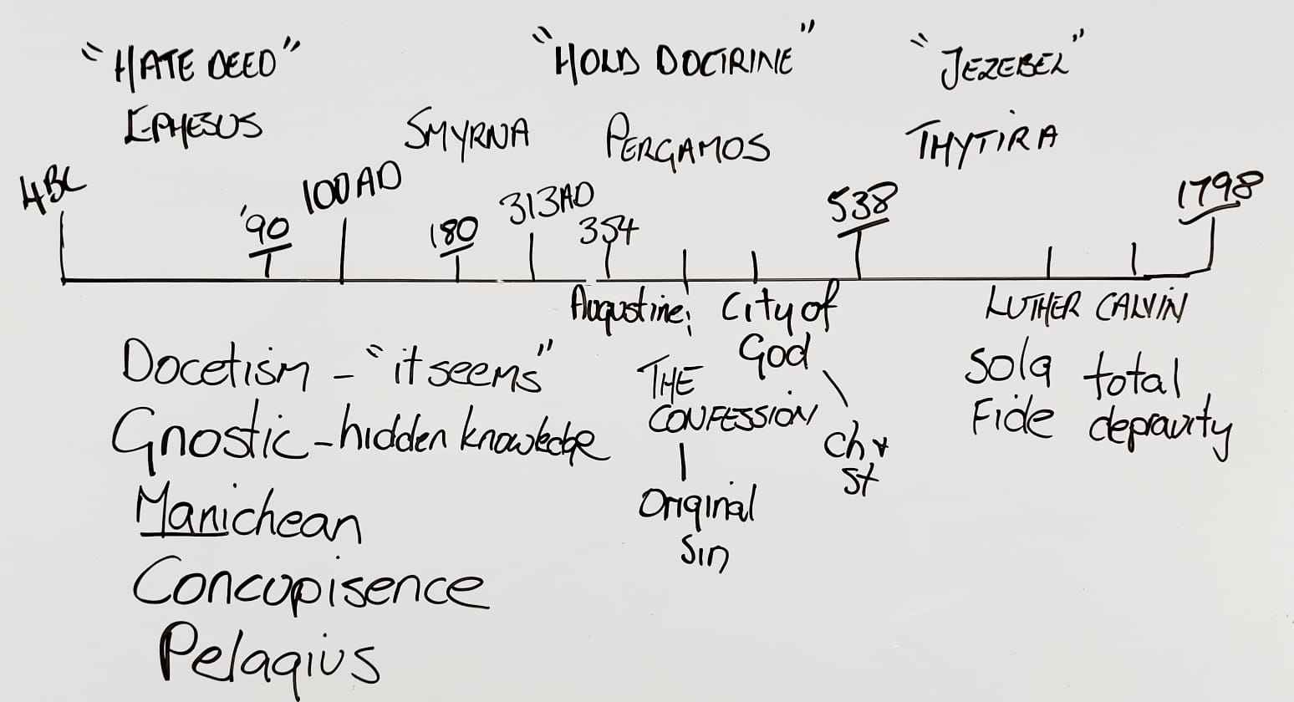
This is an Example of placing a progression of events on a line.

Slide 16
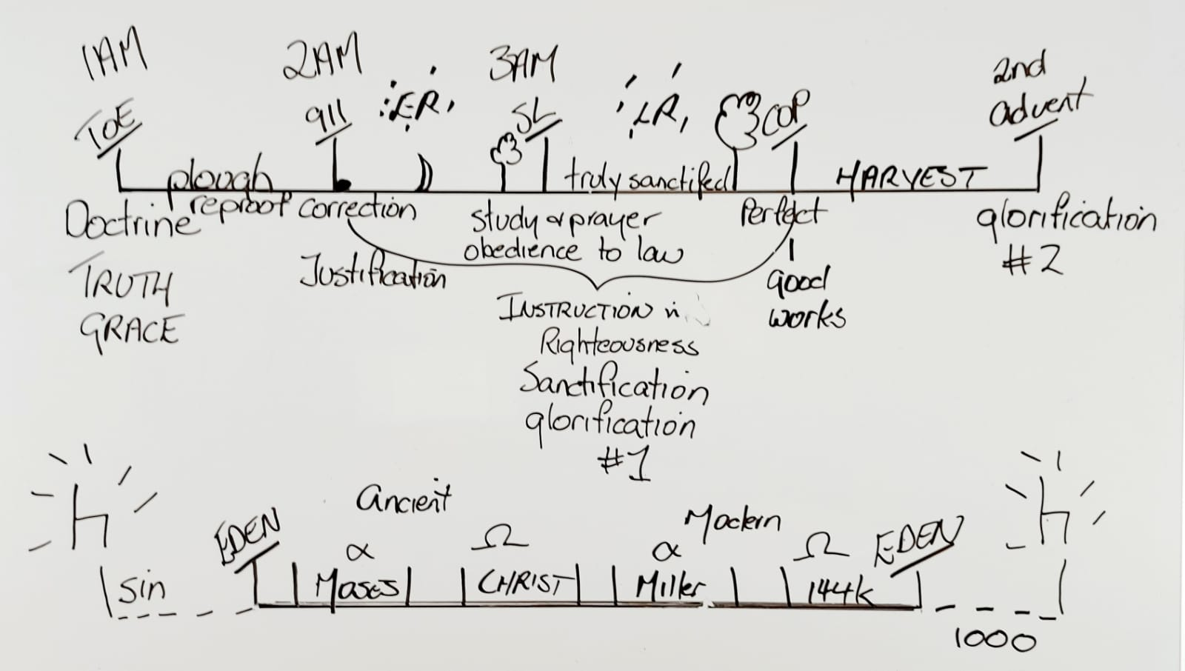
You can follow the agricultural model depending on the passage you choose.
Ploughing | Early rain | Latter Rain | Harvest

Slide 17
You may define a theme for your study. Ensure you trace it all the way through.
You may also look at the characteristics of each waymarks and find a similar pattern depending on the model you choose to follow.
Theme
Darkness | TOE | 2nd Waymark | SL | COP | 2nd Advent
- Period of sin and spiritual darkness - Servitude/bondage | - preceded by darkness - 1st AM - God choses a Messenger - A message is unsealed - A call from heaven - A call out of darkness - A prediction of time - A covenant - A people set apart - The Hour of judgement comes | - 1E - 2A - Repeat of history - Baptism/water - Covenant - Activity of the East | - 2E - 3A - A wonderful manifestation of the power of God - Loud cry - Call out of - Mocking - persecution | - Shut door - Daniel 12:1 - Rev. 22:11 - JTT: prayer/wrestling/ intercession/ Mocking/ loneliness - Death Decree - 7 last plagues Destruction, Fire, brimstone, Flood, etc. | - Mountain, - Jesus returns

Slide 18
Elder Tess’s Recommandations
When studying feminism:
It is not a simple message…We need to understand:
What is freedom and what is feminism
If you are confused, please go-back and re-watch to see the distinction between the three branches of feminism
And how to divide truth from error
How we see the links between the truth, and correct methodology, and the messages of the movement.
I don’t want to approach these kinds of issues from the position of conservatism. We should approach them from a well-researched position of what is Feminism.

Slide 19
I want to ask people as you go and study and teach to
go back to the Apis Bull,
go back over the history between the increase of knowledge and the formalization. But I know people will go research these subjects.
Please do it from a prophetic position not an emotional one.
Dissect articles, being willing to discard what does not agree.
But do it with a prophetic brain and take it to reform lines.
Donald Trump, the human embodiment of the SL. If you want to know what conservatism looks like, he will show you.
So, where I believe we should identify as a movement, the only position that agrees with our prophetic message, because the vast majority even down to Eden to Eden, comes through this channel (radical feminism). Much of the rest is compromise or frankly counterfeit.
Notice: Elder Tess is giving us a plan to follow

Slide 20
How To Breakdown A Study
The following model is the simplest but not limited
Keep in mind the theme of your study!
Breakdown the methodology that brought you to your Study
Analyse the Internal and External context
Work on the structure of your theme
Make your application
Make a summary

Slide 21
How To Separate Noise from Truth
I don’t want to approach these kinds of issues from the position of conservatism. We should approach them from a well-researched position of what is Feminism.
Dissect articles, being willing to discard what does not agree.
So, where I believe we should identify as a movement, the only position that agrees with our prophetic message, because the vast majority even down to Eden to Eden, comes through this channel (radical feminism). Much of the rest is compromise or frankly counterfeit.(1)
We discussed lateral reading, how we research and especially using external information. But some of the principles apply to inspiration as well. …To do lateral reading, you need to sift your sources. Assuming that none are Fox news, these are all good sources, still I might only agree with 20% of that one 80% of that one,80 95, 5, 60. we don’t necessary agree with everything…we need to know what to take and what to leave. (2)
Not sure of the side the articles stand on, please use the following website : https://mediabiasfactcheck.com/
Wikipedia is also a helpful source.(3)
(1) #5 Ted Wilson and The Nature of Babylon Elder Tess Lambert 10.30.2021 https://www.youtube.com/watch?v=x201X05uFKU
2) Elder Tess – Vesper # 1 : Navigating the complex : 11-02-2022 https://www.youtube.com/watch?v=jh0jWDL11lA&t=3737s
(3) #1 - The United States is Not Your Problem - Tess Lambert - Oct.1, 2021 : https://www.youtube.com/watch?v=UeJsKc8AJEE

Slide 22
We are a radical feminist movement
The articles we dissect must reflect our position
We should be ready to sift the articles and leave what we do not agree with.

Slide 23
Reasons For Our Faith – Back Up Truth -
Our stories are simple, they have to be to try to make us understand the complexity of what is happening because, we’ll remind us that Adventism believes that the trumpets look like this , not this. Adventism today has difficulty to approach Donald Trump, the republican party, russia, global politics, the pandemic. They can’t approach approach any of this from a prophetic position. They are trying to take it from a moral position. They are trying to be unifying rather than divisive. They all of those divisions within them because they can’t look at present day events prophetically (1)
Talking about Panium : People say hurray, we can see Panium vindicated in a hot war but it’s sad. Because if we have to wait to see a hot war to trust the waymark of Panium, then we never believe 2018! But it is centered on information fighting for global opinion (2)
We must use Bible/SOP + methodology to explain our faith.

Slide 24
Simplicity
People find a comfort in thinking it is just going to be simple where we don’t need to understand everything, we don’t need to worry too much because we will just see it and we see it, we will just do the right thing. If it is just Sabbath and Sunday, I will just see it in congress and then, I will keep Sabbath anyway and my salvation will be secured. (1)
People ask me what they should teach, what we take to the Levites. Individually, a lot of that depends on you. Do not summarize this message (referencing LGBTQ). No summaries. People ask for summaries, do not give it because God didn’t win you through a summary. Do not teach it without stringing them from Eden to Eden, the apis bull, gender equality unless you’re speaking to people who already know that. If people are already well grounded in that, you can bring in all the other parts of that puzzle. But to do that with people who are not strong in the message, you’ll sever gay marriage from the subject of gender. And if this (LGBTQ) was the inevitable conclusion of the midnight cry message, the MC was two streams of information and gender. You cannot split them!
If we are going to go to work, the title of priest is not just some type of card you keep in your pocket. All it means is teachers. (2)
Notice: Elder Tess is giving us a plan to follow

Slide 25
Simplicity, continues.
Unless you can draw for me the immediate history of Modern Rome, explain the Omega in relation to 1989, and the papal connection of World War One World War Two. Unless you can explain 1888 ,protestant history, 1950s and 60s, Moral Majority to today. Conspiracy theories how they interact with these three (referring the three movements) history of Adventism. Until that can be done, your own research that you want to put into those studies will not help you.
You can't build upon a foundation you don't have!
So turn off YouTube. Go to university which you'll find on the https://www.themidnightcry.co.uk. Understand the lines.
That's what the church needs. People with spiritual discernment who puts the responsibility of being a member of this movement in its right place. See the ugliness of sexism.
Notice: Elder Tess is giving us a plan to follow
#2 - Spiritual Discernment and 1850 - Tess Lambert - Oct 1, 2021 https://www.youtube.com/watch?v=gyk3Lq760RY

Slide 26
Do Not Simplify
Do Not Skip a concept
Breakdown your study
Follow the plan
God didn’t teach us that way
We will do damage to the work if we forget how God has led us
Do not compromise

Slide 27
Part III Sharing time
Let us learn from one another!

