Slide 1
Kids’ Prophecy Corner
The Cycle of Life - Menstruation
Written by K.M.L. and edited by E. I. – White Stone Foundation : http://www.white-stone.ca/
August 2021

Slide 2
In The Beginning…
When God created the earth, He made the ground, the rivers, and the oceans. He made the sun, the moon, and the stars. He made the grass and the trees. He made the animals and bugs. Then God looked at everything He made and said that it was good.
But God wasn’t finished. He said, "Let us make man in our image”. And He did! He created man and woman, Adam and Eve. He made their bodies wonderful because they resemble that of God.
And then, He commanded them to be fruitful and multiply. So they loved each other and join their lives together as one.

Slide 3
To be fruitful, God made their body parts with different functionalities. He made Adam with a penis and Eve with a uterus and a vagina. The uterus would carry babies, and the vagina would deliver them. He also gave her breasts so she could feed them.
Uterus
Vagina
Penis

Slide 4
The Cycle
To prepare to receive a baby, the woman's body tells the uterus to prepare a thick, lush, comfy bed.
The bed is lined with blood and nutrients called endometrium necessary for a baby to grow in the womb.
But if there is no pregnancy, the uterus pushes out the endometrium, which comes out of the vagina as a period.
Period

Slide 5
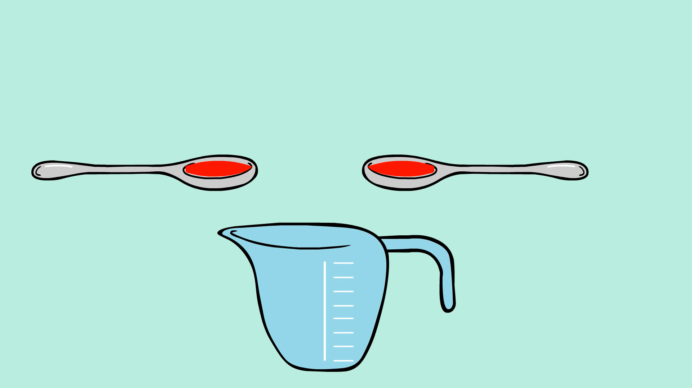
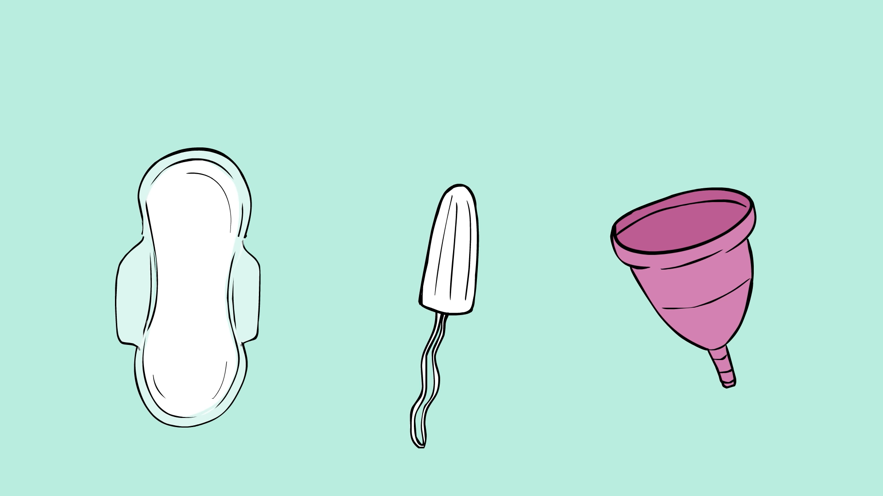
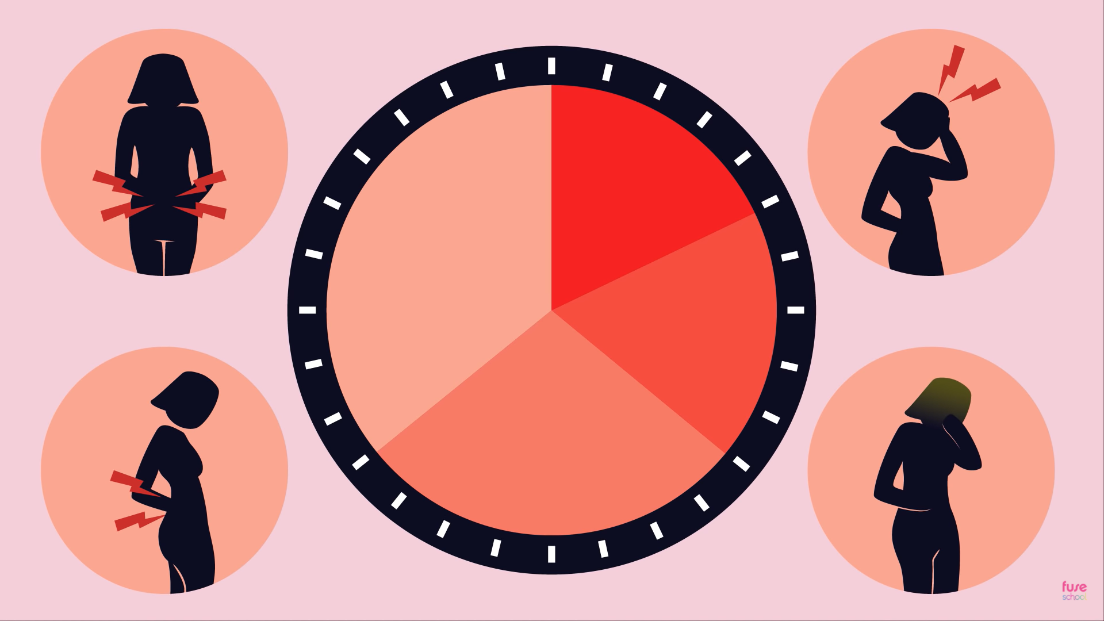
The menstrual cycle happens every 21 to 45 days in young teen girls.
Most periods last from 3 to 7 days, during which a girl may expel about two tablespoons of blood. It may seem more because of other fluids that come out as well.
To keep clothing clean, girls use pads. They may need to change them a few times a day, depending on the flow.
During that time, girls may feel bloated, tired, irritable, moody, or develop acne.

Slide 6
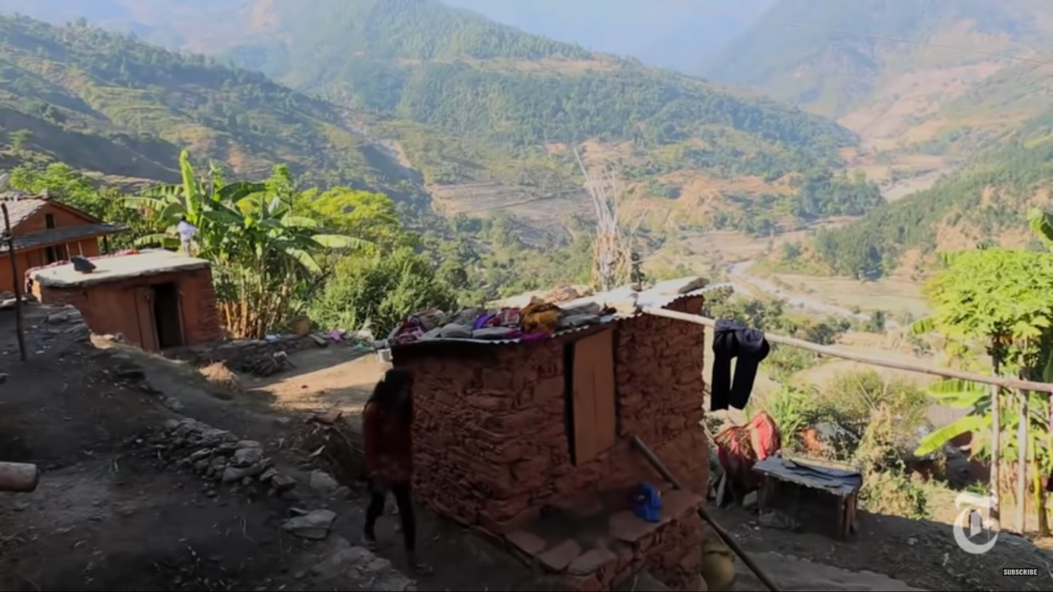
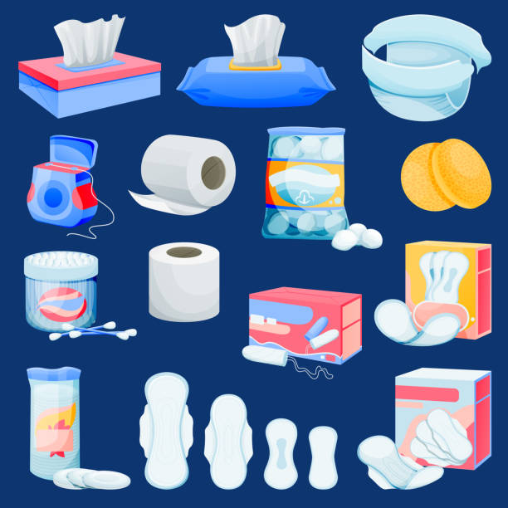
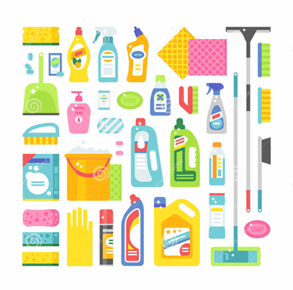
Is a Girl on Her Period Dirty?
Some people think that a girl on her period is dirty.
In some countries, girls are exiled, separated from their families because they are viewed as impure and bringing bad luck.
In Western countries, pads are labeled as sanitary products in the same way as disinfectants or toothpaste.
Some Christians use the Bible to prove it is the result of sin. They believe that God brought this curse on women therefore it should be considered unclean and dirty.
Sanitary/Hygiene Products

Slide 7
But that is not true.
The Bible says that we are fearfully and wonderfully made. God's creation is marvelous!
Menstruation is a normal process God put in place for women. It is part of the menstrual cycle - the time from one period to another- which is usually about 28 days.
It is natural and nothing to be ashamed of.

Slide 8
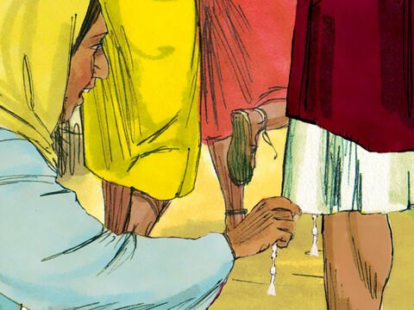
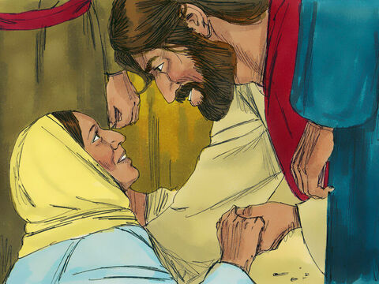
The Example of Jesus
When Jesus was on His way to Jairus’ house with His disciples, He was followed by a multitude. A woman with an issue of blood touched the hem of His garment and was instantly healed.
When He asked who touched Him and she manifested herself, He didn't condemn her. Instead, he blessed her! He said, “Daughter, be of good comfort: thy faith hath made thee whole; go in peace”.
Jesus didn't discriminate against her because of her issue or because she was a woman. In fact, among the careless throng, she was the one who received His healing virtue.
He demonstrated sympathy to her because He valued her as a woman of faith.

Slide 9
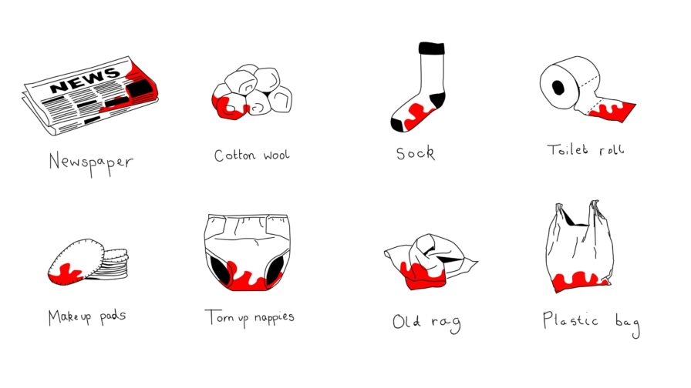
Should We Discriminate?
When we discriminate against a girl because she has her period, it is a form of sexism.
In some countries, girls who menstruate are not allowed to touch water, have milk, or cook food. They are forced to live like animals in a shed. They also don’t have access to pads. They either don’t use any protection or find alternative solutions such as using newspapers or an old rag.
The lack of access to period products is called Period Poverty.
In other countries, access to pads is a luxury product. They are expensive and therefore difficult to get. Some women have to choose between buying food or purchasing pads. They also suffer from Period Poverty.
Some girls will not be accepted in some jobs because men view them as feeble during their period.
All these conducts are sexist and discriminatory. Everyone deserves to be treated equally regardless of their condition.

Slide 10
In Summary
When God Created man and woman, He gave them different genital parts to fulfill some functions.
A girl's body changes when she reaches puberty, so she can have children. If she doesn't get pregnant during the month, the cushion her body prepared is expelled in the form of a blood flow called period or menstruation.
It is a natural and normal phenomenon that God implemented for girls.
Unfortunately, girls have been treated differently because of their period. Therefore, they suffer inequality in the form of sexism.
But we must follow Jesus' example. We must treat girls with respect. Girls should not be ashamed of their period. They should talk openly about it and express their feelings without being embarrassed. Boys should show empathy towards girls and not be disgusted about what God created.
Now it is your turn to take up the challenge. If you have doubts or questions, ask your parents who are here for you.

Slide 11
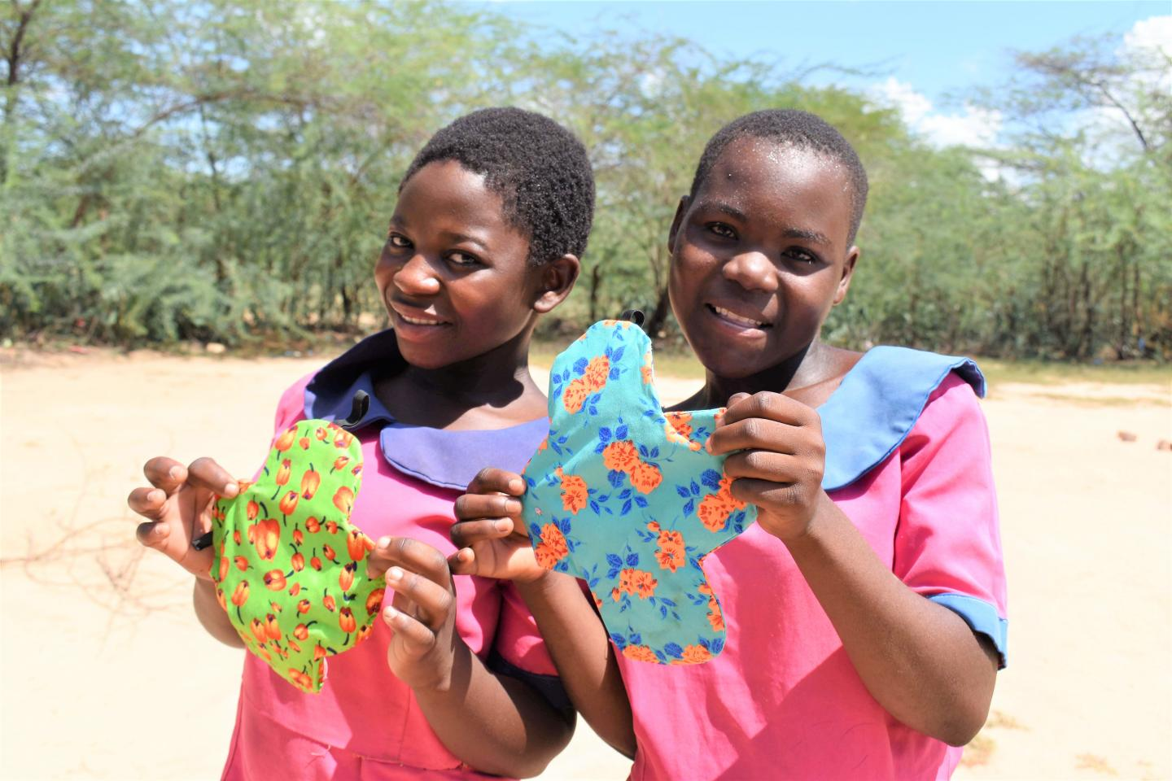
Thank You and God bless!

