Slide 1
THE RED FLOWER IN THE DAISIES
Nationalism narrated to children in the form of a parable
Study written by D.A. April 2021 – www.edenaeden.org – edeneaedene@gmail.com - https://www.youtube.com/c/EDENAEDEN/videos
Translated by K.M.L. – White Stone Foundation

Slide 2
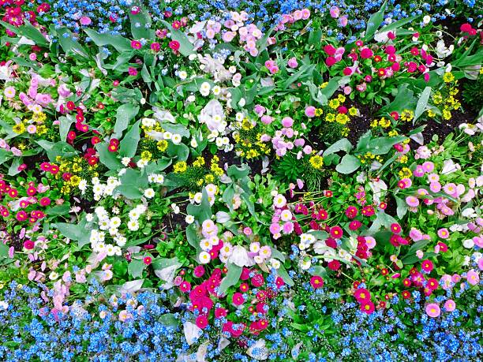
Our story begins
in a field of flowers

Slide 3
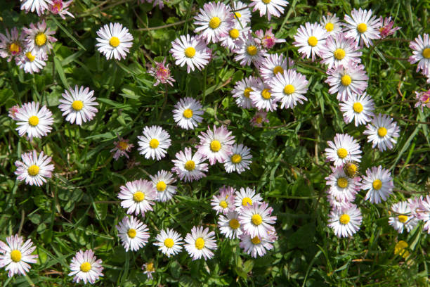
Let's go a little closer. We will discover a small corner of the field where only daisies had grown.

Slide 4
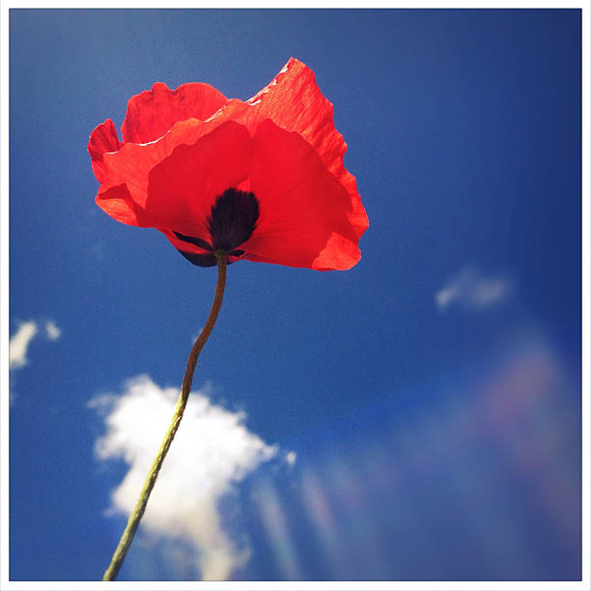
But one day, a red flower appeared in the same corner.

Slide 5
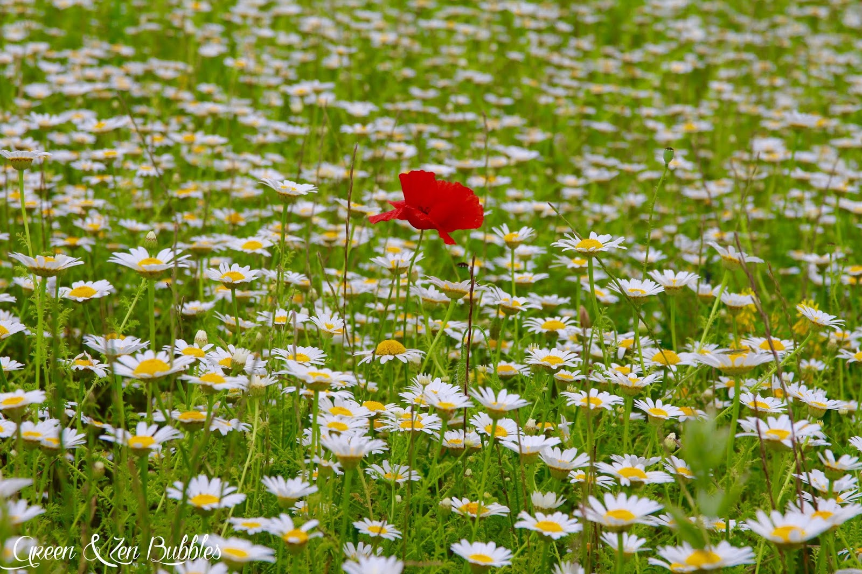
It was
the only
red flower

Slide 6
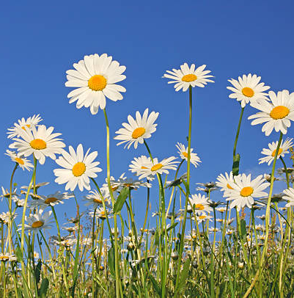
The daisies had never seen such a flower;
They began to ask it a lot of questions.

Slide 7
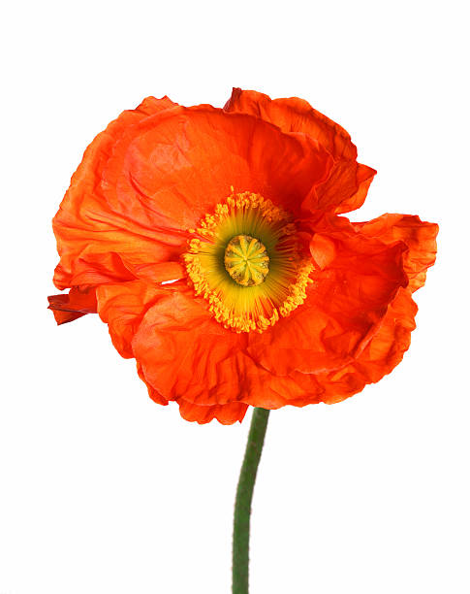
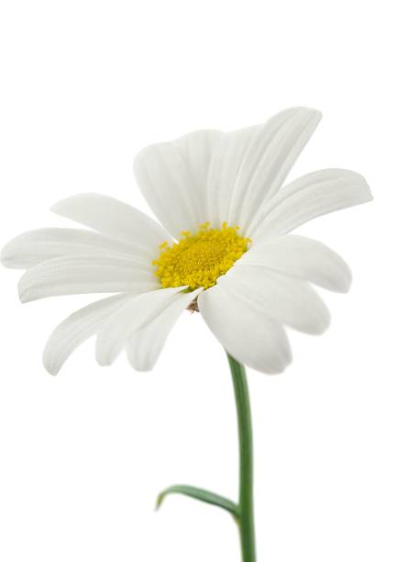
-What kind of flower are you?
-We have never seen a species like you here?
-Where are you from?
-What is your name?
But the red flower didn't answer anything because the flowers looked very aggressive.
-This flower might be dangerous! Maybe it will hurt us! Said the daisies to each other.
They decided not to talk to it anymore. They decided not to talk to it and not to go near it.

Slide 8
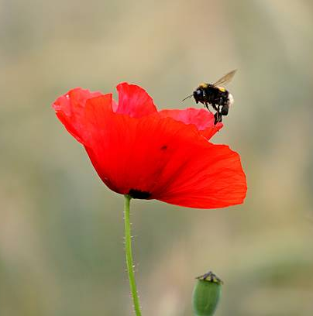
When spring came, the bees intrigued by this red flower, all came to forage for it.
When the daisies saw this, they were green with envy.

Slide 9
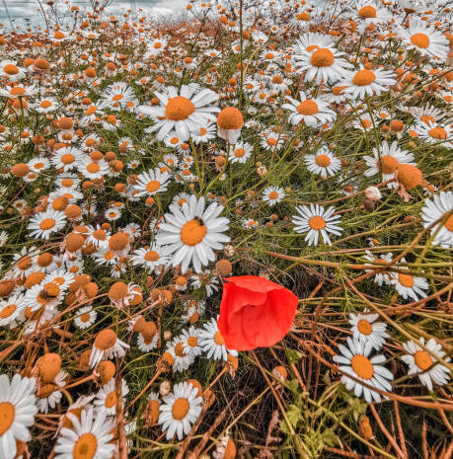
Then they began to give her violent blows to make her go away.
The red flower suddenly asked:
“Why do you hate me so much?What have I done to you?”
-We don't want you here!
-We don't know you!
-We don't know where you come from!

Slide 10
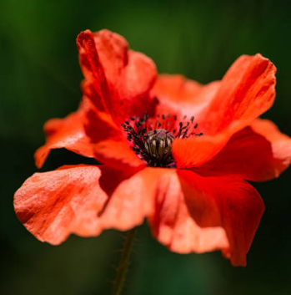
I am a poppy, a flower, like you!
Like you, at night I am cold, and during the day, I am warm.
And even if we are different, I am like you, Nourished by the same earth.

Slide 11
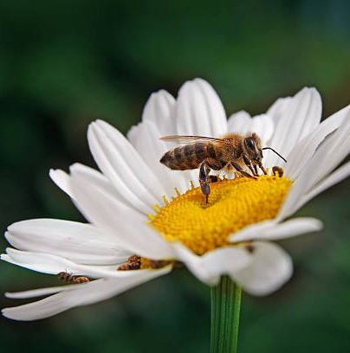
-We don't love you because you steal all our bees!!!
-Yes, you take our work
-And you pollute our honey with poppy!!!
-So go back to where you came from, get out of our field !!!

Slide 12
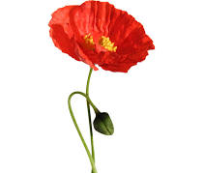
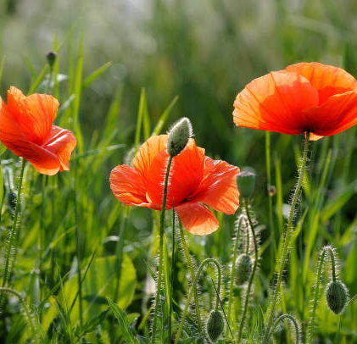
The poor poppy was very sad and felt very lonely.
But time passed, and as the bees had foraged for the poppy and pollinated the field, other poppies grew too; It was no longer alone.

Slide 13
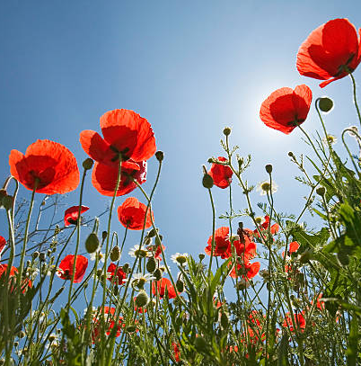
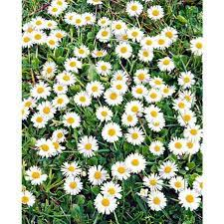
Seeing this, the daisies tried to isolate the poppies with laws they had invented so each group of flowers would remain in its corner of the field.
But it was impossible. Nature doesn’t work like this.

Slide 14
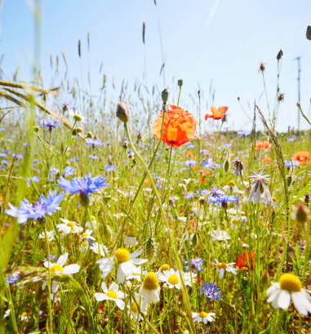
On the contrary, other species of flowers grew in the field.
-With all these flowers,
our field is no longer the same.
-We will disappear, they said to each other.
-We have to do something; after all, these flowers look like nothing,
we are the most beautiful,
they should be like us,
they should have the same petals and the same color.
-And then the bees will forage on them all, and they won't notice us anymore.
-Goodbye to our honey and our work!!!

Slide 15
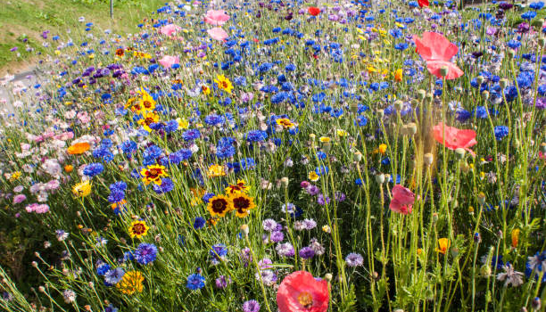
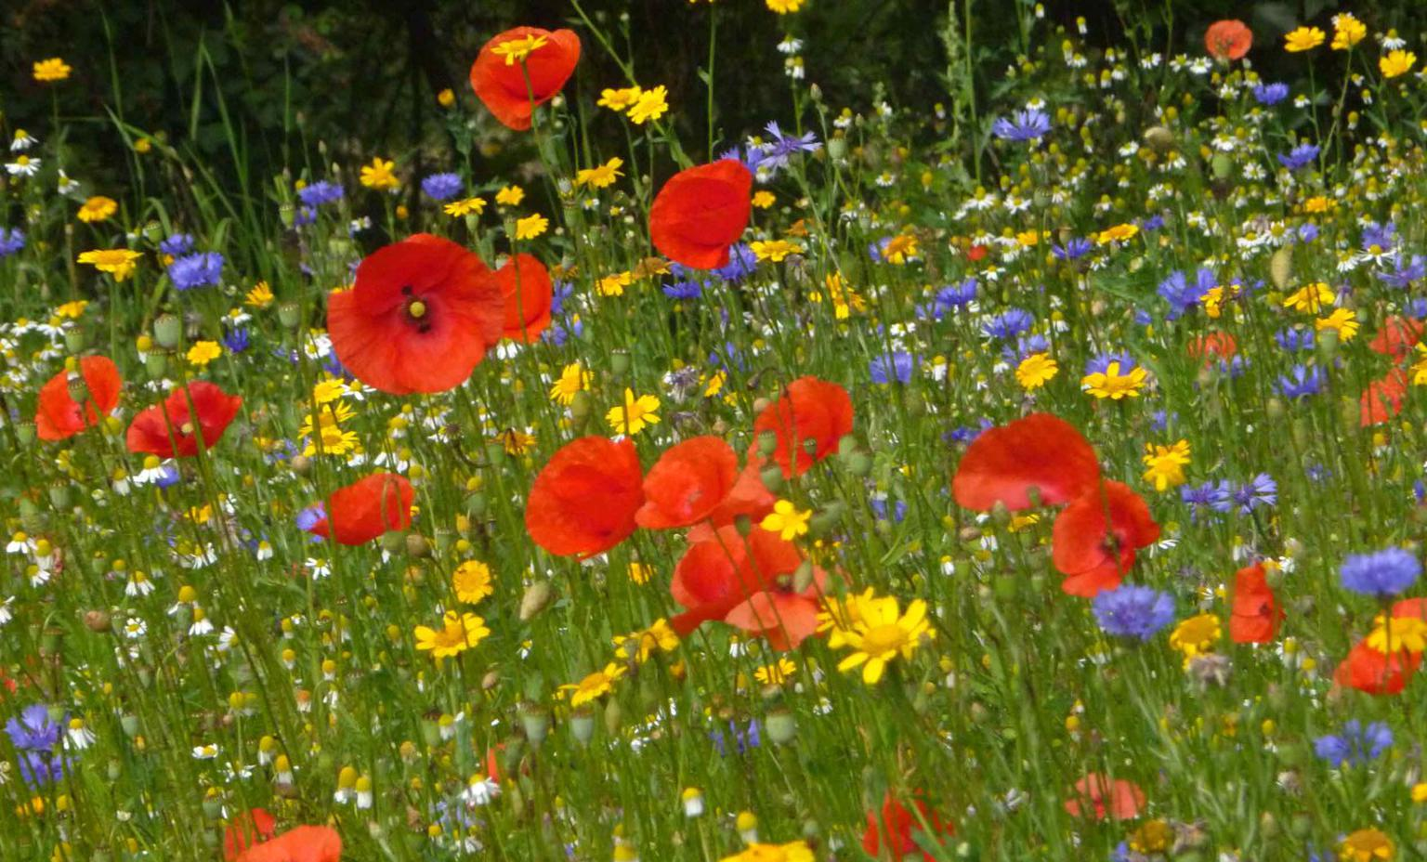
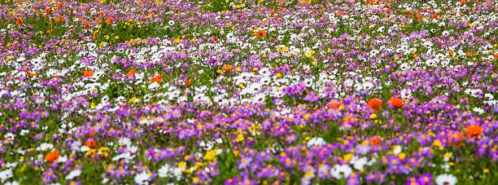
If the daisies had seen the whole field, and not just
the little corner, they would have seen how beautiful it was with all
All the different kinds of flowers that lived together.

Slide 16
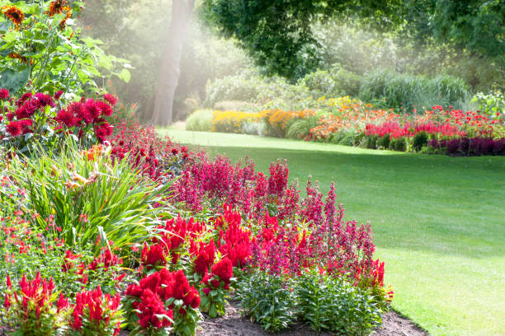
They didn't know how
God had made everything.
The Bible says in Genesis 1:11-12:
"And God said, Let the earth bring forth grass, the herb yielding seed, [and] the fruit tree yielding fruit after his kind, whose seed [is] in itself, upon the earth: and it was so.
And the earth brought forth grass, [and] herb yielding seed after his kind, and the tree yielding fruit, whose seed [was] in itself, after his kind: and God saw that [it was] good.”
God created all kinds of
plants, including flowers. The earth does not produce only one kind of
Flowers. Not only daisies!

Slide 17
QUESTIONNAIRE
1 /Where does the story take place?
2/ Who are the characters in the story?
3/ What is happening in the corner of the field?
4/ What do the daisies think of the poppy?
5/ What will the daisies do about the poppy?
6/ What happens at the end? Does the poppy stay alone?
7/ What are the daisies afraid of when they see all these flowers?

Slide 18
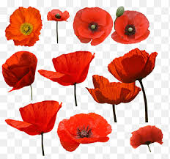
NATIONALISM
Whether we are black, white, or any other color,
we should not be nationalistic regardless of our country

Slide 19
In the Bible: Genesis 1:26-28:
1:26 “And God said, Let us make man in our image, after our likeness: and let them have dominion over the fish of the sea, and over the fowl of the air, and over the cattle, and over all the earth, and over every creeping thing that creepeth upon the earth.
1:27 So God created man in his [own] image, in the image of God created he him; male and female created he them.
1:28 And God blessed them, and God said unto them, Be fruitful, and multiply, and replenish the earth, and subdue it: and have dominion over the fish of the sea, and over the fowl of the air, and over every living thing that moveth upon the earth.”

Slide 20
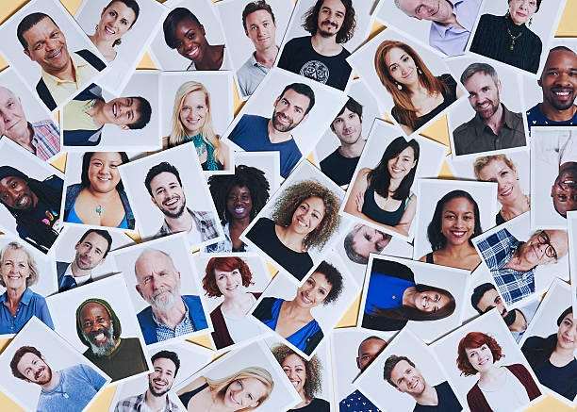
We all belong to one race which is humanity, and at the beginning, we were to form one nation, one people, that of God.
Regardless of our color or origin, we are human.
We are like the flowers of the great field:
MAGNIFICENT!!!

Slide 21
In The Bible: Galatians 3:26-28:
"For ye are all the children of God by faith in Christ Jesus. For as many of you as have been baptized into Christ have put on Christ. There is neither Jew nor Greek, there is neither bond nor free, there is neither male nor female: for ye are all one in Christ Jesus. ."

Slide 22
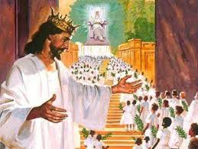
Revelation 7:9:
"After this I beheld, and, lo, a great multitude, which no man could number, of all nations, and kindreds, and people, and tongues, stood before the throne, and before the Lamb, clothed with white robes, and palms in their hands;"

Slide 23
TO SUMMARIZE
This story shows us that nationalism is not a good thing; God asks us to treat all human beings equally with ourselves and not to make a difference based on color, country, or culture because, in heaven, we will all live together.
That is love!!!
Thank you children for your participation and your attention.
May God Bless You!!!

