Slide 1
Gender
To be free to blossom
Study written by D.N June2021 – Edited by CME – www.edenaeden.org – edeneaedene@gmail.com –
https://www.youtube.com/c/EDENAEDEN/videos
Translated by K.M.L. – White Stone Foundation - Canada

Slide 2
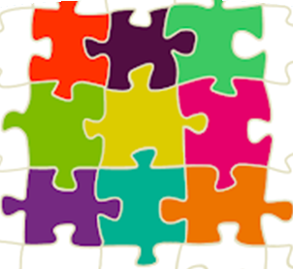
Describe the children you see in the first picture.
What do they have in common with the second picture?
We see smiling children (common point) but with differences: skin color, eyes, hair, clothes... Like the pieces of a puzzle, we are all human beings (identical) but with differences that make us unique. The society we live in comprises different human beings (puzzle pieces) that form one and unique group (puzzle).
Notes:
REMARQUE : Pour modifier une image de cette diapositive, sélectionnez-la, puis supprimez-la. Cliquez ensuite sur l’icône Insérer une image dans l’espace réservé pour y insérer votre image.

Slide 3
WHAT IS EQUALITY ?
Equality between people means having access to the same rights despite our differences.
Notes:
REMARQUE : Pour modifier une image de cette diapositive, sélectionnez-la, puis supprimez-la. Cliquez ensuite sur l’icône Insérer une image dans l’espace réservé pour y insérer votre image.

Slide 4
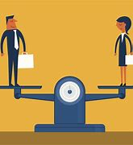
Do these images represent Equality? Why?
Equality : images 1, 3
Inequality : images 2, 4, 5.
Notes:
REMARQUE : Pour modifier une image de cette diapositive, sélectionnez-la, puis supprimez-la. Cliquez ensuite sur l’icône Insérer une image dans l’espace réservé pour y insérer votre image.

Slide 5
WHO HAS AN IDEA OF WHAT GENDER MEANS?
Children's answers:
Girl, boy, male, female
It is the characteristic of being a man or a woman, a boy or a girl. It is related to being perceived by others as a man or a woman.

Slide 6
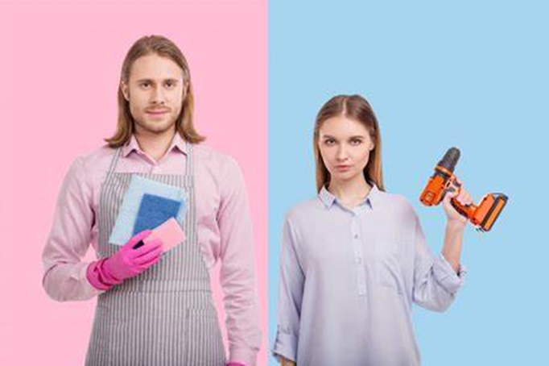
Their physical sex usually distinguishes a person's gender: most often, we are born with a 'willy' that makes us a boy or a 'fanny,' making us a girl. We often associate the two sexes with certain elements (clothes, haircuts...).
In the top right image, we can see that both the boy with the soccer ball and the girl in the dance outfit do not seem happy to be doing these activities. While in the picture below, the man is pleased to do housework, and the woman is glad to do DIY project. Whereas in society, it is generally thought that DIY work is for men and cleaning is for women. But do you think this is fair and equitable thinking?
Notes:
REMARQUE : Pour modifier une image de cette diapositive, sélectionnez-la, puis supprimez-la. Cliquez ensuite sur l’icône Insérer une image dans l’espace réservé pour y insérer votre image.

Slide 7
WITH WHOM ARE THESE ELEMENTS MOST OFTEN ASSOCIATED?
Blue
Pink
princesses
Unicorns
Men
Boys
Sport
Dancing
Babies
Women
Girls
Construction
Science
dolls
Trucks
Makeup
school

Slide 8
The freedom to choose in order to blossom
There are automatically two boxes in our minds: the boy's box and the girl's box, to which we associate elements.
Examples :
But in reality, there is only one big box in which we find all human beings. In this box, everyone is free to play the sports they want, to play the games they like, to wear the clothes they feel good in if it just makes them feel HAPPY..
princess long hair
Girl
dancing doll pink
soccer knight blue
Boy
short Hair trucks

Slide 9
Gender
The body at birth :
- Male sex.
- Female sex.
Gender identity and expression: what I feel I am, my clothes, my haircut, my name... What makes me happy.

Slide 10
TO conclude
Each individual is at the same time similar (all human beings) but also different (skin color, eyes, hair type, hair length...) like a puzzle.
Equality means having access to the same rights regardless of our physical, religious, social, gender, or sexual orientation differences.
There are no boy or girl boxes that restrict us in our activities, desires, preferences, choices, tastes…
Gender Equality = The freedom to choose to blossom.

Slide 11
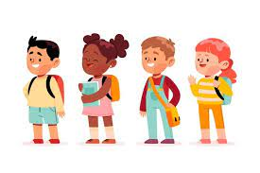
Thank You Children
See you next week for another story

