Slide 1
Kids’ Prophecy Corner
The Value of A Soul – LGBTQ+
Written by K.M.L. and edited by T.M. – White Stone Foundation : http://www.white-stone.ca/
June 2021

Slide 2
Hello Kids!
In this lesson, we are going to look at the LGBTQ+ community.
June is Pride Month when people who identify themselves as gay, lesbian, bisexual, transgender, and other gender-fluid designations celebrate their diversity and strengths.

Slide 3
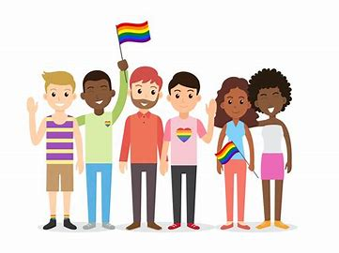
In the movement, we want to make sure we treat everybody the same, regardless their race, gender, or sexual orientation.

Slide 4
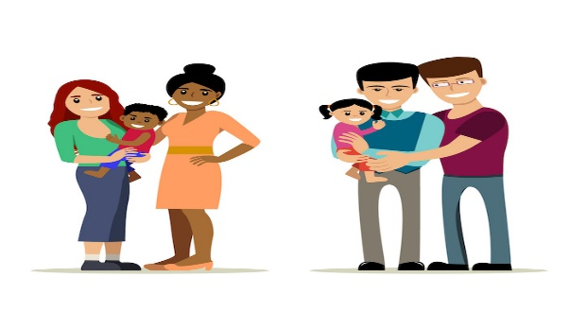
You may know a friend or a schoolmate who has got two daddies or two mommies. Or you know someone who was born a boy but now is a girl.

Slide 5
Even though this seems strange to you, it doesn’t mean we should treat them differently. Instead, please treat others the way you want them to treat you. That is the golden rule.

Slide 6
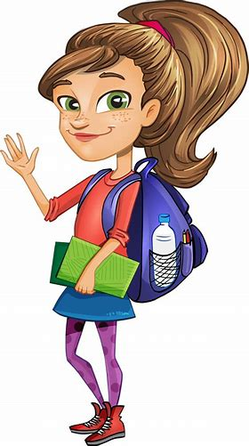
Who Are The LGBTQ+? – L Is For Lesbian
This is Lily.
She is a lovely girl who likes painting, crafting, and playing with her friends. She is also an excellent student.
Lily is a lesbian. It means she loves other girls. Lily realized at an early age that she wasn’t attracted to boys but had feelings for girls.
Lily likes fashion, so from the outside, you can’t tell she is a lesbian. Some lesbians dress like boys, and some don’t. In any case, you should be kind and treat her equally.

Slide 7
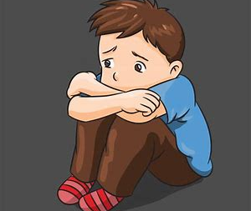
G Is For Gay
This is Gary.
He likes playing with girls toys most of the time. He also likes soccer and tennis.
Gary is gay. This means he loves boys. Just like Lily he realized at an early age that he prefers boys.
Gary struggles with his identity because his friends shame him. Because he is afraid he hides who he is and he feels depressed.
This is sad because discriminating against someone is wrong. Never bully someone who is different from you. This treatment is called homophobia.

Slide 8
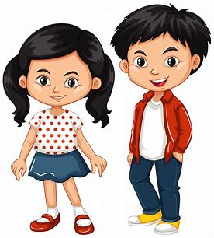
B Is For Bisexual
These are Bernadette and Bertrand.
They are both bisexual. This means they love people of both genders. They both love boys and girls.
They are bisexual instead of lesbian or gay because even if Bertrand fell in love with a boy, and Bernadette with a girl, it does not mean they have a minor attraction for the opposite sex.
No matter who their partners are, they should be treated with respect.

Slide 9
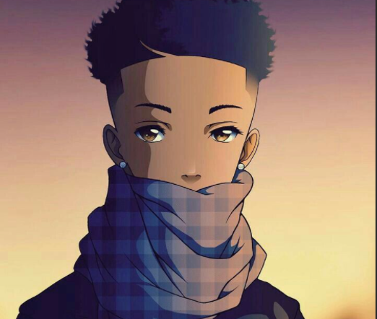
T is for Transgender
This is Tania.
She is a transgender girl. That means when she was born everyone thought she was a boy; until she was older and realized she felt like a girl.
She decided to change her appearance to look like a girl.

Slide 10
Q Is For Queer
Queer is an idea. It means being different.
Some people are gay, some are transgender, some are not sure where they fit exactly. So they are categorized as queer.
They are questioning their identity.

Slide 11
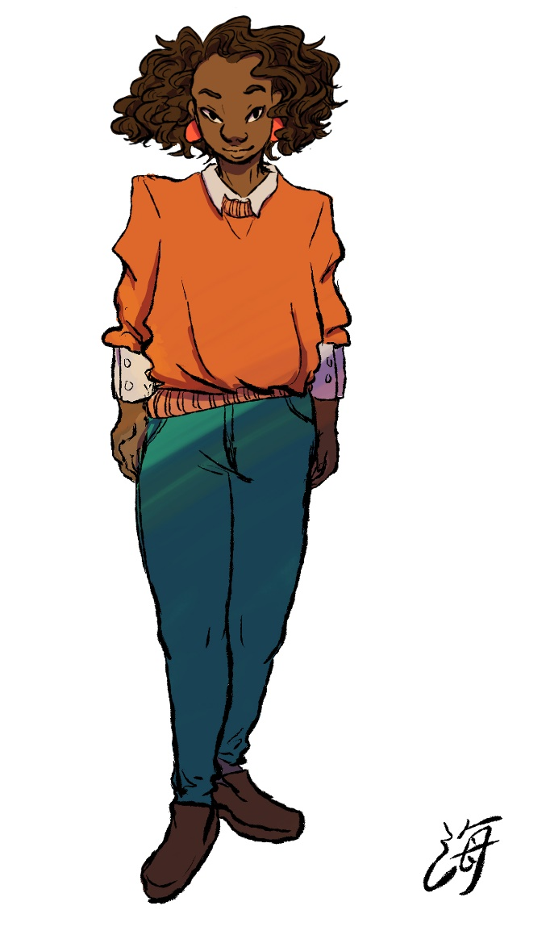
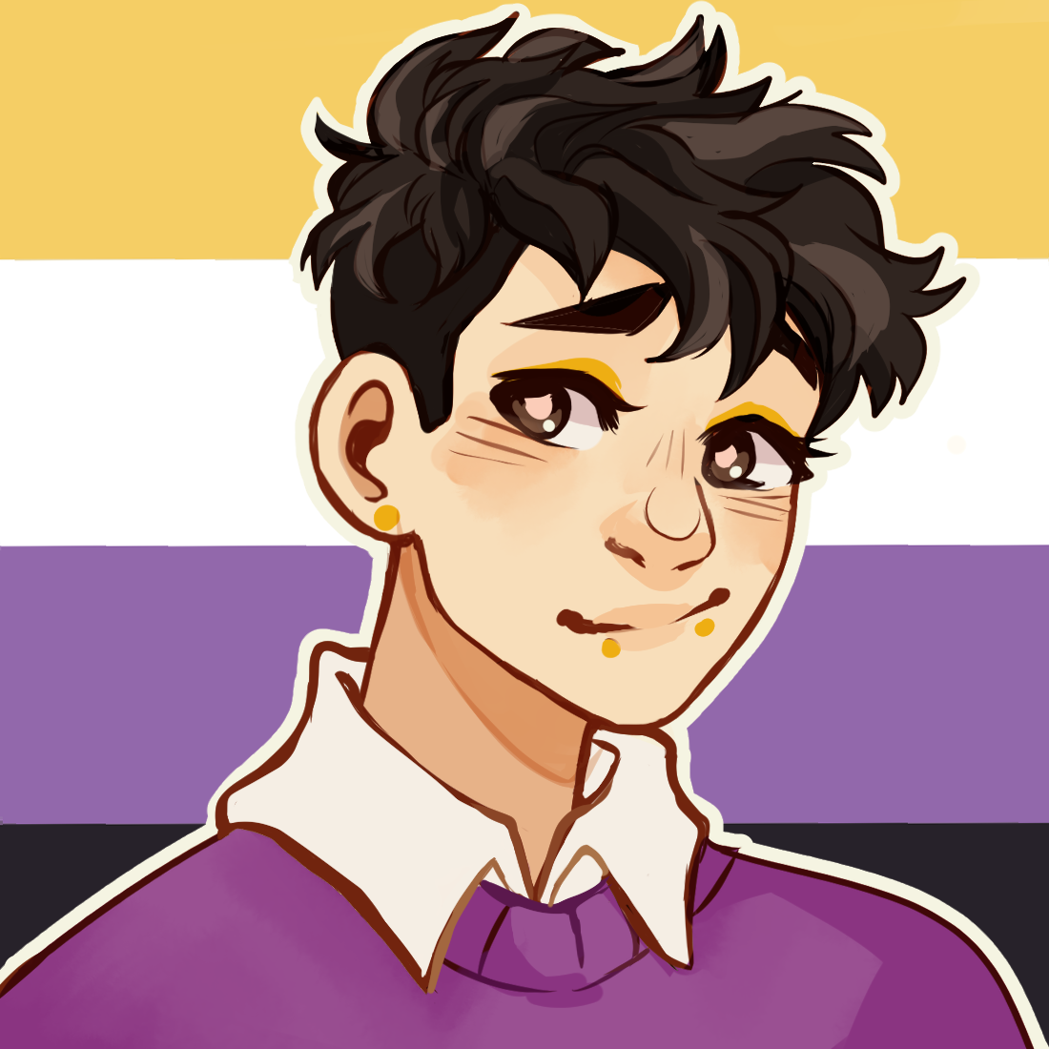
“+” Is For Other Gender-Fluid Categories.
There are other categories of people. For example, not everyone feels they are a boy or a girl.
This is Nath. When she was born, everyone thought she was a girl. But Nath is both a boy and a girl.
This is Alex. Since they* were small, they never felt that they were a boy or a girl. So Alex is neither boy nor girl.
Both Nath and Alex are non-binary
* They is used as a neutral gender pronoun

Slide 12
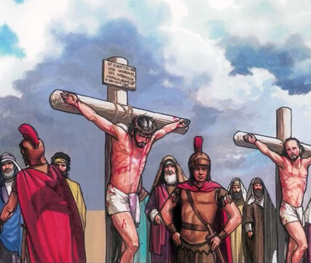
Jesus Values Everyone
Our society discriminates against people because of their gender, race, education, how much money they have, or how much they weigh. The LGBTQ+ community is also put in a box and discriminated against because they are different.
God does not see any of that as determining our value. Instead, he sees us as precious because he paid a great price to save us. Jesus died on the cross and shed his blood for everyone. So each one of us is worthy for that reason alone.

Slide 13
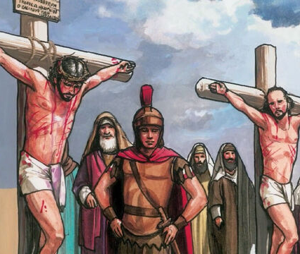
Because we are all valuable, we should treat everyone with the same value God portrays us. There is no class, no race, no group of people God has not died. He died for every single person.
So, even if the world around us is horrendous, we can make a difference with the people we interact with at school, at the store, with our family.
By planting these seeds of love, respect, and equality, many will turn to Jesus.

Slide 14
To Summarize
There are many different types of people. Some view themselves as lesbians or gays or straight (a boy who loves a girl and a girl who loves a boy).
Some are transgender, some are queer, and some are non-binary (which means they are neither boys or girls).
No matter what they are, they deserve to be respected and treated equally. The LGBTQ+ people have the same rights as everyone else.
We do not discriminate against people because of their race or gender. Therefore we should not discriminate against LGBTQ+ people. We value them and love them as much as God values them and loves them.

Slide 15
Answer The Following Questions
I have a girl brain but a boy body. I am a ...
A kid who doesn’t feel exactly like a boy or a girl is a...
A girl who loves a girl is a...
Transgender
Non-binary
Non-binary
Bisexual
Gay
Lesbian

Slide 16
Answer The Following Questions
Someone who questions their identity is...
A LGBTQ person who encounters prejudice and discrimination suffers...
Your friend who is gay was bullied at school. What are some ways you can help and comfort him?
Non-binary
Queer
homophobia
racism

Slide 17
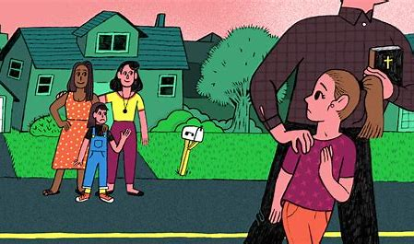
Look at the picture, explain the scenario, and tell me what you would do.

Slide 18
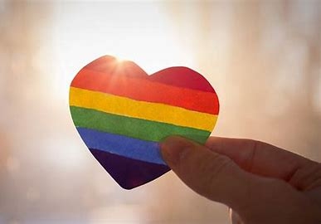
Thank You and God bless!

