Slide 1
Kids’ Prophecy Corner
The Nature of Man – Part II
Written by K.M.L. and edited by T.M. – White Stone Foundation : http://www.white-stone.ca/
June 2021

Slide 2
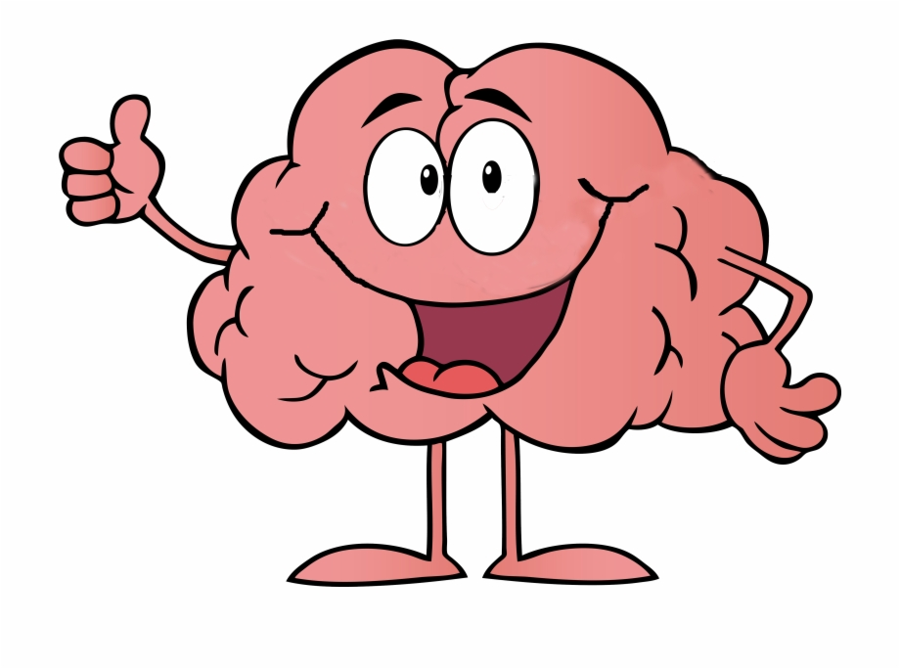
Hello kids!
In this lesson, you will learn how to use your brain efficiently.
The Bible says in Psalm 139:14 that you are “fearfully and wonderfully made.”
Did you know that your brain is God’s masterpiece? When you go to Heaven, your body will be changed, but you will keep your brain.
That is why it is essential to understand how it functions.

Slide 3
Remember the lesson done by Éden à Éden (formally LGC) on the Nature of Man?
Let’s have a quick revision.

Slide 4
Your whole being is comprised of:
- your body (the house you live in),
- your mind and your soul (what is inside you).
ME
Boy or Girl
=
SPIRIT
SOUL
BODY

Slide 5
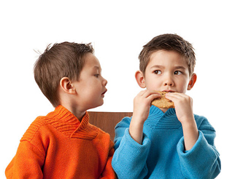
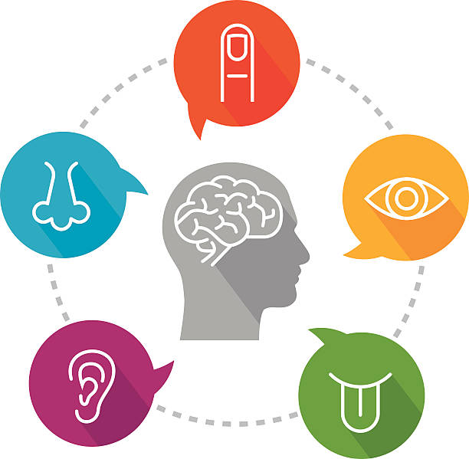
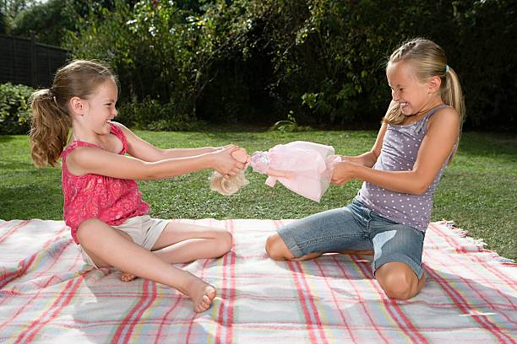
Your body is the seat of your lower powers. They are your emotions, your feelings, your thoughts, your appetite.
God gave them to you for a reason, but we need to bring them under control.
ENVY
THE 5 SENSES
FIGHTS
GLUTTONY
ANGER

Slide 6
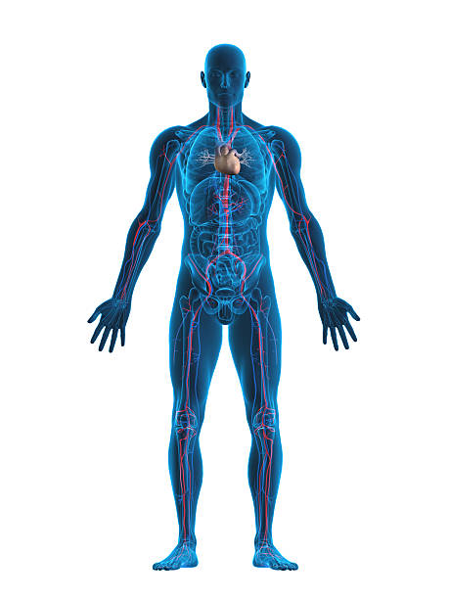
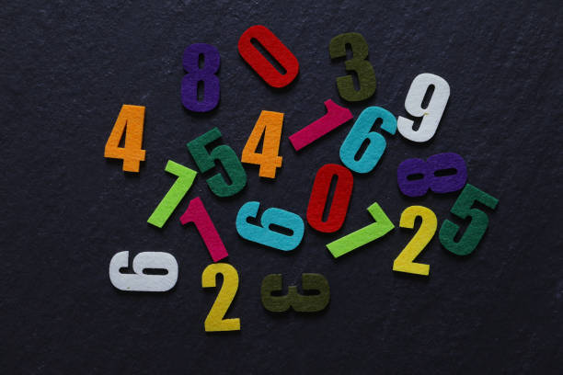
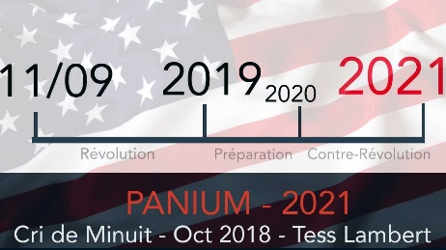
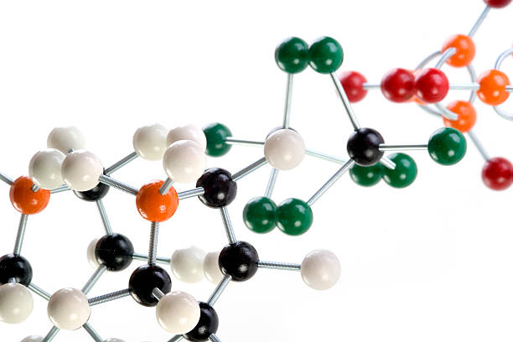
Your soul or spirit are the seat of your higher powers. You use them to control your thoughts and feelings. You also nourish them with knowledge of the Bible and methodology, and information from nature, science, etc. All this allows you to make good decisions and understand how to treat others, for example.
TEMPERANCE
FAITH
OBEDIENCE
PEACE
COMPASSION
WISDOM
KNOWLEDGE
WILL

Slide 7
Answer the following Questions
My emotions are part of my...?
My intellect is part of my...?
My whole being is comprised of...?
Higher powers
Lower powers
Lower powers
Higher powers
My face, my body, arms, and legs
Body, soul/spirit

Slide 8
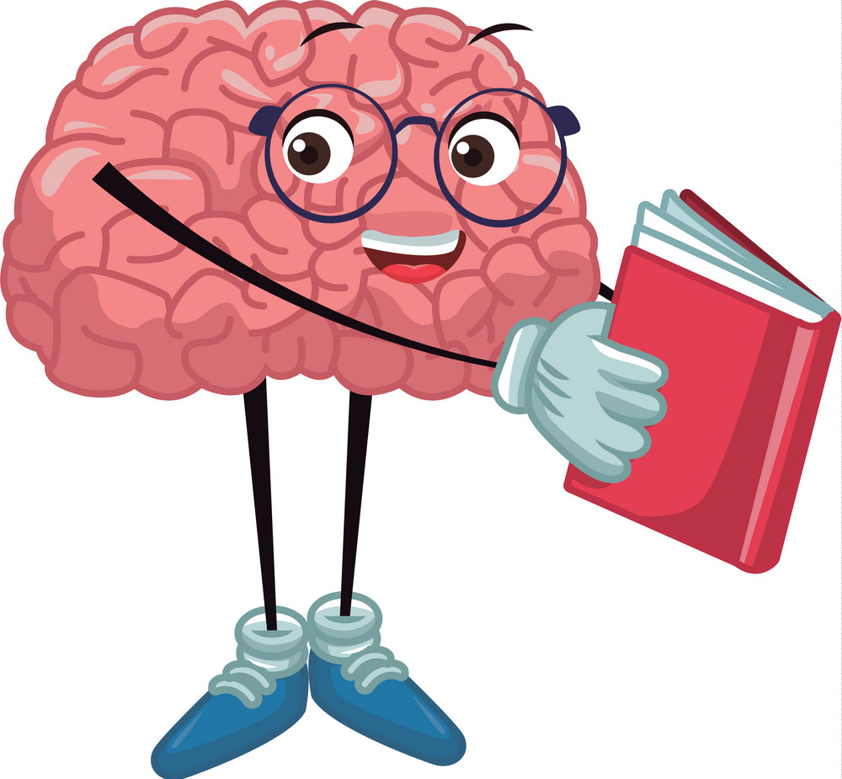
There is another way to look at your brain

Slide 9
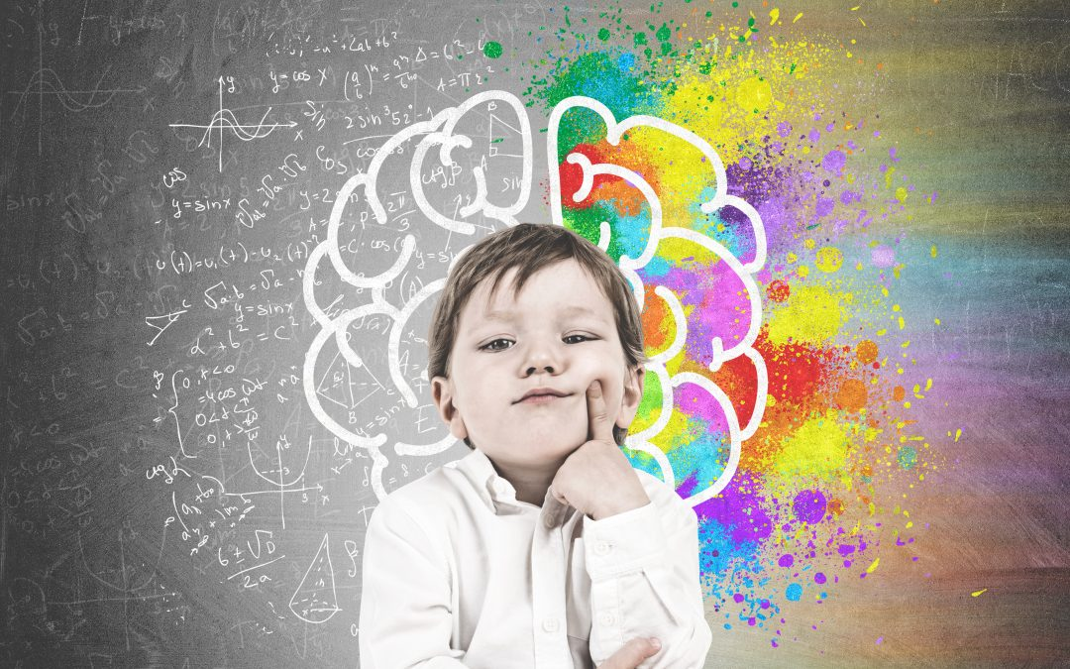
Your brain processes information in 2 different ways: by thinking fast and by thinking slow
Slow Brain
Fast Brain

Slide 10
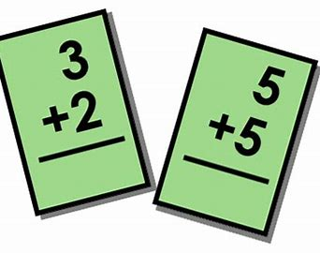
When you look at the little girl, your brain instantly realizes that she is angry. That is your fast brain in action.
When you see these math problems you must take time to think through them before answering. That is your slow brain in action.

Slide 11
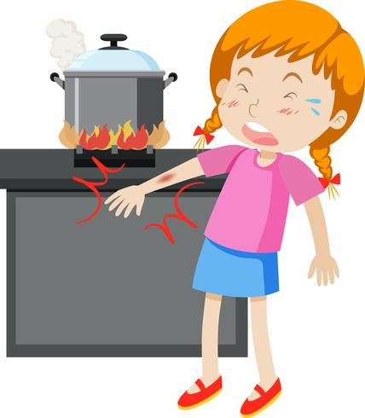
Your Fast Brain
Your fast brain corresponds to your lower powers.
It is when you use your intuition or instinct in a situation. It is always “on.”
Let’s say you touch a hot pot; you will instantly remove your hand and probably cry. Or, if you hear a noise you will react fast by looking in the direction of the noise and probably scream or run if it is a bee chasing you.
So God gave you a fast way of thinking for a reason. There are circumstances in which you need to react fast.
But sometimes, you need to control it. If your sibling bothers you, do not use your fast brain to fight or shout.

Slide 12
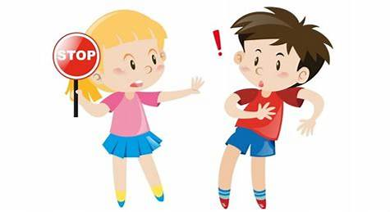
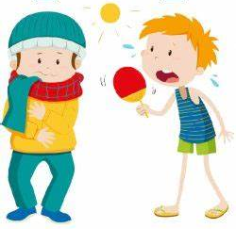
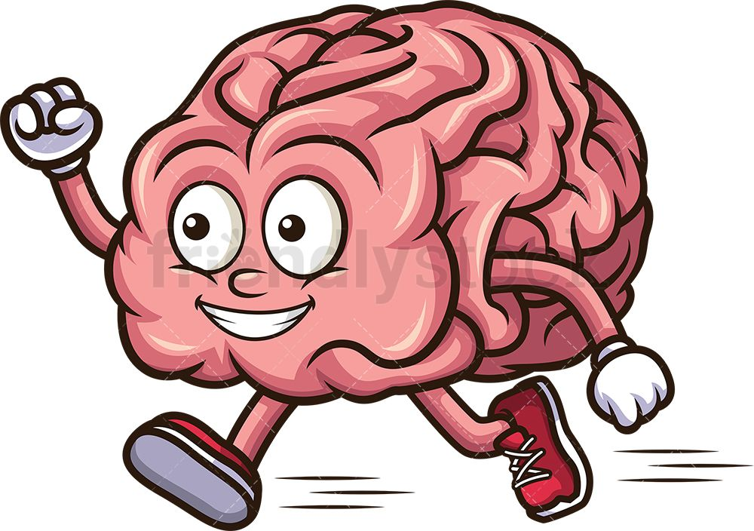
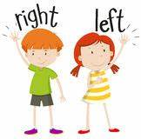
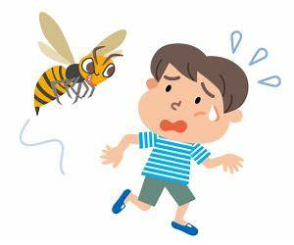
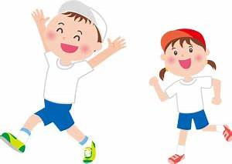
I use my fast brain to:
Scan my environment
Work automatically, instinctively and intuitively
Respond fast to a situation
Express my emothions

Slide 13
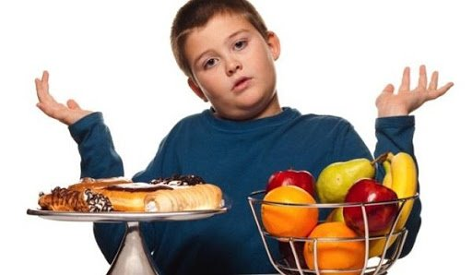
Your Slow Brain
Your slow brain corresponds to your higher powers.
You use it to think through a situation, make good decisions, control yourself, or study.
Let’s say you have the choice between a pastry and a fruit for a snack. Your slow brain would tell you to eat healthily; you would therefore choose...the fruit, right?

Slide 14
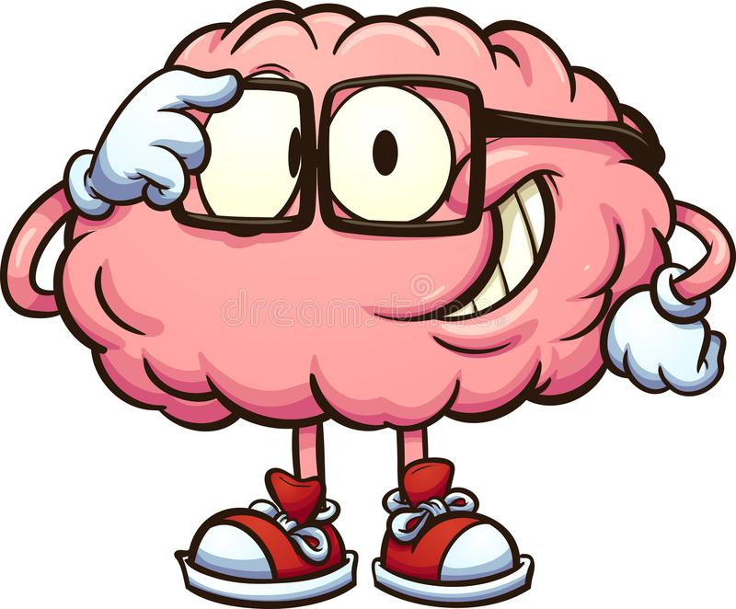
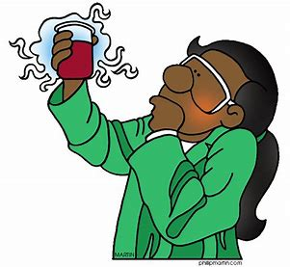
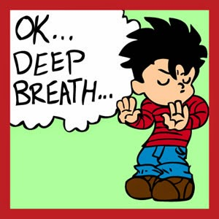
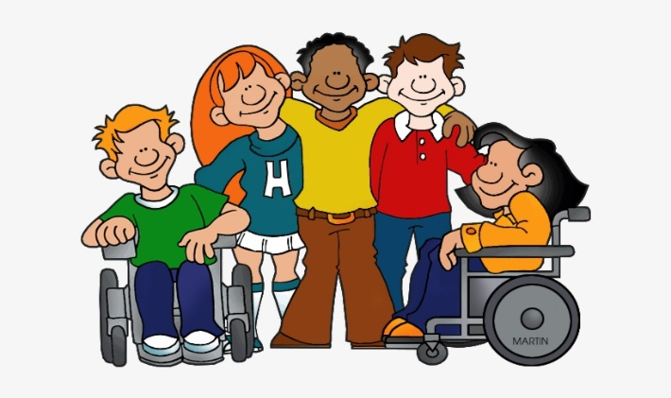
I use my slow brain to:
Analyse a situation
Solve complex problems
Exercise self-control
Study
Make good decisions

Slide 15
To Summarize
The nature of man tells us we have higher powers and lower powers
Lower powers
Thoughts
Feelings
Emotions
Appetite
Higher powers
Will
Knowledge
Temperance
Wisdom
Faith
Compassion

Slide 16
Another perspective of the nature of man is with the Fast brain and slow brain
Fast brain = lower powers
Slow brain = higher powers
Your Fast brain is:
Automatic
Impulsive
Emotional
Intuitive
Your slow brain is:
Conscious
Analytical
Reasonable
Thoughtful

Slide 17
Answer the following Questions
My fast brain corresponds to my...?
My slow brain corresponds to my...?
To catch a ball, I will use my...?
Higher powers
Lower powers
Lower powers
Higher powers
Slow brain
Fast brain

Slide 18
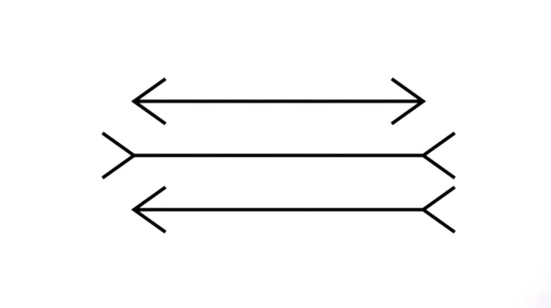
Think Fast, Think Slow
Are these lines different lengths?

Slide 19
A: If you said the lines are different lengths, then you used your fast brain. Your fast brain gave you the illusion they were different because the brain cannot switch off the button “on.” But by taking the time to analyze and measure the lines, you realize they are the same length.

Slide 20
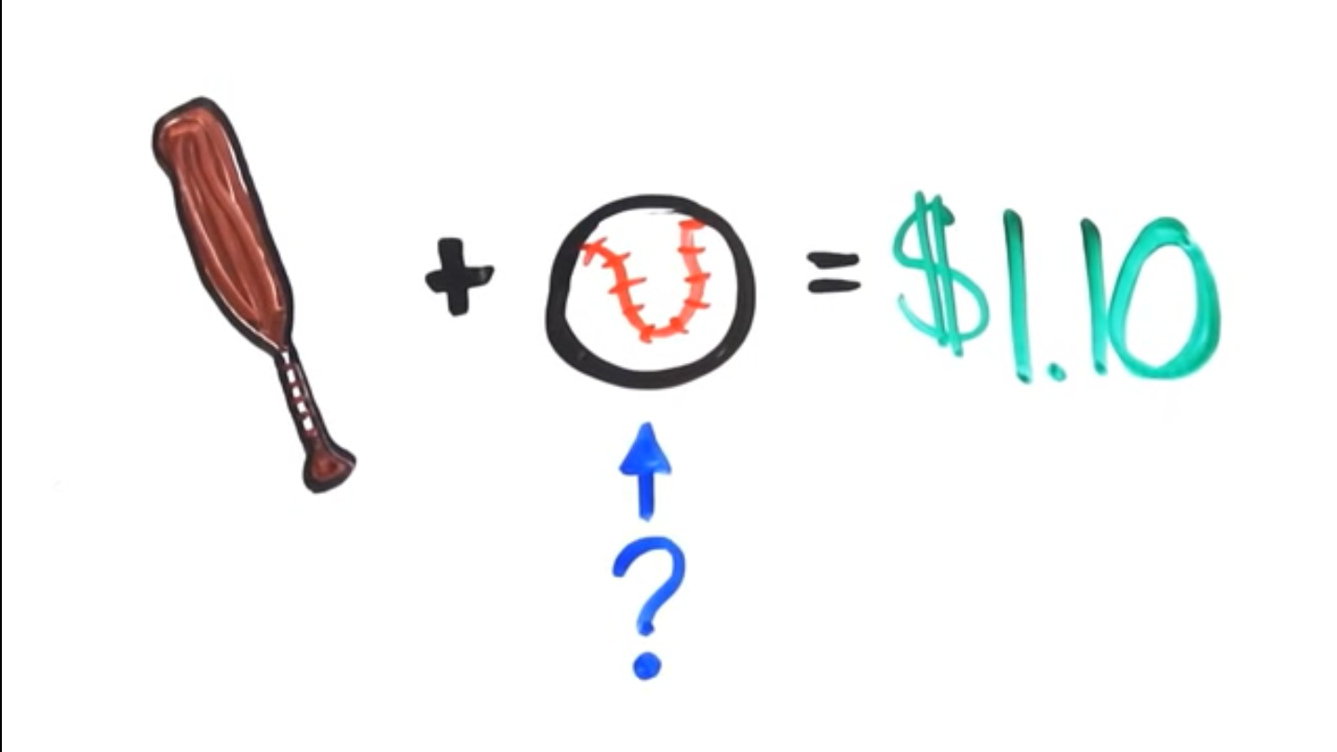
Think Fast, Think Slow
A bat and a ball cost $1.1o. The bat costs $1 more than the ball. How much does the ball cost?

Slide 21
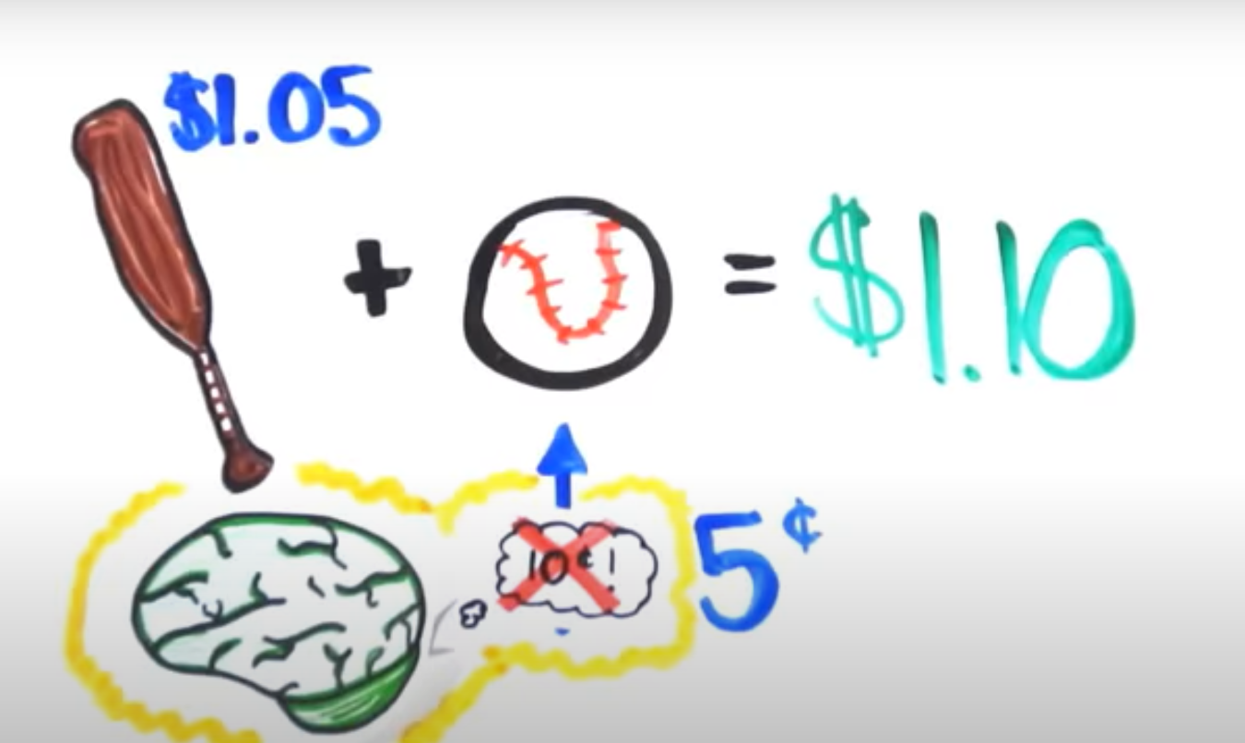
A: If you guessed 10 cents, then you used your fast brain.
If the ball costs 5 cents plus a bat that costs $1.05, it will set you back to $1.10.
And $1.05 is exactly $1 more expensive than 5 cents.

Slide 22
Think Fast, Think Slow
How many animals did Moses take on the ark?

Slide 23
A: Moses didn’t take any animals. You did an excellent job of using your slow brain and analyze the question thoroughly. Noah took the animals on the ark.

Slide 24
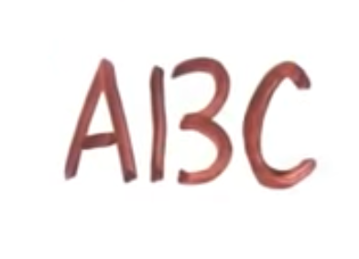
Think Fast, Think Slow
What do you read?

Slide 25
A: If you used your fast brain, you read ABC. However, a careful analysis will show you that the B is 13. Notice the space between the numbers. If it were a B, the letter would be attached.

Slide 26
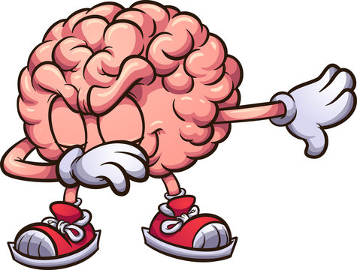
Thank You and God Bless!

