Slide 1
Kids Prophecy corner
The Three Movements
Written by K.M.L. and edited by T.M. – White Stone Foundation : http://www.white-stone.ca/
April 2021

Slide 2
In this Lesson we will study the three main movements that follow the same pattern of failure, failure, success.
Why do we need to study them?
Because, they impact our understanding of what the Sunday Law will look like, and the events that will bring about the second coming of Christ.

Slide 3
There are three major movements

Slide 4
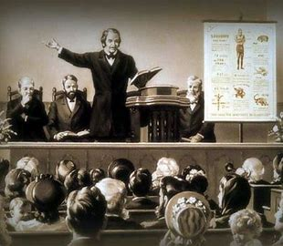
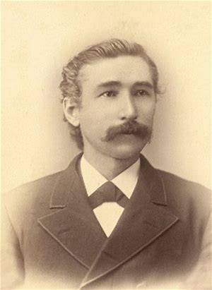
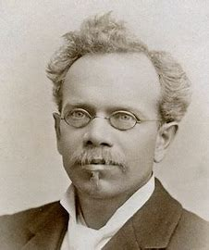
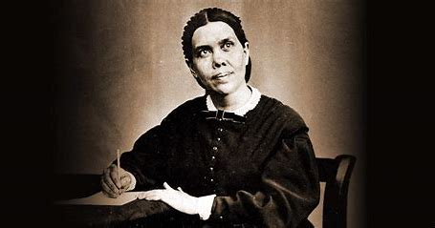
MODERN ISRAEL
The Millerites
Early Adventism
The 144, 000 – us today

Slide 5
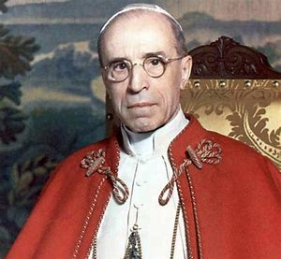
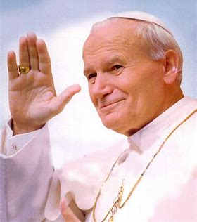
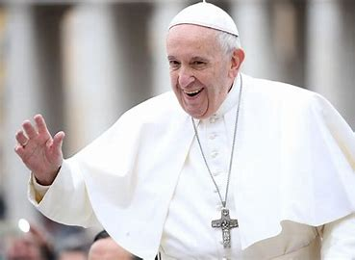
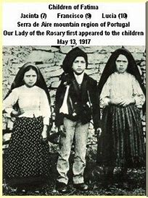
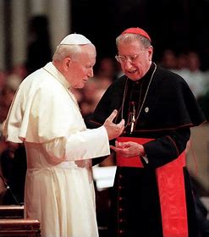
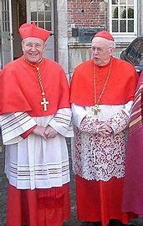
CATHOLICISM OR THE COUNTERFEIT
Eugenio Pacelli and Fatima
John Paul II Era
Pope Francis – Catholicism today

Slide 6
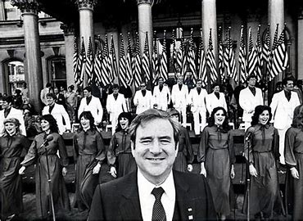
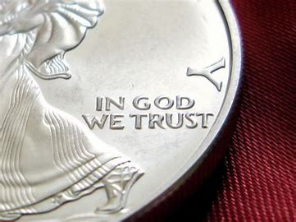
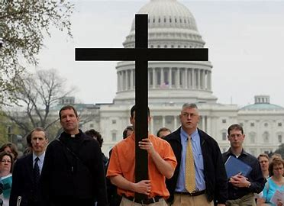
PROTESTANTISM
The Christian Right – Conservative Christians today
National Reform Movement
1940s-1950s movement

Slide 7
The Structure

Slide 8
The 3 movements parallel one another and have similarities
They have a message about God
They have an alpha and an Omega History
The Alpha history is comprised of 2 histories of failure
The Omega history is a history of success

Slide 9
Modern Israel – The True Church Of God

Slide 10
The history of Modern Israel is the history of the true church of God.
Their story starts at the time of the end in 1798 and ends at the second advent of Christ.
It is the history of Seventh-Day Adventists.

Slide 11
Their history is divided into 3 major periods.
An alpha history which includes the Millerites and early Adventism.
And an Omega history which is the history of the 144,000
Millerites
1888-Period
144,000

Slide 12
The First History of Failure in Modern Israel
The first history took place from the time of the end in 1798 and ended in 1863 when Christ was supposed to come back.
It is called a history of failure because God’s people fell into a Laodicean condition and did not finish the work required of them. Christ did not return as a result.
1798
1863
Millerites

Slide 13
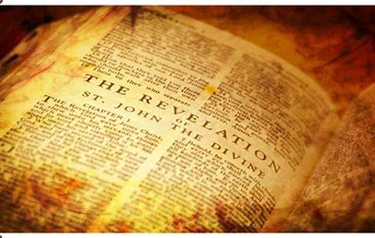
The Laodicean condition is described in Rev. 3: 14-19.
Verse 17 says “because thou sayest, I am rich, and increased with goods, and have need of nothing; and knowest not that thou art wretched, and miserable, and poor, and blind, and naked:”

Slide 14
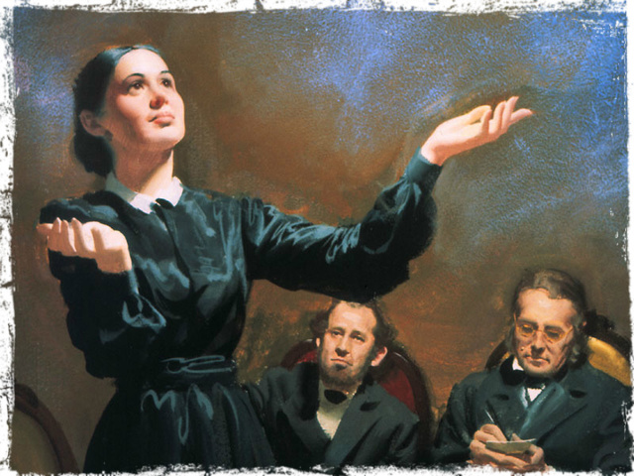
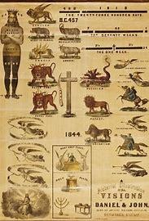
The First History of Failure of Modern Israel
What happened to the Millerites?
From October 22, 1844 (the great disappointment) to 1850, the people of God were scattered. Even though they were trying to preach the message it had but little effect.
Moreover, people were backsliding and confused doctrines and fanaticism entered the movement. Sister White described it as a Laodicean condition. This led them to reject the 2520 in 1863 and produced a new chart.
Christ didn’t come back in 1863 and as a result another scattering started.
{ 2SG 222.1 }; . {RH November 1, 1850, par. 11}

Slide 15
The Second history of Failure of Modern Israel
The second history of failure happened during the 1888 time period.
The pioneers A.T. Jones and E.J. Waggoner gave the message of righteousness by faith to the Adventist church. Unfortunately, the church did not listen to them even though Ellen White supported them.
1888 Period

Slide 16
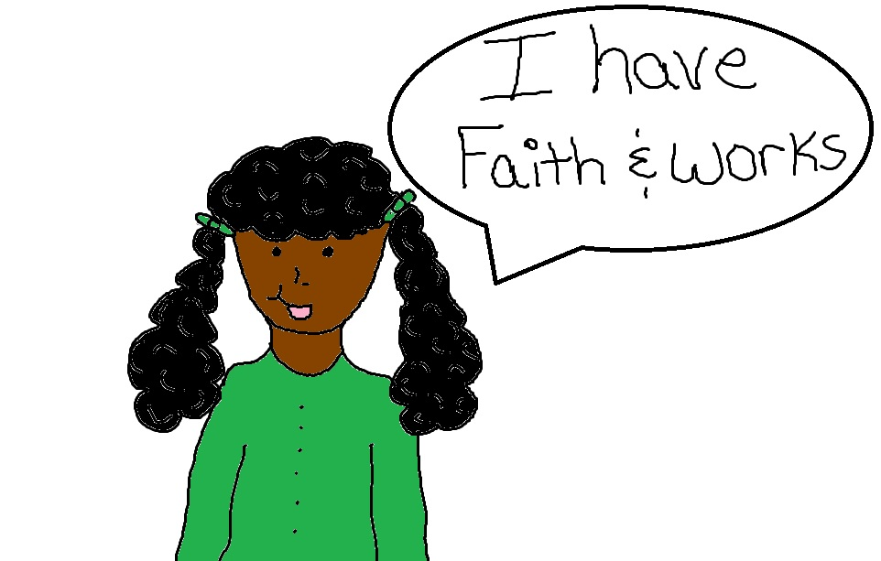
What is righteousness by faith?
The Bible says in Romans 1: 17 :
1:17 For therein is the righteousness of God revealed from faith to faith: as it is written, The just shall live by faith.
Being righteous is doing what is right in the sight of God.
It is Obeying his law with all your heart and not just with works.

Slide 17
The Blair Bill
In the US Senate, on May 21, 1888, Mr. Blair introduced a bill to “ to secure to the people the enjoyment of the first day of the week, commonly known as the Lord's day, as a day of rest, and to promote its observance as a day of religious worship.”
This bill was a Sunday Law bill. Fortunately A.T. Jones fought against it and it failed. No Sunday Law was passed.
Ellen White said in 1898 that Christ would have returned if His people were faithful. So the 1888 time period ended in failure
(13LtMs, Ms 139, 1898 par. 17)

Slide 18
The Third History of Modern Israel
The history of the 144,000 is the last history of Modern Israel.
It starts at the time of the end in 1989 and ends with the second coming of Christ.
2nd Coming
1989
144,000

Slide 19
Why is it a history of success?
This is how the Bible describes the 144,000 in Revelation 14: 3-5:
14:3 And they sung as it were a new song before the throne, and before the four beasts, and the elders: and no man could learn that song but the hundred [and] forty [and] four thousand, which were redeemed from the earth.
14:4 These are they which were not defiled with women; for they are virgins. These are they which follow the Lamb whithersoever he goeth. These were redeemed from among men, [being] the firstfruits unto God and to the Lamb.
14:5 And in their mouth was found no guile: for they are without fault before the throne of God.

Slide 20
From the Time of the end in 1989 God has been gathering His people.
They follow Christ teachings given through the methodology of parable teaching or “line upon line.” They let go of false ideas and doctrines and gladly accept to be restored into the image of God. They remove their racist, sexist, and homophobic biases. And they understand (or continue to understand) the true nature of the Sunday Law and the true character of God. No guile will be found in them.

Slide 21
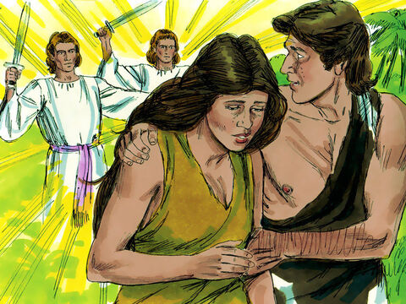
What is the Nature of the Sunday Law?
Sin #1 Adam and Eve – curse: Gender Inequality
Most Adventists think it is a question of Sabbath vs Sunday observance.
But the Eden to Eden line of restoration shows otherwise.
In Eden the first sin committed by Adam and Eve caused women to be subjected to their husbands. This is where gender inequality (sexism) started.

Slide 22
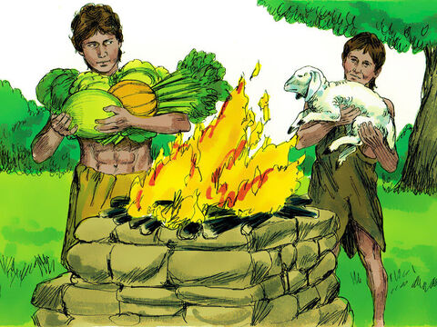
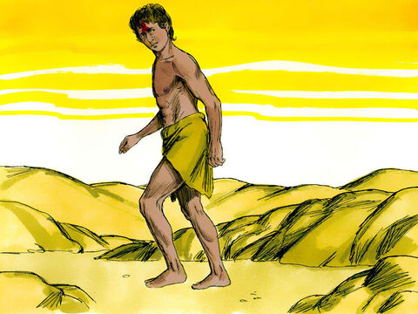
Sin #2 Cain– curse False/Sunday Worship
The second sin was committed by Cain and started false/Sunday Worship.
Cain was jealous of his brother because his offering was accepted by God and not his.
In Cain’s mind worshipping any day and giving any offering should have been accepted by God. He violated the Sabbath.
But God disagreed and rejected his offering. Because of this he killed his brother and had to flee.
{ PP 80.3}

Slide 23
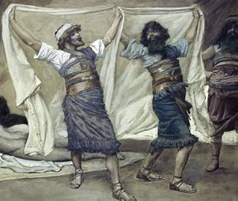
Sin # 3 Ham –Curse: Slavery/racism
The third sin was done by Ham when he saw his father Noah naked. Noah cursed him and declared that Ham’s descendants would be servants of his brothers. This was slavery/racism.
Since then the condition of mankind has degenerated. But God had a plan to restore His people.

Slide 24
At the time of the end in 1798 God started a process of restoration. Because it is a return journey, it works like a chiasm ABBA pattern.
The structure of the chiasm looks like this :
Sin #1
Sin #2
Sin #3
Sin #3
Sin #2
Sin #1
Sexism
Worship
Racism
Racism
Worship
Sexism
More on Chiasm is the study called : Fractals Lesson 3

Slide 25
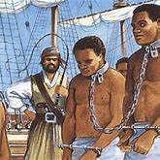
Sin #3 – slavery removed
God dealt with slavery first.
During the alpha history of modern Israel the people in the United States had to let go of slavery.
This happened in 1863 with the emancipation declaration and 1865 with the passage of the 13th Amendment.

Slide 26
Sin # 2 – Sabbath Worship reinstituted
Second, God had to restore true worship because most protestants worshipped on Sunday.
God gave Ellen White a vision of the Sabbath. Since then Adventists have worshipped on Sabbath.
True worship was the test in 1888 when A.T. Jones fought against the Blair Bill which proposed to enforce rest and religious observance on Sunday.

Slide 27
Sin #1 - Gender equality issue for our time
Third, God has to restore equality between men and women. This is the issue we are facing today.
People are fighting for gender equality which came as a result of the first sin.
As a result, the Sunday Law will be about gender equality (sexism and LGBTQ).
It doesn’t mean the other issues are not important. They are important. But they are not the testing issue for this time.

Slide 28
The Chiasm Looks like This
Sin #1
Sin #2
Sin #3
Sin #3
Sin #2
Sin #1
EDEN
Adam &eve
EDEN
Cain
Ham
1798-1863
1888
1989
sexism
Sunday worship
Slavery/Racism
Slavery/
Racism
removed
Sabbath worship
restored
sexism
Degeneration
Restoration

Slide 29
Catholicism – The Counterfeit Church

Slide 30
We look at Catholicism because it is the counterfeit church of God’s true church.
Satan’s church must have an alpha and an omega history to counterfeit the alpha and omega histories of the true church.

Slide 31
Their history is divided in 3 major periods.
An alpha history which includes the rise and work of Eugenio Pacelli (Pope Pius XII), followed by that of Pope John Paul II
And an Omega history which is the history of Pope Francis
1899-1845
1989
2001

Slide 32
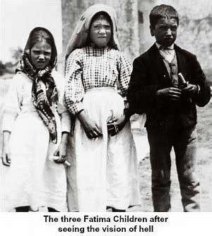
The first History of the Counterfeit
The first history was from 1899 to 1945. Their messenger was Eugenio Pacelli (Pope Pius XII) and he counterfeited William Miller, the messenger of the Alpha history of Modern Israel.
He believed in the message of Fatima which asked that the Soviet Union be converted to Catholicism. As a result, Eugenio Pacelli worked with Nazi Germany during world War II. But Germany was defeated in 1945 and the Catholic church failed to convert the USSR.
This is their first history of failure.
1899
1945

Slide 33
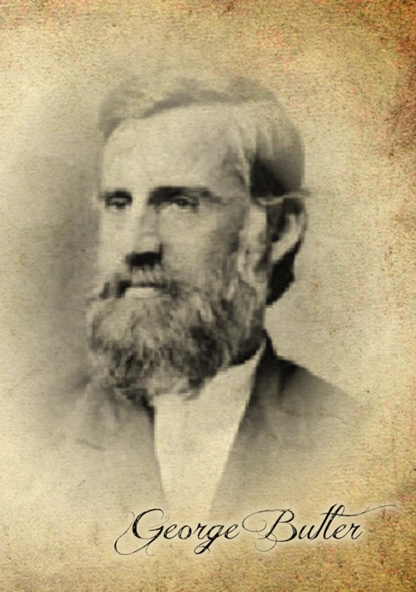
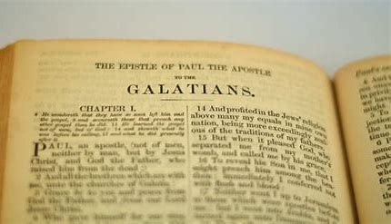
The Second History of the Counterfeit
If Modern Israel had a second history of failure then the counterfeit must have one as well.
There was friction in the Adventist church in the 1888 time period. Not only did they reject the message of righteousness by faith, there was also a fight between E.J. Waggoner and General Conference president Butler over the book of Galatians. Ellen White said they were half right, half wrong.

Slide 34
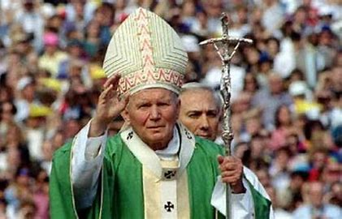
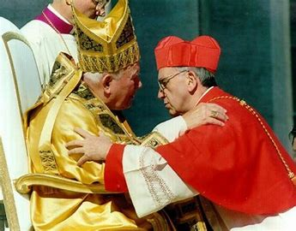
The Second History of the Counterfeit
There was also a conflict in the Catholic Church in 1989. It was between liberals and conservatives. 1989 is the counterfeit of 1888.
Pope John Paul II, a conservative, was fighting the liberal Jesuits who wanted to reform the church. Both sides were half right, half wrong and that history ended in failure.
1989

Slide 35
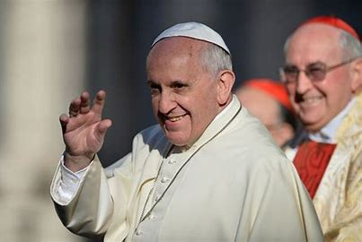
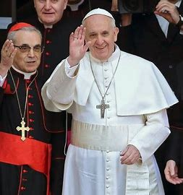
The Third history of The counterfeit
The omega history of Catholicism started in 2001 when a secret group of Bishops called the Saint Gallen Group decided to make cardinal Jorge Mario Bergoglio the next pope.
Their plan succeeded in March 13, 2013 when he became Pope Francis.
Pope Francis’ plans will be successful because it is a counterfeit of the 144,000.
2001

Slide 36
Protestantism

Slide 37
Their history is divided in 3 major periods.
An alpha history which includes the work of the National Reform movement, followed by that of the Judeo-Christian movement
And an Omega history which is the history of the Christian right today
1863- 1900
1940s-1950s
1979

Slide 38
The First History of Protestantism
The first movement can be traced from 1863 to the 1900.
In this period the National Reform Association was created.
It was a movement of eleven protestant denominations whose goal was to amend the constitution.
The civil war was ongoing and the north was losing.
They thought the war was God’s judgement for not declaring the United States a Christian Nation.
1863
1900s

Slide 39
So they pushed an agenda to make it happen. They requested for the phrase “In God We Trust” to be placed on currencies.
And it worked! The phrase was stamped on coins in 1864.
However they failed to amend the constitution. So it was ultimately a history of failure.

Slide 40
The Second History of Protestantism
The second history of failure for Protestants took place in the mid-1900’s. During that time, groups were pushing to make the United States a Christian nation.
They asked for the words “under God” to be added to the Pledge of Allegiance.
They were successful and on July 14, 1954 the words were added.
1940s-1950s

Slide 41
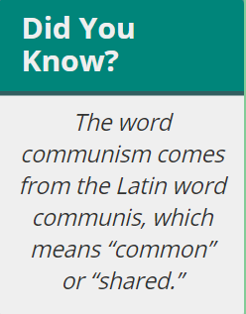
The Second History of Protestantism
At that time there was a group the protestants felt was a threat: Communism.
Communism is a type of government as well as an economic system (a way of creating and sharing wealth) where individual people do not own land, factories, or machinery. Instead, the government or the whole community owns these things and everyone is supposed to share the wealth that they create.
Because they didn’t want Communism to take over the world, the protestants wanted to make it clear that God was on their side.
So president Eisenhower allowed the words “Under God” to be added to the pledge of allegiance and 2 years later, he changed the motto “E pluribus unum” to “In God We Trust”.
They taught that capitalism, an economic system where citizens (not the government) own and run business and manufacturing enterprises was also emphasized as the Biblically correct system..
However, the constitution was not amended and in that sense, it was a history of failure.

Slide 42
The Third History of Protestantism
The third movement is led by conservative Christians.
It started in 1979 when Jerry Falwell created the Moral Majority.
They aim for a Christian nation where the government imposes moral laws upon the people. That’s the “ Sunday Law.”
1979

Slide 43
The Third History of Protestantism -Success
They are racists, against gender equality and homophobic.
They work closely with politicians from the republican party like Donald Trump to make sure their agenda goes through.
They have already started to place people in the supreme court to ensure their plan will succeed. And they will succeed. They will pass laws against minorities. And our movement will have to fight against them.

Slide 44
All the movements are now in their history of Success.
If we are faithful, the greatest success will be ours. Christ will triumph and we will see his face and sing a song of glory.

Slide 45
Song of Glory : Rev. 15: 3-4
And they sing the song of Moses,
The servant of God, and the song of the Lamb,
Saying, saying,
Chorus
Great and marvellous [are] thy works, Lord God Almighty;
Just and true [are] thy ways, thou King of saints.
Who shall not fear thee, O Lord, and glorify thy name?
For [thou] only [art] holy: [thou] only [art] holy:
For all nations shall come and worship before thee; before thee.
For thy judgments, thy judgements are made manifest, manifest.
Chorus
Great and marvellous [are] thy works, Lord God Almighty;
Just and true [are] thy ways, thou King of saints.

Slide 46
Thank You and God bless!

