Slide 1
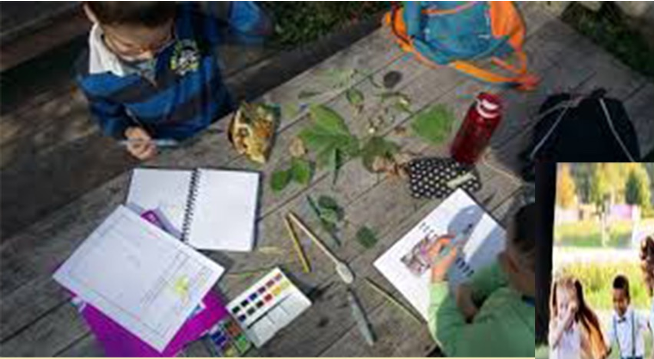
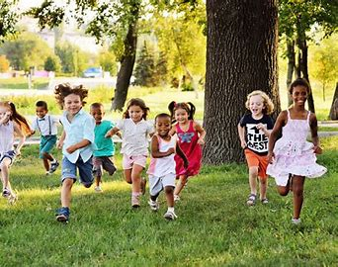
Study for Children 6-10 years of Age
In The Image Of God
The Nature of Man
Written by A.D. – LGC
https://www.legrandcri.org/
February 2021
Translated by K.M.L and edited by T.M. – WSF
http://www.white-stone.ca/kids-prophecy-corner/
February 2021

Slide 2
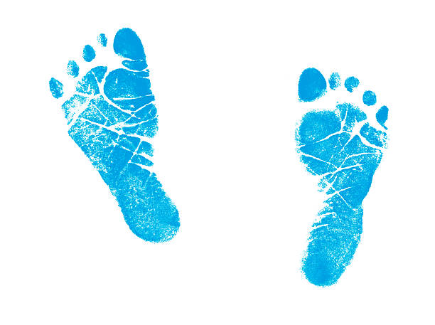
Children song from the French Hymnal. Not translated.
558. Deux mains pour servir
Deux mains pour servir le Maître,
Deux pieds pour aller partout
Dire à tous: nous voulons être,
Au bon Sauveur humble et doux.
Seigneur, prends toute ma vie,
Mon cœur et ma volonté;
Que jamais je ne t'oublie,
Dieu de grâce et de bonté.

Slide 3
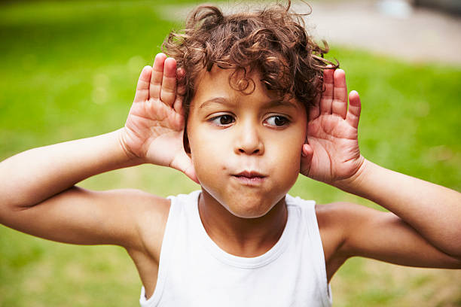
558. Deux mains pour servir
Deux oreilles pour entendre
Le vrai message du ciel;
La mémoire pour apprendre
Les leçons de l'Éternel.
Seigneur, prends toute ma vie,
Mon cœur et ma volonté;
Que jamais je ne t'oublie,
Dieu de grâce et de bonté.

Slide 4
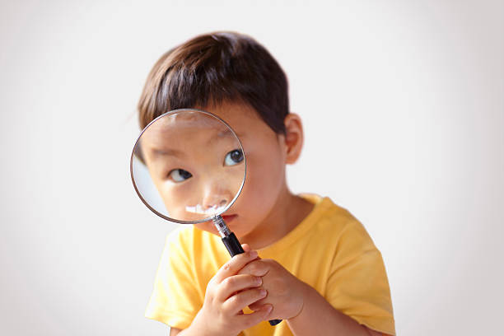
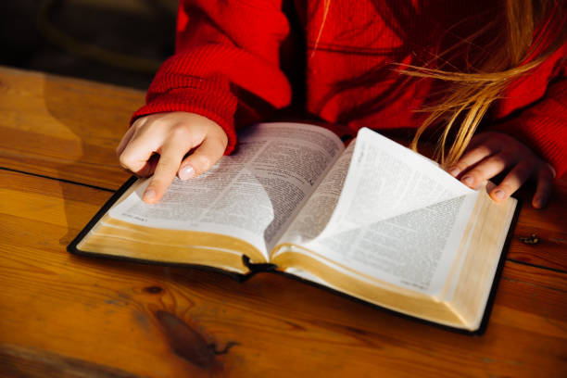
558. Deux mains pour servir
Deux yeux pour lire le livre
Qu'il faut aimer toujours plus;
C'est le pain qui nous fait vivre,
Qui nous rend forts en Jésus.
Seigneur, prends toute ma vie,
Mon cœur et ma volonté;
Que jamais je ne t'oublie,
Dieu de grâce et de bonté.

Slide 5
558. Deux mains pour servir
Un cœur pour être le trône
Où doit régner le Seigneur,
Une vie à toi se donne
Toute entière, ô Créateur!
Seigneur, prends toute ma vie,
Mon cœur et ma volonté;
Que jamais je ne t'oublie,
Dieu de grâce et de bonté.

Slide 6
Prayer

Slide 7
In the image of god?
GENESIS 1: 26-27
Notes:
Je vous propose un sujet dont parle beaucoup les adultes et je voulais voir comment vous, vous perceviez ce sujet si important.

Slide 8
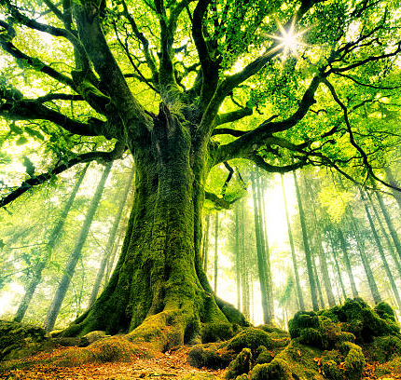
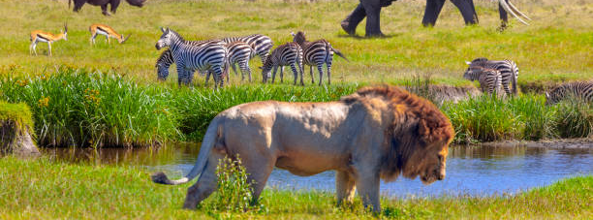
WHO WAS CREATED IN THE IMAGE OF GOD?
Notes:
Who do you think was created like God?

Slide 9
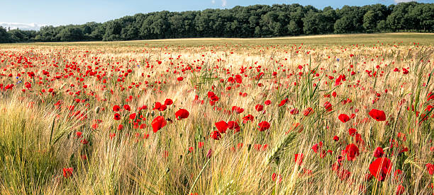
THE PLANTS?

Slide 10
11 And God said, Let the earth bring forth grass, the herb yielding seed, [and] the fruit tree yielding fruit after his kind, whose seed [is] in itself, upon the earth: and it was so.
God does not say in His word that He created plants in His image.
THE PLANTS
Genesis 1: 11

Slide 11
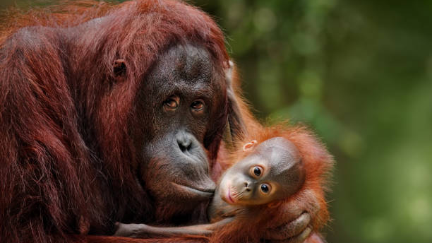
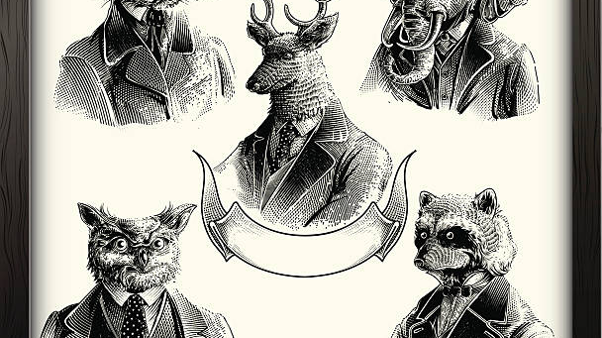
THE ANIMALS?

Slide 12
24 And God said, Let the earth bring forth the living creature after his kind, cattle, and creeping thing, and beast of the earth after his kind: and it was so.
25 And God made the beast of the earth after his kind, and cattle after their kind, and every thing that creepeth upon the earth after his kind: and God saw that [it was] good.
THE ANIMALS
Genesis 1: 24-25
God also does not say in His word that He created animals in His image even though they feel certain things and even though they can be very intelligent.

Slide 13
Mankind?

Slide 14
26 And God said, Let us make man in our image, after our likeness: and let them have dominion over the fish of the sea, and over the fowl of the air, and over the cattle, and over all the earth, and over every creeping thing that creepeth upon the earth.
27 So God created man in his [own] image, in the image of God created he him; male and female created he them.
MANKIND
Genesis 1: 26-27
In His word God Himself says that He created MALE and FEMALE in His IMAGE, so humans were created in the image of God.

Slide 15
Genesis 2:7
How did God create mankind?
" And the LORD God formed man [of] the dust of the ground, and breathed into his nostrils the breath of life; and man became a living soul."

Slide 16
3/MAN BECAME A LIVING SOUL
2/GOD BREATHED INTO HIS NOSTRILS THE BREATH OF LIFE
= MANKIND
BREATH OF LIFE
1/GOD FORMED MAN OF THE DUST OF THE GROUND
THE BODY +

Slide 17
1 Thessalonians 5:23
23 And the very God of peace sanctify you wholly; and [I pray God] your whole spirit and soul and body be preserved blameless unto the coming of our Lord Jesus Christ.
You wholly
=
ME
=
SPIRIT
SOUL
BODY
My being is
composed
Of my body,
Of my mind
And of my soul

Slide 18
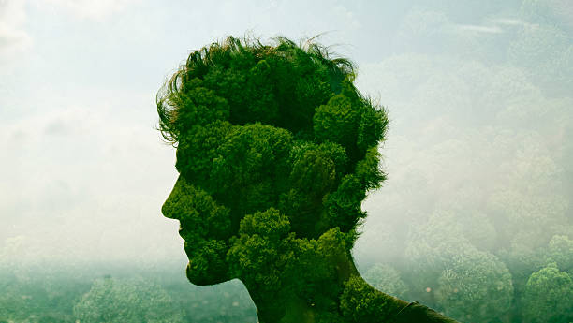
THE NATURE OF MAN
ME
=
SPIRIT
SOUL
BODY
Notes:
NATURE OF THE MAN/ IN 3 TYPES / SPIRITUAL ... Spirit - SOUL ....breath<<<<BODY....envelopes the flesh

Slide 19
BODY = PHYSICAL ENVELOPE (what we see) THE HOUSE.
BREATH OF GOD = SPIRIT + SOUL (what's inside).
ME
Boy or Girl
BREATH OF
GOD
BREATH OF GOD
=
SPIRIT
SOUL
BODY
Job 12:10: "In whose hand [is] the soul of every living thing, and the breath of all mankind.”
Job 32:8 :“ But [there is] a spirit in man: and the inspiration of the Almighty giveth them understanding.”

Slide 20
WHAT ARE THE DIFFERENT FACULTIES BEHIND:
SPIRIT
SOUL
BODY
PHYSICAL
Body
Feelings/Emotions
Senses (sight, smell, taste, touch, hearing)...
MENTAL
Reason
Knowledge
Intelligence
Wisdom…
SPIRITUAL
Faith and faithfulness
Love and empathy
Kindness and benevolence...
BODY
SPIRIT/SOUL

Slide 21
Galatians 5: 19-21
19 Now the works of the flesh are manifest, which are [these]; Adultery, fornication, uncleanness, lasciviousness,
20 Idolatry, witchcraft, hatred, variance, emulations, wrath, strife, seditions, heresies,
21 Envyings, murders, drunkenness, revellings, and such like:

Slide 22
22 But the fruit of the Spirit is love, joy, peace, longsuffering, gentleness, goodness*, faith,
* Character or quality consisting of being good, gentle and forgiving.
Galatians 5: 22

Slide 23
THE BODY OR THE FLESH
Our body Is the seat of our passions commonly called lower or inferior passions; because if they are not subjugated people will do silly things such as: arguing with their brothers and sisters or with their Friends, or eating lots of ice cream or cake, or getting angry, or envying what someone else has…
Our emotions are also part of our lower passions; they must never dictate our actions:
For example: if you get angry and want to break your toys, will this anger guide you or will you control yourself?

Slide 24
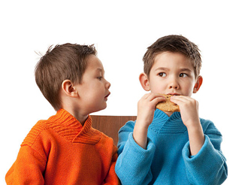
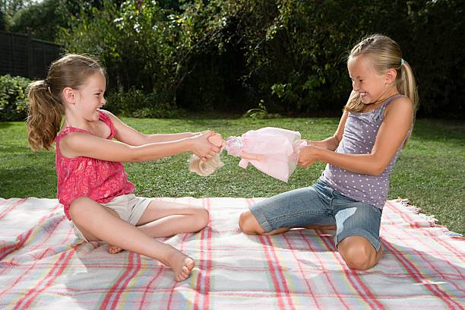
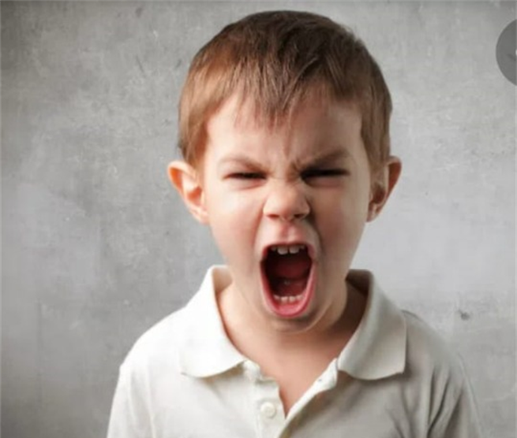
ENVY
THE BODY AND THE FLESH:
SEAT OF OUR LOWER PASSIONS
THE 5 SENSES
FIGHTS
GLUTTONY
ANGER

Slide 25
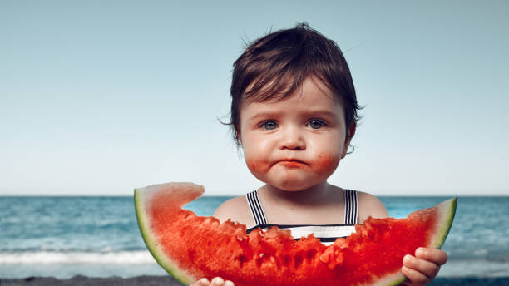
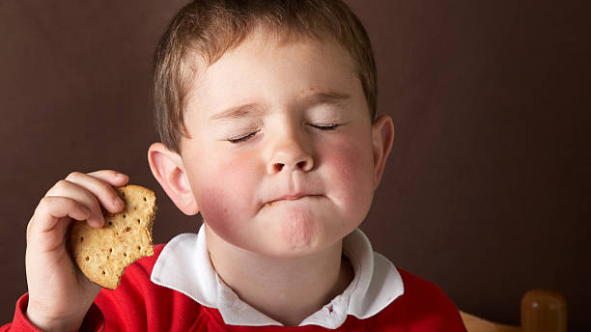
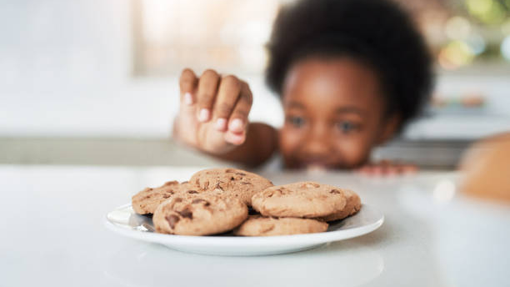
GLUTTONY

Slide 26
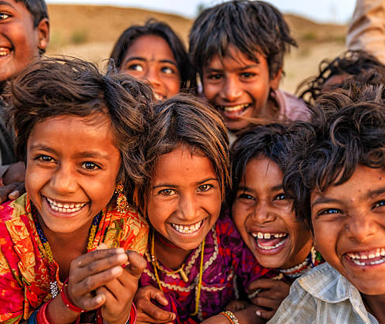
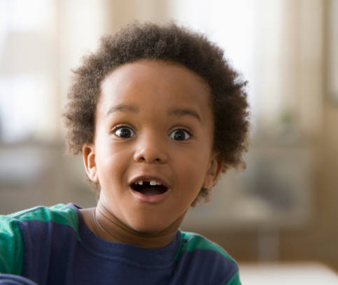
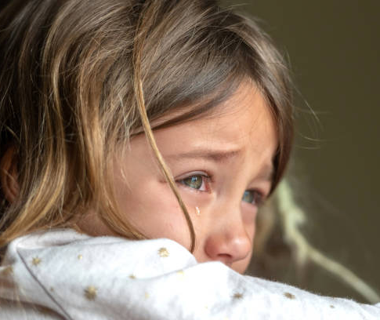
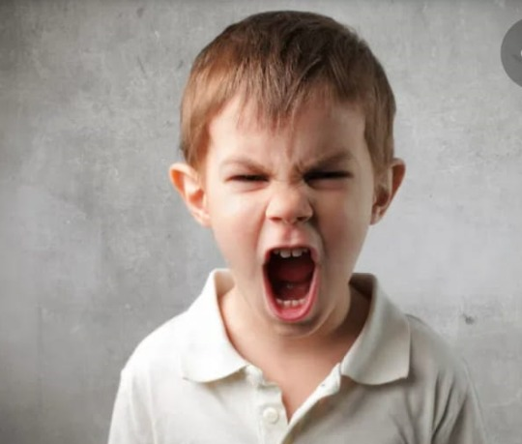
EMOTIONS

Slide 27
GOD ALSO HAS FEELINGS AND EMOTIONS
“ God [is] jealous, and the LORD revengeth; the LORD revengeth, and [is] furious; the LORD will take vengeance on his adversaries, and he reserveth [wrath] for his enemies.”
“ And I will rejoice in Jerusalem, and joy in my people: and the voice of weeping shall be no more heard in her, nor the voice of crying.”
“ The LORD [is] gracious, and full of compassion; slow to anger, and of great mercy.”
Nahum1:2
Isaiah 65:19
Psalms 145:8

Slide 28
The Soul And The Spirit
Are the seat of the higher powers, because it is these powers that must dominate our whole person and allow us to be in the image of God in our everyday behaviour with our family and friends.
That is why our mind and soul must be nourished with good knowledge and good sources of information.
It's a bit like a library in our brain that we are going to fill with good books!!! Books that increase our knowledge about everything around us and help us to grow!
Our lower passions must be controlled by our will. It is not easy to have a good will; we have to practice it every day. But the will is nourished by the knowledge we will have acquired of what surrounds us.
For example: If you feel like eating an ice cream, then another one... are you just going to eat all the ice cream you crave, or do know that eating too much ice cream will make you sick because there is too much sugar? No, you will exercise your will and reason thanks to your library of knowledge!!!

Slide 29
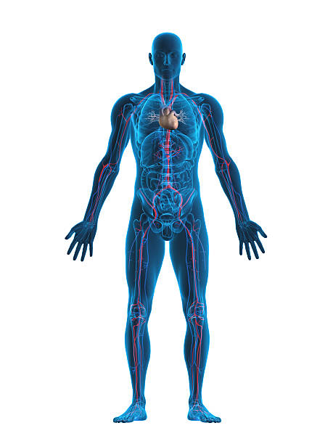
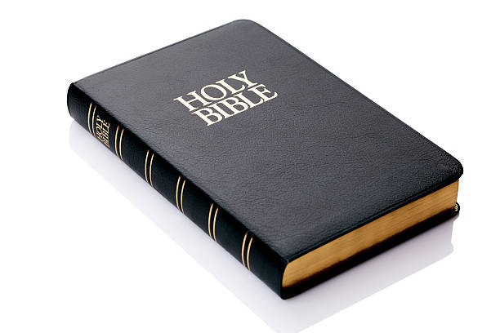
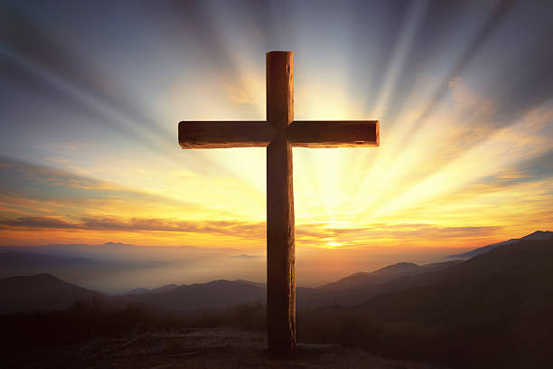
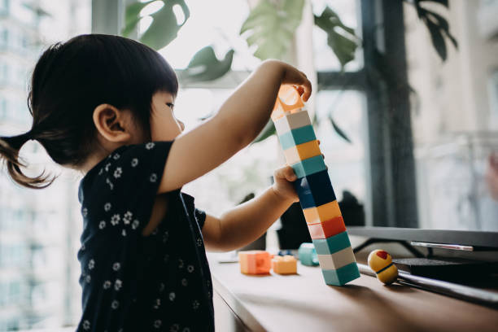
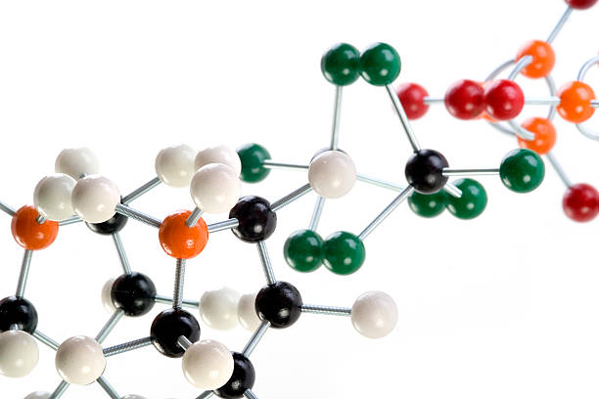
THE SOUL / THE SPIRIT:
SEAT OF OUR HIGHER POWERS
TEMPERANCE
FAITH
OBEDIENCE
PEACE
WISDOM
COMPASSION
WILL
KNOWLEDGE

Slide 30
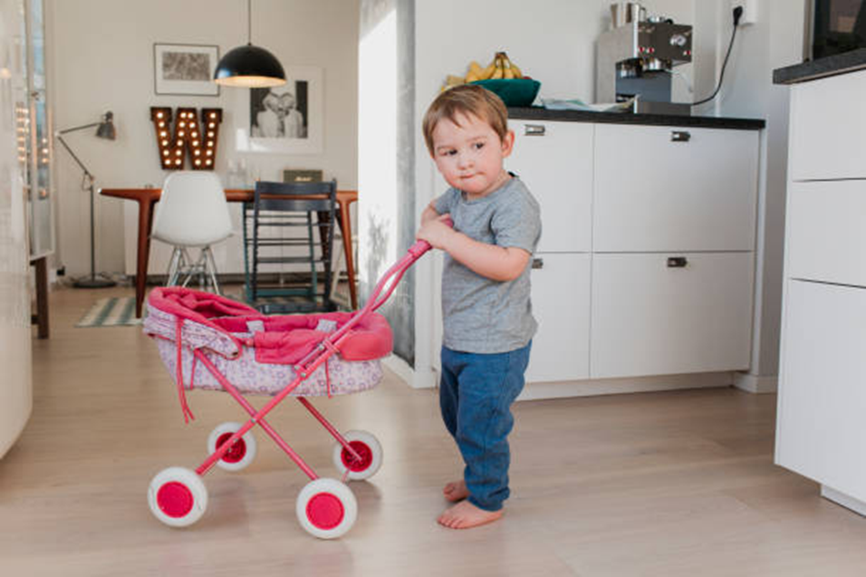
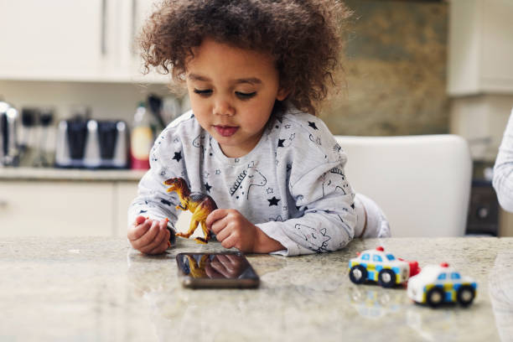
EQUALITY
For example:
My knowledge on equality allows me
To make good behavioural choices.

Slide 31
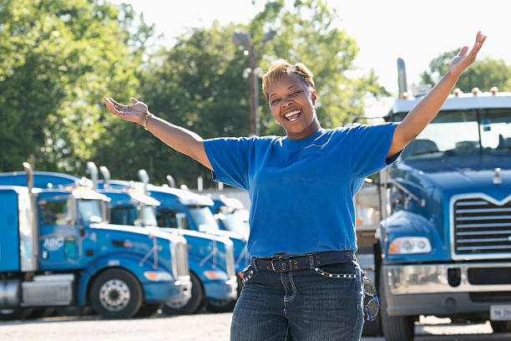
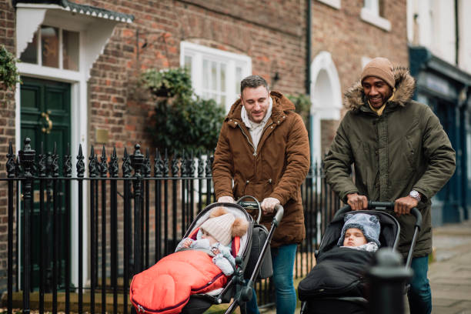
DIFFERENT BUT
ALL EQUAL
Handicaps
Occupations
Religions
Responsibilities

Slide 32
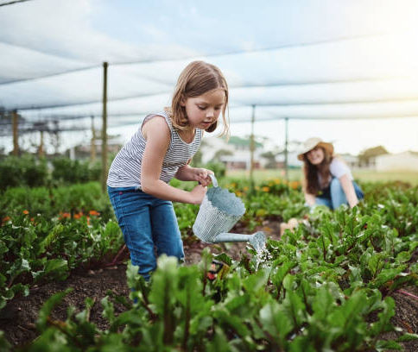
Parents can help us to fill out our library
Or exercise our will.
THE PARENTS
PRECIOUS HELPS

Slide 33
SOUL/SPIRIT
MUST BE FED
BIBLE
METHODOLOGY
NATURE
EQUALITY
SCIENCES
8 LAWS OF HEALTH

Slide 34
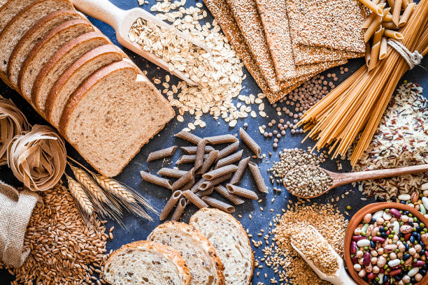
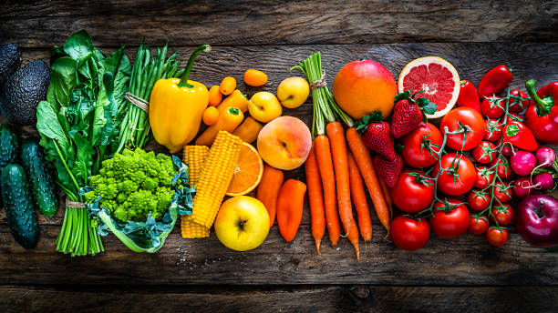
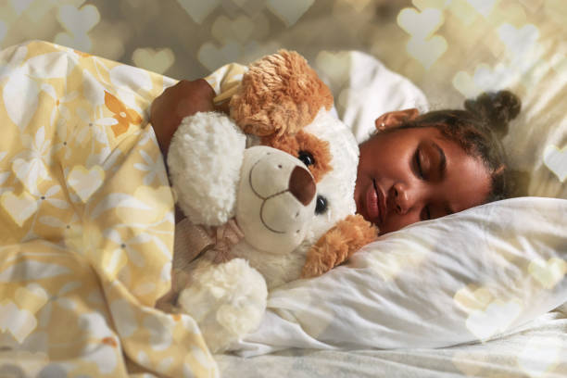
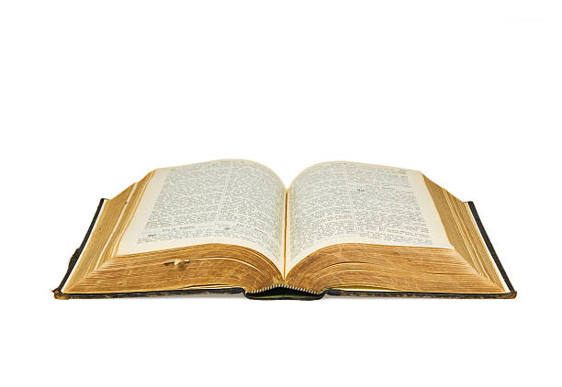
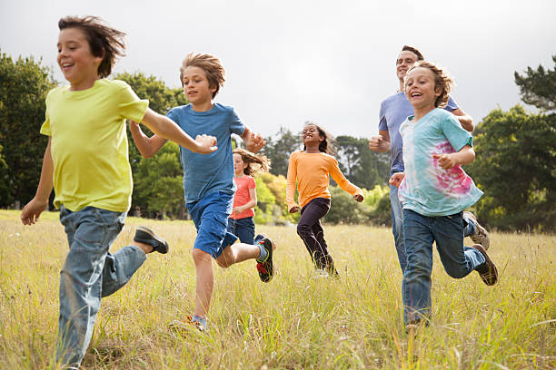
THE BODY AND THE SPIRIT
THE 8 LAWS OF HEALTH
REST
NUTRITION
SUNSHINE
WATER
TRUST IN GOD
AIR
TEMPERANCE
EXERCISE

Slide 35
CONCLUSION:
HAPPY, TOLERANT, OBEDIENT AND WISE CHILDREN : IN THE IMAGE OF GOD!
Notes:
Conclusion: Here you go children, the idea of all this is so that you can better understand how your body is made up and how it works with what God has given you to be children in His image, balanced, wise and obedient, intelligent, respectful of others and of your parents, tolerant of those who are different from you, kind and full of empathy. So you have a body that needs to be taken care of and a brain that needs to be nourished with good things from a very young age in order to have good habits and above all don't forget that your parents are there to help you.

Slide 36
THERE’S A TRANSFORMATION IN MY LIFE
THE THINGS I USED TO DO
I WON’T DO IT AGAIN
THERE’S A TRANSFORMATION IN MY LIFE }
THE THINGS I USE TO EAT
I WON’T EAT IT AGAIN
THERE’S A TRANSFORMATION IN MY LIFE }
THE THINGS I USED TO DRINK
I WON’T DRINK IT AGAIN
THERE’S A TRANSFORMATION IN MY LIFE }
THE THINGS I USED TO SAY
I WON’T SAY IT AGAIN
THERE’S A TRANSFORMATION IN MY LIFE }
TER
TER
TER
TER
TER
TER
TER
TER

Slide 37
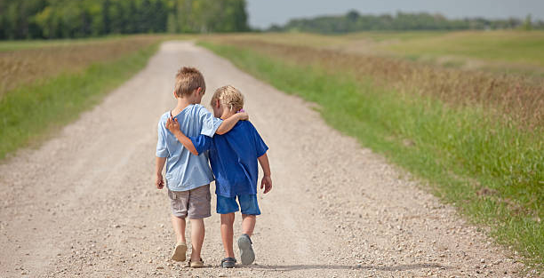
THE END

Slide 38
PRAYER

