Slide 1
Kids’ Prophecy Corner
Gender Equality
Written by K.M.L. and edited by T.M. – White Stone Foundation : http://www.white-stone.ca/
February 2021

Slide 2
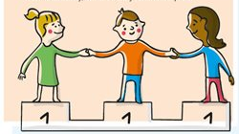
The Movement Promotes Equality
In the movement, we try our best to demonstrate equality between boys and girls. But it was not always the case.
Why do you think boys thought they were superior to girls? Is it because some boys can run faster? Is it because of your culture? Is it because mom does the cleaning and dad goes to work? Or Is it because the Bible tells us so? Can you please share your reasons?

Slide 3
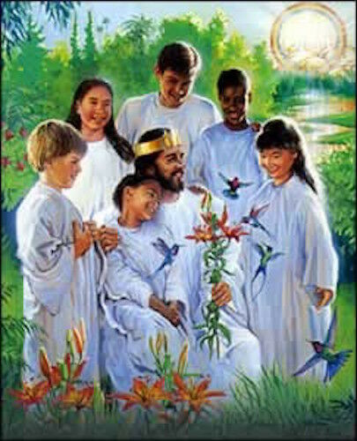
God’s Plan Of Restoration
God has a plan for us. He wants us to be restored to His image and doesn’t want anyone to be left out. He wants perfect equality between boys and girls. Can you imagine a heaven where only boys would have privileges and not girls? That would not be heaven would it?
When God created mankind he created them in His own image. The Bible says in Genesis 1:26,27 : “ Let us make man in our image, after our likeness… So God created man in his [own] image, in the image of God created he him; male and female created he them.
So God has in His character male and female traits. This is why we cannot say that God is either a man or a woman or that He has a gender identity.
God is neither male nor female because He doesn’t make babies like your parents, grand-parents, great-grand parents, uncles, aunties, you or me. The Bible describes Him as a Spirit ( John 4:24) and a spirit doesn’t have flesh and blood (Luke 24:39). Consequently, as a heavenly being, no gender applies to Him.
Gender defines what girls and boys are expected to be and do in terms of roles, responsibilities, rights and obligations. Like a boy should be strong and a girl should have good manners.
However in Heaven all the heavenly beings enjoy the same rights. They are able to do the same things and are treated the same way.
Knowing we are created in the image of God, God wants us to start practicing equality today in the same manner it is practiced in Heaven. Therefore we should not discriminate against a boy or a girl based on how we “think” they should behave.

Slide 4
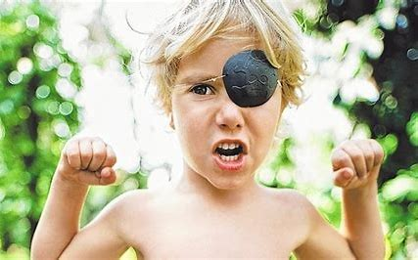
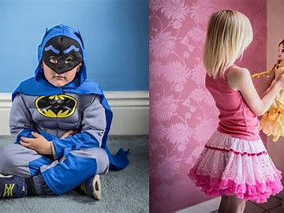
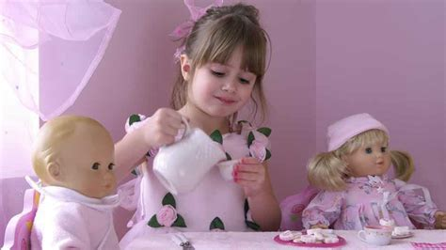
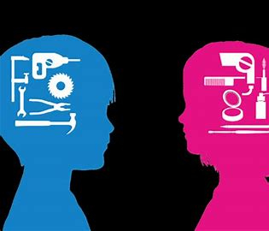
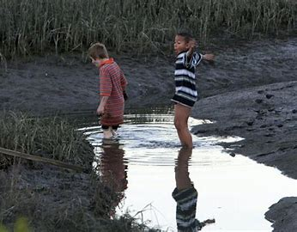
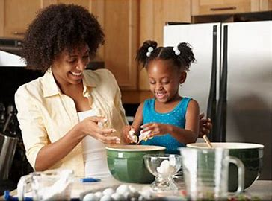
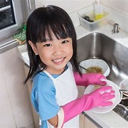
This is what Gender roles looks like
Boys are warriors
Boys are Heroes
Girls are princesses
Girls are entertainers
Girls are Homemakers
Girls are cooks
Boys love mechanics, girls like makeup and hair
Boys are wild and adventurers

Slide 5
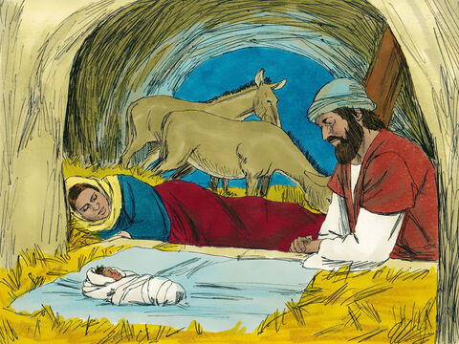
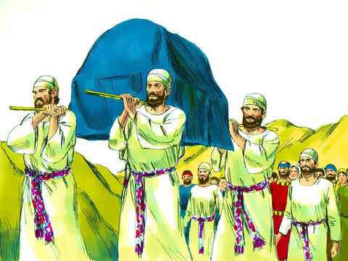
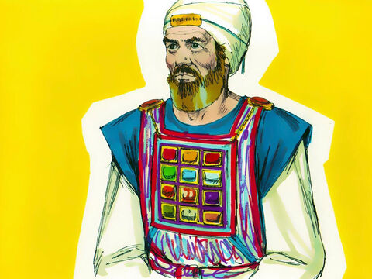
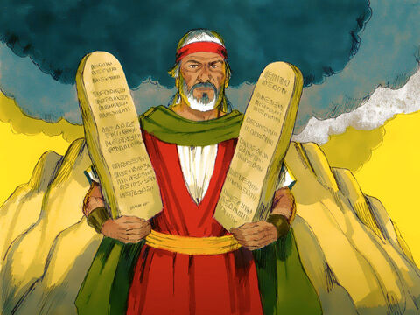
Does The Bible Discriminate Women?
But the Bible is written in such a manner that makes someone think that God gives authority to males over females. And people use that as an excuse to treat girls differently.
The Bible describes God, as “our Father in Heaven,” a male. This communicated how He related to Jesus in a way that the people would understand. In Biblical time and culture, the male represented his descendants (see Matthew 1: 1-17), and had authority in the family ( Gen.27: 1-29; 48:13-14). That Jesus was the Son of God communicated His divine lineage and His authority over the human family.
But that is not the only reason. In Hebrew society the economy was ruled by males. And that strengthened their idea that God was a man. God made men the head of the family. He used men as priests and Levites. He used men as kings and judges
When Moses wrote the laws, it was to instruct men. Some subjects were about marriage and divorce. Even the 10 commandments have instructions primarily directed to men. Can you read exodus 20: 5 and v. 17?

Slide 6
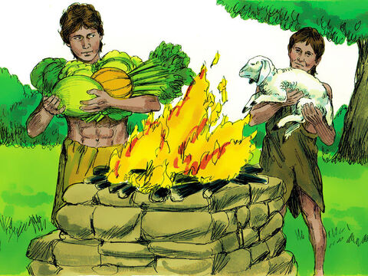
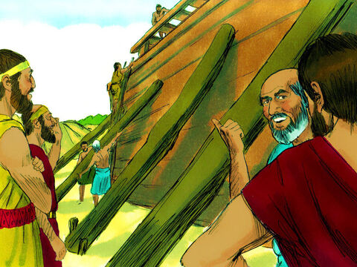
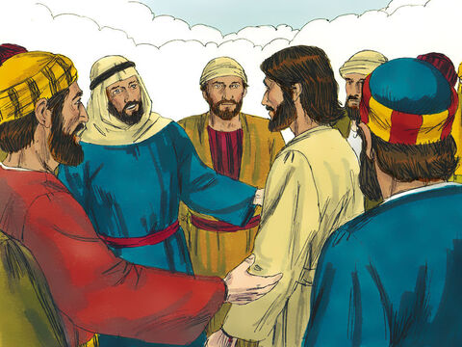
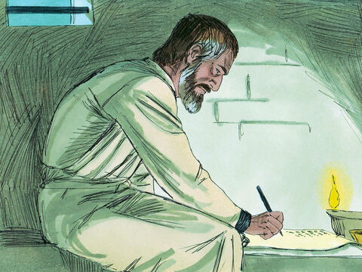
Does The Bible Discriminate Women? Continued
Do we have other examples in the Bible?
After Adam and Eve sinned, the Bible doesn’t give much attention to women. Adam and Eve had sons and daughters, but we know only of Cain, Abel, and Seth. – men. Noah built the ark with his sons Shem, Japheth and Ham. But we don’t know the names of their wives.
The majority of the prophets, disciples and apostles were men. Can you name them? Can you count how many books of the Bible have the name of a man and how many have the name of a woman? Do you think it’s fair?
Ellen G. White wrote many books with male titles like Patriarchs and Prophets or Prophets and Kings. And although she herself bore the title of prophetess, she was considered a lesser prophet by many because she was a woman.

Slide 7
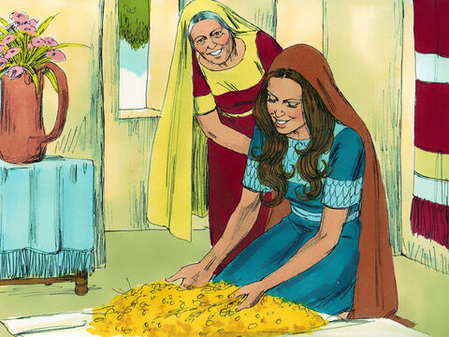
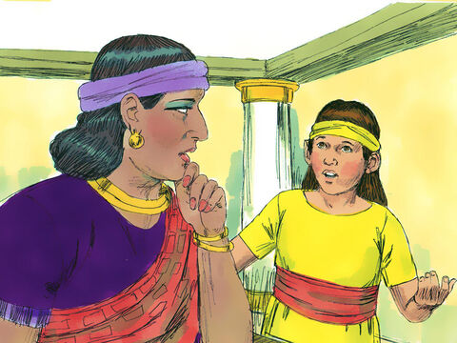
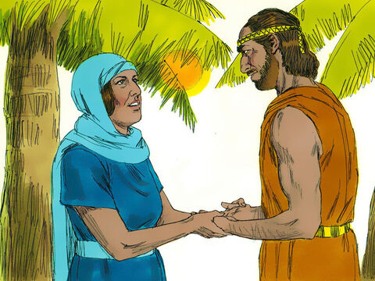
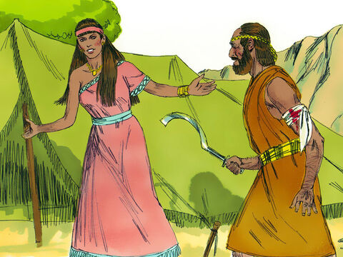
God Doesn’t Want Discrimination
But why didn’t God choose to represent Himself as female? Although the Bible was written by men, many women are mentioned. Some did great things like Ruth, Jael, and Deborah. Can you name a few more? Unfortunately, most of them were submissive.
There are other ways God can represent Himself. What can you receive from Him? Yes, Wisdom! And wisdom is a feminine word which comes from the Greek word Sofia, a woman. The word instruct found in Hebrews 12:5 is also a feminine noun in the Greek!
In reality, God never wanted women to be submissive, to be slaves, or to be neglected. But He had to work with the culture and traditions His children were brought up with. He was limited by their way of thinking.
It is painful for God to see His creation being afflicted. This is why, in our time, at the end of the world, He doesn’t want His children to misrepresent who He is. He loves, cares, and protects everyone one equally no matter the gender or the race. And we have to show others that we love and care for them equally no matter their gender or their race.

Slide 8
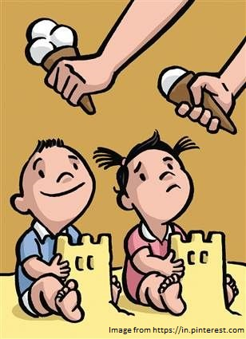
Gender Inequality
Sometimes we may not realize we are discriminating against a friend or a sibling because of their gender. A girl must do “girls stuff” and a boy should do “boys stuff.” We probably think that one gender has more rights and opportunities than another.
When you see the following behaviours show kindness or empathy to the person who is affected.
When someone :
Leaves her/him out on purpose
Hurts his/her feelings
Treats her/him unfairly or badly
Hurts you physically
Tell me what is wrong with the picture?

Slide 9
True Or False Gender Equality is when Boys and Girls enjoy the same rights, resources, opportunities, and protection
Girls are more caring than boys
Boys are stronger and faster than girls
Girls and boys are brave and strong
Girls play with doll and boys with cars
Girls can cry, boys don’t
Boys are better at Math
Boys and girls deserve the same opportunities
Pink is for Girls and blue for boys
There is no superior gender
Only boys can be president
Only boys can become Scientists
Girls can’t read maps

Slide 10
If someone says,.... I will say (promote Gender Equality)
Boys are Heroes, girls are princesses
When you grow up, girls will be teachers and boys firemen
Gym class is for girls and soccer for boys?
I don’t play with girls
I don’t play with boys
Girls always cry and talk too much
Girls are too girly
Boys are strong, girls are weak

Slide 11
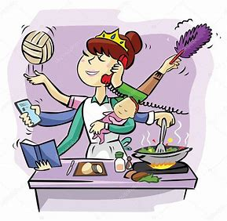
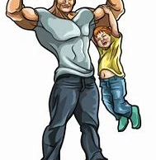
Gender Stereotypes For each example, decide what ways of thinking are associated with the stereotype and what other possible ways of thinking there might be which are not shown in the examples.
Perfect Housewife
Strong dad
Girl and her dolls

Slide 12
Who Should Be Doing This? Mom or Dad?
Cleaning the house
Buying children’s clothes
Doing weekly shopping
Buying a car
Mowing the lawn
Cooking
Buying a washing machine
Repair the car
Take out the trash
Iron the clothes
Pay the bills
Drive to church

Slide 13
Occupation Checklist Who Should become a…..a man or a woman?
Teacher
Lawyer
Telephone Operator
Astronaut
Pilot
Bus driver
Nurse
Engineer
Cashier
Dentist
Daycare
Welder
Flight Attendant
Homemaker
Architect
Farmer

Slide 14
Gender Roles
What does it mean to act ‘like a man’? What words or expectations come to mind? (e.g. men don’t cry; men are tough; etc.).
What does it mean to act ‘like a woman’? What words or expectations do you think of? (e.g. girls are polite; girls are neat and submissive; etc.).
Where do we learn these gender roles? What people influence our learning of them? Can you mention any specific examples? Where else in society do we find these messages?
What are some situations where you may be pressured to ‘act like a man’ or ‘be a lady’?
How might these stereotypes lead to violence?

Slide 15
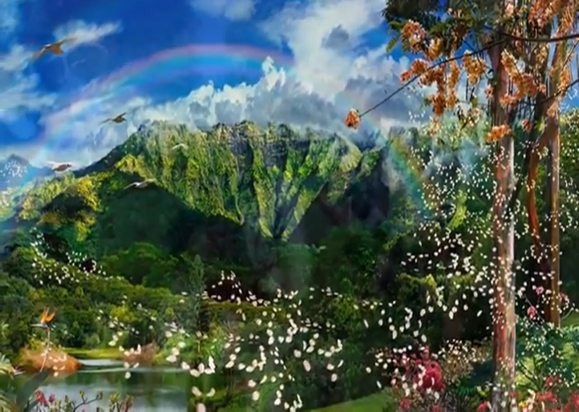
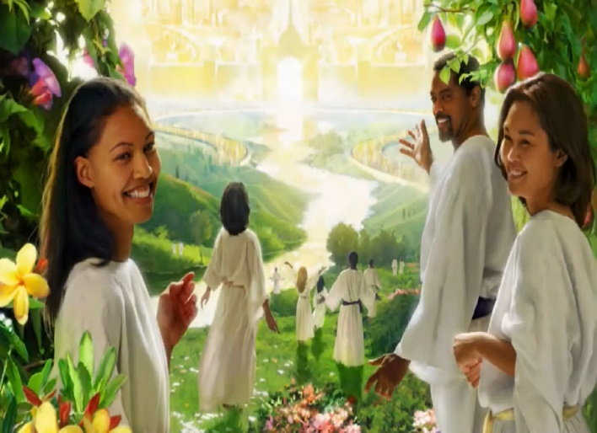
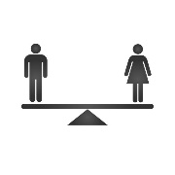
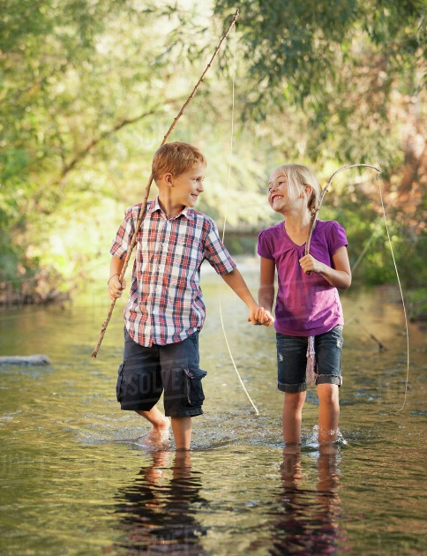
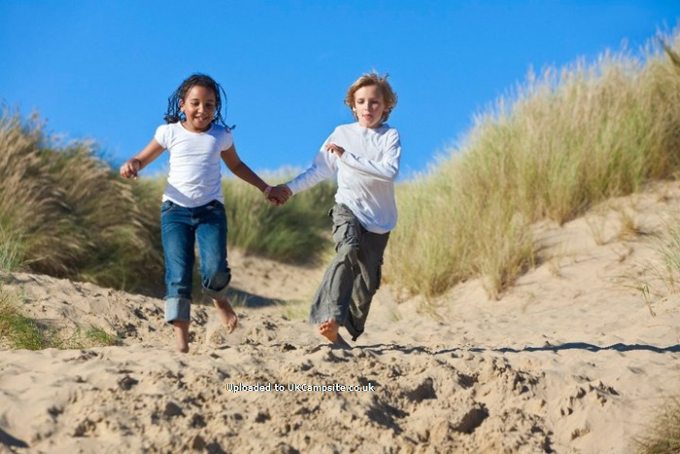
2021
2nd Advent
Eden
Eden
Remember, we are here. Strive to show equality in your everyday actions.

Slide 16
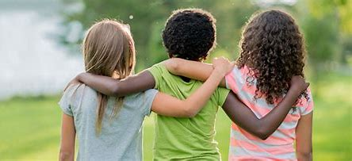
Thank You and God Bless

