Slide 1
Kids’ Prophecy Corner
Vaccination
Building Memory Cells and Being Empathetic
Written by K.M.L. and edited by T.M. – White Stone Foundation : http://www.white-stone.ca/
January 2021

Slide 2
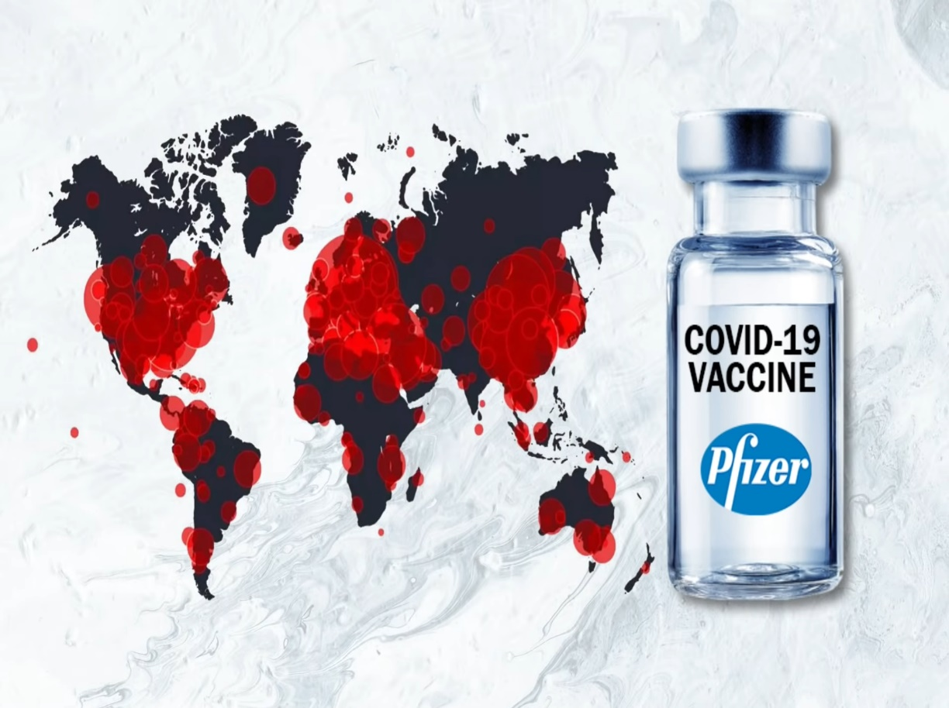
The Pandemic
In November 2019 the first case of Covid-19 was declared.
Since then millions of people contracted the virus and many lost their lives.
However, by the end of the year 2020 a cure has been developed and approved. It is a vaccine developed by scientists*.
The distribution all over the world has already begun.
* If your child is older, use the terms virologists, epidemiologists, and biochemistry specialists.

Slide 3
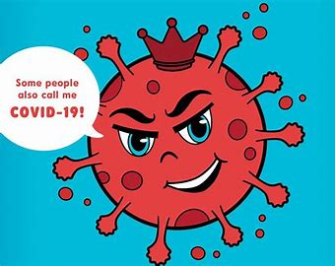
Who is Corona?
Corona is a virus so small that you need a microscope to see it.
Corona means crown in Latin and it has little antennas that stick out of it just like the points on a crown.
Viruses are odd. They don’t eat and they don’t poop. So, in order to live, they need to attach themselves to people. They travel into the nose, the mouth and even the eyes. And when they are inside you, you can get sick.
Luckily, our body knows how to protect itself. Special cells battle against viruses to get rid of them. These cells make up your immune system.
There are many types of corona virus. They are all from the same family. But this time a new family member arose and because of this our body doesn’t know how to fight it.
This Corona virus has different names. You can call it SARS-CoV-2, or Corona, or Covid-19.

Slide 4
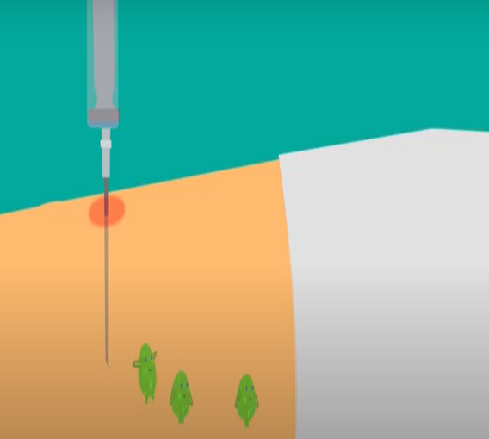
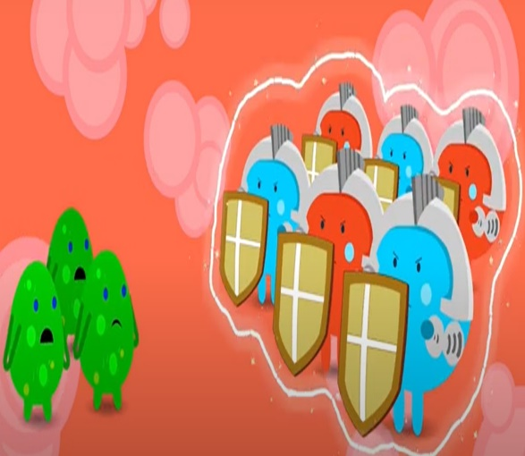
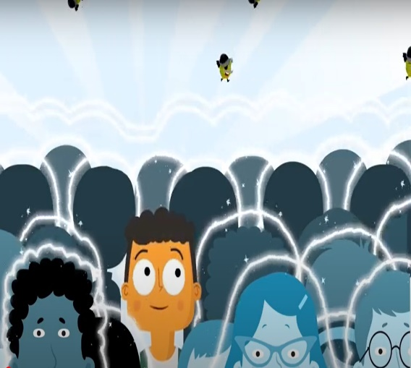
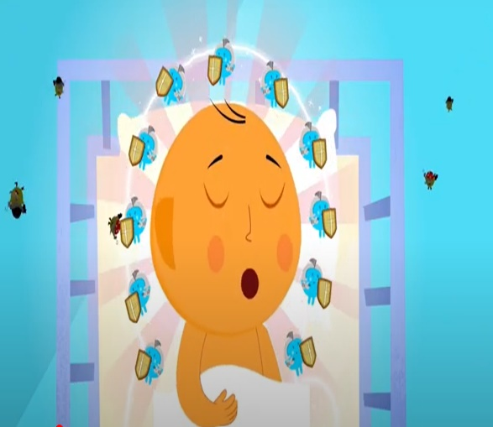
How Do Vaccines work?
Vaccines supply a weakened version of a known disease* directly into the body in order to spur our natural immune response. They ensure we are protected against the real more dangerous version of the disease.
Their function is also to protect the community. As the more people are vaccinated, the better they work to ensure the disease doesn’t spread among the most vulnerable members such as babies, the elderly, and people with medical conditions who cannot be vaccinated.
Some children will suffer mild symptoms like fever. These are signs that the immune system is strengthening itself against that particular disease. It means it is working.
* If your child is older use the word pathogen instead of disease.

Slide 5
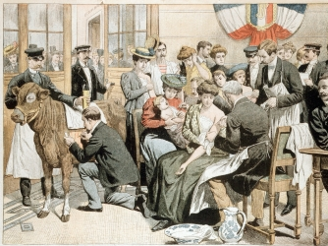
A Brief History of The First Vaccine
In 1798, at the time of the end, the inventor (Edward Jenner) made known his cure against smallpox.
He had heard many rumors that dairy maids, after being infected with cowpox, a lesser virus similar to smallpox, received immunity from both diseases. After studying a dairy maid with fresh cowpox lesions on her hand he saw that she was immune to smallpox. After much thought and careful planning he decided to inoculate a boy with fresh cowpox lesions. After a mild case of cowpox occurred he decided to take fresh smallpox and place it on an open wound on the boy. After a few weeks no smallpox had shown up and Edward Jenner concluded that immunity was complete. This discovery paved the way for the eventual eradication of this disease from the world (1).
Since then there has been an increase of knowledge on the need to produce vaccines which would eradicate deadly pandemics.
Vaccines* have been found to fight viruses that our immune system cannot fight naturally.
(1) https://kids.kiddle.co/Smallpox
*If your child is older, name some of the vaccines like Measle, mumps, rubella, influenza, etc..
Parents: Build your memory cells by looking at the photos here : https://www.cdc.gov/vaccines/vpd/photo-all-vpd.html

Slide 6
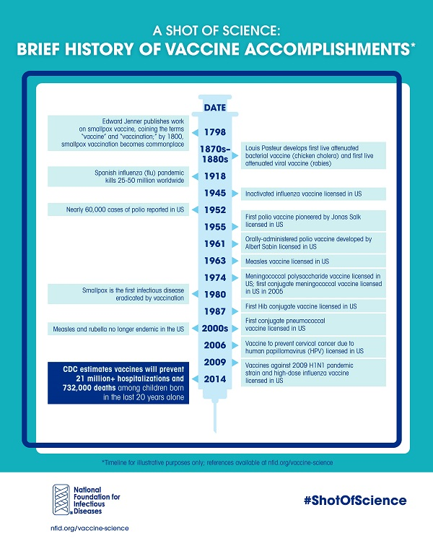
Here is a short timeline for your personal knowledge. We can now add the date 2020 with the licensing of the Covid-19 vaccine.

Slide 7
Memory Cells And Our Prophetic Message
The vaccine is a nice parable for our prophetic message.
When you are invaded by a virus, you create memory cells. If the virus comes again your memory cells come alive and kill it.
Every time you study a prophetic subject, let’s say slavery, you take a painful injection, but it can protect you from a much greater disease which is racism today.
This is why our prophetic message always looks at past histories from the Bible and from the world to have an accurate understanding of the present and the future.
So if you want to be vaccinated against racism, study slavery. If you want to be vaccinated against sexism, study the lives of Deborah and Jael. If you want to be vaccinated against nationalism, study the conduct of the Jews toward the gentiles. If you want to be vaccinated against conspiracy theories, study the history of the Millerites or WW3.
Virus
Virus
ZZZ
ZZZ
Memory Cells
Vaccine
Memory Cells

Slide 8
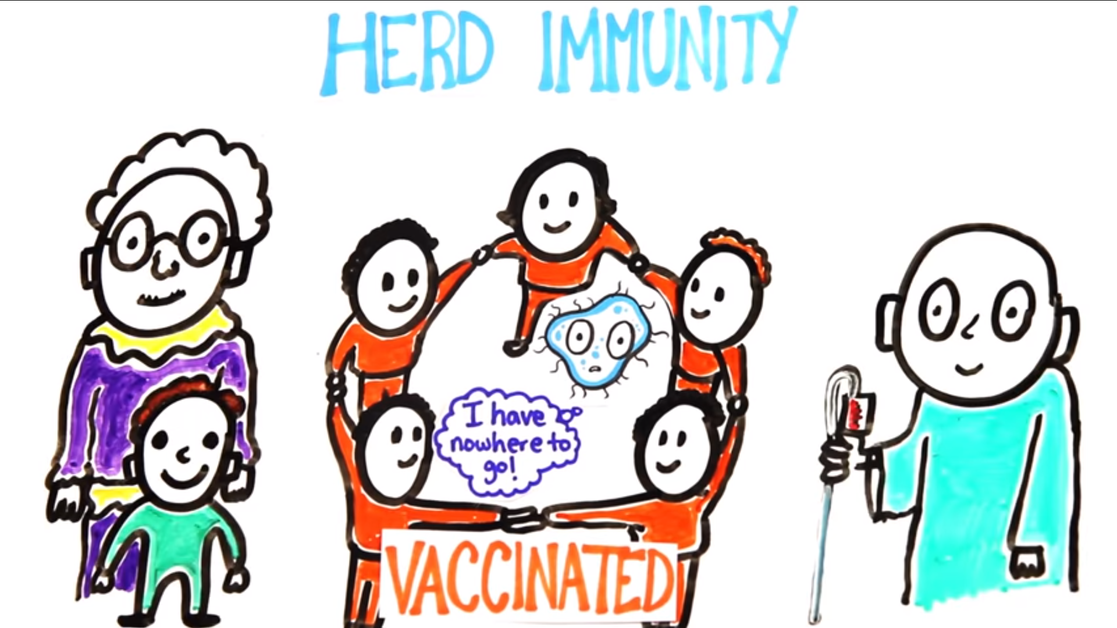
Vaccines and Empathy
Many people have concerns about vaccines. They doubt the level of protection they can offer. What can you do?
First, listen to what they have to say by asking politely about their concerns. Do not invalidate their emotions.
Second, validate their emotions by saying: “ I understand your concerns about the harmful chemicals…” then continue by sharing facts and information: “ did you know we ingest more aluminum a day (30-50mg) through food and drink than what is contained in a vaccine dose (0.125mg)? Its purpose is to make the vaccine more effective”. Or : “ Did you know that vaccines are the most highly regulated substances we can put into our bodies and they are given mostly to children as a preventative measure rather than a treatment?”. Or : “Vaccines save millions of lives every year”.
Your role is to give accurate information and build trust. Let them know that when you take a vaccine you don’t do it for yourself but for the safety of others, especially those with compromised immune systems. It hurts to see people suffering and dying. The last thing you want is to see an outbreak. The safest course to pursue is to have the entire world inoculated against life threatening diseases. This would provides a shield of protection around them; what we call herd immunity. This is a great way to show empathy.

Slide 9
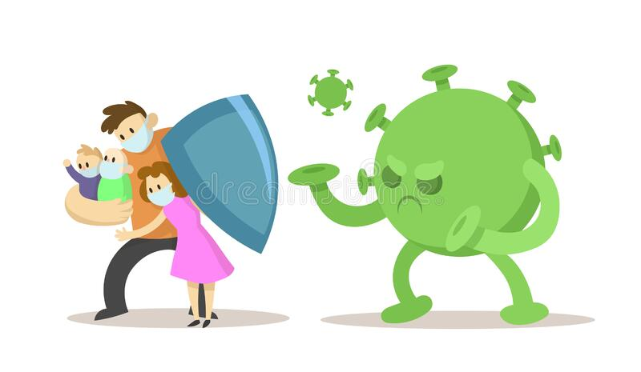
Parents Have To Show Empathy
As a child, there are many ways you can protect yourself and others: clean your hands often, cough or sneeze in your bent elbow, wear a mask, and practice social distancing.
However the Covid-19 vaccine is only available for adults which means children are not protected against it.
So your parents have the duty to get the vaccine. It shows how much they care for you. They are the ones creating that shield of protection around you. It is a big decision but the more adults take the responsibility, the more children and vulnerable people will be safe.

Slide 10
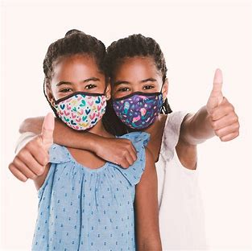
Vaccines can be scary. But remember when you are vaccinated you no longer have to worry about being infected. Your memory cells will fight for you.
Same with the message. The more you learn, the more your memory cells will fight against wrong behaviours and understanding. And it allows you to care for others just like God cares for you.

Slide 11
Let Us Build Our Prophetic Memory Cells!
If I want to be vaccinated against I need to Learn about* __
Indifference
Church and State
Conspiracy Theories
Nationalism
Acts 27
WW3
History of Vaccines
The Counterfeit
WWI + WWII
Conservatism
WWI and Spanish Flu
Sexism
Equality
Disinformation
Slavery
1260
Not loving our neighbours
Racism
Jews toward gentiles
Civil War
Pyrrhus
Millerites History
SDA&USA misleading
The Papacy
Empathy
Deborah and Jael
Parable Teaching
Dictatorship
The King of the South
Covid-19
* There can be more than one response, add your own.

Slide 12
Show Empathy. Help your friends with their concerns
What about the chemicals?
But it hurts.
But I eat healthy.
Most diseases don’t exist anymore, why do we need vaccination?
And if I get sick?
God says He will protect His children from diseases. Shouldn’t I trust Him?
No one is vaccinated in our family and we are fine.
I heard it causes Autism.

Slide 13
Play it safe!
Only one person is wearing their mask properly. Explain why the others are not.

Slide 14
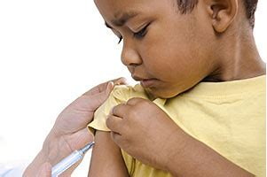
Thank You and God bless!

