Slide 1
Kids’ Prophecy Corner
The Story of Joseph In Prison – A Lesson in Empathy

Slide 2
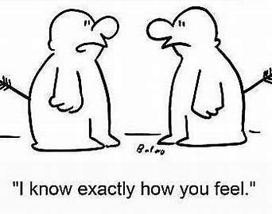
A Definition
It is important to show empathy to others.
Empathy is a big word which communicates that you sense how another person thinks or feels.
You give another person your full attention and really listen to what they have to say without judging.
In other words, you put yourself in their shoes.
But empathy is a bit different from sympathy.

Slide 3
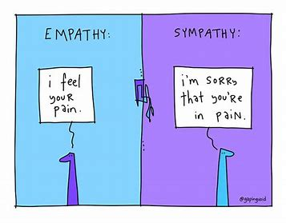
Sympathy Is Not Empathy
Sympathy means that you acknowledge or recognize the other person’s pain but it may lead to judgement or unwanted advice.
When you have Empathy you would say “I feel how you feel.”
When you have sympathy, you would say “I am sorry about how you feel.”

Slide 4
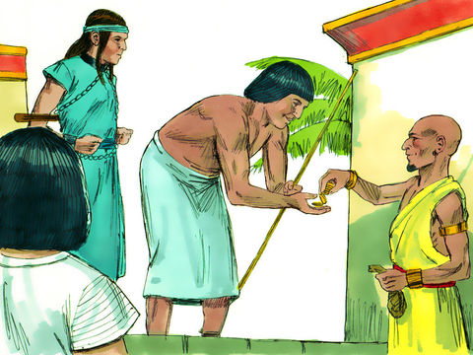
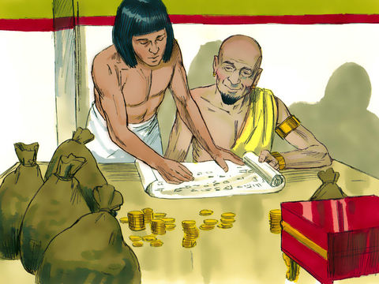
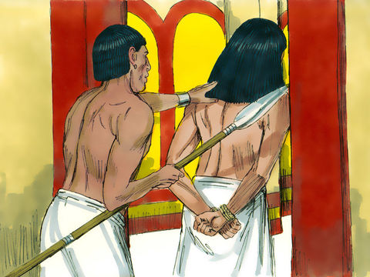
The Context
I am sure you are familiar with the Story of Joseph.
He was sold by his jealous brothers as a slave to Ishmaelite traders
When He arrived in Egypt he was sold to one of Pharaoh’s officials - Potiphar a captain of the guard. Potiphar trusted Joseph because he worked hard for him and was successful in all he did.
But Potiphar’s wife wanted to seduce him. Because Joseph did not respond to her advances, she made false accusations against him.
Potiphar knew his wife was lying. So to spare Joseph’s life he opted to put him in prison.
Genesis 39; 1 SP 133; { PP 218.1}

Slide 5
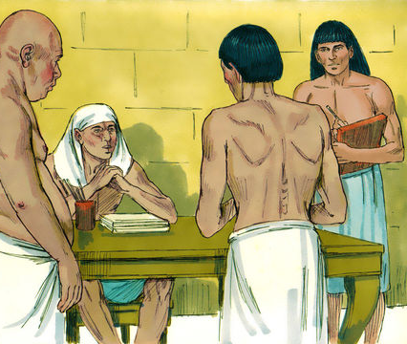
Joseph Is In Prison
While confined in prison, Pharaoh became offended with two of his officers - the chief baker and the chief butler. So he put them in the prison where Joseph was bound.
The prison warder was impressed with Joseph’s conduct. He was useful, humble, faithful and did not complain. He cared about those who were in trouble or distressed. As a result of his conduct Joseph was entrusted with the charge of all the prisoners.
The chief baker and chief butler also came under Joseph’s charge.
{ 1SP 133.3 }; { PP 218.3} Genesis 40

Slide 6
The Dreams
One morning, as Joseph brought food to the king’s officers, he observed that they were looking very sad. He kindly inquired, “Wherefore look ye so sadly today? And they said unto him, We have dreamed a dream, and there is no interpreter of it. And Joseph said unto them, Do not interpretations belong to God? Tell me them, I pray you.”
Have you noticed how Joseph demonstrated empathy? He saw their emotions; he saw how they looked sad and he pitied them.
{ 1SP 134.1 }

Slide 7
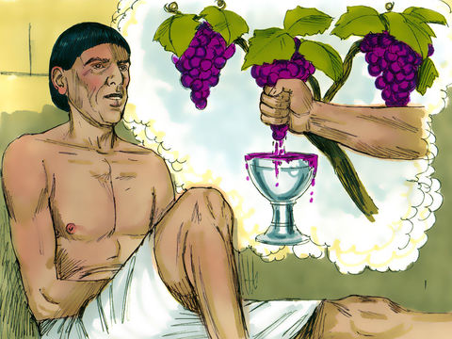
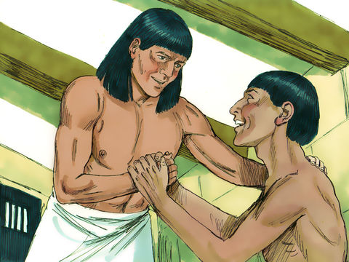
The Butler
Then the butler related his dream to Joseph. Joseph told the chief butler that in three days he would be no longer be a prisoner. He would be restored to his position as Pharaoh’s cupbearer.
He felt very grateful to Joseph because of the interest he had shown in him, and the kind treatment he had received from him; and above all, for helping him by interpreting his dream.
Let’s pause here. Because Joseph manifested kindness in a touching manner, the butler showed him his gratitude. Joseph did not judged him for his past deeds. Instead he lovingly communicated the good news he had for him.
Did you notice that the butler was in great distress of mind? Nowadays, we would say he was depressed. Joseph understood his mental state and helped him to feel better by interpreting the dream.
{ 1SP 134.1 }; { 1SP 134.2 }

Slide 8
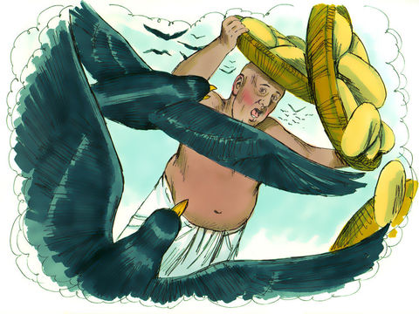
The Baker
Now, It was the chief baker’s turn to relate his dream.
As soon as he related his dream, Joseph looked sad. He understood its terrible meaning. Joseph had a kind, sympathizing heart, yet his high sense of duty led him to give the truthful, yet sad, interpretation of the chief baker’s dream. In three days he would be hung upon a tree.
There is a great lesson here. Joseph was not withholding affection. He was not treating the baker badly and saying “you are wicked, you will die”.
When Joseph related the dream to the baker he looked sad. It was the genuine sadness of an empathizing heart. Yet his high sense of duty led him to speak the truth to the chief baker.
Joseph was oppressed and in prison yet he showed sympathy to other people who were oppressed.
So we should have kind sympathizing hearts but also always tell the truth.
{ 1SP 134.2 }

Slide 9
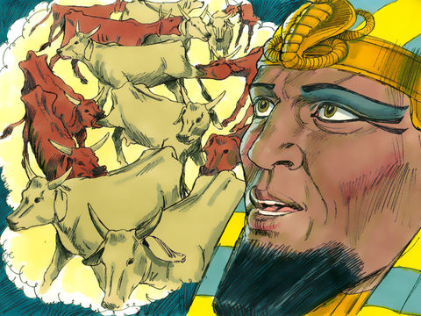
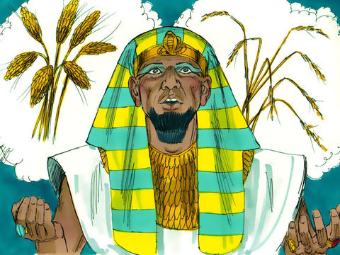
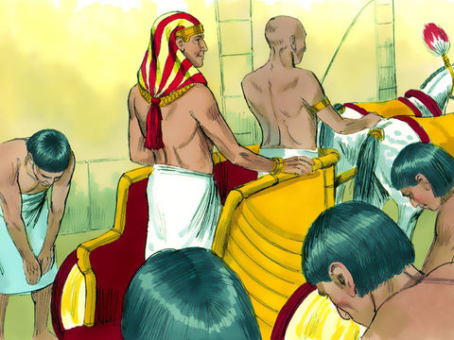
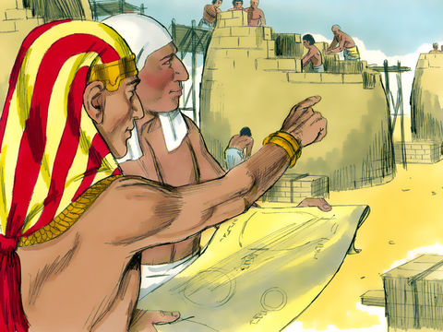
A Story of Success
Because of Joseph empathy, his interest in others, and his right behaviour, God used him.
Two years later Joseph gave Pharaoh the interpretation of his dreams.
Pharaoh rewarded him by making him the second ruler over Egypt. He also gave him a wife!
And when in this position Joseph conducted the affairs of Egypt with faithfulness and dependence upon God. He did not compromise!
Seven years of plenty were followed by seven years of famine. But no one missed anything because of Joseph’s faithfulness. There was so much that strangers from other countries came to Egypt. Even his brothers.
All bowed down to him. He was respected and the nation prospered.
{ 1SP 138.2 }

Slide 10
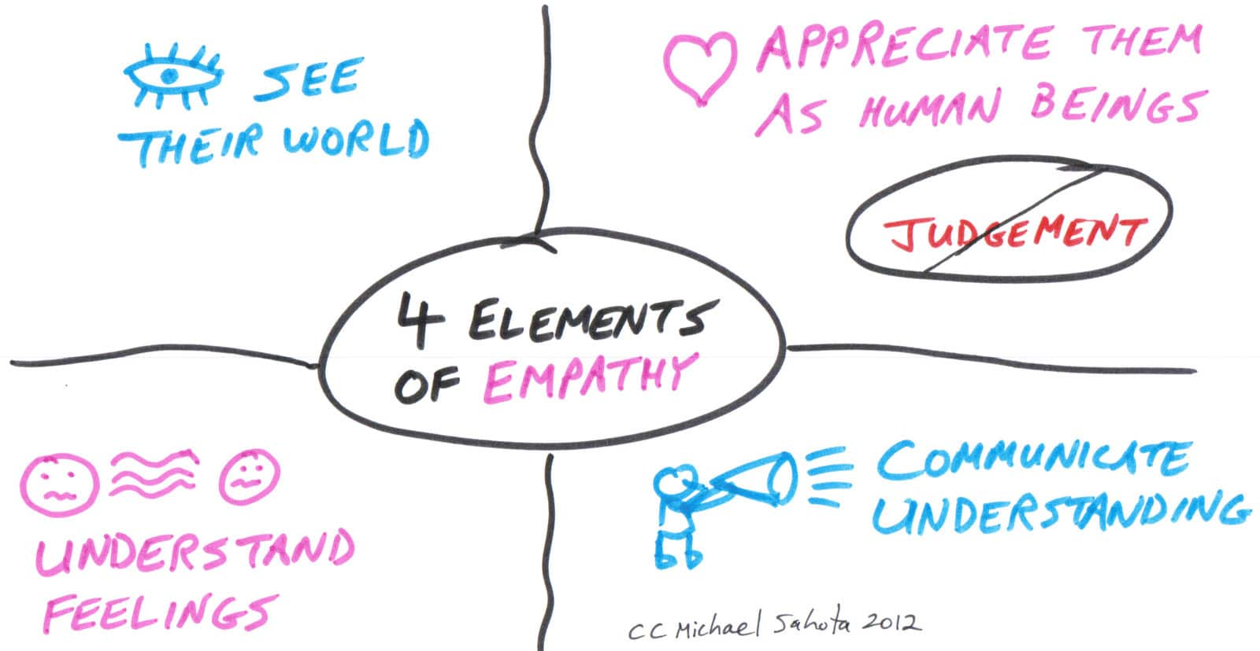
How to show Empathy?
There are many ways to demonstrate empathy:
Listen to someone without making judgements.
Be kind to others.
Respect other’s culture and race.
Learn about different cultures. It allows you to enlarge your views on certain people and avoid racist biases.
Take care of a pet.
Visit a foster home or a refugee camp.
Volunteer in a soup kitchen.
Do some fun activities as a group and be attentive to everyone’s needs.
Give someone a hug.

Slide 11
Can I Show Empathy?
He scraped his knee, I can…
His puppy needs surgery, I can…
She received a gift from her cousin, I can…
She has been in the car for 3 hours, I can…
She is hungry and wants dinner now, I can…
His Friend did not want to play, I can…
More examples here : http://www.momentsaday.com/empathy-game/

Slide 12
Role Play. Empathy is when we are aware of other people feelings. Pick one of the faces below and show how you might cheer your friend up.
Sick
Sad
angry

Slide 13
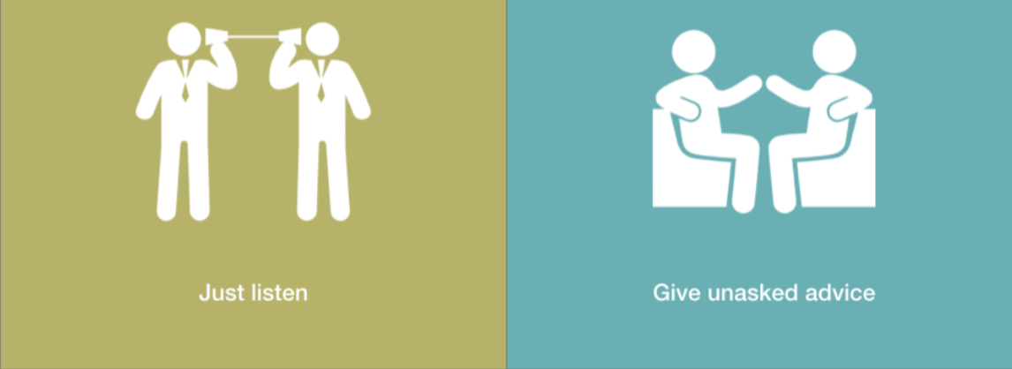
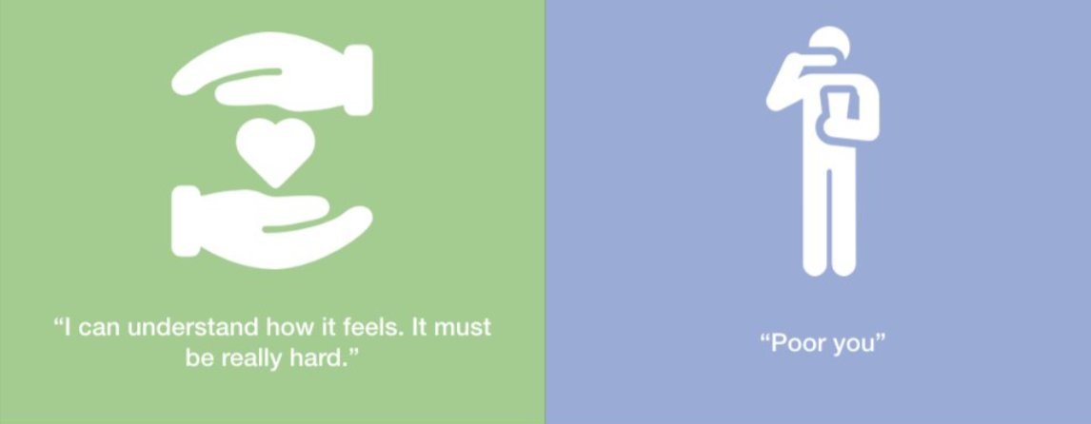
Look at the Pictures, Show where there is empathy or Sympathy

Slide 14
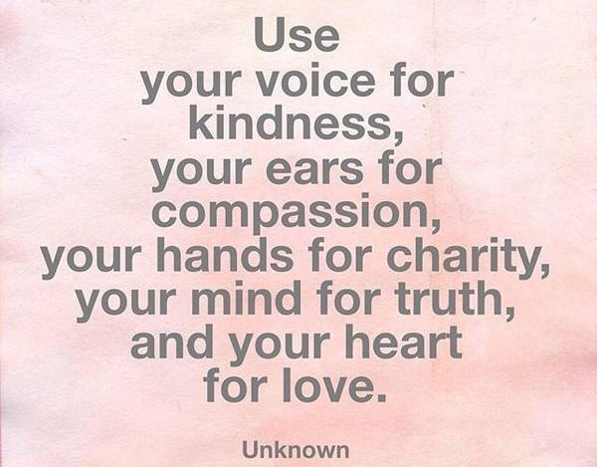
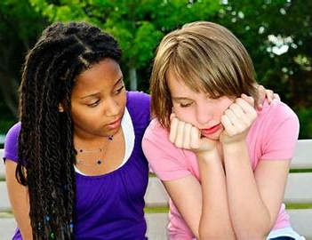
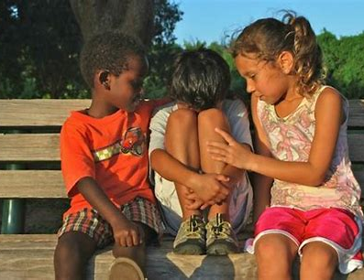
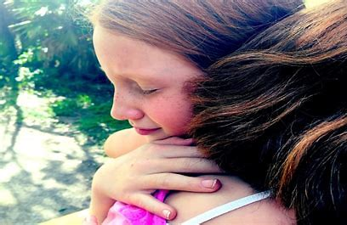

Slide 15
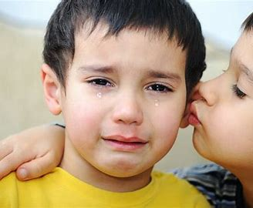
Thank you and God Bless!
Learn about others’ needs! That knowledge kindles empathy, which is the basis for effective ministry. As you try to learn about the tremendous needs of persons…, you will become less self-centered and more sympathetic to the desperate plight of millions.
{ AC 101.3 }

