Slide 1
Kids’ Prophecy Corner
The Apis Bull
Written by K.M.L. and edited by T.M. – White Stone Foundation : http://www.white-stone.ca/
February 2021

Slide 2
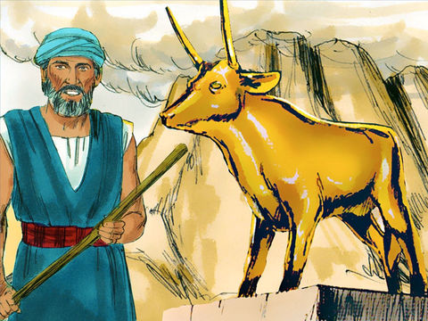
The Story Of The Golden Calf
Exodus 32 relates the story of the golden calf.
Moses was on Mount Sinai for 40 days and the people wondered if he would ever come back. So they came to Aaron and demanded that gods be made to lead them. Being in captivity in Egypt for 400 years, they came to worship idols like the Egyptians. They lost the knowledge of God’s law and its precepts. They lost sight of the Sabbath.
Because Aaron wanted peace and unity in the camp he told them to take off the golden earrings the women, boys, and girls were wearing and give them to him so they could be melted down to make an idol.
The gold was melted down and shaped into a golden calf. The people responded by declaring ‘These [be] thy gods, O Israel, which brought thee up out of the land of Egypt.’ ‘To morrow [is] a feast to the LORD.’ declared Aaron. Early the next day, people sacrificed burnt offerings, ate, drank and started a wild, noisy party worshipping the golden calf.

Slide 3
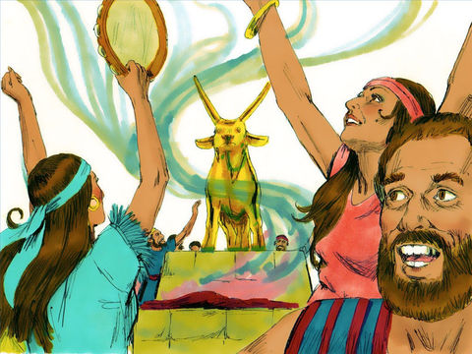
The Golden Calf Is The Apis Bull
The Hebrew people chose a particular animal which supposedly represented the form and character of the true God. They chose the Apis Bull.
In Egypt the Apis Bull was a sacred animal chosen to represent pharaohs. It had the attributes that all great kings would want to possess.
So it was worshipped as a god because it symbolized the courageous heart, great strength, and fighting spirit of the king.
Other characteristics were fertility, divinity and eternity.
The Hebrews saw God the same way. A strong, courageous god with a fighting spirit who brought them out of Egypt. And they made an idol of Him and worshipped it.

Slide 4
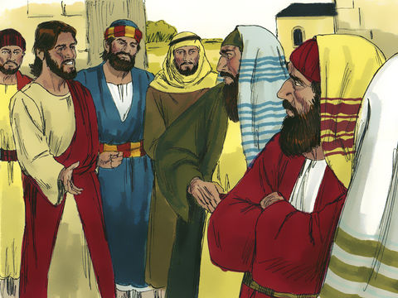
The Jewish Nation’s Conservative Mindset is The Apis Bull
Idolatry was such a big issue in the lives of the Israelites that God had to bring them into captivity in Babylon for 70 years.
After the captivity, they were partially cured from idolatry. They no longer made images (the form) but held on the characteristics (the spirit).
This is why they isolated themselves from other nations. They thought they were too peculiar to mingle with others. And most importantly, they kept the Sabbath and the ordinances of Moses perfectly.
But when Christ came they couldn’t recognize Him. Why? Jesus didn’t look like a king, He was a poor carpenter. He didn’t act like a king instead, He ate with sinners! He didn’t deliver them from the Romans’ yoke; instead he gave his life. And on Sabbaths He healed people and ate in the field!
This wrong view of the Messiah was held by most Israelites and even the disciples. But the most stubborn were the Pharisees who had a conservative mindset. They upheld the writings of Moses so intensely (the spirit) that they couldn’t understand who Christ really was and the nature of His kingdom. Christ wasn’t that strong, courageous king with a fighting spirit who would deliver them from the captivity of the Romans.
Christ was patient and wanted people to come out of idolatry. So through out his ministry He spoke in parables, comparing the natural kingdom with the spiritual kingdom, so His followers could grasp the nature of His kingdom.

Slide 5
We can represent the Idolatry of Ancient Israel this way:
400 years of Captivity in Egypt
( Apis Bull)
Sinai
Moses
Babylon
Rome
Sabbath reinstituted
But
They made a golden calf
( Apis Bull)
They Practiced idolatry
(form and spirit)
( Apis Bull)
They were partially cured from Idolatry. They didn’t worship idols anymore but thought God had idolatrous character.
( Apis Bull)
The Jews didn’t recognize Christ nor understood the nature of his kingdom.
They wanted a warrior king
( Apis Bull)

Slide 6
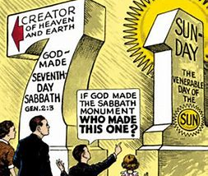
Sunday Worship Is The Apis Bull
Just as the Israelites who were in captivity for 400 years in Egypt, and lost sight of the Sabbath, the same happened to the protestants.
During 1260 years the protestants were oppressed by the papacy and lost sight of the Sabbath. They worshipped on Sunday which was a day set apart for the sun god. So they were in idolatry and idolatry is the Apis bull.
But during Millerite history, God raised up Ellen G. White who instructed the Millerites/Adventists to keep the Sabbath. So the idolatry of Sunday worship was fixed.

Slide 7
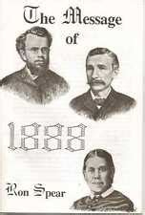
The Adventist Conservative Mindset is the Apis Bull
During the 1888 time-period Adventists became conservative. They kept the character of the Apis Bull just like the Jewish nation after the Babylonian captivity.
The Jews thought they were peculiar and didn’t mingle with other nations. The Adventists thought they were so peculiar that they didn’t mingle with people who weren’t like them. They isolated themselves.
The Jews wanted a warrior king because they didn’t like other nations, the SDAs became conservative by not liking other religions who worship on days other than Saturday.
This is the spirit of the Apis Bull: conservatism. It means that people want to keep things as they are. They refuse to change. They refuse to be taught and want to preserve their current understanding as the apple of their eyes.

Slide 8
The Adventist Conservative Mindset is the Apis Bull - continued
Do you think Adventists in our time are in idolatry? Do they keep the Sabbath holy? Do they eat healthy? Do they listen to worldly music or watch worldly videos ?
Although they behave the right way, they are in idolatry. In the time of Christ the Jewish nation couldn’t recognize Him because they had a literal view of the Messiah: a strong, courageous king with a fighting spirit . Their conservative mindset prevented them from seeing how wrong they were and they could not accept the teaching of Christ in parables.
Adventism today follows the same track. They read the Bible and Spirit of Prophecy literally. Their conservative mindset prevents them from seeing Christ’s message for the last days which is given through Parable teaching. As a result most of them reject the message of equality and the movement as a whole.
Conservatism is the idolatry, the apis bull of Adventism. People want to keep their faith heritage and are reluctant to changes.

Slide 9
We can represent the Idolatry of Modern Israel this way:
SDA Today
Captivity during the 1260
Sunday worship
( Apis Bull)
Ellen G. White
1888 History
Sabbath reinstituted
Adventists still believed God had an idol character. They isolated themselves
( Apis Bull)
Adventists don’t recognize Christ’s message. They believe He has a conservative character
( Apis Bull)

Slide 10
Answer The Following Questions
From which nation does the idolatry of the Apis bull come?
Why did the Israelites choose the Apis bull to represent God?
Why did Aaron agree to make the Golden Calf? (answers can vary)
Babylon
Egypt
It has the characteristics of a king
They didn’t have enough gold to make another idol
The Israelites wondered if Moses would come back
He wanted peace in the camp

Slide 11
Answer The Following Questions
What Do you need to form an Idol?
After the Babylonian Captivity, did the Jewish nation have idols?
What is the spirit (character) of the Apis Bull?
Wood, silver and Gold.
An image (form) and/0r character (spirit)
Yes, their idols had no form. They just kept the character/spirit
Of the Apis Bull. They were conservative.
No, they are cured
A courageous heart, great strength, and fighting spirit
Death and Resurrection

Slide 12
Answer The Following Questions
Did the Jewish nation recognize Christ? Why?
Was Sunday worship Idolatry? Explain.
Who was raised up to cure the protestants from Sunday Worship?
No, because he didn’t have the characteristics of a courageous king.
Yes, that is why Christ had many followers
No
Yes
William Miller/Samuel Snow
Ellen G. White

Slide 13
Answer The Following Questions
Were Adventists in the 1888 history in Idolatry? Explain.
Are the Adventists in our time in Idolatry? Explain.
What is the cure for idolatry today?
No
Yes
No
Yes
Stop watching worldly movies
Parable teaching

Slide 14
Thank You and God Bless!

