Slide 1
Kids’ Prophecy Corner
How God Prepares the Way for the Gospel to Spread
Written by KML and Edited by TM – White Stone Foundation – Canada
December 2020 -info@white-stone.ca - http://www.white-stone.ca/ -
https://www.youtube.com/channel/UCApdXZhX3mlOvSVndDP6Rvw

Slide 2
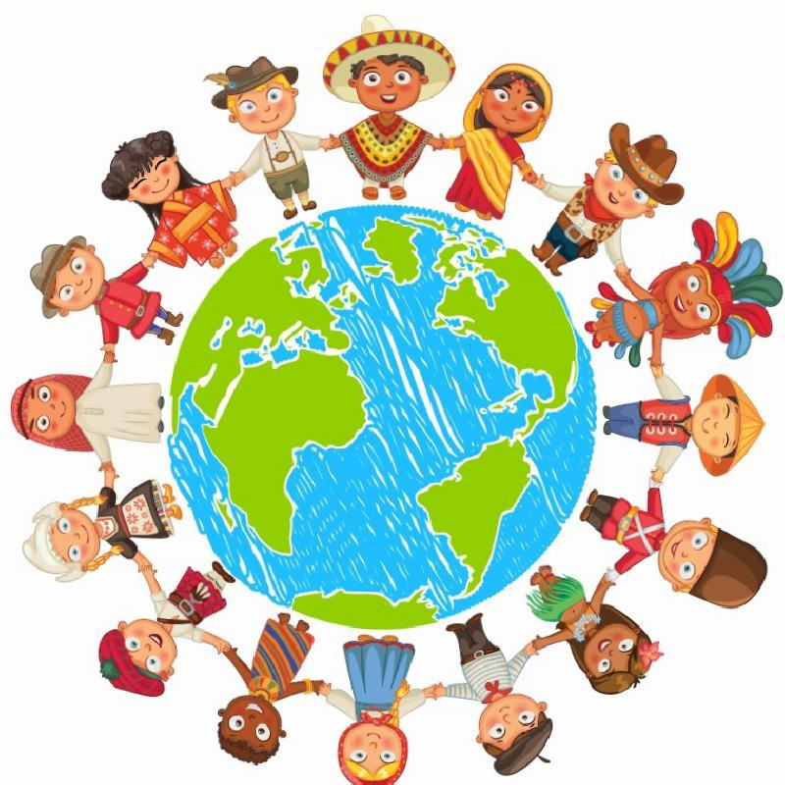
The Gospel Needs To Spread
Have you ever wondered how the Gospel spreads all over the world?
You may think of missionaries who travel to far away countries.
But what means of communication do they use to spread their message? And who created those means of communication?
Together we are going to explore some of the inventions that revolutionized the way people communicate; and which God used to assist His messengers in their mission.

Slide 3
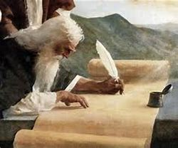
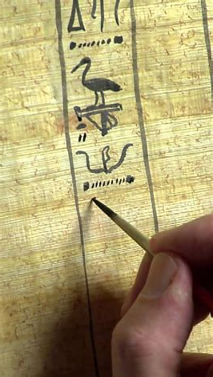
In The Alpha of Ancient Israel
So we are in Egypt in the time of Moses. Moses was raised up by God to deliver His people from Egypt.
During his 40 years in the wilderness he was mandated by God to write the Pentateuch which includes the first five books of the Bible (Genesis, Exodus, Leviticus, Numbers, and Deuteronomy).
In Egypt a few things were invented to allow him to accomplish this task. Do you know what they were? Yes! black ink and Papyrus and the ability to write in Hieroglyph.
Egypt was the first nation to formalize languages into written script. Before everything was transmitted by spoken words.
Thanks to these inventions, Moses was able to write the laws and ordinances given by God in the Hebrew language.

Slide 4
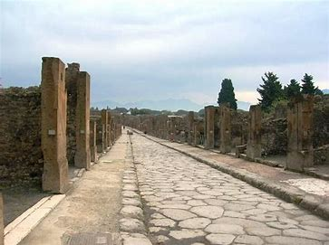
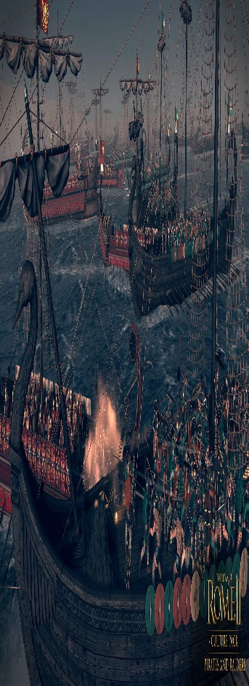
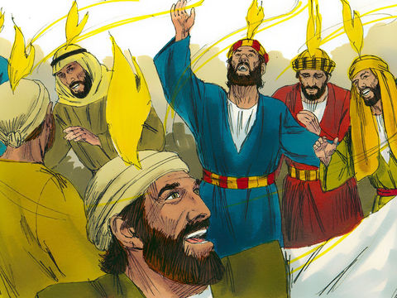
In The Omega of Ancient Israel
It was in the era of Pagan Rome that Jesus was born and his disciples spread the gospel to all nations.
In the time of Rome, they developed a system for communicate within the empire. It was roads. You might know the expression “all roads lead to Rome.” In fact by the end of the Roman Empire over 400,000 kilometres of roads were built by the Roman. A road network which spanned Egypt to Britain! By around 200AD there were 29 major highways going in and out of Rome. With the average width of a road being 2.5 metres (8ft) you can imagine the large numbers of people that were able to go about their business in the ancient capital.(1)
They also removed all pirates from the sea so people could travel travel safely. (2)
Coupled with a time of peace (no big wars) Jesus came on earth to accomplish his mission.
Did you know that most people at that time spoke Greek? This was the universal language. And that is why the New Testament was written in Greek.
But God is so wonderful, he wanted all nations to understand the plan of redemption. So at Pentecost, when the tongues of fire fell on the disciples, the gift of languages was given. Yes! They were able to speak different languages so everyone could receive the good news. And They used roads and ships to accomplish their mission.
https://www.knowtheromans.co.uk/blog/roman-inventions/ (2) https://www.ancient.eu/Roman_Naval_Warfare

Slide 5
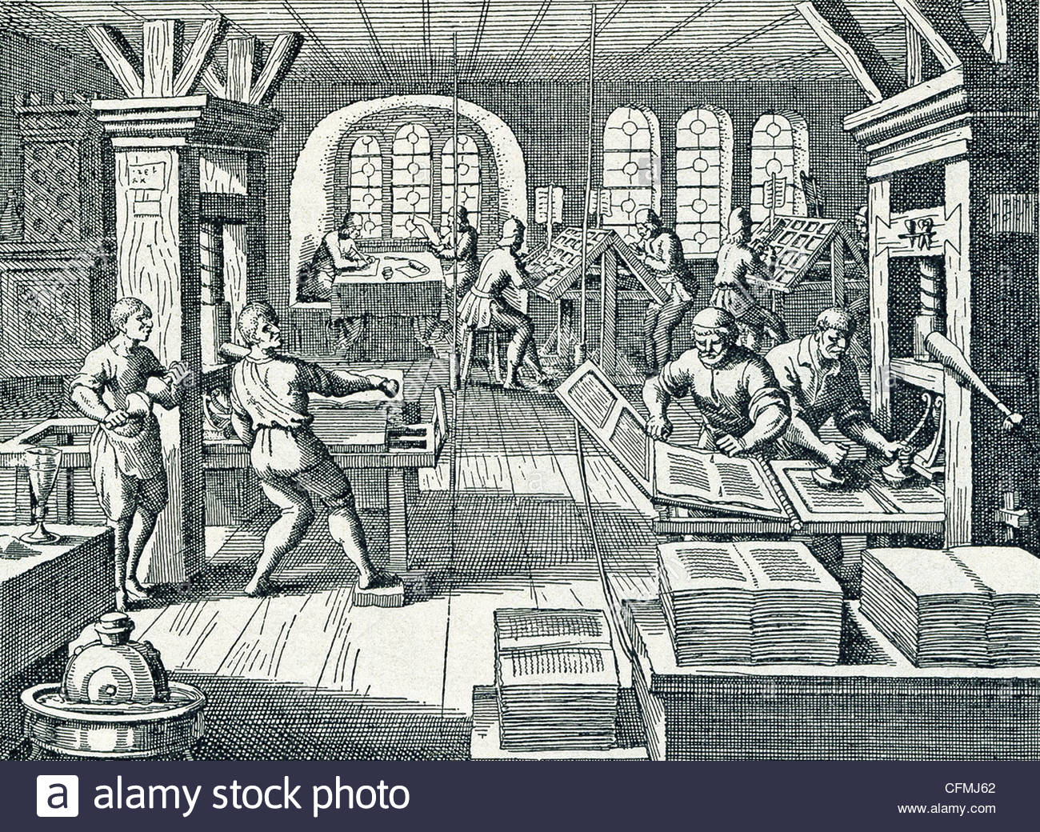
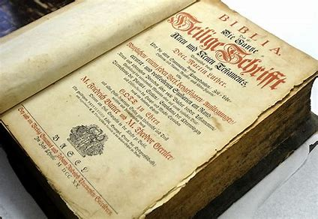
In The Time of The Reformation
In the era of Papal Rome many false doctrines were spread. How could people differentiate between right and wrong? The protestants used the printing press to copy passages of the Bible to be distributed secretly and openly.
Actually, it was during this time that many Bibles were printed and that included the King James Bible.
The printing press allowed Bibles to be duplicated and translated into many languages more rapidly. And the means of transportation by road or water eased their distribution.

Slide 6
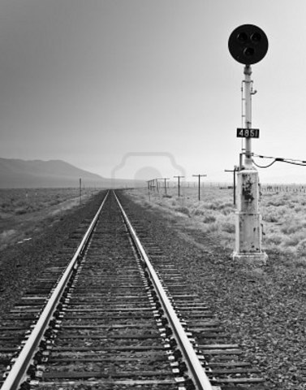
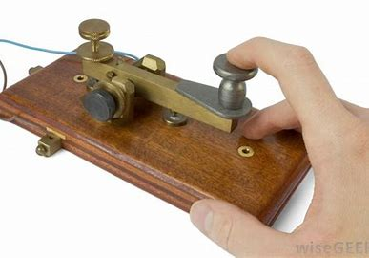
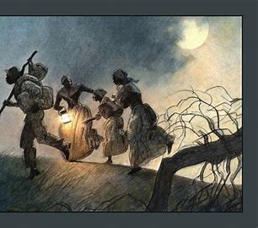
In The Alpha of Modern Israel
This is the time of the Millerites who were raised up to give the message of the second coming of Christ.
Two inventions helped them in their mission - the railroads and the telegraph.
Do you notice how God allows the good news to be spread more rapidly each time? He loves his children so much that He provides the inventions that allow His truth to be spread faster.
There was another type of railroad that emerged at that time - the underground railroad. It was a network of secret routes and safe houses established by abolitionists and other sympathetizers with the abolitionist cause. It allowed many slaves to flee their masters and their cruelty. The slaves would mostly walk during the night and hide in different houses during the day. This is not a coincidence! God thinks of everyone.

Slide 7
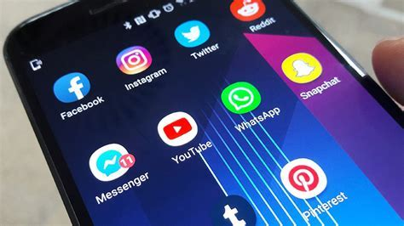
In The Omega of Modern Israel
In our time - that of the final generation - we have a great work to do to spread the good news.
In 1989, the World Wide Web was invented. This is the internet. Now more than ever, the internet helps in preparing the way for the gospel to spread.
In a few seconds you can send an email, a text, or a document to the other side of the world. You can connect via zoom and talk to your family or friends or participate in a study. You can find information on prophetic events and share them.
It is true that Satan uses this tool as well. This is why it is important to gather information from the right sources (the right stream). Not all information is true. One stream bears truth while the other bears dangerous errors.

Slide 8
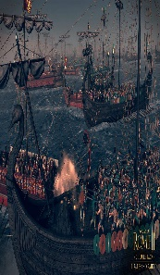
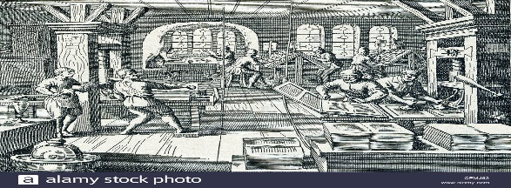
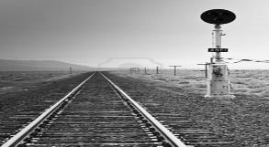
Here Is A Recap For You:
Time Period | Location/Era | Inventions/ Interventions | Raised up
Alpha of Ancient Israel | Egypt |  | Moses can write the Pentateuch
Omega of Ancient Israel | Pagan Rome |  | Jesus can come on earth, the disciples can spread the gospel
Reformation | Papal Rome |  | The Protestants can spread the gospel
Alpha of Modern Israel | Modern Rome |  | The Millerites can spread the gospel
Omega of Modern Israel |  |  | The final generation can spread the Gospel

Slide 9
Answer The Following Questions
Who invented the Papyrus and black ink?
Who built roads and removed pirate ships from the sea?
When were the railroad and telegraph invented?
Pagan Rome
Egypt
Papal Rome
Pagan Rome
In the Millerites time
During the reformation

Slide 10
Answer The Following Questions
What was invented during the Reformation?
When was the WWW invented?
Who was raised up in Egypt?
Printers
Printing press
1969
1989
Aaron
Moses

Slide 11
Answer The Following Questions
What is the fastest invention of all time we can use to spread the gospel?
Who benefited from the underground railroad?
What did the disciples receive at Pentecost?
Airplanes
Internet
The Millerites
The slaves
Tongues of fires
Gift of languages

Slide 12
Thank you and God Bless!

