Slide 1
Kids Prophecy Corner
Fractals – Lesson 3

Slide 2
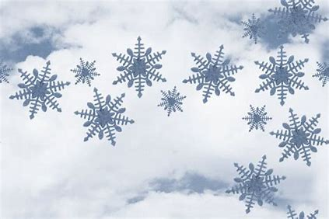
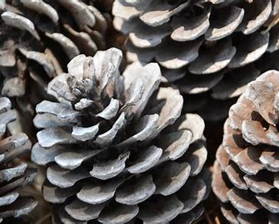
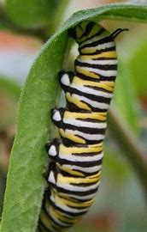
In Nature
Did you know that fractals are everywhere in nature?
Look around you. What do you notice on this carrot leaf, the snow flakes, the pine corns or this caterpillar?
What do they have in common? Repeating patterns, yes!
Fractals are repeating patterns. This means that a shape repeats itself and repeats itself over and over again.
q

Slide 3
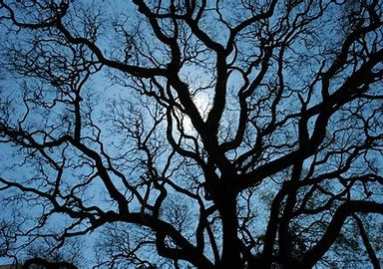
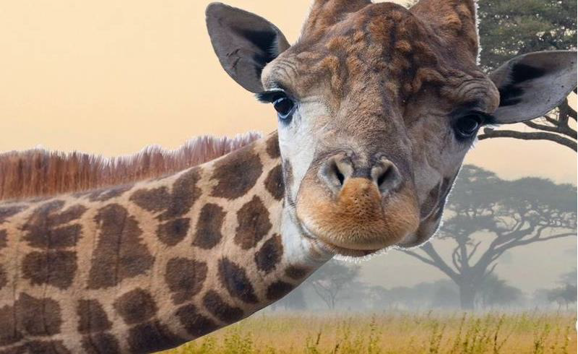
Nature has 2 types of Fractals: Exact self-similar and quasi self-similar.
Fractals that are exact self-similar have a repeating pattern that is identical when it repeats itself. It is the case of a tree for example. The twigs have the same shape of the trunk.
Fractals that are quasi self-similar have a repeating pattern that is approximately (but not exactly identical) at different scales. Can you see them on the giraffe?

Slide 4
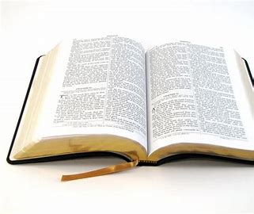
In The Bible
Yes! You can find repeating patterns in the Bible. You can find sentences that repeat themselves.
The most common pattern, is ABBA Pattern.

Slide 5
Here are some examples
A | B | B | A
Sabbath | man | man | Sabbath
Exalt | abased | Humble | exalted
first | last | last | first
last | first | First | last
The Sabbath is made for man, not man for the Sabbath
And whosoever shall exalt himself shall be abased; and he that shall humble himself shall be exalted. (Matthew 23:12)
The first shall be last, and the last first.
The last shall be first, and the first last.

Slide 6
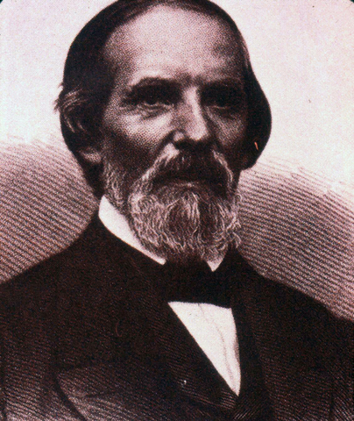
In The Movement
You might have heard people in the movement say: Boston, Concord, Exeter, Test.
These terms are taken from the Millerites’camp-meetings held on July 21, 1844 in Boston, on August 1, 1844 in Concord, and on August15, 1844 in Exeter.
Samuel Snow gave his message called “The true Midnight Cry” where he announced that Christ would return on October 22, 1844.
These camp-meetings describe a repeating pattern.
This repeating pattern shows that each waymark has specific characteristics that repeat in each dispensation.
Boston marks the unsealing of a message.
Concord marks unity and agreement on a specific message as it swells. People experience an increase of knowledge.
Exeter marks the formalization of a message and it has an element of time.
Test is when the people are tested upon the information given during a period of time. For the Millerites it was on October 22, 1844.

Slide 7
On A Line,The Repeating Pattern Looks Like this :
Unsealing of a message
Increase of Knowledge
Formalization
Test
Boston
Concord
Exeter
Test

Slide 8
On The Line of the 144,000,The repeating pattern Looks Like this :
1989
9/11
SL
COP
2nd Advent
Increase of Knowledge
Increase of Knowledge
Increase of Knowledge
Increase of Knowledge
Formalization
Formalization
Formalization
Formalization
144K
Test
Test
Test
Test
Test
Test
Test
Concord
Test
Boston
Concord
Exeter
Boston
Concord
Exeter
Boston
Concord
Exeter
Boston
Exeter
New mess. arrives
New mess. arrives
New mess. arrives
New mess. arrives

Slide 9
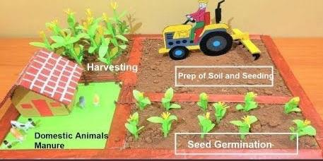
The Agricultural model
Another pattern the movement uses is the agricultural model.
It allows us to understand the work a message does in each dispensation.
The story of agriculture teaches us more about the work God does for His people to be reformed or ripen so they can be ready for His kingdom.
God is like a farmer and we are like the seeds. God takes care of us and helps us to grow until we are ready to be used.
There are four steps: Step 1 : Ploughing - the land is prepared first. The seeds are put in the ground
Step 2: Early rain – the first rain helps the seed to start growing
Step 3: latter rain – the heavy rains ripen the fruits/crop
Step 4: harvesting – the fruits/crop are ripe and ready to be harvested.

Slide 10
On The Line of The 144,000,The Agricultural model Looks Like this :
1989
9/11
SL
COP
2nd Advent
144K
Ploughing
Early Rain
Latter Rain
Harvest

Slide 11
All these different repeating patterns or fractals help us to understand how God works.
God uses a specific method or methodology that repeats itself so his people can understand what is going on in the world and in His church.
His people can therefore do an internal work of reform on themselves and an external work to bring others to his kingdom.

Slide 12
The Fractals Song (tune: The Wise man Built his house upon the rock)
Jesus created repeating patterns
I can see them all over the world
The flowers, the trees, the leaves, or the snow,
They are fractals in nature.
Chorus
Fractals can be exact self-similar
Fractals can be quasi self-similar
Fractals are just repeating patterns
On which the house of God stands firm
Reform lines have repeating patterns
We find them in each dispensation
Boston, Concord, Exeter, and test
They are part of the structure
First! we have a message who arrives
Second! We have an Increase of Knowledge
Third! The message itself formalized
Fourth! We finish with a test.

Slide 13
Thank you for Coming And God bless!

Slide 14
Look At These Pictures and tell me what type of Fractal it is.
Exact Self-Similar or Quasi-self-Similar
Exact Self-Similar or Quasi-self-Similar
Exact Self-Similar or Quasi-self-Similar

Slide 15
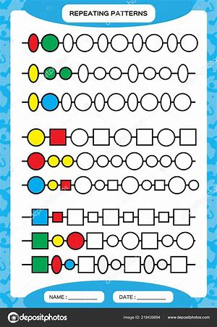
Find The Repeating Pattern
Worksheets can be found here: https://www.education.com/worksheets/identify-continue-shape-patterns/?page=2

Slide 16
Find the Pattern
A | B | B | A
Ask not what the movement can do for you. Ask what you can do for the movement.
One should eat to live, not live to eat
Home is where the great are small and the small are great.
Nice to see you…To see you nice

Slide 17
Place The Repeating Pattern In Order
The Agricultural model
Millerites.
The message
Harvest
Early Rain
Ploughing
Latter Rain
Boston
Test
Exeter
Concord
Message arrives/unsealed
Formalization
Increase of Knowledge
Test

Slide 18
Thank you and God bless !

