Slide 1
Kids Prophecy Corner
The Alpha History of Ancient Israel – The line of Moses
Lesson4

Slide 2
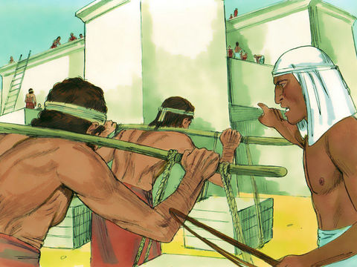
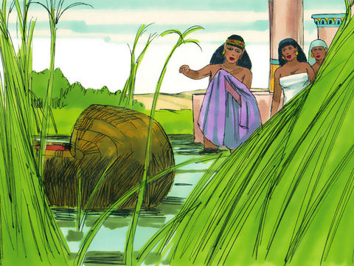
The Time Of The End
The Time of the End is when Moses was born.
The people of Israel were in Egypt for 400 years. They spent a lot of these years in bondage. They were enslaved by the Egyptians.
But God made a promise to Abraham long before. He promised a deliverer will come to bring his people out of Egypt.
The deliverer was Moses who was saved from the waters by Pharaoh's daughter at his birth. He grew and after spending 40 years in the wilderness, he came back to Egypt to deliver the Hebrew nation.

Slide 3
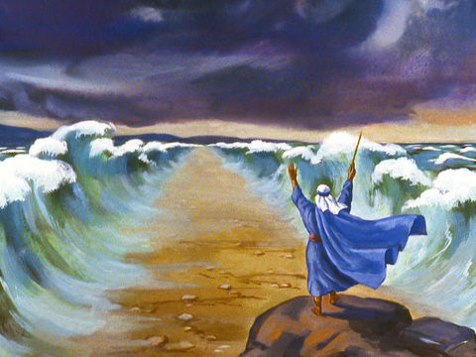
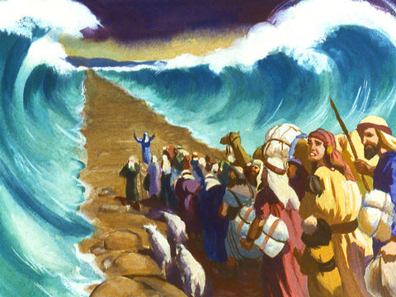
The Red Sea
Pharaoh had a hard time letting the Hebrew people Go. But Finally, after the 10 plagues that fell on Egypt, He agreed to free them.
They left Egypt and started their journey to the promise land.
But they faced an obstacle. Pharaoh changed his mind and sent all his army to capture them.
The red sea was in front of them. After much prayer Moses stretched out his rod and the waters parted, and Israel went into the midst of the sea, upon dry ground, while the waters stood like walls on each side.

Slide 4
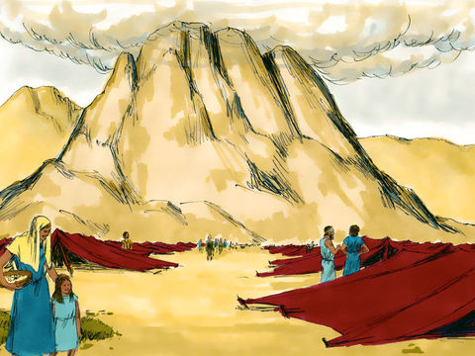
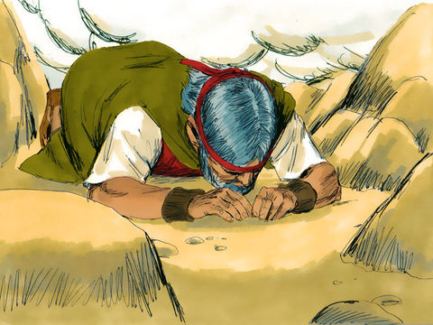
Moses Went Into The Mountains
Soon after they arrived in the desert of Sinai where they pitched their tents, Moses was called up many times into the mountains to meet with God.
His longest absence was for 46 days. It was a time of waiting and suspense for Israel.
During this period of waiting they had time to meditate upon the law of God - the 10 commandments - which they had heard from God himself. It also allowed them to prepare their hearts to receive further instructions because they were no more a slave people. They were now a special, peculiar people chosen by God!

Slide 5
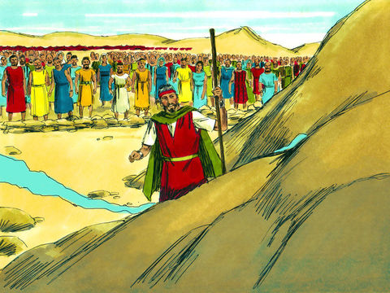
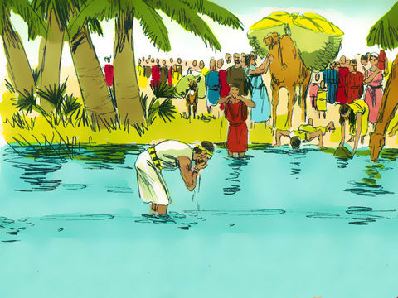
Moses Strikes The Rock
After leaving the wilderness of Sin the Israelites encamped in Rephidim. There was no water here and the people distrusted the providence of God again.
They asked Moses: “give us water that we may drink”. “Did you bring us up out of Egypt, to kill us and our children and our cattle with thirst?”
In distress Moses cried to the Lord, “What shall I do unto this people?” And the Lord said unto him, “Behold, I will stand before thee there upon the rock in Horeb; and thou shalt smite the rock, and there shall come water out of it, that the people may drink.” He obeyed, and the water burst forth in a stream that abundantly supplied the encampment.

Slide 6
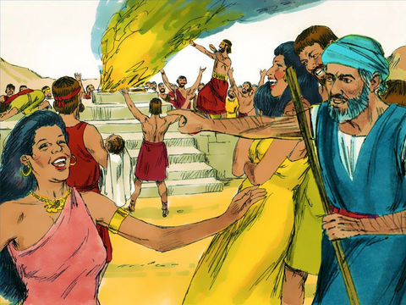
Apostacy At The Jordan
40 years had passed. The Israelites had already gained possession of a valuable territory, and they were confident of the immediate conquest of Canaan. Only the river Jordan lay between them and the Promised Land.
The land was beautiful and rich with natural resources. Yet the people of that country were in complete idolatry and worshipped Baal.
Unfortunately, their practices influenced the people of Israel to worship Baal and depart from the true God. Balaam the false prophet even invited the people of Israel to attend a feast in honor of Baal. Many Israelites went to the feast bowing down to the idols and offering sacrifices.
That was too much! Judgement came upon them and all the men that came out of Egypt died except Caleb and Joshua family

Slide 7
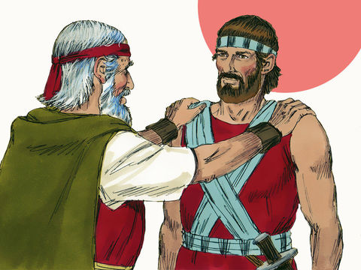
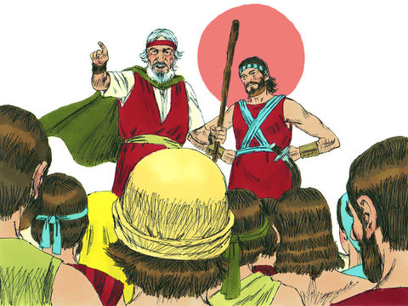
The Change of Leader
Before Moses died Joshua was chosen as leader. He was a man of wisdom, ability and faith. During the time in the wilderness he had acted as a prime minister to Moses. The Lord was pleased with Joshua and chose him to succeed Moses.
When Moses laid his hands on him to be set apart as the leader of Israel, Joshua was also admitted to share the leadership. He could now talk to and ask advice from Eleazar the high priest, the son of Aaron. The children Of Israel would listen to his instructions from now on.
As for Moses, his work was coming to an end. He would die and not lead the children of Israel into the promise land.

Slide 8
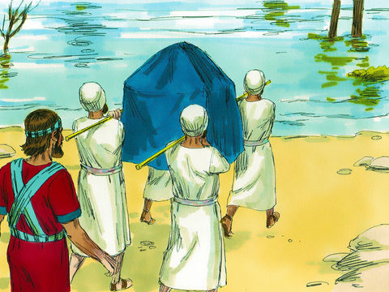
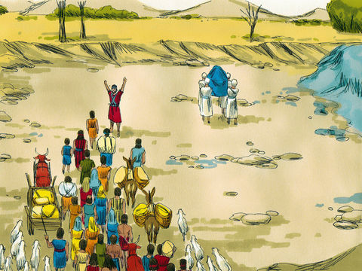
Jordan
Moses died and the time came time to cross the Jordan river.
Arrangements were made to cross the Jordan. The people prepared a three days' supply of food, and the men of war prepared for battle.
The people had to follow Joshua’s commands with all their hearts and with faith.
The priests were required to step into the water by faith – faith in Joshua’s leadership and faith in God. Only after they crossed the Jordan could they begin the work of conquering the Glorious Land.
So they obeyed the commands of their leader and went before the people carrying the ark of the covenant. The waters split in two the same way it happened at the Red sea. The priests stayed in the middle of the river until all the people cross on the other side.
This experience really made an impression on the people’s minds.

Slide 9
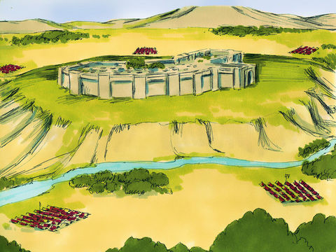
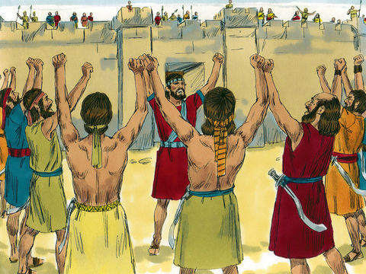
Jericho
The work of conquering began at Jericho.
Jericho was seen by Joshua to be the first step in the conquest of Canaan.
Now they could finally and fully appreciate the work of God. They learned to trust him and understood that if they didn’t follow the leader God had appointed over them they would fail in their mission.

Slide 10
The Story of The Priests In The Movement
This story relates to the priests of this movement from 1989 to 2021.
The Birth of Moses = 1989
1989 is the time of the end. Elder Jeff Pippenger was raised up to lead the movement. He represents Moses. His mission was to free the Seventh-Day Adventists from their spiritual bondage. God gave him the methodology of line upon line and the message of Daniel 11:40-45 . People in the SDA church started waking up and realizing that God is coming soon.
The Red sea = 9/11
The reason we say the red sea is a symbol of 9/11 is because the people passing through the water represents baptism. When you are baptised you make a covenant with God. The Israelites did the same. As they obeyed the words of Moses, the Red sea parted before them and they went through it in the path God had prepared for them.

Slide 11
The Story of The Priests In The Movement
Moses goes into the mountains = The tarrying time
After 9/11 the tarrying time for the priests started. It is a time where the priests wait for the development of a message. They wait for an increase of knowledge.
Moses strikes the rock= 2012
In 2012 the 2520 was formalized by Elder Parminder. From his studies, he discovered that we can set times for prophetic events by using symbolic numbers. Those numbers are 126 and 151 which are found in the story of Belshazzar. This new light was the water flowed from the rock before the Hebrews. New truths and studies streamed into the movement.

Slide 12
The Story of The Priests In The Movement
Change of Leader = 2014
In 2014 the movement experienced a change of leadership. Elder Jeff is no longer the one who will carry on the work of the movement. From now on, Elder Parminder is the new leader. People have to follow his studies and apply them with all their hearts. But even before that change, some did not want to listen to either Elder Jeff or Elder Parminder. They apostatized by leaving the movement.
Jordan = 2019
The change of leadership was not really visible in 2014. But in 2019 everyone can see it. Now the priests must put all their trust in the new leaders : Elder Parminder and Elder Tess. They must also accept the test of equality.
Jericho = 2021 (Panium)
It takes time to prepare a people. Now the priests are receiving spiritual food on the subject of equality which will fully equip them to go to “war” by calling the Levites in 2021. They must remove all racism, sexism, and homophobia before conquering the Levites and thereafter the world. They must be ready by 2021.

Slide 13
The Line of Moses Looks like this :
Red Sea
Change of leader
Moses to Joshua
Jordan
Jericho
Birth of Moses
Moses strikes the Rock
Tarrying Time
1989
9/11
2012
2014
2019
2021
E. Jeff Pippenger
Baptism
Foundation laid
Time Setting : 126,151
Change of Leader
E. Jeff Pippenger to E. Parminder
Trust your new leaders : E. Parminder and E. Tess.
Test of Equality
Panium. Priests are ready to go to work

Slide 14
Thanks for Coming!

Slide 15
Answer These Questions
What does the birth of Moses symbolize?
When is the time of the end for the priests.
Who was raised up in 1989
The tarrying Time
The Time of The end
1989
9/11
Elder Parminder
Elder Jeff

Slide 16
Answer These Questions
What does the red sea symbolize?
Which waymark is the red sea for the priests?
What start after 9/11?
The Time of The end
Baptism
1989
9/11
The Tarrying Time
2012

Slide 17
Answer These Questions
Why did Moses strike the rock?
Which waymark does the striking of the rock symbolize for the priests?
The change of leadership was between:
The people were thirsty
The people wanted to see God
2012
2014
Josuah and Elezear
Moses and Josuah

Slide 18
Answer These Questions
The change of leadership in 2014 was between?
Which waymark does the crossing of the Jordan represent?
Which waymark does Jericho represent?
E. Jeff to E. Parminder
E. Parminder to E. Tess
2021
2019
2019
2021

Slide 19
Thank you and God bless !

