Slide 1
Kid’s Prophecy Corner
The Waymarks – Lesson 2

Slide 2
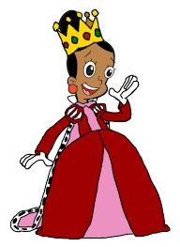
The Story
Once upon a time there was a Queen who lived in a far away land. This Queen had a beautiful kingdom and she loved her kingdom and all the people that lived in it. The people loved their Queen but sometimes they did not listen to the rules of her kingdom.
The Queen had a secret that her father told her when she was a little girl. One day she decided to share this secret with ten of her most faithful /good servants. She said to them,
“There is a hidden city in the mountains. A city with beautiful precious stones and all manner of fruits you could ever think of. This city is located in the heart/center of the mountains. I have a map and a secret route/path that can get you to this city but you have to listen and pay attention to all the instructions that I will give you.”

Slide 3
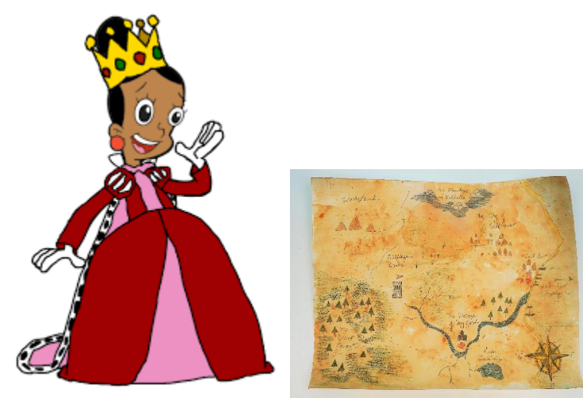
The servants were very excited and ready to leave. They really wanted to see this place and enjoy all the beautiful things that it had to offer them.
The Queen continued, “It takes only one night to get to the hidden city. If you want to make it to this place, your journey starts now. At this very moment, the beginning of your journey is the most important checkpoint. Take this map and use it to stay on the path. It has four more check points that will guide you. The last checkpoint is the end of your journey, the hidden city is here at this last checkpoint.” she pointed.

Slide 4
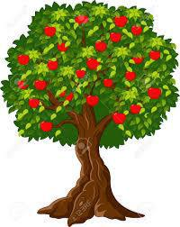
“You will leave when the sun sets. The moon will give you light. You will walk and walk until you get to a very big fruit tree that is right here!” she pointed on the map.
“ Take some fruits for your journey but do not forget that you have to reach the city before the sun rises. The fruit tree is your second checkpoint.

Slide 5
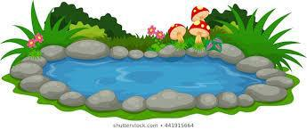
You will continue to walk on the path facing the moon until you reach a pool of water. When you see the pool of water be glad, for it is a checkpoint. Your third checkpoint is there to show that you are going the right way.
Now listen carefully. Have a drink from this pool. It will give you strength for you to reach the next checkpoint. Carry some water with you. When you stand by the pool and face the moon you will see a very high wall, all you need to do is to get to the other side of the wall. A large gate stands open at the end of the field but only a few who have gone on this journey have reached the large gate.”

Slide 6
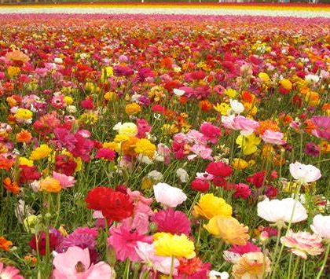
“From the pool you are going to start running. Run until you reach a large field of flowers. Run as fast as you can across the field of flowers until you reach the gate. The field of different beautiful flowers is your fourth checkpoint but you will not be able to enjoy them as you will have to run.”
The servants packed a few things and went off their journey.

Slide 7
A man called Trevor was given the map.
Trevor was very happy when they reached the big tree. He sat on a large stone and began to enjoy the fruit. The other servants begged Trevor to continue with the journey but Trevor said, “Go on ! I will catch up”.
A young girl by the name of Alison took the map and they continued the journey without Trevor.

Slide 8
“I can see the pool!” one of the servants shouted with joy. They all ran over to the pool and took a drink. They had never tasted sweet water before. Two of the servants really wanted their friend Trevor whom they had left behind to taste the water too.
Alison begged them,” we have to leave, don’t you remember what the Queen said?”
The two servants Thabo and Sekai stayed because they wanted to wait for their friend and also enjoy the water.
“Go on ! we will find our way.” they shouted as they jumped in the pool and have a drink.
Ali was very sad because she knew that they were not going to find their way without the map. “Don’t forget to carry some water in your bottles,” she reminded the others.

Slide 9
They could see the high wall from the pool. The servants began to run. They ran and ran until they could see the large field of flowers. The flowers were so beautiful. “if these flowers can look so beautiful in the moon light, I wonder how beautiful they would look when the sun is shining.” Said one of the servants.
“No! No! No! we have to go! We have to run!” shouted Ali.
“Oh my! Look at the brown flower, it is glowing.” Another servant said.
“We are going to start running at the count of three. Who is with me?” said Ali. Only four servants lifted their hands.
The 3 D servants, Debby, Douglas and Daniella were busy exploring the field of many different beautiful flowers that they had never seen before. They wanted to examine each dimension.
The three servants didn’t even hear Alison as she shouted, “ Three!, two! One! GO!”

Slide 10
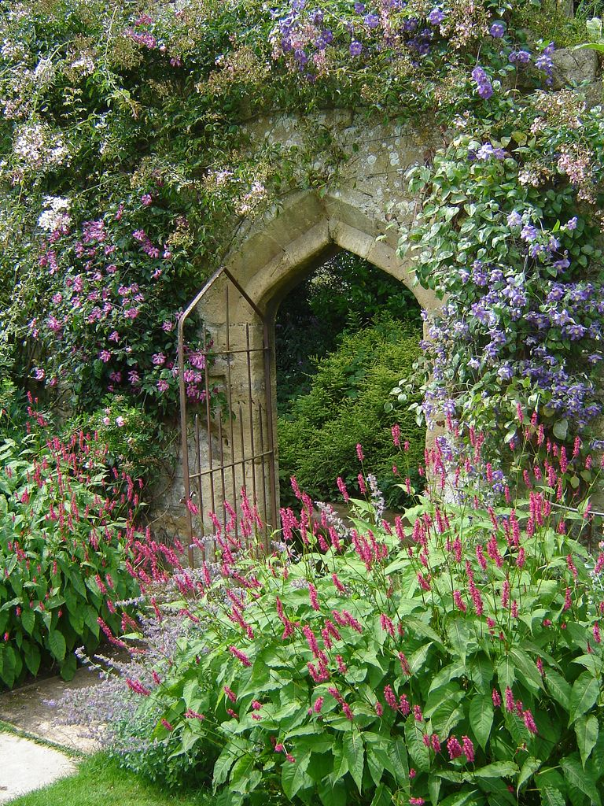
Alison, Annabelle, Tiffiny and Jonathon ran across the field as fast as they could. They ran and ran and ran. They began to sweat and their chests began to hurt.
“I don’t think I can make it.” Annabelle said.
“But I can see the gate!” she added with a sense of relief. That gave her strength to reach the gate.
The four ran until they reached the gate. They ran through the gate and they fell down to the bright green grass as they took a rest.
What a wonder it was! The city was covered with beautiful flowers more beautiful than the ones they had seen in the field, large fruit trees, fountains and pools.
The journey was short but the servants themselves made the journey longer by not following the instructions that they were given by the Queen.
Six of the servants did not reach the gate because they did not pay attention to the Queen’s instructions.
THE END !

Slide 11
Defining the Waymarks
The word waymark can be separated to make two parts way – mark
It is a mark along the way. We can see in this picture the marks along the way that the servants had to get to in order for them to reach the gate
The first waymark is the Queen who gave them the secrets to reaching the gate.
The next waymark is the tree, followed by the pool of water, field of flowers and the gate. waymarks are like these checkpoints.

Slide 12
A Reform Line
A reform like is also like a journey, God is leading us on this journey. God sends His messengers because we cannot see Him. He sends His messengers to give us secret messages of how to get out of darkness just like how the Queen gave her servants a map to help them remember the way to the hidden city.
Here is a REFORM LINE with CHECKPOINTS OR WAYMARKS
This Reform line is called the reform line of the 144 000.

Slide 13
Waymarks in a Reform Line
The first waymark on this journey is 1989. In 1989 Elder Jeff Pippenger understood a message from the book of Daniel 11:40-45. This was the beginning of the journey.
The second waymark on the journey is called 9/11 or 2001.
The middle waymark is called the Sunday Law.
The fourth waymark is called C.O.P which stands for Close of Probation.
The fifth waymark is the 2nd Advent. This is the end of our journey.
If we follow God’s instructions and obey Him we will pass all the tests that come at every Waymark. By the time we get to the last waymark we will be changed to be what God wants us to be. Remember that God is our helper. He is leading us with His right hand out of the dark and scary world.

Slide 14
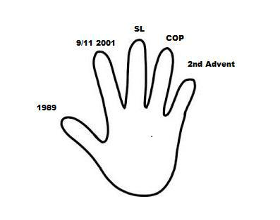
Here is a simple way to remember the waymarks. You can use your hand and pretend it is GOD’s hand that leads His people.

Slide 15
The waymarks Song
Waymarks x3
5 in a Reform line.
Waymarks are the checkpoints
Testing my obedience.
God’s hand is leading,
I’ll show you with my own hand
Starting with 1989.
The Time of The End
The journey begins.
My thumb is the time of the End
Followed by my index,
This one’s 9/11,
The middle one is Sunday Law,
Mr. ring is COP which means close of Probation,
My Pinkie is the Second Advent.
The journey ends.
We have arrived.

Slide 16
Answer these Questions
What is a waymark?
What do we find at each waymark?
What can happen when God’s people do not obey and follow God’s instructions?
A checkpoint
A sign
An event
A map
God will help them
They can be lost

Slide 17
Answer These Questions
Name the 5 waymarks in the line of the 144 000.
What is the name of the first messenger in the line of the 144 000?
How can I represent these waymarks?
1989, 9/11, SL, COP,2nd Advent
1989, 9/11, 2014, 2019, 2021
Elder Jeff
Elder Parminder
With my right hand
With my left hand

Slide 18
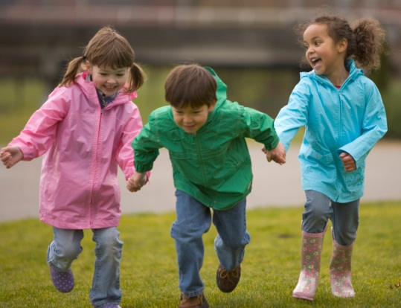
Thank you and God bless!

