Slide 1
Kids’ Prophecy Corner
The Reform Lines - Lesson 1

Slide 2
In The Bible
The term “reform line” is not found in the Bible.
So you need to use specific rules of parable teaching to understand the concept.
The rule we are going to use is called the rule of first mention.
This means that we are going to look in the Bible and study where the term “reform” and the term “line” are first mentioned.

Slide 3
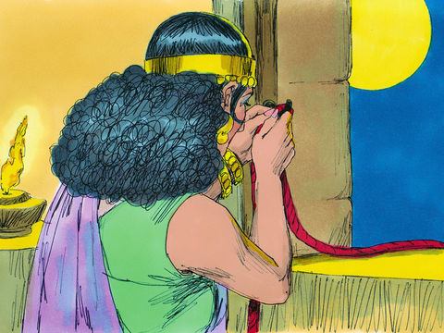
The 1st Mention of the Word Line
The word line is first found in the book of Joshua 2:17-18. It is the story of Rahab.
The Bible says:
2:17 And the men said unto her, We [will be] blameless of this thine oath which thou hast made us swear.
2:18 Behold, [when] we come into the land, thou shalt bind this line of scarlet thread in the window which thou didst let us down by: and thou shalt bring thy father, and thy mother, and thy brethren, and all thy father's household, home unto thee.

Slide 4
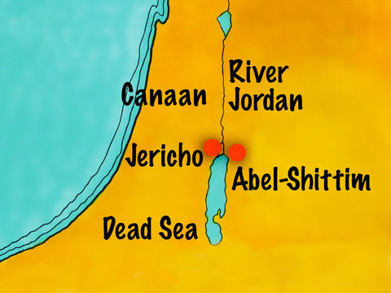
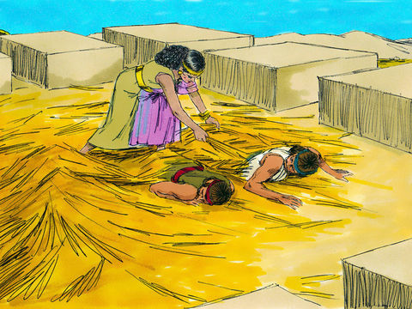
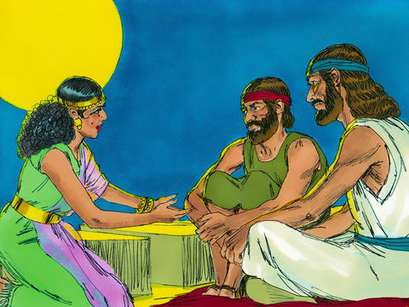
The Israelites spent 40 years in the wilderness. Now they had to enter the land God promised them - Canaan. But to do so they needed to destroy Jericho.
So Joshua sends two of his spies to explore the country.
But they were noticed. Rahab hid them in her house and asked them for a favour.
She wanted her and her family to be spared from the destruction of Jericho.
The spies agreed to save her. To do so she needed to leave a line of scarlet thread hanging from her window.

Slide 5
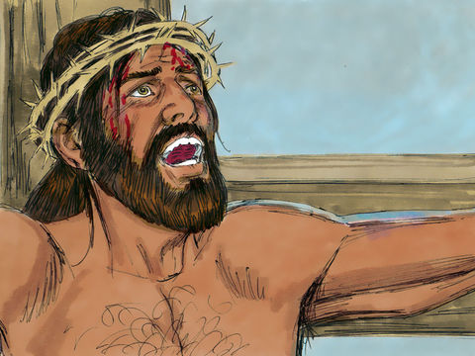
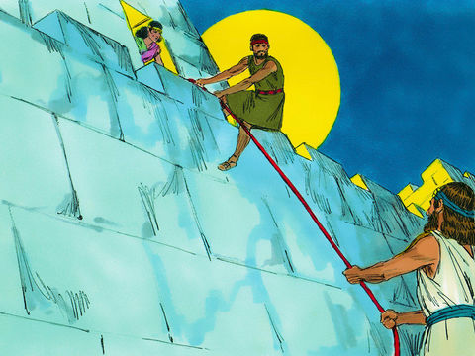
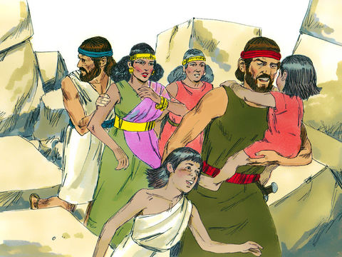
Do you know why the line was scarlet?
It is because it represents the blood of Jesus.
When Jesus died on the cross, He gave his blood to save us.
So the scarlet line is a symbol of Christ who saves us.
The line is a promise that God makes to us. If we hold on to it, it will save us just as Rahab and her family were saved.

Slide 6
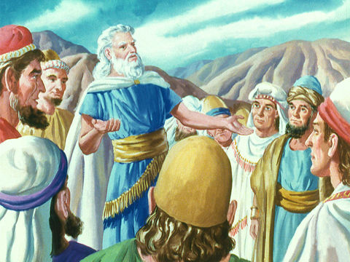
The 1st Mention of the word Reform
You will not find the word reform in your Bible. Instead, you will find the words “reformed” or “reformation.”
In the Old Testament, the word is found in Leviticus 26:23
The Bible says:
26:23 And if ye will not be reformed by me by these things, but will walk contrary unto me;
26:24 Then will I also walk contrary unto you, and will punish you yet seven times for your sins.

Slide 7
This chapter deals with the blessings and curses that God will send to His people.
If His people obeys Him, He will bless them.
If His people disobeys Him and refuses to change, He will curse them.
The word reformed in verse 23 means to be changed. If the people refuse to be reformed, then God will send them curses.

Slide 8
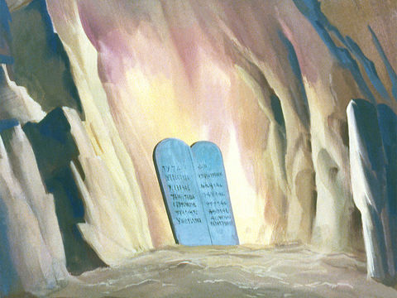
So the word reform means that you accept that God is changing you.
When God reforms you, you obey His commandments.
If they tell you to stop worshipping idols, or to observe the Sabbath, you obey them.
It is a matter of life and death. You obey, you have eternal life. You do not obey, you are lost.

Slide 9
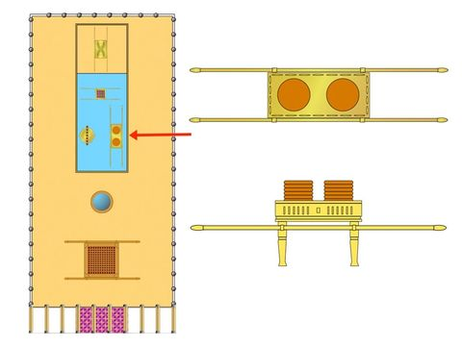
In the New Testament, you find the word reformation in Hebrews 9:10
The Bible says:
9:10 [Which stood] only in meats and drinks, and divers washings, and carnal ordinances, imposed [on them] until the time of reformation.

Slide 10
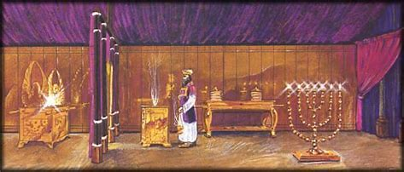
Do you know why Paul is saying this?
When Jesus ascended to heaven, He went to the Holy Place of the Celestial Tarbernacle.
Now the ceremonies and sacrifices that God's people made on earth are no longer necessary.
Since Jesus sacrificed Himself for the forgiveness of our sins, the way we worship Him must change. A reformation must occur because it is another dispensation, another phase, a new stage in how God relates to His people.

Slide 11
The reform line shows us that if we do not enter into this new dispensation, we cannot be saved.
A reform line is the way God leads His people out of darkness. After so much disobedience to God's word, God's people lose their way. However God gives them a new way so that they can return to Him. This way leads the people to a better place where they are happier and better able to do God's work.
But how are you reformed? How can you be sure you're going in the right direction?
Since God is love and does not want anyone to perish, He uses a reform line to guide us along the way.
This line begins in 1989 and ends at the Second Coming of Christ.

Slide 12
1989 is the Time of the End and the beginning of the realization of God’s promise. His people come out of darkness.
At the Second Coming He will take with Him all those who have followed His commandments but also His reforms.
Reforms will produce a change of mentality or mindset in you.
Since Christ is a symbol of the line and you follow that line, you will practice everything Jesus did in your daily life.

Slide 13
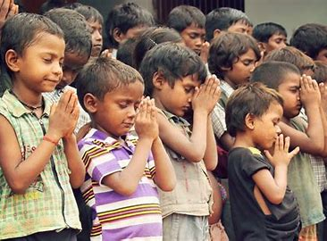
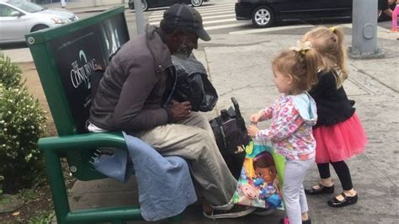
Here are some examples of what you can do:
You will obey your parents of course.
You will treat your neighbor as yourself. This is the golden rule.
You will not make fun of people who are different from you. No matter their skin color, where they come from, or their gender.
You will respect what they believe, even if it is different from what you believe.
You will treat boys and girls equally and with the same respect.
You will be a model, a light for all those around you.

Slide 14
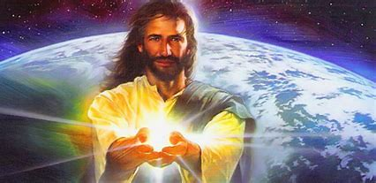
Jesus wants His life to be reflected in you.
Every day pray and ask him to show you how to behave towards your neighbor. This includes your parents, siblings, family, friends, and other people you may meet.
This is very important because you are a priest whom God has chosen to do a work among the Levites and the Nethinims.
So give the best of yourself.

Slide 15
The Song " The Reform Line".
Reform lines are God's way of guiding His people.
Leading them out of this dark and scary world.
They've lost their way and are scattered all about.
Disobedience has scattered them, oh! scattered
Chorus
Yes, Jesus loves me.
He wants me to know where I am and what to do.
Yes, Jesus loves me.
My reform line tells me so.
The word reform means to change or renew.
To change and to stand with Jesus all the way.
Jesus Himself will be guiding me through.
Guiding, to help me be the best that I can be.
A line is the way that I'm waking along.
I'm walking, I'm walking with Jesus Christ my king.
He gives me the light that can chase away the darkness.
Guiding, to help me be the best that I can be.

Slide 16
May God bless you!

Slide 17
Answer These Questions
What does the word "reform" mean
What does the word "line" mean
What is a reform line?
To change or renew
Refusing to be changed
A promise to be saved
A cord
It is God's way of leading His people out of darkness.
It's just a line

Slide 18
Answer These Questions
Where do you find the word line in the Bible for the first time.
What color was the line of thread?
What does the color scarlet represent in the Bible?
Joshua 2:17
Leviticus 26
scarlet
purple
The blood of Jesus
A line of thread

Slide 19
Answer These Questions
Where do you find the word reform in the Old Testament?
What will happen if God's people do not want to change?
Where do you find the word reform in the New Testament?
Leviticus 26:23
Joshua 2:17
They will be cursed
They will be blessed
Hebrews 9:10
Acts 9:10

Slide 20
Answer These Questions
What does the word reform mean in the New Testament?
What will happen if God's people do not want to change?
When does our reform line begin?
Dispensation
renewal
They will still be saved
they will not be saved
1989
1991

Slide 21
Answer These Questions
What do you need to do during this time?
Is it okay to make fun of someone who is different from you? Explain why.
What rule tells you treat your neighbor as yourself or do to other what you want them to do to you?
Changing your mindset/mentality
nothing
yes
no
There is no rule
The Golden Rule

Slide 22
Answer these Questions
What is the term the movement uses to treat everyone the same?
What change will God produce in you if you follow the lines
What is the reward for those who follow him and accept to be reformed?
Equality
Inequality
A change of mentality/ mindset
No change
Eternal life
Eternal death

Slide 23
God Bless!

