Slide 1
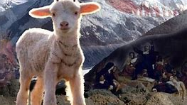
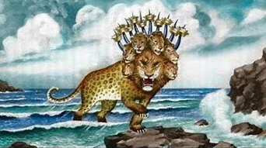
Kids’ Prophecy Corner
Revelation 13

Slide 2
The Two Beasts of Revelation 13
1st beast
Sea
Object
Many People
2nd beast
Earth
Image
Few people

Slide 3
The Two Beasts of Revelation 13
1st beast
Sea
Object
Many People
2nd beast
Earth
Image
Few people
Bad beast
Good beast / USA

Slide 4
The Two Beasts of Revelation 13
1st beast
2nd beast
Sea
Object
Many People
Bad beast
Old world
dragon
Earth
Image
Few people
Good beast
New world
dragon

Slide 5
The Two Beasts of Revelation 13
1st beast
2nd beast
Sea
Object
Many People
Bad beast
Old world
dragon
1260
Earth
Image
Few people
Good beast
Old world
dragon
“1260”

Slide 6
The Two Beasts of Revelation 13
1st beast
2nd beast
Sea
Object
Many People
Bad beast
Old world
dragon
1260
Change time and law
Earth
Image
Few people
Good beast
Old world
dragon
“1260”
Change time and law

Slide 7
The Two Beasts of Revelation 13
1st beast
2nd beast
Sea
Object
Many People
Bad beast
Old world
dragon
1260
Change time and law
Earth
Image
Few people
Good beast
New world
dragon
“1260”
Change time and law
Dragon
Lamb
Dragon
Dragon

Slide 8
The Two Phases Of The Second Beast
Great Controversy pages 440.1 to 441.1 : 1st phase – church and state separated
- There is a lamb like beast coming out of the earth.
- It did not come through the overthrowing of other powers, but it rises in a territory previously unoccupied
- It grows up gradually and peacefully.
- Its developments were from being peaceful, being lamb-like to being a dragon and being harmful.
- She explains what the old world is by quoting Revelation 17:15. The Old World—that turbulent sea of “peoples, and multitudes, and nations, and tongues.”
- The nation in 1798 that was rising into power giving promise of strength and greatness was unmistakably the United States of America.
- She then describes the principles of its success as a nation: Republicanism and Protestantism. These principles are the secret of its power and prosperity.
- Also attached to these two principles is the constitution which guarantees to the people the right of self- government, providing that representatives elected by the popular vote shall enact and administer the laws.
- Also, freedom of religious faith was granted.

Slide 9
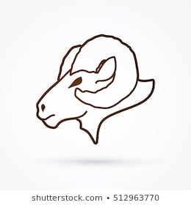
Declaration of Independence + Constitution
Republicanism
Protestantism

Slide 10
Great Controversy 442 : Second phase – the speaking
The speaking of the nation is the action of its legislative and judicial authorities.
{ GC 442.1}
The legislative :
Law
Parliament – House of Representatives + Senate
The Judiciary
- implements
- Executes judgement
The executive is held by the presidency.

Slide 11
Lamb
Dragon
Good
Bad
Speaks as a Lamb
Speaks as a Dragon
Church // State
Church
State
1798
SL
Lamb
Dragon

Slide 12
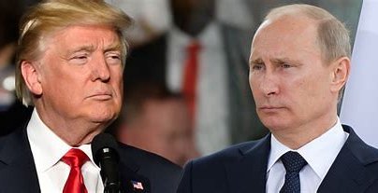

Slide 13
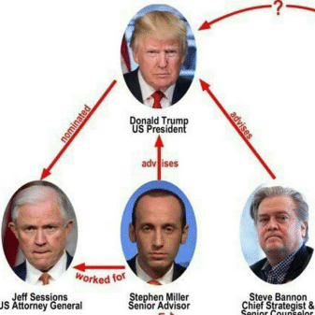

Slide 14
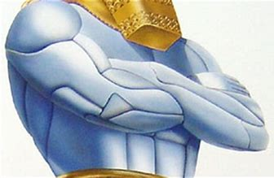
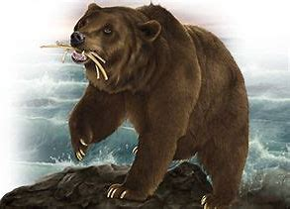
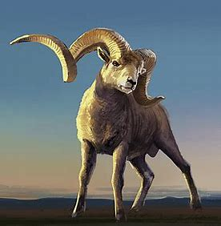
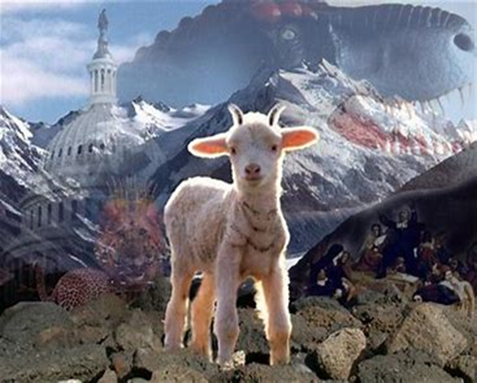
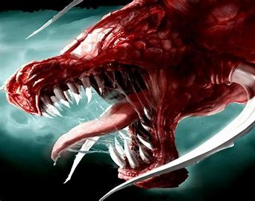
The United States And Medo-Persia
Daniel 2 | Daniel 7 | Daniel 8:3,20 | Rev. 13:11
The chest The silver | A beast ( bear) The shoulders: one high, on low | A beast ( ram) Two horns: one higher than the other | Lamb beast Dragon beast Two horns

Slide 15
The Lamb-beast and The Dragon-beast

Slide 16
Like = Equal to
Daniel 7: 4
7:4 The first [was] like a lion, and had eagle's wings: I beheld till the wings thereof were plucked, and it was lifted up from the earth, and made stand upon the feet as a man, and a man's heart was given to it.
Romans 8:3
8:3 For what the law could not do, in that it was weak through the flesh, God sending his own Son in the likeness of sinful flesh, and for sin, condemned sin in the flesh:

Slide 17
The Lamb-beast and The Dragon-beast

Slide 18
The Two Horns
Lamb-beast
Dragon-beast
Civil liberty and Religious Liberty
Civil oppression and Religious oppression

Slide 19
The 1260 & “1260”
538
1798
Royal Oppression
Priestly intolerance
1260
Church and State
SL
COP
Civil Oppression
Religious intolerance
“1260”
Church and State

Slide 20
The Two Beasts of Revelation 13
1st beast
2nd beast
Sea
Object
Many People
Bad beast
Old world
dragon
1260
Change time and law
Earth
Image
Few people
Good beast
New world
dragon
“1260”
Change time and law
Dragon
Lamb
Dragon
Dragon

