Slide 1
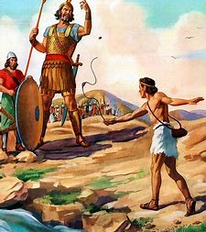
Kids’ Prophecy Corner
David and Goliath
1 Samuel 17

Slide 2
Review
Daniel 2

Slide 3
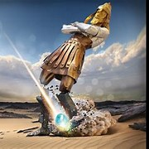
Daniel 2: 44-45 / 2:34-35
V.44
God of Heaven Kingdom break in pieces these kingdoms (these Kings)
V.45
Cut out without stone brake in pieces iron, brass, clay, silver, gold
Hands
V.34-35
Cut without hands stone broken to pieces together iron and clay, brass, silver and gold

Slide 4
Babylon
Medo Persia
Greece
Rome
The Whole Image Collapses Not Just The Feet!

Slide 5
Daniel 7: 11-12 And Revelation 17:5
Daniel 7:11-12
Revelation 17:5
Babylon Lion
MP Bear
Greece Leopard
Pag. Rome Dreadful beast
Pap.Rome Little horn
Papal Rome = Mystery Babylon = Spiritual Babylon
Dominion taken, life prolonged

Slide 6
King of the North’s Kingdom
Gold
Babylon
Church + State
USA
Silver
M- P
Dual Parts
USA
Brass
Greece
Rules the whole earth
USA
Iron
Pagan Rome
Strong Nation, Singular
USA
Iron + clay
Papal Rome
USA
Church + State, Spiritual Babylon
End of the World

Slide 7
Kids’ Prophecy Corner
David and Goliath
1 Samuel 17

Slide 8
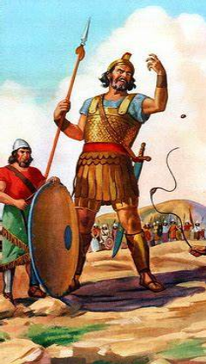
The Materials
17:4 And there went out a champion out of the camp of the Philistines, named Goliath, of Gath, whose height [was] six cubits and a span.
17:5 And [he had] an helmet of brass upon his head, and he [was] armed with a coat of mail; and the weight of the coat [was] five thousand shekels of brass.
17:6 And [he had] greaves of brass upon his legs, and a target of brass between his shoulders.
17:7 And the staff of his spear [was] like a weaver's beam; and his spear's head [weighed] six hundred shekels of iron: and one bearing a shield went before him.

Slide 9
Brass
Iron
Brass

Slide 10
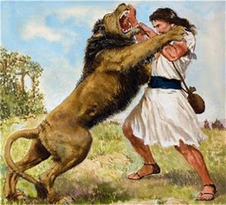
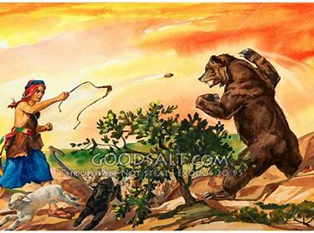
The Animals
17:32 And David said to Saul, Let no man's heart fail because of him; thy servant will go and fight with this Philistine.
17:33 And Saul said to David, Thou art not able to go against this Philistine to fight with him: for thou [art but] a youth, and he a man of war from his youth.
17:34 And David said unto Saul, Thy servant kept his father's sheep, and there came a lion, and a bear, and took a lamb out of the flock:
17:35 And I went out after him, and smote him, and delivered [it] out of his mouth: and when he arose against me, I caught [him] by his beard, and smote him, and slew him.
17:36 Thy servant slew both the lion and the bear: and this uncircumcised Philistine shall be as one of them, seeing he hath defied the armies of the living God.

Slide 11
Natural and Spiritual
Natural Spiritual
Lion
Bear
“as”
Goliath

Slide 12
1Samuel 17 and Daniel 2,7
2 Samuel 17 | Daniel 2,7
Lion | Babylon
Bear | Medo-Persia
Brass | Greece
Iron | Rome

Slide 13
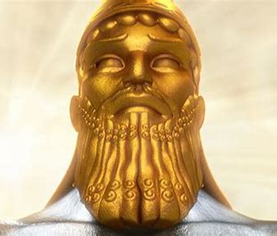

Slide 14
Babylon
Destroyed from Head to toe
Babylon
David
Spiritual Babylon
Collapses

Slide 15
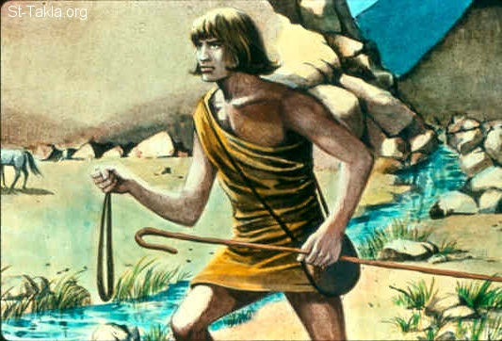
The Instruments
17:40 And he took his staff in his hand, and chose him five smooth stones out of the brook, and put them in a shepherd's bag which he had, even in a scrip; and his sling [was] in his hand: and he drew near to the Philistine.

Slide 17
Stone to destroy
Staff to save

Slide 18
The Stone
Instrument in the Hand of God
Not Christ x
Stone will do a work of destruction and of redemption
Stone = Priests and Levites = This movement

Slide 19
The Stone
2019
2021
SL
Priests succesfully Harvested
Levites succesfully Harvested
Stone fully formed

Slide 20
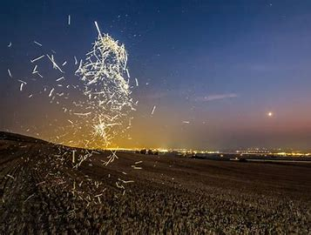
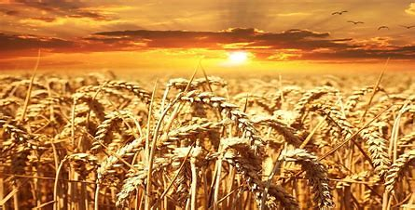
The chaff and the Wheat 2: 35 Then was the iron, the clay, the brass, the silver, and the gold, broken to pieces together, and became like the chaff of the summer threshingfloors; and the wind carried them away, that no place was found for them: and the stone that smote the image became a great mountain, and filled the whole earth.

