Slide 1
Kids’ Prophecy Corner
The Vision Of The Path

Slide 2
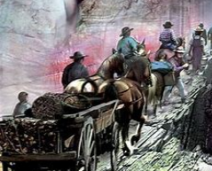
The Dream Of Sister White In January 12, 1869
When Sister White was in Battle Creek, she had a vision.
She dreamt she was with a large body of people but only a portion of them were preparing for a journey.
They had heavily loaded wagons.

Slide 3
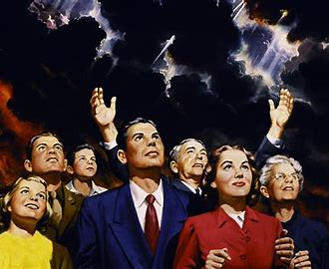
Who Are The people In The Dream ?
The people in the dream are Seventh-Day Adventists. They are the large body.
They are the Adventists who join the movement in 1989. But only a portion of them complete the journey.
Their heavy loads are all the doctrines or ideas they got from the church.

Slide 4
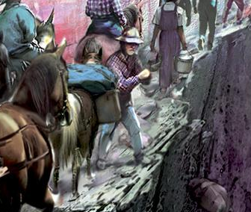
The Road And Their Belongings
In the dream the road seemed to ascend. On one side of this road was a deep precipice. On the other side was a high, white, smooth wall.
But As they journeyed on, the road grew narrower and steeper.
Because of that they had to get rid of their wagons and journey on horseback.

Slide 5
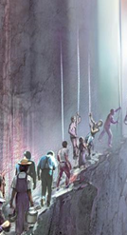
The Road And Their Belongings, continued
As they progressed the path continued to narrow.
It was so dangerous they had to let go of their luggage.
But that was not enough. At a point they had to leave their horses and continue on foot.
But God in his providence provided them with cords to hold on to.

Slide 6
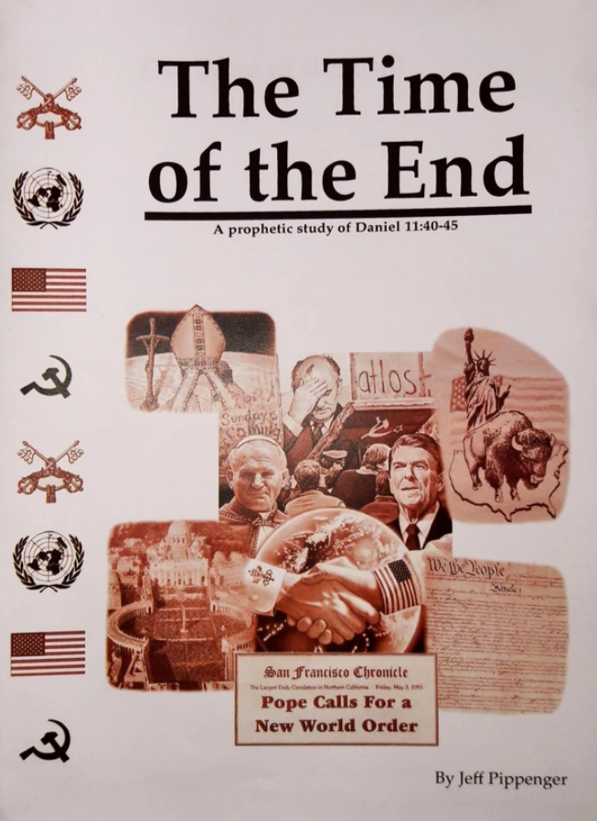
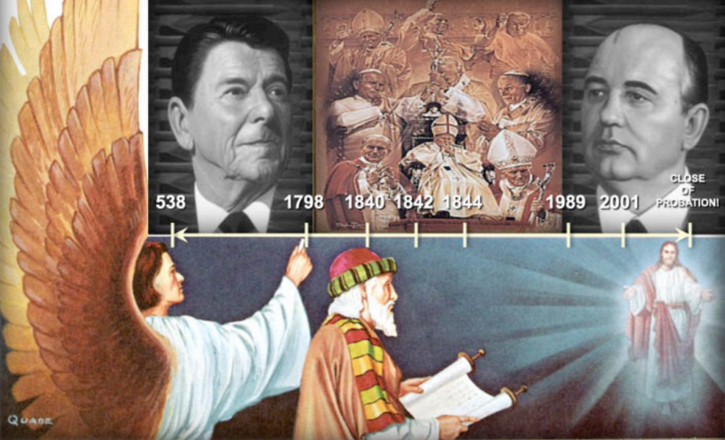
The Path of the Movement (1989-9/11)
This story relates the path of the priests since 1989.
A portion of the SDA church begin their journey in 1989.
In 1991 they let loose of their “wagon” or way of studying and begin to use line upon line. That is the increase of knowledge.
In 1996 They get rid of their luggage at the formalization of the message with the Time of the End magazine.
At 9/11 they left their horses behind. Then God could fully help them. He gave them cords.
The cords represent the line upon line methodology or what we commonly call Parable teaching. At the beginning they are very small just like our methodology. But they continue to grow (develop) until the Midnight Cry message.

Slide 7
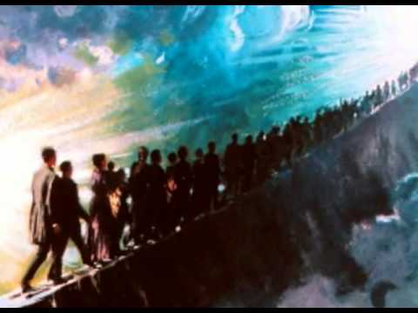
The Road, the Cords And Their Attire
In the dream the path now is extremely dangerous. To stay on it and be safe they first decided to remove their shoes and then their stockings.
Some people fall of the path because it was so narrow and hard.
The danger of falling from the pathway increased. They pressed close to the white wall, yet could not place their feet fully upon the path for it was too narrow.
They then suspended nearly their whole weight upon the cords.
The cords moved with them and grew in size as they travelled.

Slide 8
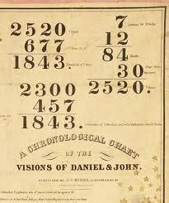
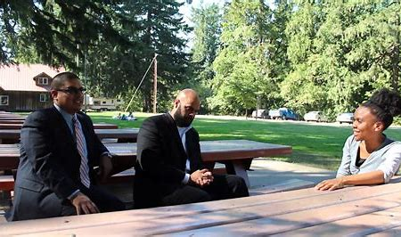
The Path Of The Movement (9/11 to 2014)
At 9/11 Christ gives us the line upon line methodology. This is the work of the second and third angels.
The lines are movable and grow with the movement.
In 2009 the 2520 was rediscovered. Many accepted this prophecy but others in the SDA church did not.
In 2012 time setting entered the movement. This is represented by the removal of the stockings and the feet start to hurt. It was a hard truth to accept.
Between 2012-2014 there were big shakings in the movement. People fell away. They left the movement because more sacrifice was required of them such as accepting the Leadership.
The major split was in 2014 with Path of the Just.

Slide 9
The Cords And The Music
Back in the dream, the people that were still on the pathway suspended nearly all their weight upon the cords and exclaimed “We have hold from above! We have hold from above!”
They could hear noises from the bottom of the steep cliff - laughing and worldly music; bad words and dirty jokes; war songs and dance songs; and cursing, cries, wails and loud laughter. They were so anxious to stay on that narrow path!

Slide 10
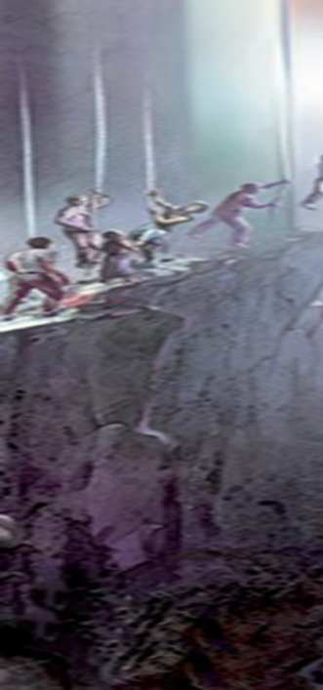
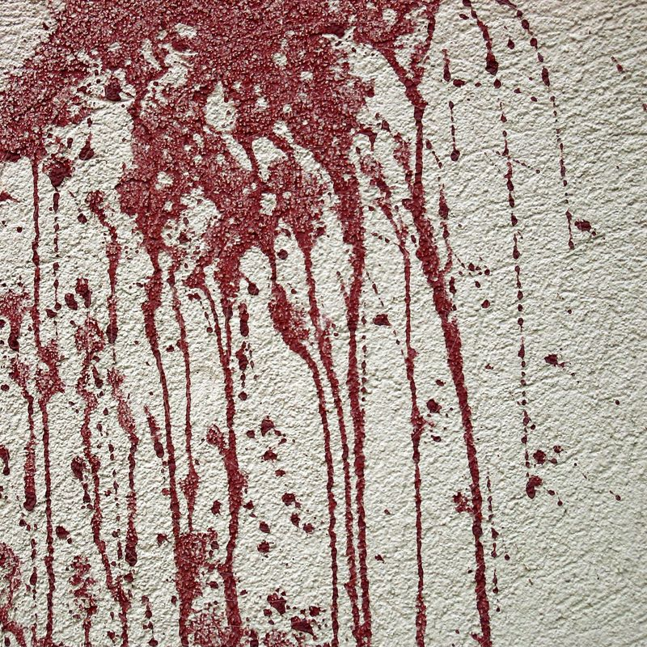
The Cords And The Blood
Now they depended more on the cords which grew as they went on. Ellen saw that the beautiful white wall was stained with blood. She felt sad to see it but then felt it was as it should be.
Those who are following after will know that others have passed the narrow, difficult way before them and that they can do the same.
As the blood shall be pressed from their aching feet, they will not faint and give up; but seeing the blood upon the wall, they will know that others have endured the same pain.

Slide 11
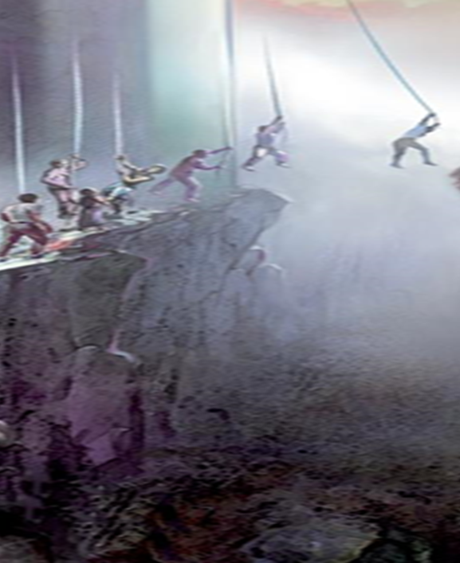
The End of the Path
Finally the path ended at a drop-off. There was no path for their feet at all.
They were hanging on the cords which had grown to be almost as big as their bodies.
For a while they were afraid. “What is holding the cords?” they asked. They were having a hard struggle. If they failed now the hard journey would have been for nothing!

Slide 12
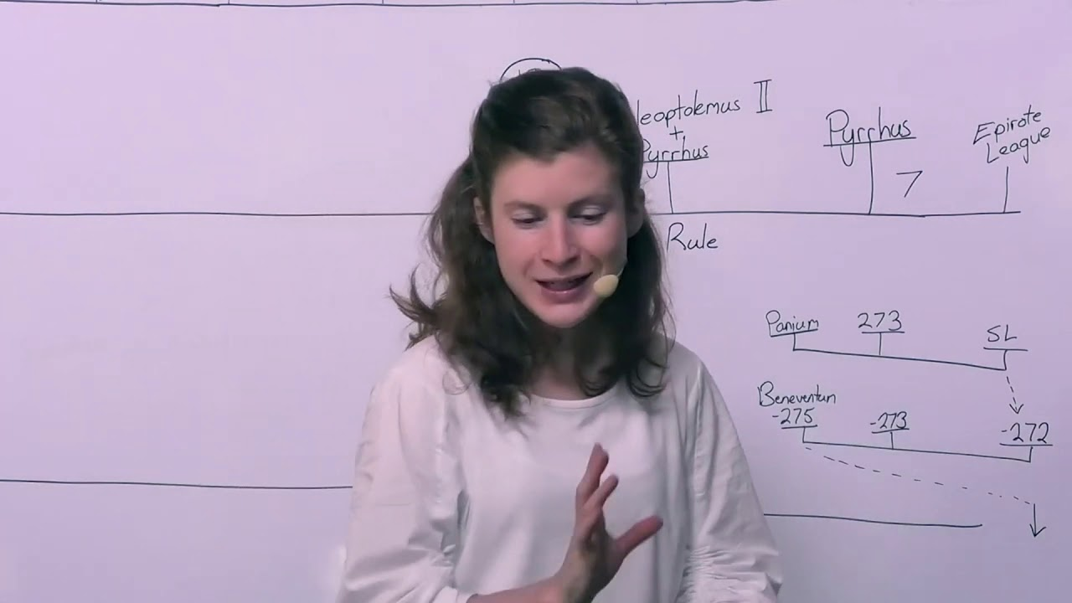
The Path Of The Movement 2014-2019
This part of the story relates the experience of the priests from 2014 to 2019.
The priests had to let go of wrong methodology and put their trust in parable teachings.
Although they faced mockery, disappointments, and anxiety, they trusted the lines without question.
The lines continued to grow, particularly during the Midnight Cry message.
It was not an easy experience but they had to go through it.

Slide 13
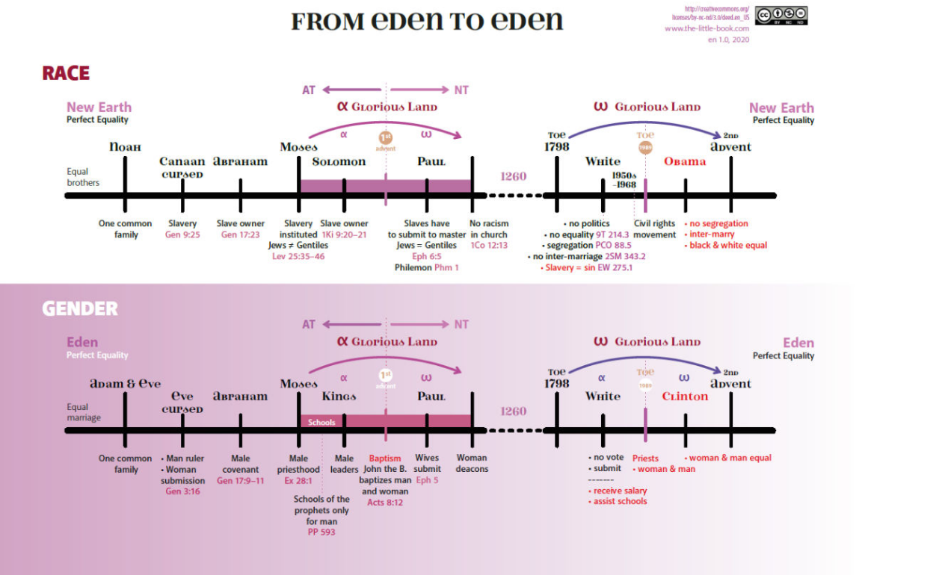
The Path Of The Movement 2014-2019, continued
Then they reach a large chasm at which the path ended.
This is November 9, 2019. The close of Probation for the Priests.
Now there is no more earthly support.
This means the priests have to put their trust or their faith entirely in the lines. Also, they cannot hold on wrong doctrines or ideas like inequality, racism, sexism, homophobia, conservatism, etc.
This produces a bloody sweat. Like Jesus in the wilderness and in Gethsemane.

Slide 14
The 2 Experiences Of The Priests After Nov.9, 2019
In the wilderness, Jesus contemplated his mission and his work. He realized how great his was mission. If he failed the whole human race would be lost forever.
The priests have to do the same and not fall into Satan’s temptations. Otherwise they will fail their mission to build the kingdom of God and bring the Levites and Nethinim into it.
In Gethsemane, at the end of his ministry, Jesus went through the same experience. His face was marked with blood and sweat from his agony. He knew that if he failed his entire ministry would have been for nothing and humanity would be lost forever.
The priests must not think they are safe and free to do what they want. If they keep wrong ideas and teach the wrong nature of the kingdom of God, they will fail their mission, be swept away , and many will be lost!

Slide 15
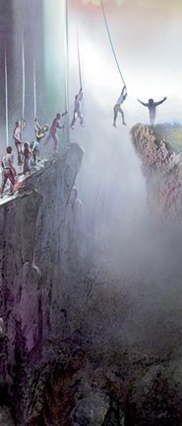
The Other Side Of The Chasm
On the other side of the chasm was a beautiful field of green grass about six inches high. Bright, soft beams of light, resembling fine gold and silver, were resting upon this field.
Nothing upon earth was like it in beauty and glory. But could they reach it? What if the cord would break? In whispers the words were breathed: "What holds the cord?"

Slide 16
Their Hope
For a moment they hesitated then said, "Our only hope is to trust wholly to the cord. It has been our help all the difficult way. It will not fail us now.
Still we hesitated then the words were said: "God holds the cord. We need not fear." These words were then repeated by those behind: "He will not fail us now. He has brought us thus far in safety."
They then swung over safely one by one to the lovely field. They heard voices Praising God.

Slide 17
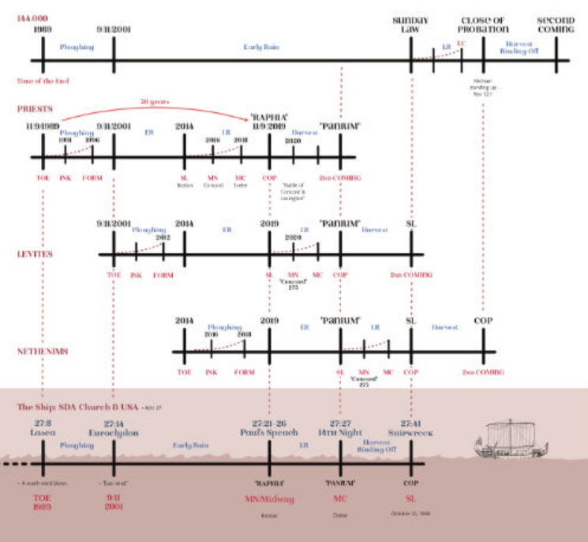
The Path Of The Movement : 2019-2021
Now the only hope for the priests to reach the end of their journey (2021 or the “second Coming”) is to put their whole trust in the methodology.
Some people have been doubting. They ask: “who holds the lines?”. They wonder if the line of Christ teaches the truth. They wonder if Acts 27 is a perfect parable. They question all the lines.
All have to realize that the priests must exhibit a great amount of faith! If our faith is not anchored in the lines we cannot make it to Panium!
We must be confident that it is God who holds the lines. He will not fail us! We will make it through!

Slide 18
The Line Of The Vision Of The Path
Light
2nd Advent
2021
1989
2014
Nov.9, 2019
9/11
2A/3A
Suspend almost all their weight
1991
1996
2009
2012
Cords increase in size
CHASM
Portion begins journey
Waggons
Luggage
Lose horses cords let down
shoes
Stockings
We have hold from above
blood
Wilderness
Gethsemane

Slide 19
Thank You For Coming!

Slide 20
Here Are some Questions For You
When did Sister White have her Vision?
Who does the large body represent?
Who does the portion of people who begin the journey represent?
1865
1869
SDA church
The world
The priests
SDA church

Slide 21
Here Are some Questions For You
Do you know another story where we see a large body and a portion? Explain.
What do the wagons represent?
What is the waymark when they let go of the horses and where God gave them cords?
David and Goliath
Daniel 2
Doctrines and ideas
methodology
2014
9/11

Slide 22
Here Are some Questions For You
What do the cords represent?
What year marks the removal of the shoes
What does the removal of the stockings represent? Explain why it hurts.
Parable teachings
Numerology
2012
2009
Time setting
2520

Slide 23
Here Are some Questions For You
What happened in the movement between 2012 and 2014?
How do the priests hold the lines from 2014 to 2019
What is their level of confidence in the lines (2014-2019)?
Major shakings
Major organization
They put almost all their weight on the lines
They put their entire weight on the lines
They accept the lines without question
They doubt them

Slide 24
Here Are some Questions For You
What does the chasm represent for the priests? (all answers are good, more are welcome ( e.g. J.T.T., etc.)
Which of these examples correspond to the first temptation of Jesus? Discuss
Which of these examples correspond to the second temptation of Jesus? Discuss
Experience of the priests in wilderness and after the cross
Experience in Gethsemane
Priests should go protest because it is part of our message
Priests should build the kingdom of God for people to find hope
Priests don’t need to fear Covid-19 or wear masks because they are chosen of God.
Priests should differentiate between presumption and faith

Slide 25
Here Are some Questions For You
Discuss these examples that correspond to the third temptation of Jesus. Give more examples.
Discuss these examples of earthly support. Find more examples (racism, sexism, homophobia, freedom, liberalism, power, etc.)
What is the light sister White saw on the other side of the chasm?
Priests think they know equality enough, they can set-up a political movement
Priests teach that the second coming will not happen. They will be the ones guiding everyone on earth
Nationalism
Conservatism
Light from Heaven
The sun

Slide 26
Extra Activities
Find pictures of a wagon, luggage, horses, shoes, stockings, cords, blood, light. Put them in order and tell the story.
Try the same activity with articles at home. For the blood use food coloring or paint.
Make a watercolor paint of the story. (just google, Ellen White vision of the path, and look at the image tab).

Slide 27
Thank You and God Bless !

