Slide 1
Kids’ Prophecy Corner
The line of Jesus From Baptism to The First Temple Cleansing
(Or the Experience of the Priests From 2019 to 2021)

Slide 2
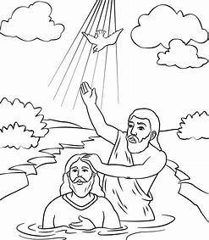
Jesus’ Baptism
When Jesus is 30 year-Old he got baptized by John the Baptist in 27 AD.
On the line of the priests this is 2019.
This marks 30 years from 1989 to 2019.

Slide 3
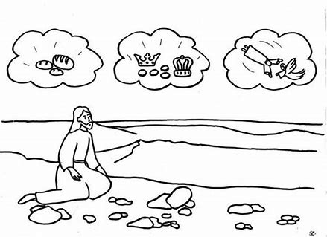
Jesus Is In The Wilderness for 40 Days
After the Baptism, Jesus went into the wilderness for 40 days and 40 nights to contemplate his mission and his work.
This is the experience of the priests right now after November 9, 2019.
Jesus was tempted by the devil 3 times.

Slide 4
The Three Temptations
The first temptation was when Satan asked Jesus to turn stones into bread. Stones represent the people of the world. Bread represents a message. This means that the priests can be tempted to turn a message from the world into a message for the movement.
The second temptation was when Satan asked Jesus to throw himself from the temple and the angels would protect him. But this is presumption not faith! So the priests can be tempted to put themselves into harm’s way and expect to be safe.
The third temptation was when Satan told Jesus that if he bowed down and worshiped him, he wiould give Jesus control over all the kingdoms of the earth. For the priests, the temptation is to accept a worldly kingdom or movement.

Slide 5
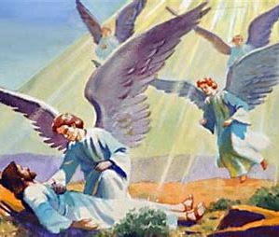
The End of The 40 Days
After the 40 days in the wilderness, angels came to minster unto Jesus.
They comforted him and gave him bread to strengthen him for his ministry.
Bread represents a message. For the priests, it represents an increase of knowledge.
So after our experience in the wilderness, we will receive new light on our message.
This will strengthen us in our mission to bring the Levites in our movement.

Slide 6
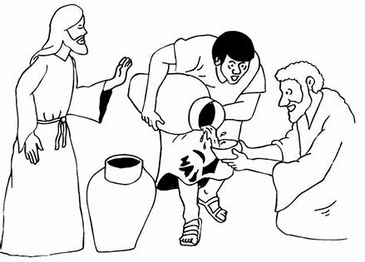
The Marriage at Cana
At the marriage at Cana, Jesus performed his first miracle in public.
This proved that he is the Messiah. We call this the formalization.
After the increase of knowledge, the message for the priests will also be formalized. It will happen between 2020 and 2021.

Slide 7
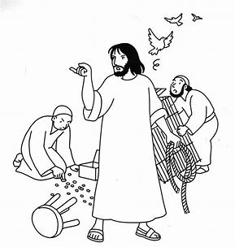
The First Temple Cleansing
The first temple cleansing marked the beginning of Christ’s work.
This was the first major event in his public ministry.
For the priests this will happen in 2021. It will be the beginning of their work. They will call the Levites to join the movement.

Slide 8
On A Reform Line, The Line Looks Like This :
Angels ministered to Christ
(2020)
First Temple cleansing
(2021)
AD 27
(2019)
Marriage at Cana
40 days Wilderness
Jesus baptised at 30 years of age
Angels give bread to Christ,
Increase of knowledge for the Priests
Jesus’ mission is formalized,
Formalization for the Priests
Jesus begins his work,
The Priests begin their work

Slide 9
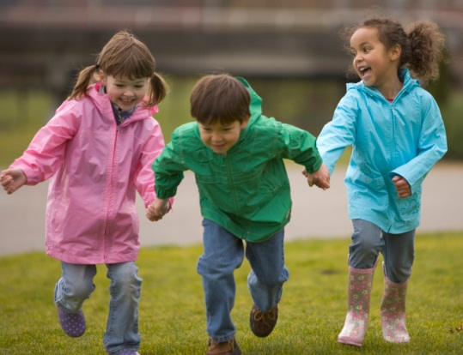
Thank You for Coming!

Slide 10
Now, here are some questions for you :
What year was Jesus baptized?
How old was Jesus when he got baptized?
Where did Jesus go after Baptism?
27 AD
30 AD
30-Year-old
27-Year-old
In a marriage at Cana
In the wilderness

Slide 11
More questions :
What does the first temptation symbolize for the priests?
What does the second temptation symbolize for the priests?
What does the third temptation symbolize for the priests?
Take a message from the world and turn it into a message from God
Stop eating bread
We can do anything now; we are all safe because we are priests
We must not think we are safe because we are priests
We can accept anything from the world now.
We have to be on our guard and accept a wordly kingdom

Slide 12
More questions :
What a stone represent?
What does bread represent?
What will the Priests receive at the end of their wilderness experience?
people
bread
A message
food
An increase of Knowledge
bread

Slide 13
More questions :
The marriage of Cana is a symbol of?
The temple cleansing is a symbol of?
Who will join the movement in 2021?
Beginning of the work
Formalization
Beginning of the work
Formalization
The Nethenims
The Levites

Slide 14
Put These Events In Order.
This is the Marriage at Cana or formalization (2)
This is the temple cleansing. (3)
This is the 40 days in the wilderness and the 3 temptations (1).

Slide 15
Thank You and God Bless!

