Slide 1
Kids’ Prophecy Corner
September 11

Slide 2
September 11, 1798
On September 11, 1798, the sultan of Turkey, under feeling of jealousy against France, artfully fostered by the English ambassadors at Constantinople, and exasperated that Egypt, so long a semi dependency of the Ottoman Empire, should be transformed into a French province, declared war against France.
1897 UrS, DAR 304.2 (on CD Rom); 111 on PDF

Slide 3
September 11, 1816
The Battle of Plattsburgh, also known as the Battle of Lake Champlain took place from September 6-11, 1814
William Miller was a leading captain in the battle.
At that time, William Miller is extremely impressed on how the battle ends up. There were more British soldiers than American soldiers. Yet, the Americans won the battle. And this really amazed him.
2 years later in 1816, the memorial or anniversary of the battle takes place on September 11, 1816.
The following Sunday, William Miller gets an overwhelming feeling that God exists. He immediately left the church, declares his faith, and starts studying. He is a converted man.
{1853 SB, MWM 66.1 – 67.1}

Slide 4
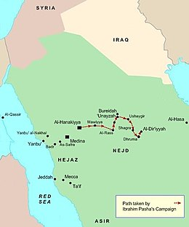
September 11, 1818
There is an important conflict. On September 11, 1818, the Saudi Wahhabis are restrained by Egypt.
Wahhabis are a denomination within Islam and are known to be ultraconservative. They want to follow literally the sharia law and sharia only. And they want to follow the Quran and the Quran only. They want to restore the oneness of God (monotheism).
Wahhabism is still present till this day.
They participated to the attacks of September 11, 2001. Osama bin Laden was part of the Wahhabi/Salafi movement.
https://en.wikipedia.org/wiki/Wahhabism
https://fr.wikipedia.org/wiki/Exp%C3%A9dition_de_Najd

Slide 5
August 11, 1840
Josiah Litch had predicted that on August 11, 1840, The Ottoman Empire would fall or be restrained.
We are in an Ottoman – Egyptian war over Syria (1839-1841).
Turkey accepts the help of Christian nations on August 11, 1840.
As a result of this agreement, on September 11, 1840, open war broke out in Beirut.
https://en.wikipedia.org/wiki/Egyptian%E2%80%93Ottoman_War_(1839%E2%80%931841)

Slide 6
During the second woe that occurred from July 27,1449 and August 11, 1840, four major events happened on September 11.
* Today, we would call that law against immigration
Sept. 11, 1565 | Sept. 11, 1609 | Sept.11, 1683 | Sept. 11, 1697
Siege of Malta | Muslim Expulsion from Spain* | Battle of Vienna (Austria) | Battle of Zenta (Yugoslavia)
The Turks wanted to invade Malta to take control of Sicily and Italy | Spain (catholic country) doesn’t want Muslims in their country. They passed a decree on Ap.1609 and read it out loud on 9/11 | The Turks came to help the king of Hungary. But a league between Holy Roman Empire and the Commonwealth was formed against them. | The Holy league of 1684 took the Ottoman army by surprise at the crossing of the Zenta river. Many Turkish soldiers died and there is a peace treaty.
The Turks are defeated (30,000 killed out of 40, 000) and Christianity is saved | 300,000 Moriscos were expelled | Turks are defeated. the Ottoman army was thought to be between 90,000 – 300,000 individuals. | 30,000 Turkish soldiers killed or drown. Turks defeated by the Holy league. Peace treaty of Karlowitz (1699)
They are Restrained | A decree is passed | They are restrained and there is a league | Restraint, league, peace treaty

Slide 7
September 11, 1844
J. N. Loughborough, "Heavenly Visions" JNL HV THE PROPHETIC GIFT. page 0027 paragraph 6 Another instance of the manifestation of the gift of prophecy is found in the case of a young man who resided in Poland, by the name of Hazen Foss. He was a man of fine appearance, pleasing address, with a good academic education. In the month of September 1844, about six weeks before the close of the twenty-three hundred days, the Lord gave him a vision, in which he, like Brother Foy, was shown the "three platforms" in the heavenly pathway. Some messages of warning to individuals were also given him, which he was instructed to deliver. In connection with this he was shown the trials and persecutions that would follow if he was faithful in relating what had been shown to him. As he also was expecting the Lord to come "in a few more days" (as they then sang), he did not understand the third step ("platform") in the journey; and shrinking from the cross, he refused to relate the vision. http://ellenwhite.org/content/file/william-foy-and-hazen-foss#document

Slide 8
September 11, 1989
Hungary announced today that it is allowing thousands of East Germans who have refused to return home to leave for West Germany.
The announcement cleared the way for more than 7,000 East Germans, who have said they wanted to go west, to do so beginning at midnight.
Hungary has decided to temporarily suspend a 20-year-old agreement with East Germany and to allow the refugees free passage ''to a country of their choice.‘’
The agreement marked the first break by a Warsaw Pact country in the customary cooperation in blocking citizens from going to the West.
https://www.nytimes.com/1989/09/11/world/hungary-allows-7000-east-germans-to-emigrate-west.html

Slide 9
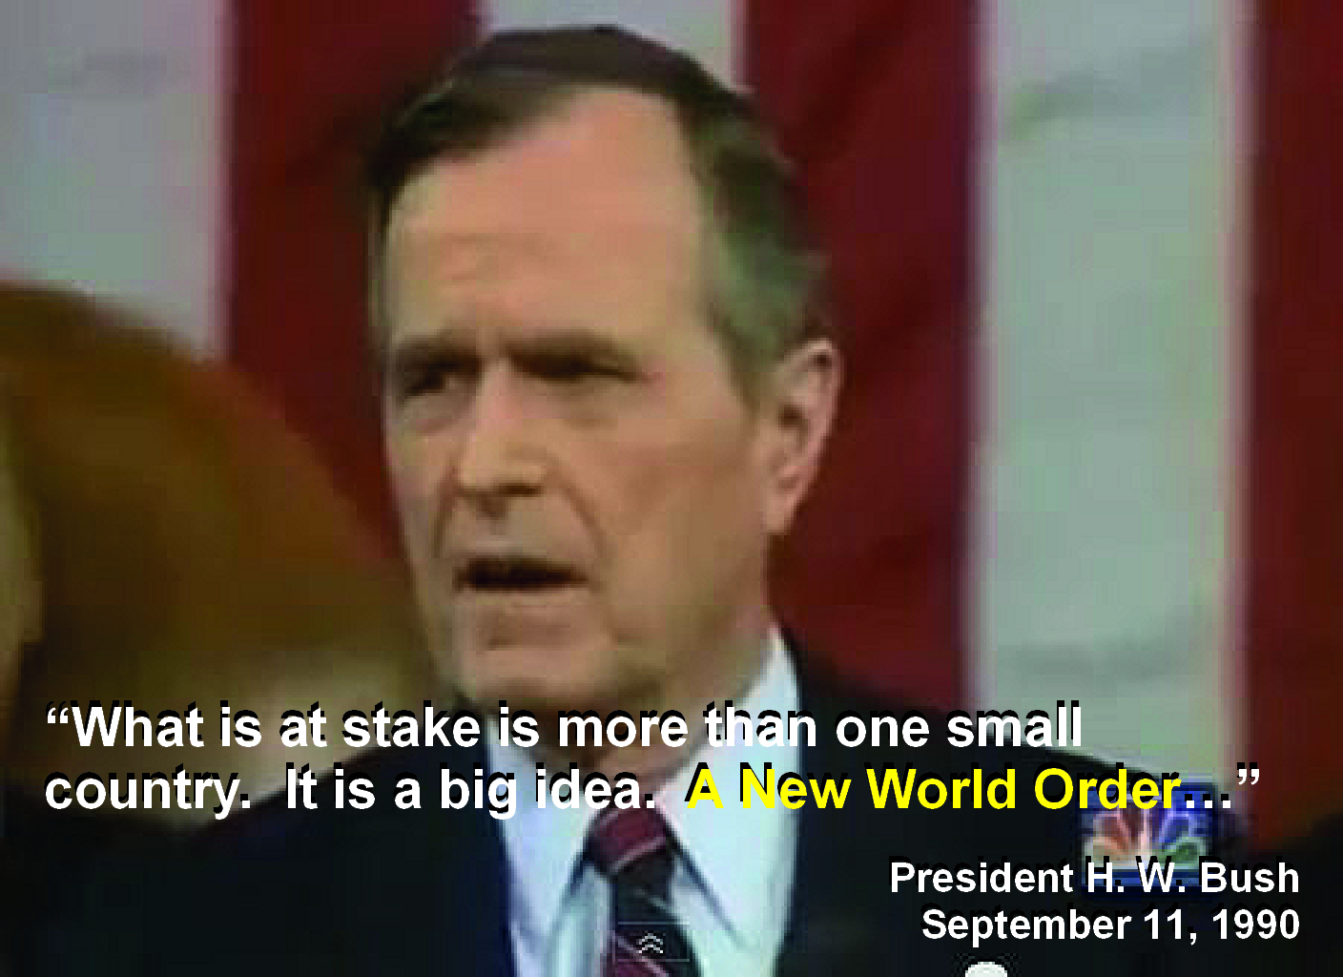
September 11, 1991
George W. H. Bush says :
We stand today at a unique and extraordinary moment. The crisis in the Persian Gulf, as grave as it is, also offers a rare opportunity to move toward an historic period of cooperation. Out of these troubled times, our fifth objective — a new world order — can emerge: a new era — freer from the threat of terror, stronger in the pursuit of justice, and more secure in the quest for peace. An era in which the nations of the world, East and West, North and South, can prosper and live in harmony.

Slide 10
September 11, 2001
Twin towers fall
Harbinger or a precursor of what sister White speaks about in 9T11-12; Life Sketches 411; RH July 5, 1906.14
Externally, George W Bush the son, put a restraint on Islam on his famous speech where he says, “Either you are with us, or you are with the terrorists,"
Parallels August 11, 1840

Slide 11
September 11, 2012
This is a terrorist attack against two American infrastructures that took place in Benghazi, Libya on September 11, 2012. It was revendicated by members of the Islamic group Ansar al-Sharia.
The Group is a Salafist Islamist militia that advocated the implementation of strict Sharia law across Libya. This group has been dissolved in 2017
https://en.wikipedia.org/wiki/2012_Benghazi_attack
https://en.wikipedia.org/wiki/Ansar_al-Sharia_(Libya)

Slide 12
September 11, 2016
This is an internal event.
There is the Camp meeting in Germany, and it ended on September 11, 2016.
The main subject was Matthew 13.
And it was the catalyst for Mark Bruce to leave the movement.

Slide 13
September 11
TOE | IK | Formal. | Restraint of Islam | Islam | Internal
1798 | 1816 | 2012 | 1818 | 1798 | 1816
1989 | 1818 |  | 1840 | 1818 | 1844
2001 (Levites) | 1991 |  | 2001 | 1840 | 2016
 | 2016 |  |  | 2001
 |  |  |  | 2012

