Slide 1
Kids’ Prophecy Corner
The History Of The Millerites

Slide 2
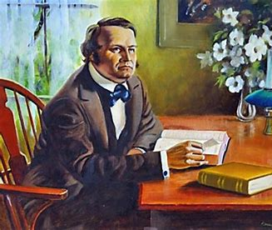
Who Is William Miller?
William Miller was a farmer and the leader of the Millerite movement during the first part of the 1800s.
God called him to leave his farm. At the beginning he was scared but he began to tell the people the mysteries of the kingdom of God through Bible prophecy. William Miller and those who joined with him proclaimed the second advent of Christ.
GC 317.1; EW 229.2; (2) {1845 WiM, WMAD 11.2}

Slide 3
Why Do We Look At The Millerites’ History?
Millerite history closely resembles our history. Theirs is the Alpha history of Adventism. We are in the Omega history.
By studying their history we can see parallels or similitudes with ours which allow us to better understand ours history.
It will also allow us to explain to the Levites what we believe and why the message in our movement is powerful and true.

Slide 4
How Do the Millerites Lines Work?
There are two main lines for the history of the Millerites. An internal line and an external line.
Each reform line has 5 primary waymarks. And in between you have 4 dispensations.
Ap. 19,
1844
July 21, 1844
Oct. 22, 1844
1863
1798
Internal
1798
Aug. 11,
1840
1850
1861
1863
External

Slide 5
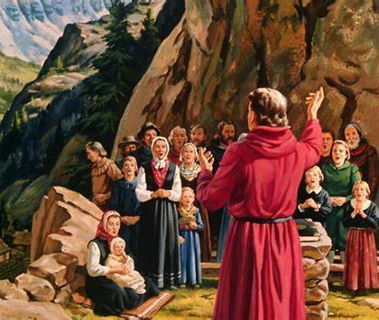
The Internal Line
Darkness
The Period of darkness is the 1260 years of persecution prior to the time of the end. It is also called the dark ages and runs from 538 to 1798.
It was a period of darkness, error and superstition where the knowledge of God was almost suppressed.(1)
(1) PK 714.1; (2) EW 240.1

Slide 6
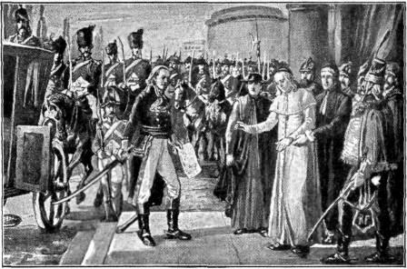
1798 - The Time Of the End
The Time of the end is 1798.
This was the arrival of the 1st Angel.(1)
This was when the Pope Pius VI was taken captive by Napoleon’s General.
This event is mentioned in the Bible in Daniel 11:40a. The King of the South – France – “pushes” the king of the north – the papacy.
In 1798 William Miller was raised up or called by GOD even if he doesn’t start his work right away.
In 1798 William Miller received his Cruden’s concordance.
(1) GC 355.1 to 356.2; TM 115. 2-3 ; (2) pic from https://www.sutori.com/item/1798-general-berthier-takes-the-pope-captive-sparking-renewed-interest-in-bi

Slide 7
1816-1818 – The Increase of knowledge
William Miller studied the Bible for 2 years. (1)
Before that he participated in a battle where the American soldiers won.
In 1816 There was a memorial of the battle and he has an overwhelming feeling that God exists. Miller was converted and started to study the Bible.
The battle of Plattsburg ended on September 11, 1814 (6-11 september 1814)(3)
The Memorial of the battle of Plattsburg was on September 11, 1816. The following Sunday, the Lord impressed William Miller’s heart and he started studying.(4)
There was an important event on September 11, 1818 as well. The Saudi Wahhabis were restrained by Egypt. The Wahhabis are a denomination within Islam. (5)
(1) GC 88 320.2; EW 229.2; (2) {1875 JW, SLWM 38.3} ; (3) https://en.wikipedia.org/wiki/Battle_of_Plattsburgh; (4) {1853 SB, MWM 66.1}; (5) https://fr.wikipedia.org/wiki/Septembre_1818; https://en.wikipedia.org/wiki/Wahhabi_War

Slide 8
1831-1833 – The Formalization of the message
In 1831 William Miller began to publicly teach that Christ would come soon.
And 2 years later in 1833 he received his credentials to teach in the churches.
On November 13, 1833 a great prophecy happened: The falling of the stars.
In Matthew 24:29, Jesus says that one of the signs of his soon coming would be the stars falling from heaven.
And it happened that night and lasted for hours! Everybody was amazed!
GC 332.1 to 333.1

Slide 9
April 19, 1844 – The First Disappointment
William Miller predicted that Jesus would return in 1843.
According to the Jewish calendar, it would have happened on April 19, 1844.
But Jesus did not return on that date. The faith of his people was tested by this disappointment. The tarrying Time starts there. (1)
This is also the arrival of the second angel. (1)
The Bible uses a different calendar than the one we use today.
There are actually 5 different Jewish calendars. The most popular is the Rabbinic calendar. But there is also the Karaite calendar, the Samaritan calendar, the Qumran calendar also known as the Enoch calendar, and the civil Persian calendar. (2)
The one used by the Millerites to calculate the date of April 19, 1844 was the Karaite calendar.
(1) EW 246.2 to 247.2 ; (2) https://en.wikipedia.org/wiki/Hebrew_calendar

Slide 10
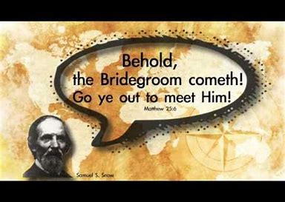
July 21, 1844
Samuel Snow was at his first Camp-meeting in the city of Boston. It was the first time his message “The True Midnight Cry” was publicly given. But it did not receive so much attention. However it was given 2 more times (at Concord and Exeter).
They called this date midway or midnight. A word they derived from the parable of the 10 virgins.
(1) GC 398.3

Slide 11
August 1, 1844
On August 1, 1844 there was a camp-meeting in Concord.(1)
Concord means harmony, agreement, or to be in one accord.
August 15, 1844
On August 15, 1844, there was a third camp meeting. It was held in Exeter.
The Millerites understood that this was the midnight cry.
This was when the message of Samuel Snow was empowered which meant that they gladly accepted the truth that Jesus would come on October 22, 1844.
{1847 JB, BP2 72.3}

Slide 12
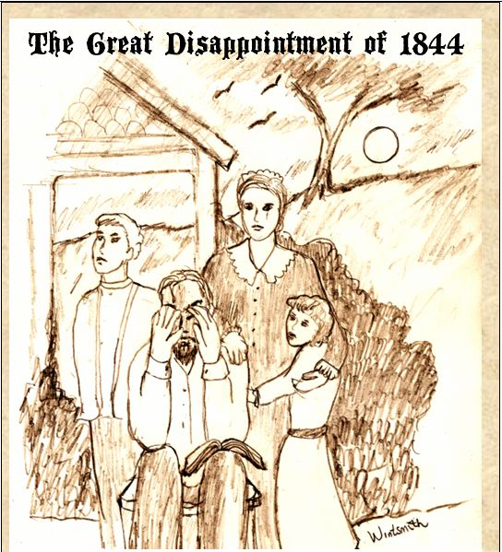
October 22, 1844
On October 22, 1844 the Millerites experienced the great disappointment. Jesus did not come. Out of 50,000 people only 50 remained.
Soon after, the remaining people realized that the sanctuary was not the earth but the sanctuary in Heaven.
Jesus, instead of coming to the earth, moved from the Holy place to the Most Holy Place.
We mark this event as a close of probation because there was a shut door. When Jesus changed apartment he shut the door of the Holy place. (1) (2)
Pic from https://www.pinterest.ca/pin/352688214539636004/; (1) 1SM 63 - 64; (2) EW 254, 259-260

Slide 13
1863
We use the agricultural model to know where the line would end.
1798-Ap. 19, 1844 is the ploughing
Ap. 19 –July 21 is the early rain
July 21- Oct. 22, 1844 is the latter rain
Oct. 22, 1844-1863 is the harvest
So, 1863 would be the end of their harvest. If you line it up with the five primary waymarks of a reform line, it would parallel the second Advent. (1)
Another witness is the 2520. The chiasm ends in 1863.
Agricultural Model
1798
Ap. 19,
1844
July 21, 1844
Oct. 22, 1844
1863
Early rain
Latter rain
Ploughing
Harvest
TOE
SL
COP
2nd
Coming
{ DS March 14, 1846, par. 2 }

Slide 14
But why didn’t Jesus come back in 1863?
In 1863 the SDA church was formed but they rejected the 2520 and made a new chart. The 1863 chart.
Before that date they entered into a Laodicean condition which prevented them from giving a proper message to the world.
The Lord had no choice but to delay his coming.
When the 1863 chart was being produced the eldest son of James and Ellen White was in the factory. During his break he went outside and got cold. He was so cold they laid him down on the 1863 chart to get warm. But days later he died. Exactly the year his father, James White, rejected the 2520!
{ HR February 1, 1874, Art. A, par. 13 }; { 2BIO 70.4 }

Slide 15
The Internal Line looks like this :
Ap.19,
1844
July 21, 1844
Oct. 22, 1844
1798
1863
TOE
Pope Captive
Miller Cruden concordance
1st Disappointment.
Midway/Midnight
“ SL”
COP
Great Disappointment
2nd Advent
1863 chart

Slide 16
The External Line
In addition to the internal line which we have covered we can also see an external line for Millerite history.
The external line shows only external events (events in the world outside the Millerite movement).
These events impacted the world and were calculated to help them to join the Millerites and be ready for the second coming of Christ.

Slide 17
1798 - The Time Of the End
The Time of the end was 1798.
This was also the arrival of the 1st Angel.(1)
Pope Pius VI was taken captive by Napoleon’s General in that year.
Another important event that year was the Ottoman Empire declaring war against France
On September 11, 1798 the sultan of Turkey (Ottoman Empire) declared war against France because he didn’t want Egypt to become a French province.(2)
(1) GC 355.1 to 356.2; TM 115. 2-3 ; (2) DAR 293

Slide 18
August 11, 1840
August 11, 1840 is a very important date for the Millerites. Josiah Litch had predicted in 1838 that on August 11, 1840, The Ottoman Empire would fall or be restrained. (1)
He used the day for a year principle established by William Miller.
He applied it to the prophecy of the second woe in Revelation 9.
The Ottoman Empire fell on that very day!
Because of the agreement between Turkey and the four Christian nations on August 11, 1840, on September 11, 1840 another war broke out. (2)
So, not only August 11, 1840 parallels September 11, 2001. We also have a real battle on September 11, 1840!
(1) GC 335.1; GC 611.1 (2) DAR 293; https://en.wikipedia.org/wiki/Egyptian%E2%80%93Ottoman_War_(1839%E2%80%931841)

Slide 19
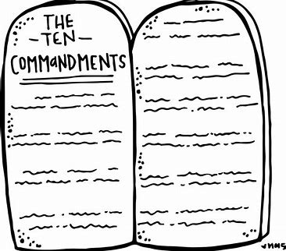
1850
1850 is the middle waymark in the external line. It has the characteristics of a Sunday law.
On September 18, 1850, the Fugitive Slave Act was passed.
This law was meant to lead to the capture of any slaves that escaped from their masters. It was passed because a slave named Harriet Tubman was able to escape slavery and she helped many other slaves to flee.
Slavery is considered by Sister White to be a sin. She compares it to the sins of Babylon.
This law forced people to break the 10 commandments. On November 1, 1850, a new chart, the 1850 chart was produced. They wanted to give a message to the world because Jesus was about to return.
4
6
(1) 1T 264 – Ch. 55; (2) John 2:20; Find examples in everyday life how each commandments can be broken.

Slide 20
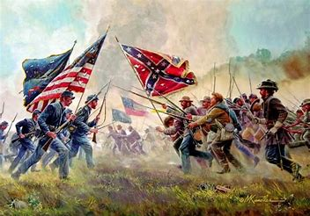
1861
We mark 1861 as the close of probation in the external line because this was when the judgement of God began (the Civil War).
This was the beginning of the Civil war and Sister White compared this period to the 7 last plagues (1).
Slavery had not been abolished and this displeased God. As a result the civil war broke out. And this war is considered the deadliest of all the American wars till this day.
God would not appease his furry until the slaves were freed and considered as humans.
1T 264 – Ch. 55

Slide 21
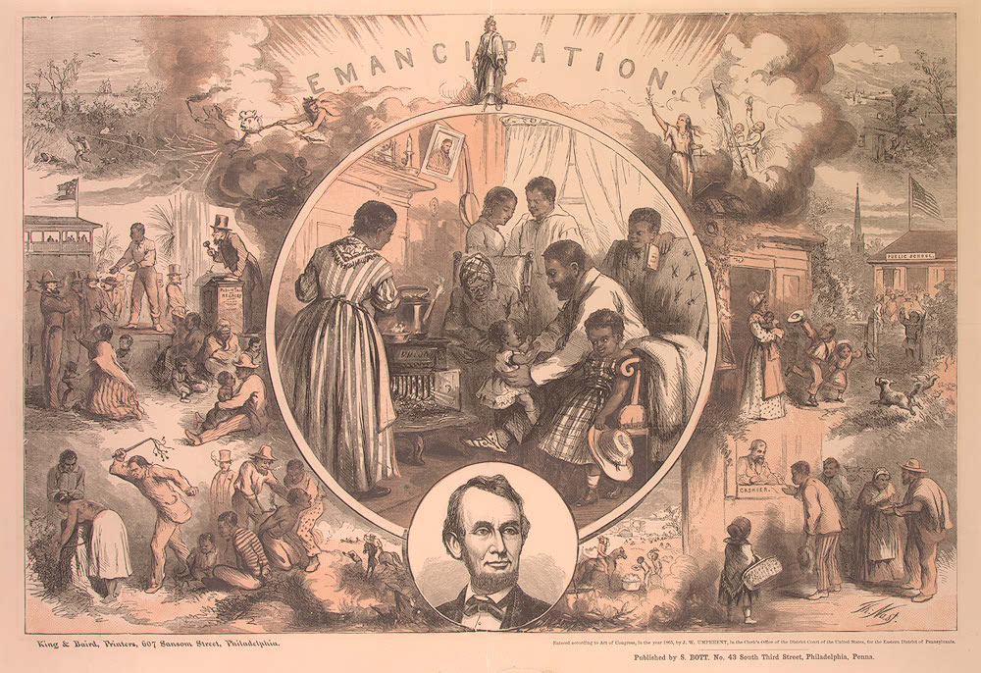
1863
1863 is the second advent in the external line. It was also the middle-point of the civil war.
President Lincoln issued the Emancipation Proclamation on January 1, 1863, which proclaimed the freedom of slaves.
However, Jesus did not come back and slavery continued in the southern states until they lost the war 2 years later.
Pic from : http://www.loc.gov/exhibits/odyssey/archive/05/0509001r.jpg; https://en.wikipedia.org/wiki/American_Civil_War

Slide 22
The External Line looks like this :
Aug.11,
1840
1850
1861
1798
1863
TOE
Pope captive
Turkey/France
Fall of Ottoman
Empire
“ SL”
Fugitive slave Act
1850 chart
COP
Beginning of Civil war
2nd Advent
Middle of Civil war.
Emmancipation proclamation

Slide 23
Conclusion
Although Christ did not come in that time the history of the Millerites is powerful.
We are still learning a lot from them
From their lines, you learn about, equality, race, gender, civil war, Islam, and how to interpret the Bible.
If you know it well, Adventists, especially the Levites, will see how God’s work is in perfect order and in harmony with our message.
By comparing and contrasting this history with ours, they will become convicted.

Slide 24
Thank You and God bless!

