Slide 1
Kids’ Prophecy Corner
The Parable of the Mustard Seed

Slide 2
Matthew 13: 31, 32
13:31 Another parable put he forth unto them, saying, The kingdom of heaven is like to a grain of mustard seed, which a man took, and sowed in his field:
13:32 Which indeed is the least of all seeds: but when it is grown, it is the greatest among herbs, and becometh a tree, so that the birds of the air come and lodge in the branches thereof.

Slide 3
Mark 4:30-32
4:30 And he said, Whereunto shall we liken the kingdom of God? or with what comparison shall we compare it?
4:31 [It is] like a grain of mustard seed, which, when it is sown in the earth, is less than all the seeds that be in the earth:
4:32 But when it is sown, it groweth up, and becometh greater than all herbs, and shooteth out great branches; so that the fowls of the air may lodge under the shadow of it.

Slide 4
Luke 13: 18, 19
13:18 Then said he, Unto what is the kingdom of God like? and whereunto shall I resemble it?
13:19 It is like a grain of mustard seed, which a man took, and cast into his garden; and it grew, and waxed a great tree; and the fowls of the air lodged in the branches of it.

Slide 5
When and Where Did Jesus Give This Parable?
Matthew13:1 The same day went Jesus out of the house, and sat by the sea side.
Matthew 12:1 At that time Jesus went on the sabbath day through the corn; and his disciples were an hungred, and began to pluck the ears of corn, and to eat.

Slide 6
Matthew 13: 31-32 | Mark 4:30-32 | Luke13: 18-19
Kingdom of Heaven | Kingdom of God | Kingdom of God
Field | Earth | Garden
Grain of mustard Seed | Grain of mustard seed | Grain of mustard seed
Herb | herbs | X
Tree | X | Great tree
Branches | Great branches | Branches
Birds | Fowls | Fowls
Least | Less | X
Greatest | Greater | Waxed great
Lodge | Lodges | Lodge
X | shadow | X

Slide 7
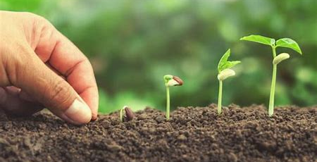

Slide 8
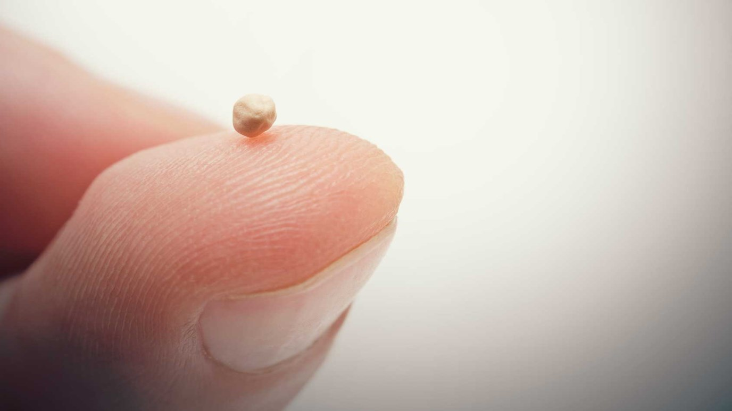

Slide 9
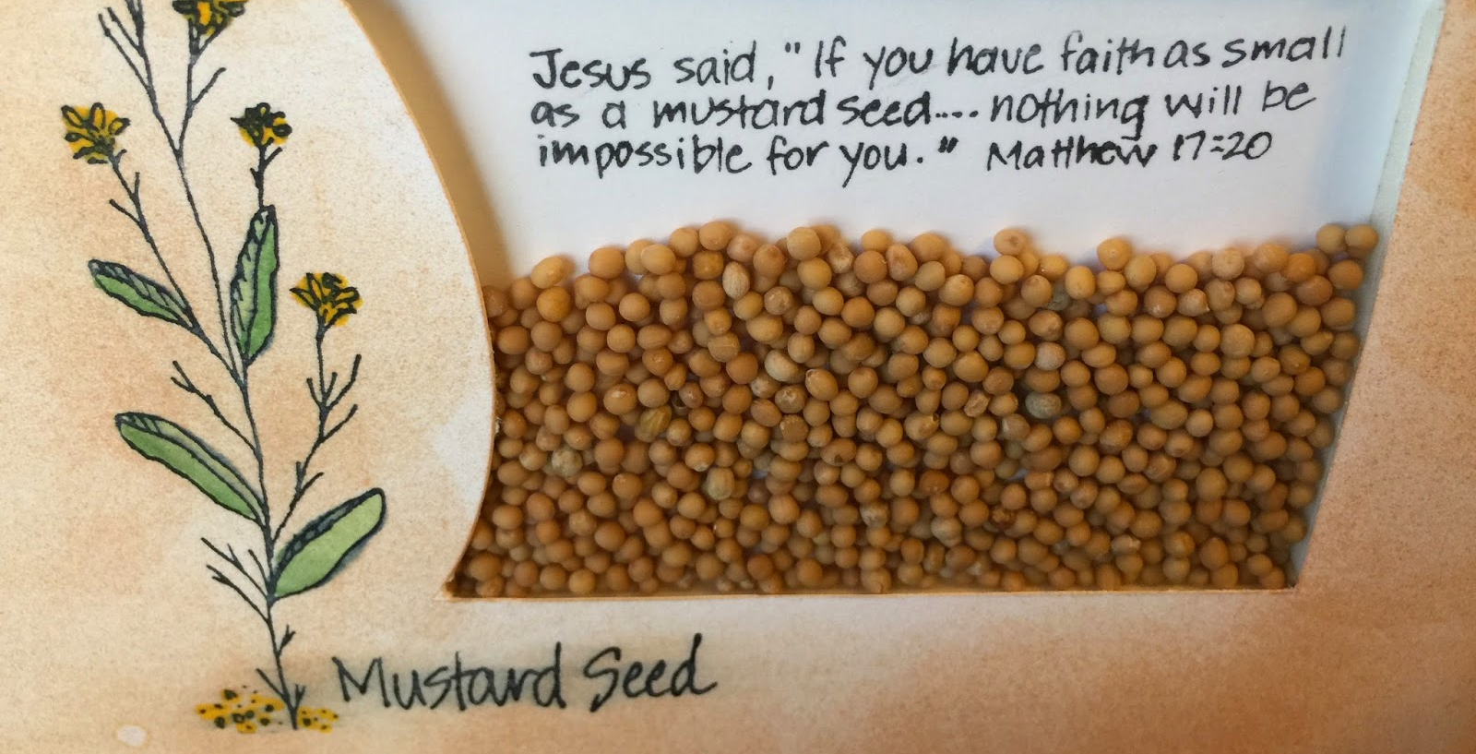

Slide 10
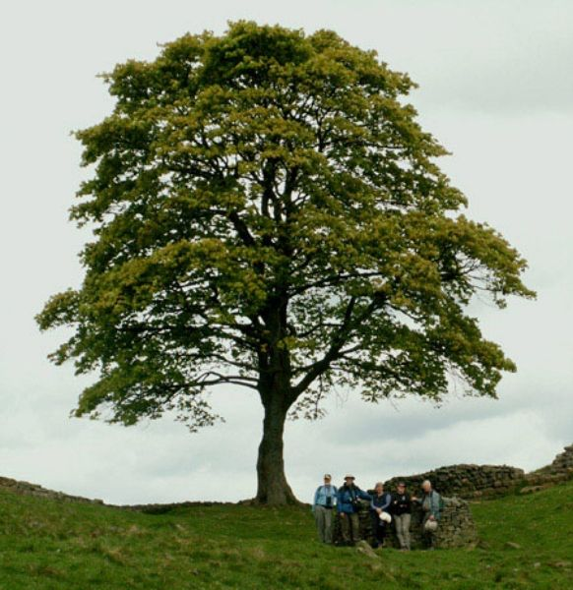
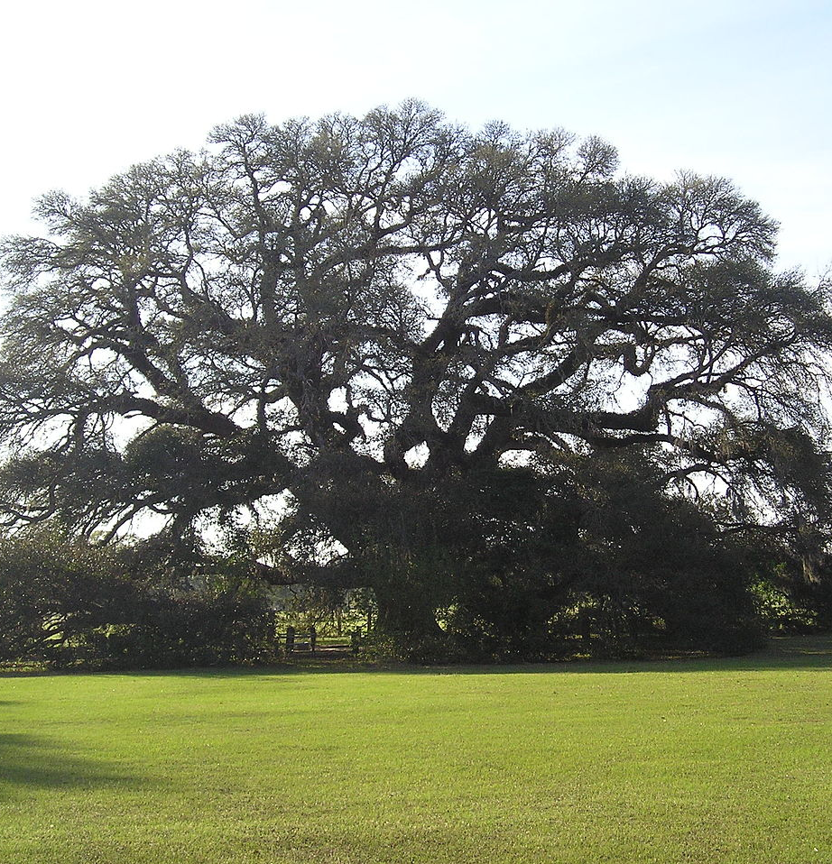

Slide 11
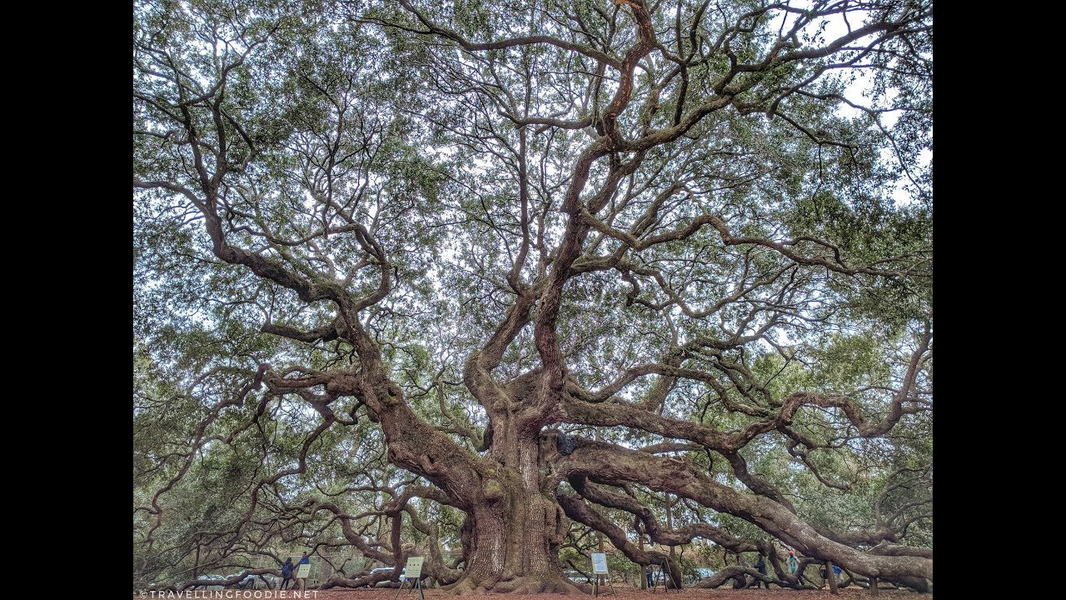

Slide 12
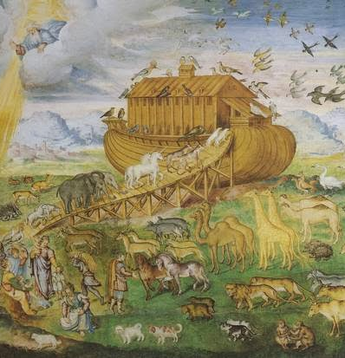
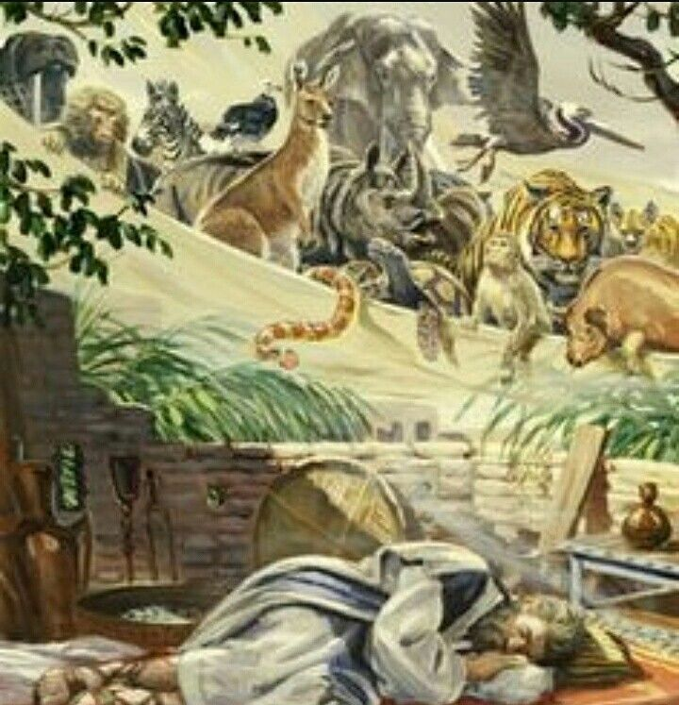

Slide 14
Field The world, the church, the heart
Seed An offspring, a remnant. The church triumphant. Also a message (MYP 146.2)
Mustard seed Kingdom of heaven. Also a symbol of faith (Matt.17:20;
Luke 17: 5,6)
Herbs A vegetable
Tree Compared to an Oak tree (G1186).
Symbol of strength and safety.
Symbol of a kingdom. Also the kingdom of Heaven.
Branches Symbol of Patriarchal system, symbol of family tree, symbol of doctrines
Birds Symbol of the gentiles ( Acts 10:11)
Shadow Symbol of trust (Judges 9: 8-15)
Least, greatest/great Symbol of equality

Slide 16
God’s People In The World
Galatians 3:28-29 King James Version (KJV)
²⁸ There is neither Jew nor Greek, there is neither bond nor free, there is neither male nor female: for ye are all one in Christ Jesus.
²⁹ And if ye be Christ's, then are ye Abraham's seed, and heirs according to the promise.

Slide 17
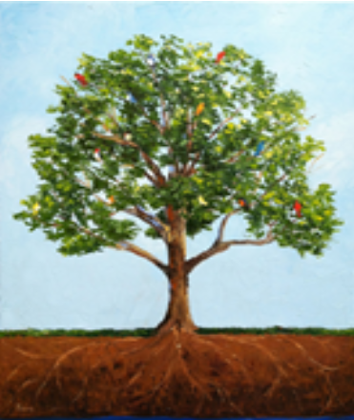
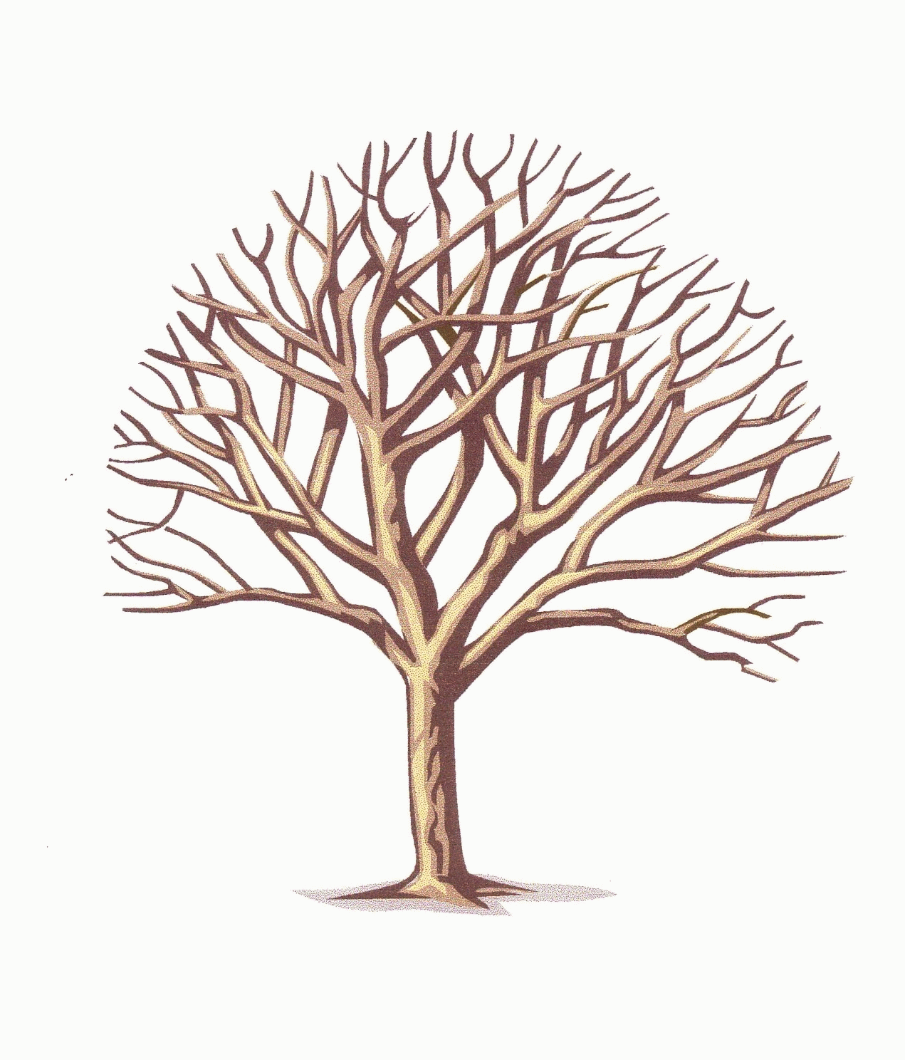
1989
2nd
^{Advent}
2001
SL
COP
144K
Plough
Early Rain
Harvest
Latter Rain
= Truth
= Line Upon Line
Branches = body of doctrine, Knowledge, prophetic truth, people
Message = truth
Messengers = people
Church
world
Sealing= settling into the truth both – intellectually (message)
and spiritually (character development experience)

