Slide 1
Kids’ Prophecy Corner
The Line of the US Presidents

Slide 2
Ronald Reagan
George H.W Bush
Bill Clinton
George W. Bush
Barack
Obama
Donald J. Trump

Slide 3
Ronald Reagan
George H.W Bush
Bill Clinton
George W. Bush
Barack
Obama
Donald J. Trump
Democrat
Democrat

Slide 4
Nayirah Testimony
Nayirah Al-Ṣabaḥ during her testimony. It was later revealed that she was the daughter of the Kuwaiti ambassador to the United States and that her testimony could not be verified.
Nayirah testimony was a false testimony given before the Congressional Human Rights Caucus on October 10, 1990 by a 15-year-old girl who provided only her first name, Nayirah. The testimony was widely publicized, and was cited numerous times by United States senators and President George H. W. Bush in their rationale to back Kuwait in the Gulf War.
In her emotional testimony, Nayirah stated that after the Iraqi invasion of Kuwait she had witnessed Iraqi soldiers take babies out of incubators in a Kuwaiti hospital, take the incubators, and leave the babies to die.
On January 6, 1992, The New York Times published an op-ed piece by John MacArthur entitled "Remember Nayirah, Witness for Kuwait?"[57] MacArthur discovered that Nayirah was the daughter of the Kuwaiti Ambassador to the U.S., Saud Nasir Al-Sabah.[57] MacArthur noted that "the incubator story seriously distorted the American debate about whether to support military action"
We disseminated information in a void as a basis for Americans to form opinions.
— Frank Mankiewicz, Vice Chairman, Hill & Knowlton[

Slide 5
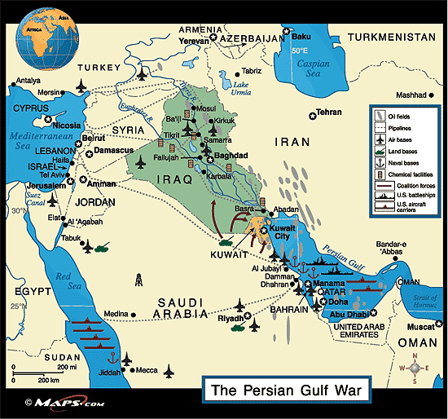
The Gulf War
The Gulf War was fought between Iraq and a coalition of nations that included Kuwait, the United States, the United Kingdom, France, Saudi Arabia, and more. It began when Iraq invaded Kuwait on August 2, 1990 and ended with a cease fire declared on February 28, 1991.
The leader of Iraq was a dictator named Saddam Hussein. In May of 1990, Saddam began to blame the economic woes of his country on Kuwait. He said they were producing too much oil and driving down prices. He also accused Kuwait of stealing oil from Iraq near the border.
On August 2, 1990 Iraq invaded Kuwait. A large Iraqi force crossed the border and made for Kuwait City, the capital of Kuwait. Kuwait had a fairly small army that was no match for the Iraqi forces. Within 12 hours, Iraq had gained control of most of Kuwait.
On February 24, a ground force invaded Iraq and Kuwait. Within a few days, much of Kuwait had been freed. On February 26, Saddam Hussein ordered his troops to withdraw from Kuwait.
A few days later, on February 28, 1991, the war came to an end when President George H. W. Bush announced a ceasefire.
https://www.ducksters.com/history/us_1900s/gulf_war.php

Slide 6
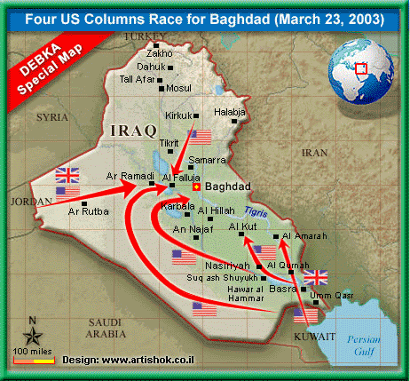
The Iraq War
The Iraq War was fought between Iraq and a group of countries led by the United States and the United Kingdom. It began on March 20, 2003 and ended on December 18, 2011. The war resulted in the toppling of the Iraqi government led by Saddam Hussein.
The term "Weapons of Mass Destruction", sometimes just called WMDs, are weapons that can cause harm to a lot of people. They include things like nuclear weapons, biological weapons, and chemical weapons (like poison gas).
On March 20, 2003, President George W. Bush ordered the invasion of Iraq. The U.S. forces were led by General Tommy Franks and the invasion was called "Operation Iraqi Freedom." Some countries allied with the U.S. including the United Kingdom, Australia, and Poland. However, many members of the United Nations including France and Germany did not agree with the invasion.
The Iraq War officially ended on December 18, 2011 with the withdrawal of U.S. combat troops.

Slide 7
Ronald Reagan
George H.W Bush
Bill Clinton
George W. Bush
Barack
Obama
Donald J. Trump
Democrat
Democrat
Iraq War
Based on lie
Iraq War Based on
lie

Slide 8
Ronald Reagan
George H.W Bush
Bill Clinton
George W. Bush
Barack
Obama
Donald J. Trump
Democrat
Democrat
Iraq War
Based on lie
Iraq War Based on
lie

Slide 9
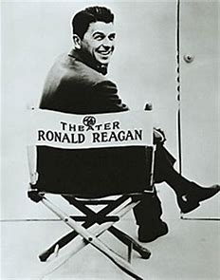
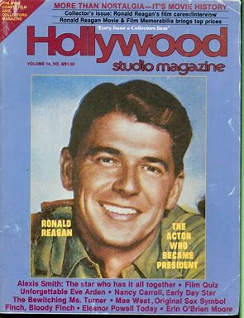
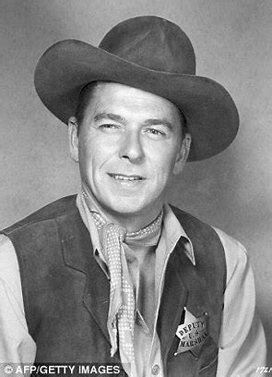
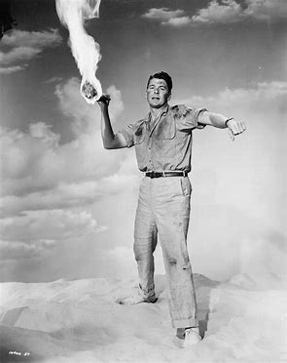
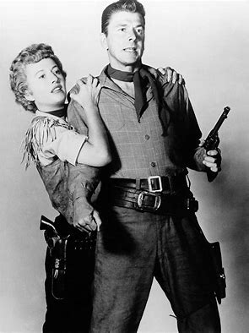
Ronald Reagan
Before being the 40th President of the United States, Ronald Reagan was a celebrity.
He began a career as an actor, first in films and later television, appearing in over fifty movie productions and gaining enough success to become a famous man.
He started his political career in the early 1960s.
He became president in 1981 at 69 years old.
He was the 40th president (1981-1989)

Slide 10
Ronald Reagan
George H.W Bush
Bill Clinton
George W. Bush
Barack
Obama
Donald J. Trump
Republican
Democrat
Democrat
Celebrity
Iraq War
Based on lie
Iraq War Based on
lie

Slide 11
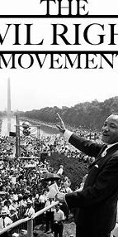
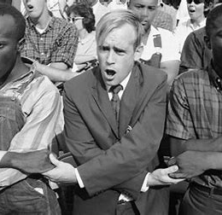
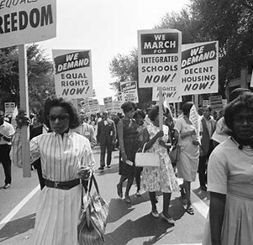
The civil Right Movement
The African-American Civil Rights Movement was an ongoing fight for racial equality that took place for over 100 years after the Civil War. Leaders such as Martin Luther King, Jr., Booker T. Washington, and Rosa Parks paved the way for non-violent protests which led to changes in the law. When most people talk about the "Civil Rights Movement" they are talking about the protests in the 1950s and 1960s that led to the Civil Rights Act of 1964.
In 1964, the Civil Rights Act was signed into law by President Lyndon Johnson. This act outlawed segregation and the Jim Crow laws of the south. It also outlawed discrimination based on race, national background, and gender. Although there were still many issues, this law gave the NAACP and other organizations a strong base on which to fight discrimination in the courts.
In 1965, another law was passed called the Voting Rights Act. This law said that citizens could not be denied the right to vote based on their race. It outlawed literacy tests (a requirement that people be able to read) and poll taxes (a fee that people had to pay to vote).

Slide 12
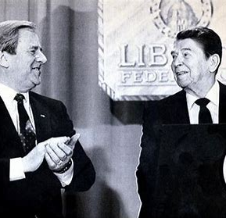
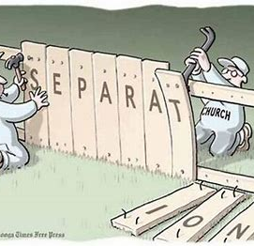
The Moral Majority
The Moral Majority was a prominent American political organization associated with the Christian right and Republican Party. It was founded in 1979 by Baptist minister Jerry Falwell and associates and dissolved in the late 1980s. It played a key role in the mobilization of conservative Christians as a political force and particularly in Republican presidential victories throughout the 1980s.

Slide 13
Ronald Reagan
George H.W Bush
Bill Clinton
George W. Bush
Barack
Obama
Donald J. Trump
Republican
Democrat
Democrat
Celebrity
Jerry Falwell
Iraq War
Based on lie
Iraq War Based on
lie
White Nationalism

Slide 14
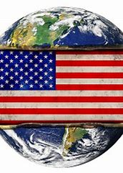
World Systems
Unilateralism
Bilateralism
Multilateralism
Unilateralism
when there is one superpower who is in control of all the nations. This type of system can lead to dictatorship.
Bilateralism.
when you have 2 superpowers are in control and all the other nations are under the hand of one of the two superpowers. The two superpowers are not friendly to one another because they seek to control the nations their own ways.
Multilateralism
when you have many nations working together. Today we use the term globalism. This system is the best because there is not a nation above another one to try to gain control of others. This is what do the United Nations or the European Nations. Many think this system is bad, but it allows nations to have accountability and run the world affairs. Nations cannot do what they want otherwise they get sanctions. If it is unilateral, you end up with nationalism which most of the time finishes as a dictatorship.

Slide 15
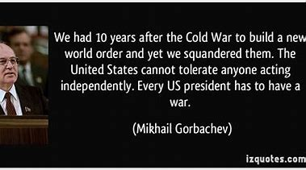
New World Order
Gorbachev says :
Further world progress is now possible only through the search for a consensus of all mankind, in movement toward a new world order. We have arrived at a frontier at which controlled spontaneity leads to a dead end. The world community must learn to shape and direct the process in such a way as to preserve civilization, to make it safe for all and more pleasant for normal life. It is a question of cooperation that could be more accurately called "co-creation" and "co-development." The formula of development "at another's expense" is becoming outdated. In light of present realities, genuine progress by infringing upon the rights and liberties of man and peoples, or at the expense of nature, is impossible.

Slide 16
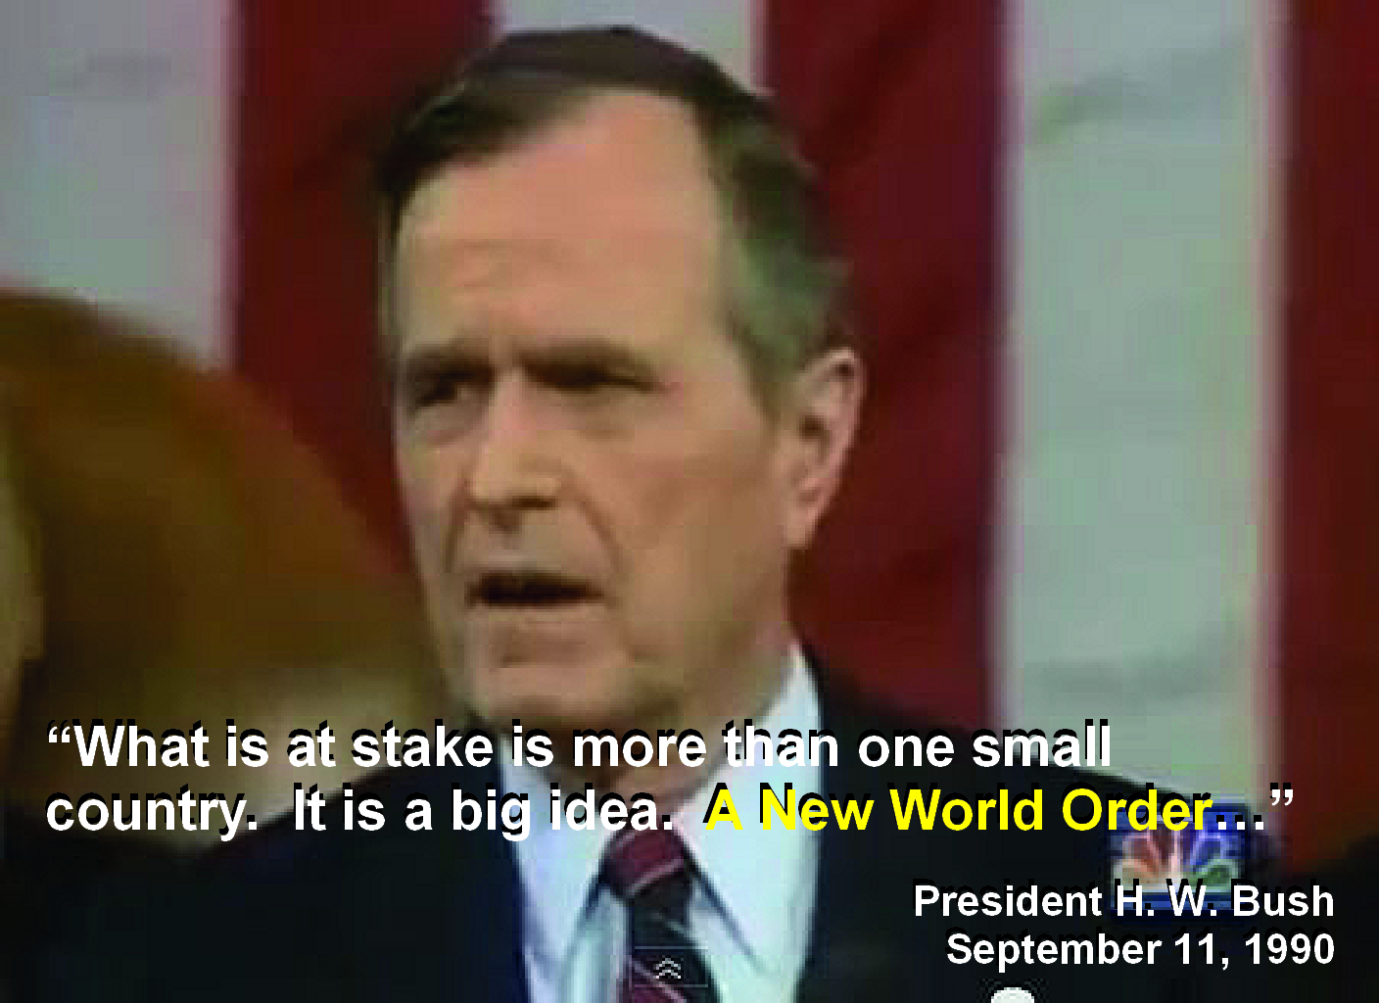
New World Order
George W. H. Bush says :
We stand today at a unique and extraordinary moment. The crisis in the Persian Gulf, as grave as it is, also offers a rare opportunity to move toward an historic period of cooperation. Out of these troubled times, our fifth objective — a new world order — can emerge: a new era — freer from the threat of terror, stronger in the pursuit of justice, and more secure in the quest for peace. An era in which the nations of the world, East and West, North and South, can prosper and live in harmony.

Slide 17
1989
1991
USSR
Bilateral
Unilateral
USA

Slide 18
Ronald Reagan
George H.W Bush
Bill Clinton
George W. Bush
Barack
Obama
Donald J. Trump
Republican
Democrat
Democrat
Celebrity
Jerry Falwell
Iraq War
Based on lie
Iraq War Based on
lie
White Nationalism
Unilateralism

Slide 19
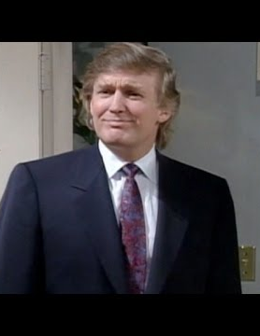
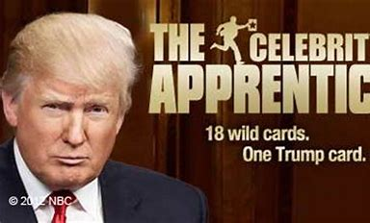
Donald J. Trump
Donald Trump is the 45TH president of the United States.
Before entering politics, he was a businessman and television personality.
He was known for producing the reality show the apprentice.
He made cameo appearance in 14 television series and 12 films.
He was given a weekly unpaid guest commentator spot on Fox & Friends that continued until he started his presidential candidacy in 2015.

Slide 20
Ronald Reagan
George H.W Bush
Bill Clinton
George W. Bush
Barack
Obama
Donald J. Trump
Republican
Democrat
Democrat
Republican
Celebrity
Celebrity
Jerry Falwell
Iraq War
Based on lie
Iraq War Based on
lie
Jerry Falwell Jr
White Nationalism
Unilateralism

Slide 21
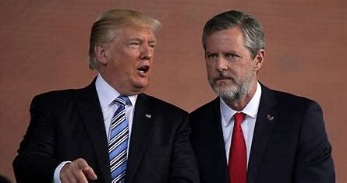
Jerry Falwell Jr.
Jerry Falwell Jr is the president of Liberty University.
He succeeded after his father’s death Jerry Falwell.
On January 26, 2016, Falwell Jr. announced his endorsement of Donald Trump for the Republican Nomination in the 2016 Presidential Election.
In an August 19, 2016 editorial in The Washington Post, Falwell compared Trump to Winston Churchill: "We need a leader with qualities that resemble those of Winston Churchill, and I believe that leader is Donald Trump.“
A group called the "Red Letter Christians" criticized Falwell for the pivotal role he played in "forging the alliance between white evangelicals and Donald J. Trump, who won 81 percent of their vote."
In April 2017, Falwell referred to Trump as the "dream president" for evangelicals and cited "uniting with Israel" and appointing "people of faith" in his administration as the reason why evangelicals support Trump.

Slide 22
Ronald Reagan
George H.W Bush
Bill Clinton
George W. Bush
Barack
Obama
Donald J. Trump
Republican
Democrat
Democrat
Republican
Celebrity
Celebrity
Jerry Falwell
Iraq War
Based on lie
Iraq War Based on
lie
Jerry Falwell Jr
White Nationalism
White Nationalism
Unilateralism

Slide 23
Panium
SL
USSR
Bilateral
Unilateral
USA

Slide 24
Ronald Reagan
George H.W Bush
Bill Clinton
George W. Bush
Barack
Obama
Donald J. Trump
Republican
Democrat
Democrat
Republican
Celebrity
Celebrity
Jerry Falwell
Iraq War
Based on lie
Iraq War Based on
lie
Jerry Falwell Jr
White Nationalism
White Nationalism
Unilateralism
Unilateralism

