Slide 1
Kids’ Prophecy Corner
The Impeachment Process Of Donald Trump

Slide 2
The Founding Fathers Dilemma
When America’s founding fathers were debating how to set up a brand-new government, they ran into a problem: What should happen if a president, has “rendered himself obnoxious?”
Obnoxious means extremely unpleasant.

Slide 3
English Common Law
Eighteenth century British sources display a close connection between impeachment and violation of fiduciary duty. For example, Parliamentary articles of impeachment explicitly and repetitively described the accused’s conduct as a breach of trust.
Popular secondary legal sources justified impeachment as arising from breach of trust or in similar fiduciary terms. Blackstone’s Commentaries begins its discussion of misprisions by observing that “THE first and principal [misprision] is the mal-administration of such high officers, as are in public trust and employment,” which was “usually punished by the method of parliamentary impeachment.
This Photo by Unknown Author is licensed under CC BY-SA

Slide 4
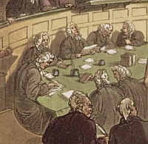
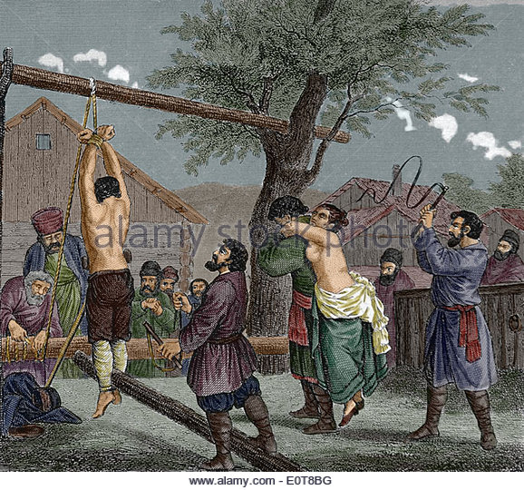
English Common Law
TRIAL
CONVICTION
JUDGEMENT

Slide 5
American Constitution
Text of Article 2, Section 4:
The President, Vice President and all civil Officers of the United States, shall be removed from Office on Impeachment for, and Conviction of, Treason, Bribery, or other high Crimes and Misdemeanors.
Treason – Helping enemies of the United States
Bribery – Taking money or gifts in exchange of political favor
High Crimes and Misdemeanors – the word is not defined in the constitution, but it is serious offenses against the republic and serious breaches of trust.

Slide 6
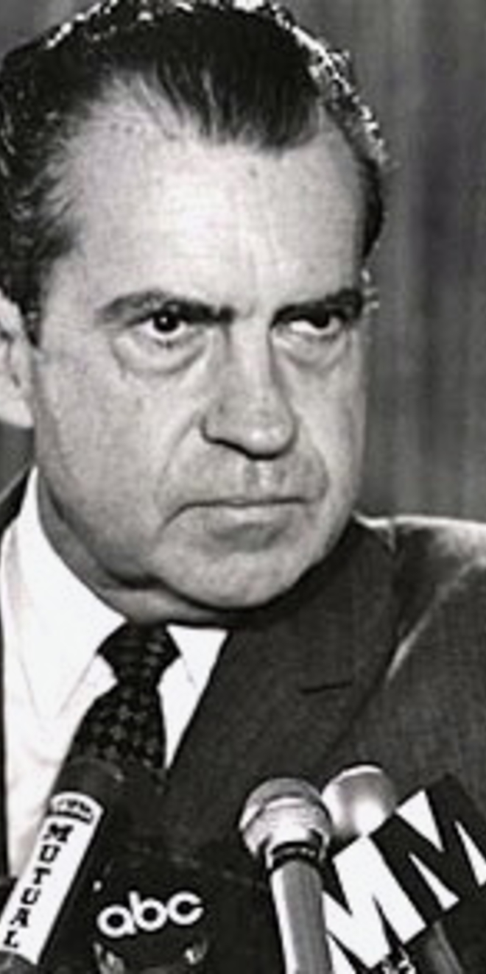
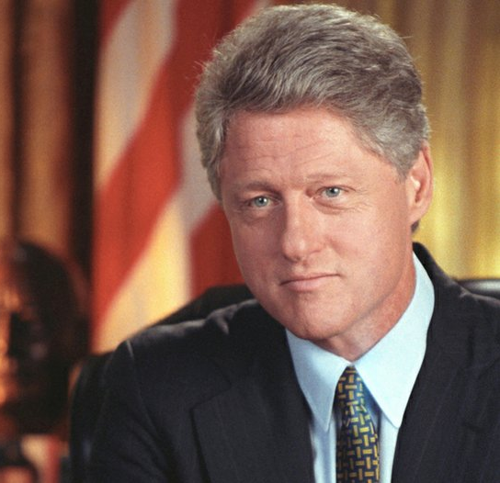
High Crimes and Misdemeanors
Three US presidents have been convicted of High Crime and other Misdemeanors.
Andrew Johnson
Richard Nixon
Bill Clinton

Slide 7
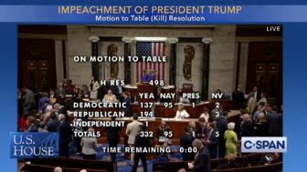
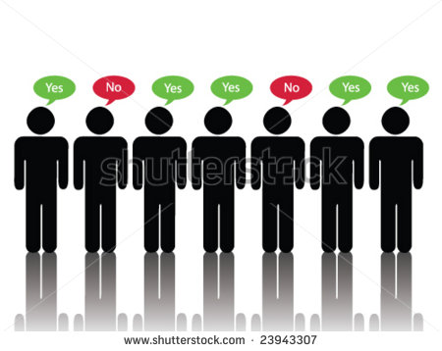
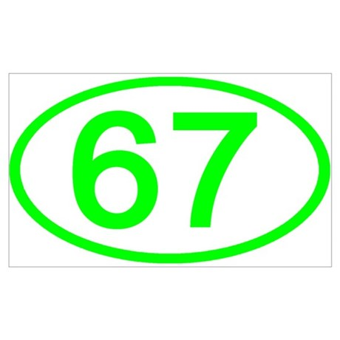
Impeachment Process
1
2
1 - The impeachment process starts in the house of representative.
Any member can introduce an impeachment resolution.
2- House committee approval.
Impeachment charges has to be approved by a majority of the House Judiciary Committee.
3- House vote
Next, the house vote whether to impeached. If a simple majority votes yes, the president is impeached. But it doesn’t mean they loose presidency.
4- Senate trial
If at least 67% vote to convict, the president is removed from office. But this never happen
3
4

Slide 8
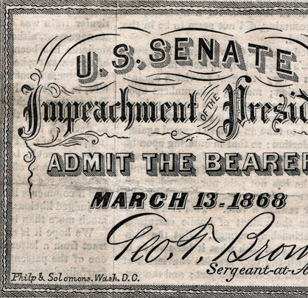
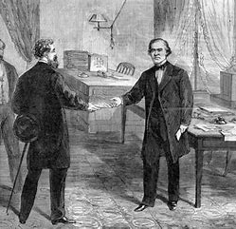
Andrew Johnson
Was charged for firing his secretary of war Edwin Stanton.
It happens after the civil war ( 1861-1865) and during the reconstruction
Johnson was not removed by one vote. 64.8% voted for.

Slide 9
Bill Clinton
Bill Clinton was not removed from office by the Senate.
This is because the house and trial in the Senate were split almost completely by party.
The disagreement in the Senate was about the context in which Clinton’s actions had taken place.
Clinton lied under oath that he had an affair with Monica Lewinsky. But after said the truth.
Because the oath is a public action, republicans in the house argued it should be impeached
Only 45% of the Senate voted for the impeachment.
“ The respondent William Jefferson Clinton, is not guilty as charged as the Senate article of Impeachment.
Despite the process, his popularity did not suffer.

Slide 10
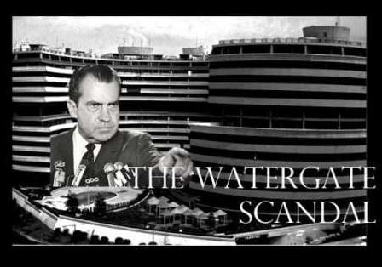
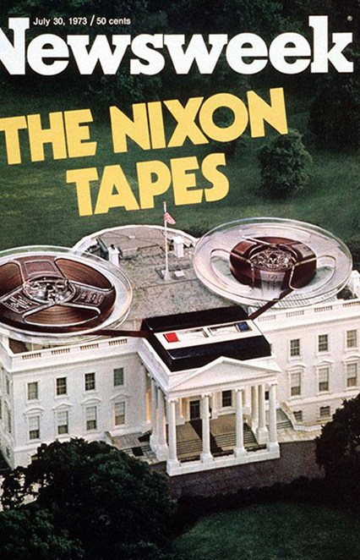
Richard Nixon
Over the course of several months in 1973, members of congress, and the American people, learned about Nixon’s possible involvement in a break-in at the offices of the Democratic National Committee (DNC) which was located in the Watergate office building.
Republicans, members of Nixon’s party, in both the House and the Senate, called for investigations into the president’s behavior.
In the House Judiciary Committee, Republicans joined with Democrats to approve articles of impeachment against Nixon in 1974.
But he resigned before the full house could vote on impeachment.

Slide 11
The 151
Mene Mene Tekel Upharsin | 50 50 1 25 | 60 60 1 30
 | 126 | 151
Daniel 5:25 And this [is] the writing that was written, MENE, MENE, TEKEL, UPHARSIN.
We get the time periods of 151 and 126 years from Daniel 5. The judgement pronounced against Belshazzar was written as Mene, Mene, Tekel, Upharsin. If we convert these words into monetary value, we can derive the 151 and 126. A Mene is worth fifty shekels. A Upharsin is worth half a Mene, or in this case, twenty-five shekels. A Tekel is worth one Shekel. So, if you add all the shekels up from Mene, Mene, Tekel, Upharsin, you come up with the sum of 126 Shekels. But, a Mene can also be worth sixty Shekels (Ezekiel 45:12). And this means that an Upharsin can be worth thirty Shekels. The sum is, therefore, 151. If you convert the 126 shekels into gerahs, the sum is 2520 gerahs (so one shekel is worth twenty gerahs). That is how the 126 and 151 represent the 2520, and so, they are significant time period.

Slide 12
151
1868
2019
1St Presidential Impeachment
Andrew Johnson
Premiere reason: firing Secretary of war Edwin M. Stanton and insulting congress
Mr. Trump Impeachment process.
Premiere Reason:
Abuse of power – Trump Ukraine Scandal.
(Trump sought to use his powers of office to press Ukraine into doing political favors for him.)

Slide 14
 | House Impeachment | Senate Trial | Senate Conviction
Andrew Johnson | . | . | X
Richard Nixon | X | X | X
Bill Clinton | . | . | X

Slide 15
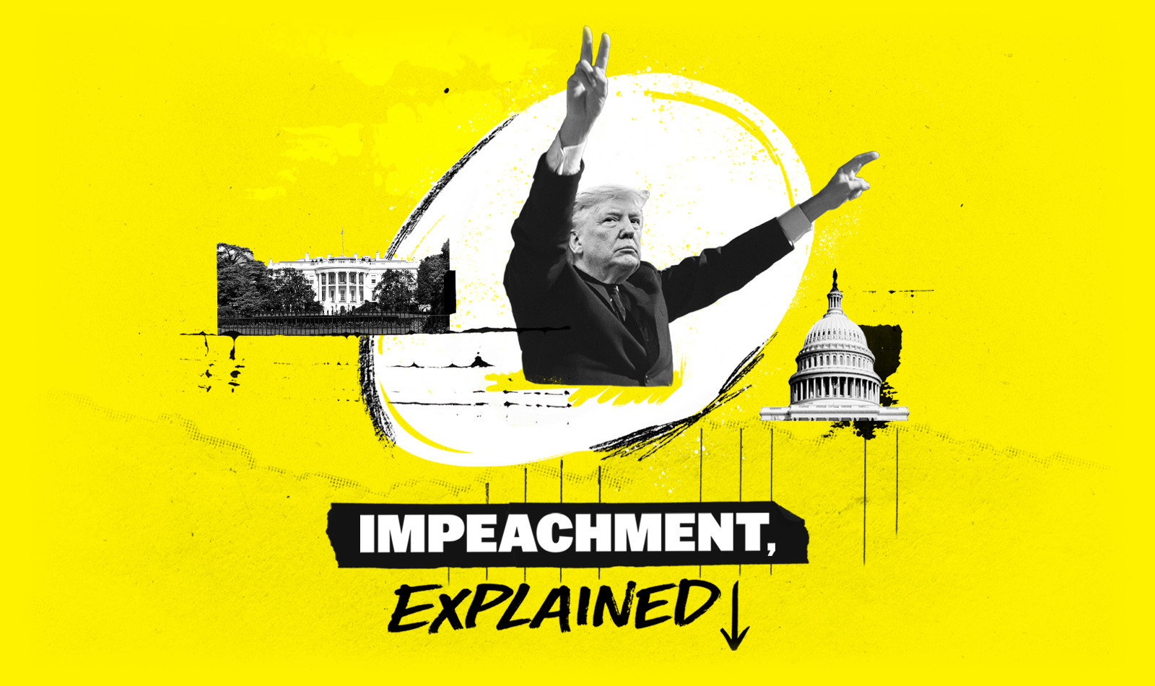

Slide 16
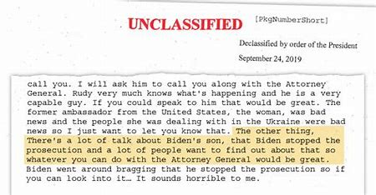
The Trump-Ukraine Scandal
The Trump-Ukraine scandal began in September 2019 with the revelation that an intelligence officer had filed a whistleblower complaint to the intelligence community inspector general alleging wrongdoing on the part of Trump.
The complaint offers a damaging portrait of a president willing to use his office for political gain by asking Zelensky to investigate his political rivals — specifically former Vice President Joe Biden, and his son, Hunter Biden.
President Donald Trump used the “power of his office” to solicit help in the 2020 elections from Ukrainian President Volodymyr Zelensky and the Trump White House chose to voluntarily release an official record of the phone call with Zelensky.
Zelensky asked Trump for an increase in military aid. Trump responded by saying, “I would like you to do us a favor though.”
The favor turned out to be about two investigations Trump would like Ukraine to conduct: one involving a bizarre and unfounded theory about Ukrainian possession of a Democratic email server, the other an effort to smear the Biden family’s dealings with a Ukrainian prosecutor as corrupt.

Slide 17
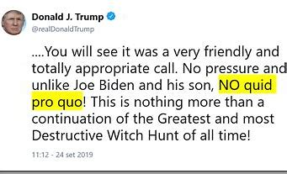
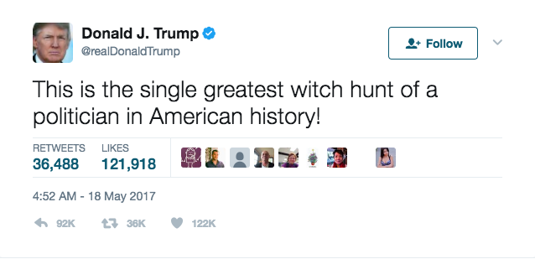
Trump’s Defense
There is no “Quid pro quo”. The call is perfect.
It is a Hoax, it is witch-hunt, It is a lie, it is a shame, it is a fraud.
It is a shame for American people.
It is a disgrace and a mock for our country.
He takes “ zero” responsibility for Impeachment.
On December 17, 2019, He sent a letter to the House speaker Nancy Pelosi denouncing articles of impeachment against him.
He says She violated her oath of office and that the impeachment is unconstitutional. It is an illegal partisan attempted coup.

Slide 18
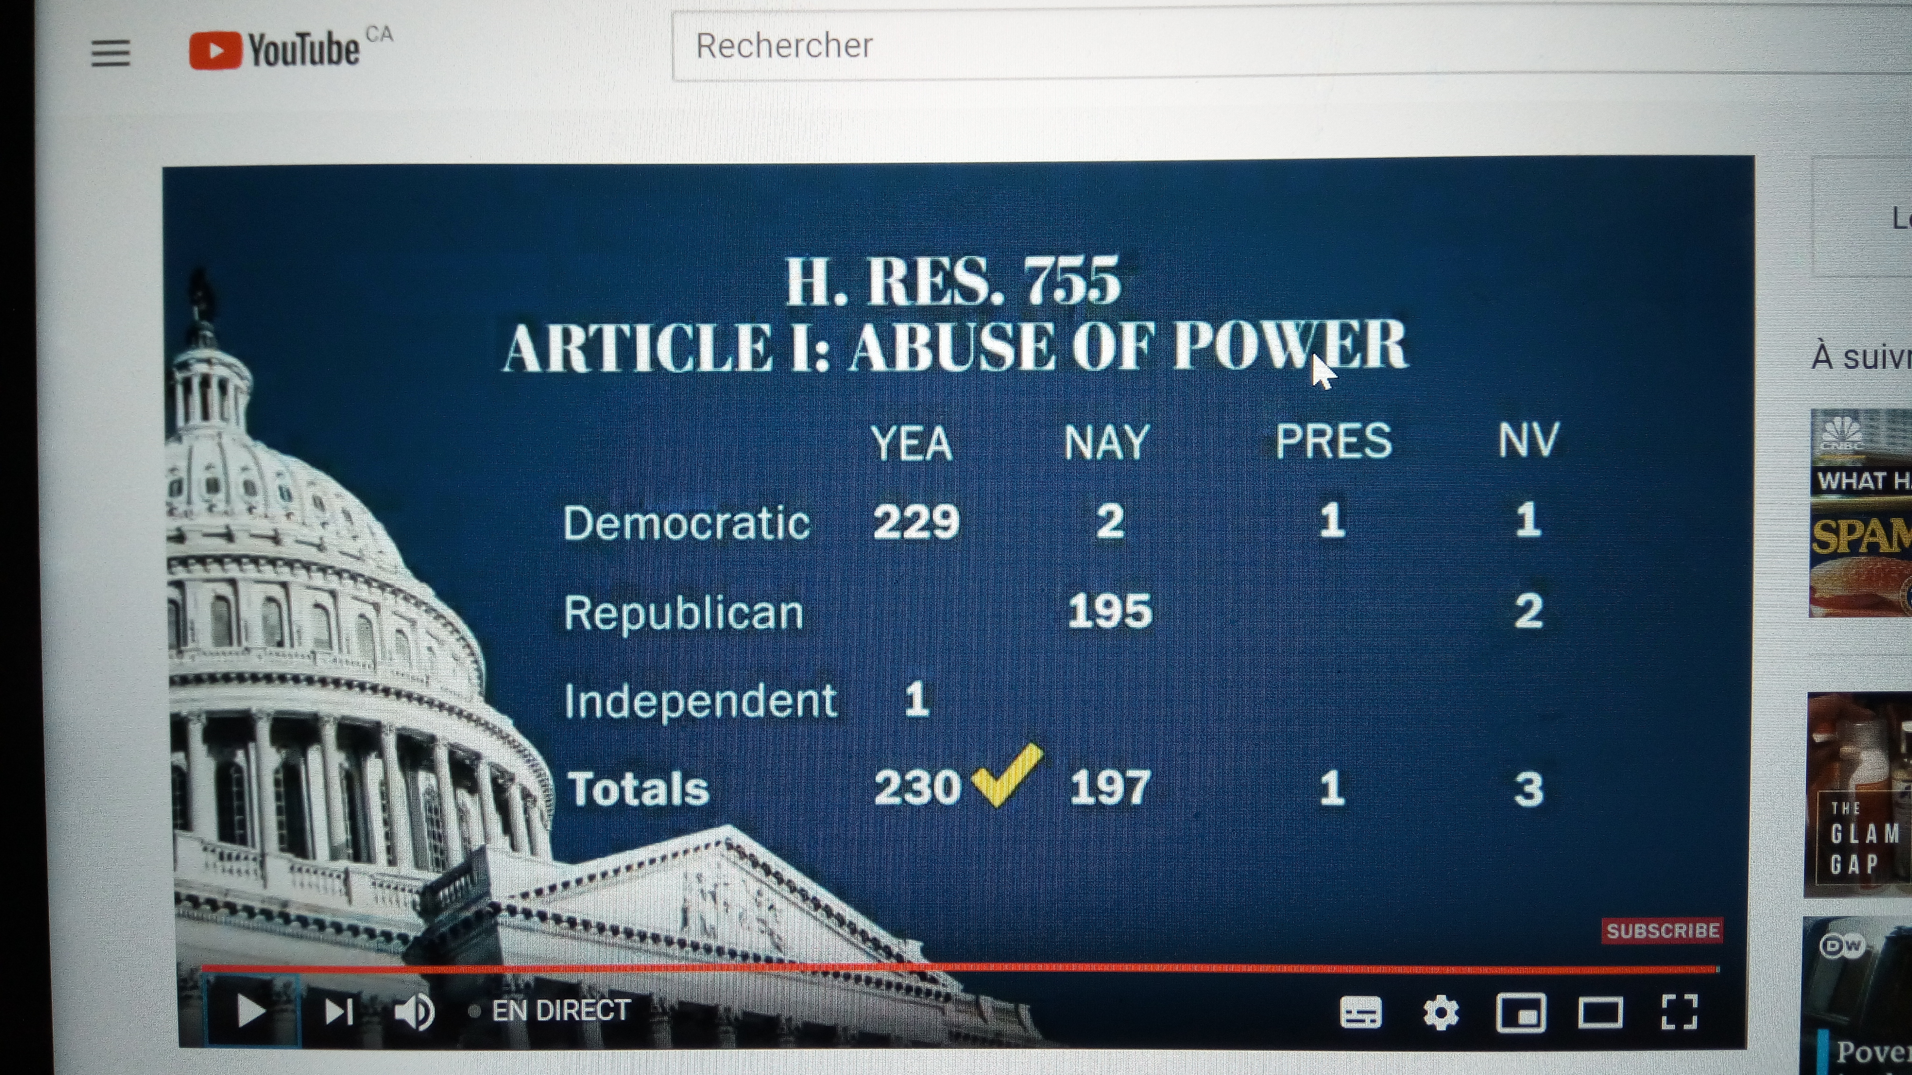
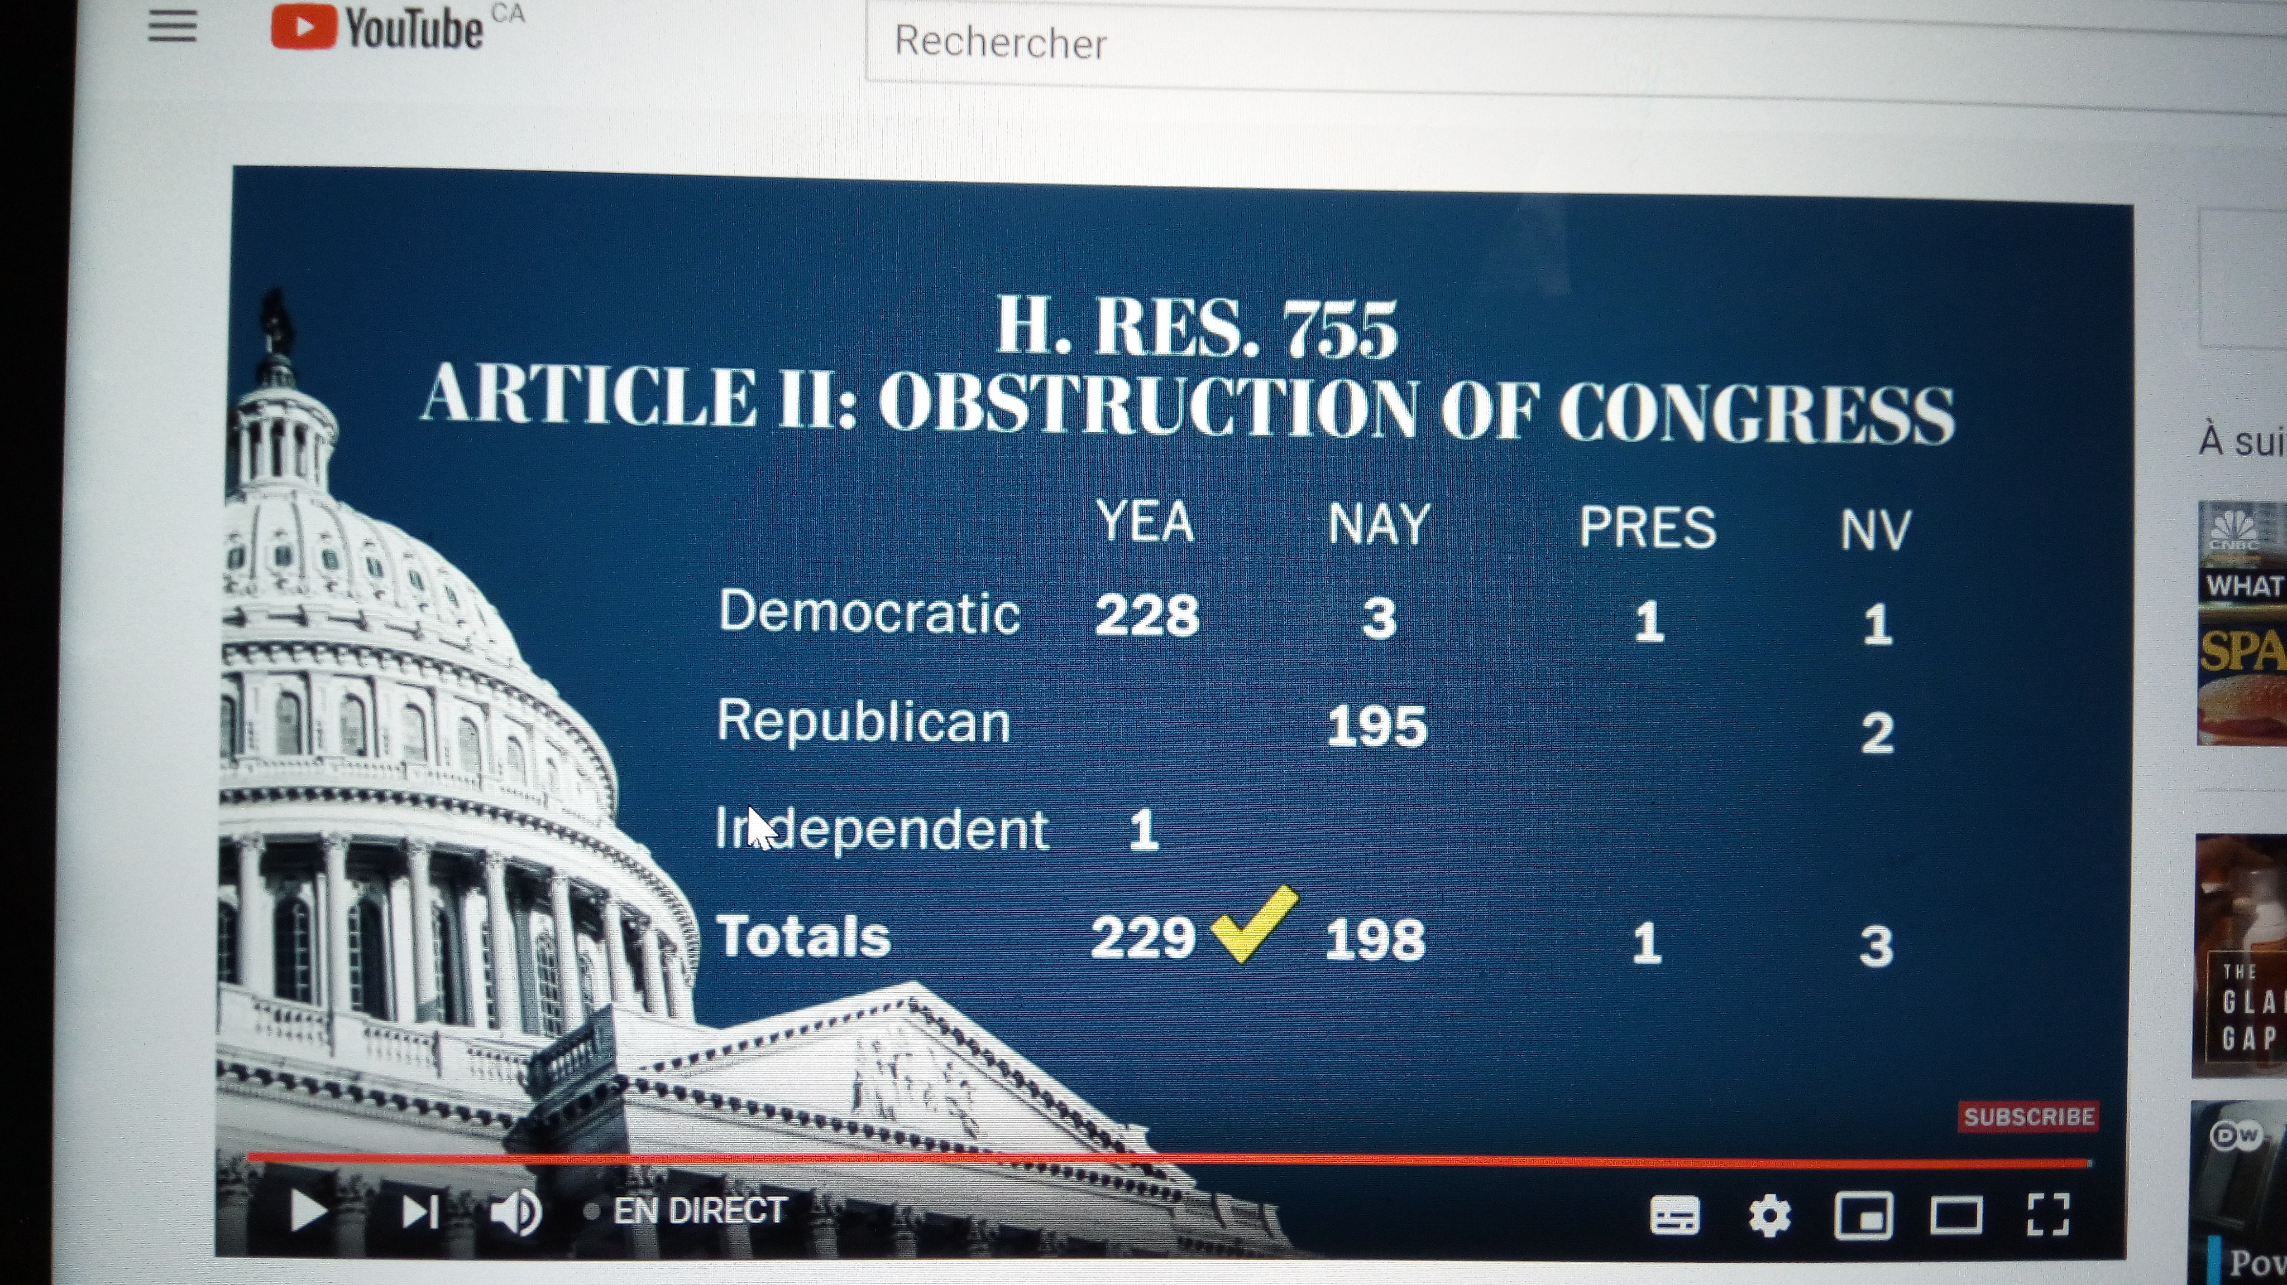
Impeachment Vote 18 December, 2019
President Trump is accused of using the power of the presidency for his own benefit.
Trump is accused of blocking Congress’s investigation into his alleged wrongdoing.

Slide 19
 | House Impeachment | Senate Trial | Senate Conviction
Andrew Johnson | . | . | X
Richard Nixon | X | X | X
Bill Clinton | . | . | X
Donald Trump | . | . Date TBA | TBA

