Slide 1
Kids’ Prophecy Corner
The Line of Jesus
(Or The Experience Of The Priests Until 30-Year-Old)

Slide 2
The Time of The End
The time of the End is when Jesus was born in 4BC.
John the Baptist is born also. He is the one who will do the work of the first angel.
This means, John will tell the people to repent for the kingdom of God is at hand. The deliverer is about to come. And this is Jesus.

Slide 3

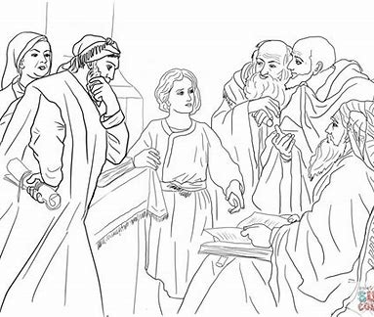
Jesus is 12-Year-Old
When Jesus is twelve Year-old, He goes to the temple with his parents for the feast of Passover.
When it was time to go home, he goes in the temple instead, and teaches the rabbis.
This proves that boys and girls can teach at a young age

Slide 4
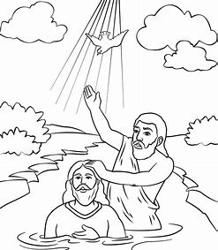
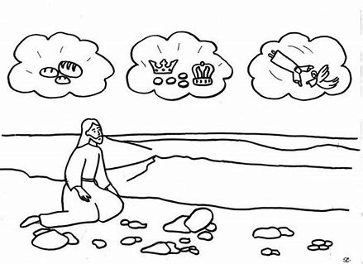
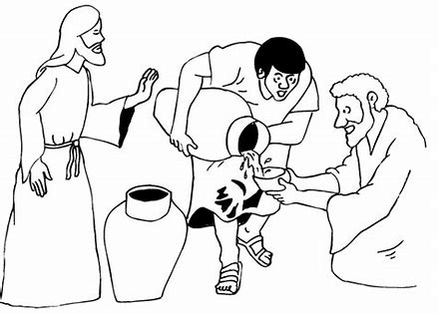
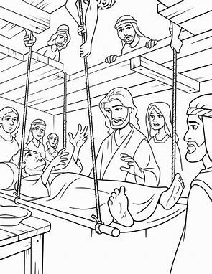
Jesus is 30-Year-Old
When Jesus is 30-year-Old he got baptized by John the Baptist
This is when He starts his public ministry.
After going into the wilderness, turning water into wine at the marriage of Cana, and cleansing the temple He starts teaching, makes miracles and heals people.

Slide 5
On a reform line, the line of Jesus looks like this:
Birth of Jesus
4BC
Jesus is 12
Jesus is 30
Time of the End

Slide 6
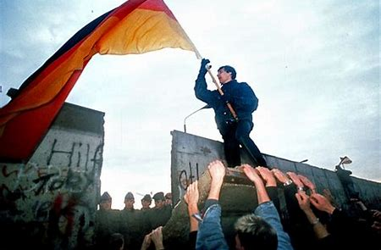
The Time of The End
Now, the time of the end in our time is 1989, for the priests.
This is when the Berlin wall falls on November 9, 1989.
This is also when Daniel 11:40-45 is unsealed. Which means that someone started to study it.
This is Elder Jeff Pippenger who does that study.

Slide 7
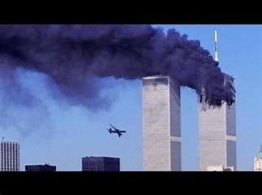
September 11, 2001 or 9/11
At 9/11, the twin towers fall down
This was done by an Islamic group who doesn’t like America. Islam is another religion.
The Bible talks about this religious group as the 3rd woe.
And it happened exactly 12 years after 1989.

Slide 8
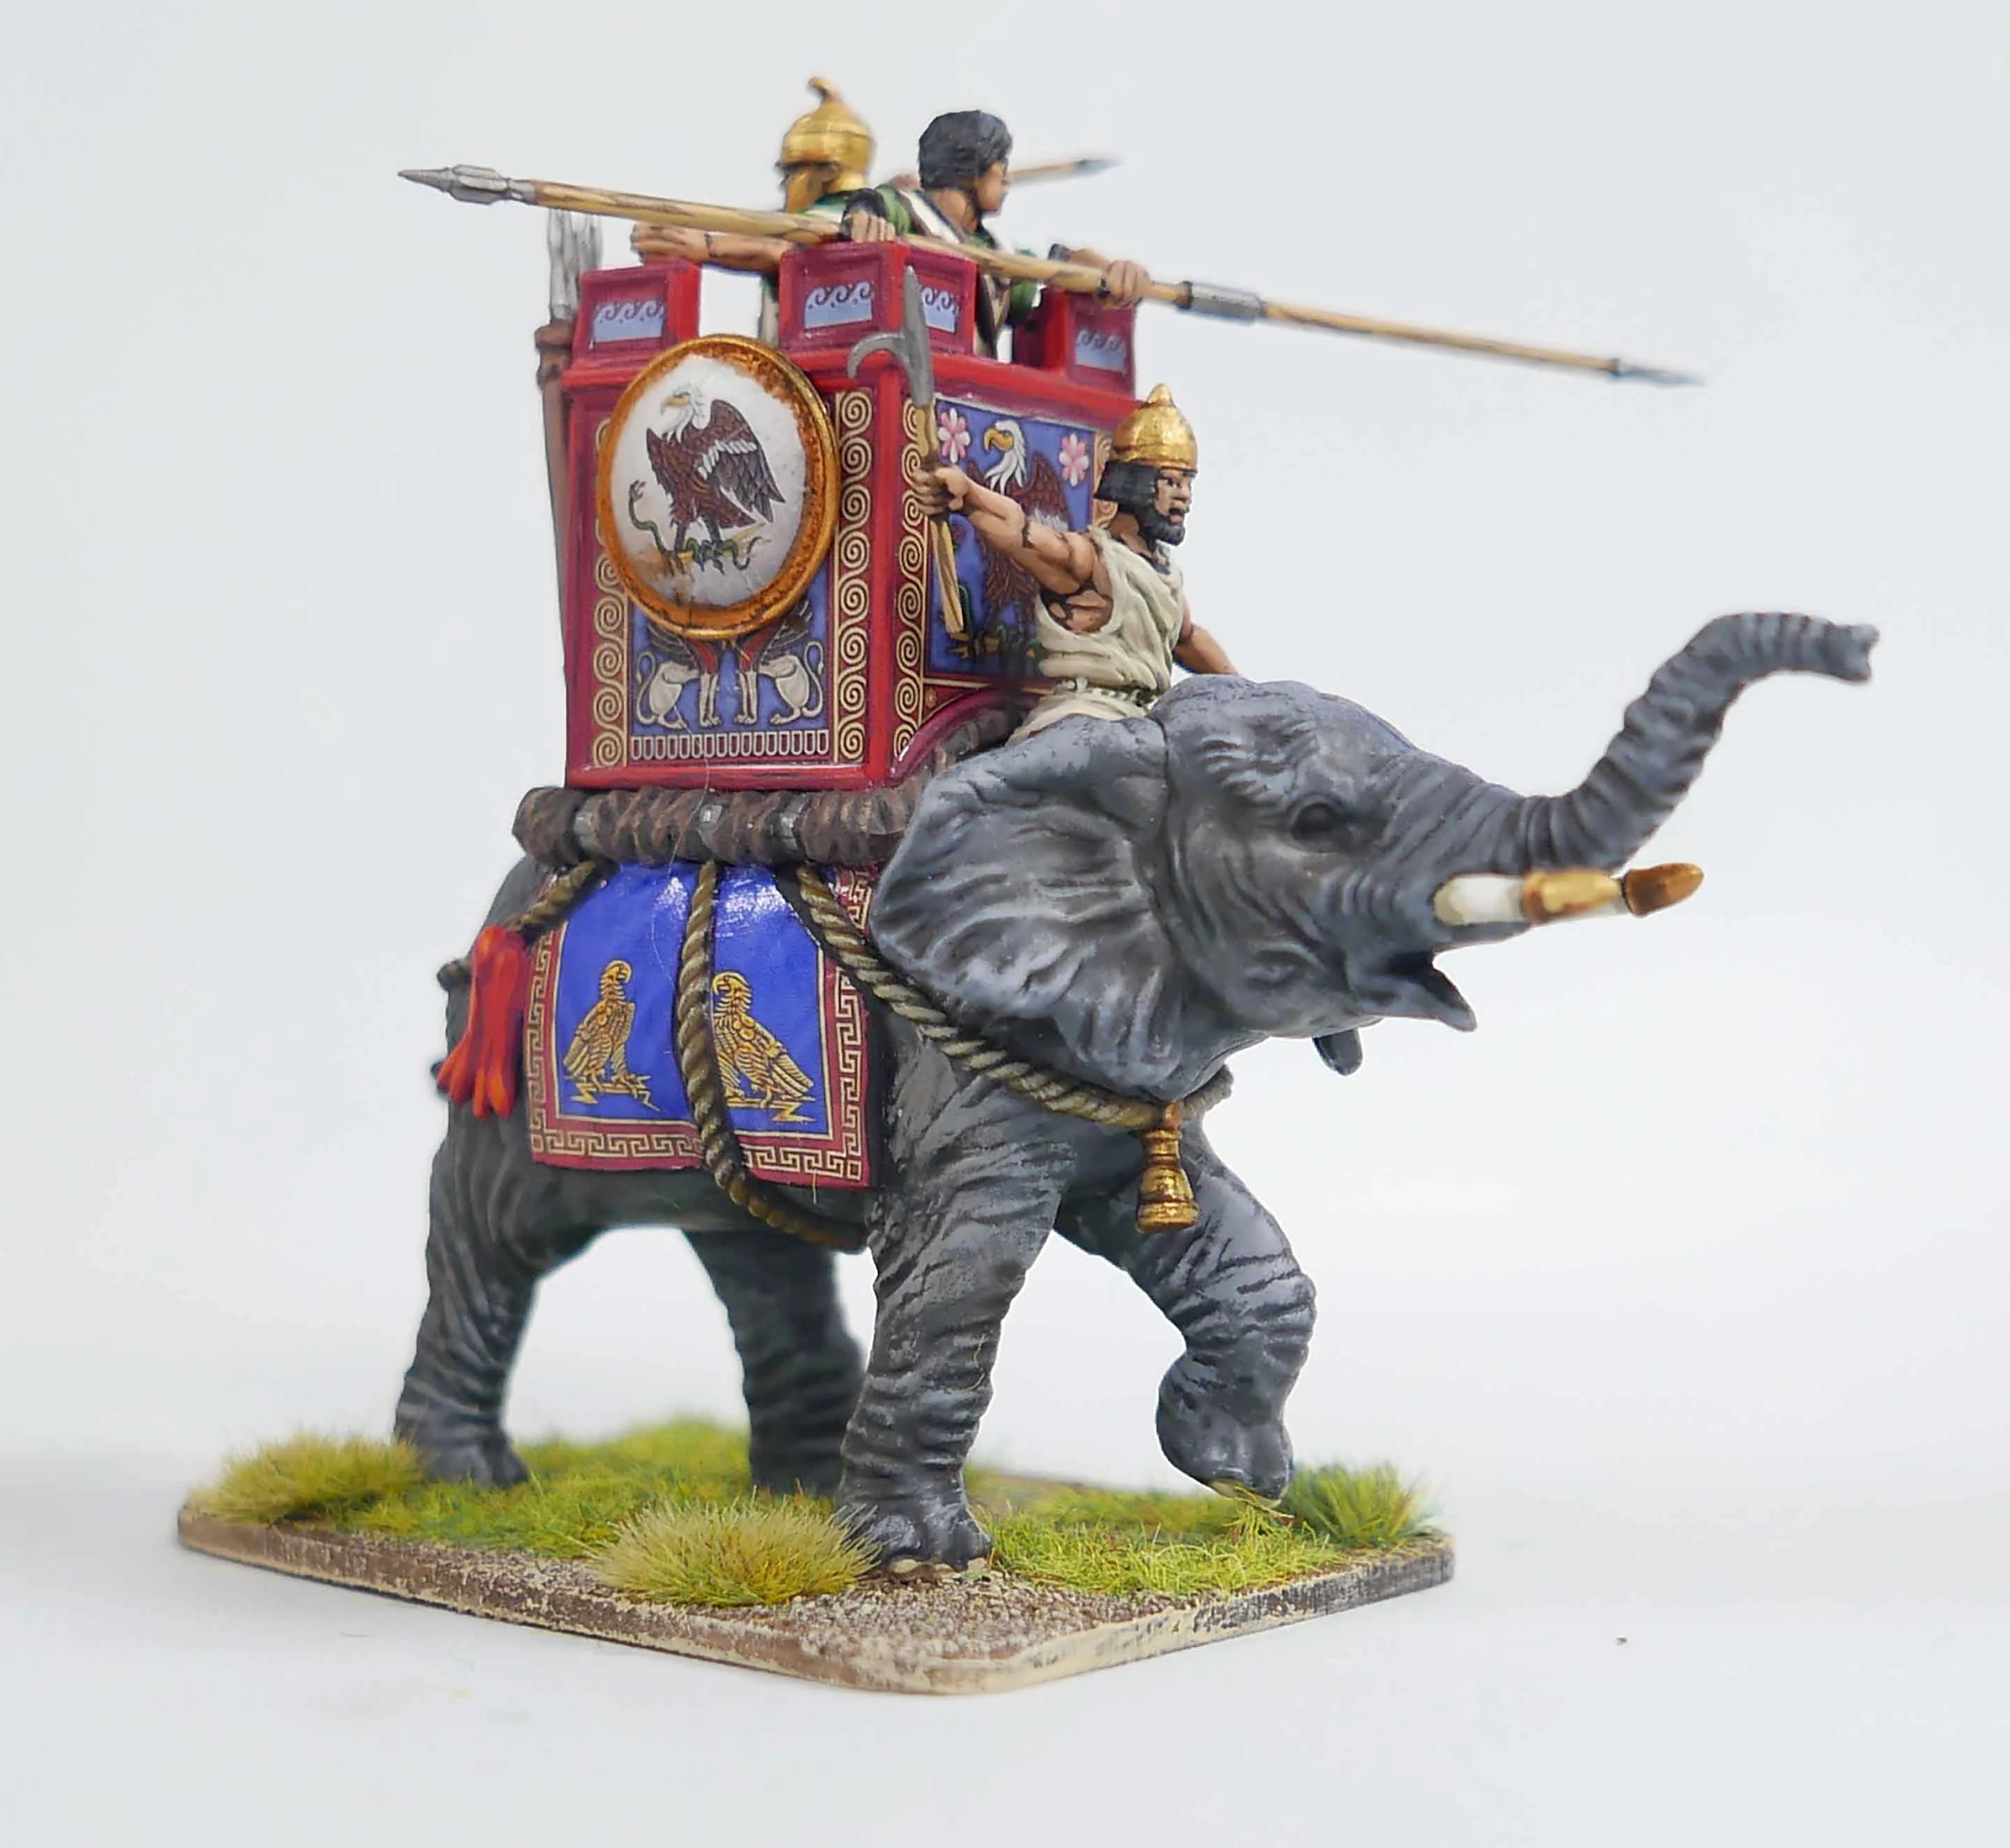
November 9, 2019
November 9, 2019 is 30 years from November 9, 1989
Christ is also 30 year-old. So after 40 days spent in the wilderness, the priests will go to work.
This means that when the priests know and understand very well the message they will go to work and harvest the Levites which are seventh-day Adventists.
This is also the Battle of Raphia which marks the close of probation for the priests.
This means that all who studied the message were tested and they passed or failed the test.
The battle of Raphia is a battle where the king of the south won against the king of the North. In our time, it happened when the president of Russia, Vladimir Putin, gained more territories or spheres of influence and the president of the USA, Donald Trump, lost some spheres of influence

Slide 9
On a reform line, the line of Priests looks like this:
Birth of Jesus
Jesus is 12
Jesus is 30
Jesus
Time of the End
30 years
Nov.9, 1989
9/11
Nov.9, 2019
Priests
12 years
Time of the End

Slide 10

Thank You for Coming!

Slide 11
Now, here are some questions for you :
What year was Jesus born?
Who else was born this year?
How old was Jesus when he went to the temple?
4 BC
1AD
Simon Peter
John the Baptist
12-year-Old
6-year-old

Slide 12
More questions :
How old was Jesus when he was baptized?
How old was Jesus when he started his ministry?
When does the time of the end start on the line of Jesus
30-year-old
29-year-old
29-year-old
30-year-old
At his Birth
At his Baptism

Slide 13
More questions :
What happened in 1989?
What is the name of that waymark : 1989?
What happened at 9/11?
The Berlin Wall falls
The Twin towers fall
Time of the End
Close of Probation
The Twin towers fall
The Berlin wall falls

Slide 14
More questions :
How may years are between 1989 and 2001?
To know it, Subtract :
2001
-1989
How may years are between 1989 and 2019?
To know it, Subtract :
2019
-1989
When was the close of Probation for the Priests?
21
12
13
30
Nov.9, 2019
Nov.9, 1989

Slide 15
Tell Me Which Event Happened In The Picture And When.
The Fall of the Berlin wall on November 9, 1989
The fall of the twin towers in September 11, 2001 (9/11)
The Battle of Raphia. The Battle lasted the whole year of 2019. The culminate point was on October 2019 when President Trump (USA) removed his military troups from Syria and thus giving more influence to President Putin (Russia) in that region.

Slide 16

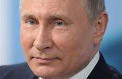
Can You Tell Me Who Is On The Picture?
President of the United States: Donald J. Trump
President of Russia : Vladimir Putin

Slide 17
Definitions
Public Ministry : A ministry is an activity carried out by Christians to express or spread their faith. Jesus started his ministry when He was 30 year-old. He preached the good news, made miracles and heals people.
Sphere of Influence : A sphere of influence is a metaphorical region of political influences surrounding a country. When a country falls into another's "sphere of influence" that country frequently becomes subsidary to the more powerful one, operating as a satellite country or de facto colony.

Slide 18
More Homeschool And Fun activities To Do
Geography
Find on a map where is :
Germany and especially Berlin
New York
Syria
Jerusalem
Reading
Read with your parents about :
the life of Jesus
The Berlin wall
The twin towers
The Battle of Raphia
Writing
Write in print and cursive all the name of the lessons :
Jesus, John the Baptist, Time of the end, Jerusalem, Raphia, etc…

Slide 19
More Homeschool and Fun activities To Do
Math
Calulate the time between 1989 and 2001; 2001 to 2019; 1989 to 2019
If you are tiny, count unto 30 using blocks, beads, spoons, etc…
Make a timeline out thread, sticks and post-it.
Align 1989 to 2019 beans in your all house and count by 10, 100 and 1000.
Science/ craft/ games
Make the twin towers or color a picture
Make a berlin wall
Pretend play the battle of Raphia
Print some coloring pages of the life of Jesus
Make a bag or a cussion with the line of Jesus on one side and the line of the priests on the other side.
Memory verse
Learn Daniel 11:40-45. sing it or recite it to your parents
Finally, play a lot outdoor whenever the weather permits

Slide 20
See you next time and God Bless !

