Slide 1
Kid’s Prophecy Corner
Deborah And Jael, A Story Of Equality

Slide 2
The Story Of Deborah And Jael In Judges 4
Today, we will look at one of our major themes in our movement which is equality. For that we will look at the story of Deborah and Jael.
God’s people are in trouble. After the death of a judge called Ehud, God’s people turned to worshipping false gods again. As a result, God let them be conquered by King Jabin of Hazor, a Canaanite king.
The commander of King Jabin’s army was Sisera, who lived in Harosheth-haggoyim.
Sisera, who had 900 iron chariots, ruthlessly oppressed the Israelites for twenty years. Then, they cried out to God for help.

Slide 3
So, God raises up a leader to help and assist his people.
God has decided in his wisdom and providence that he will raised up a woman. This woman is Deborah.
Deborah, the wife of Lappidoth, was a prophetess who was judging Israel at that time.
She would sit under a Palm, between Ramah and Bethel and the Israelites would go to her for advice and to settle their disputes by God’s laws.

Slide 4
One day, Deborah sent for Barak, son of Abinoam, who lived in Kedesh in the region of Naphtali. Barak travelled south to meet her.
Deborah told him, ‘This is what the Lord, the God of Israel, commands you to do. Gather 10,000 warriors from the tribes of Naphtali and Zebulun at Mount Tabor. I will call out Sisera, commander of Jabin’s army, along with his chariots and warriors, to the Kishon River. There I will give you victory over him.

Slide 5
Barak replied, ‘I will go, but only if you go with me.’ ‘Very well,’ Deborah replied, ‘I will go with you. But you will receive no honour in this venture, for the Lord’s victory over Sisera will be at the hands of a woman.
So Deborah went with him. Barak called together the tribes of Zebulun and Naphtali, who lived east of Lake Galilee, and 10,000 warriors went with him and Deborah to Mount Tabor.
At that time, women are not allowed to fight a battle. So, the honor to kill the captain Sisera will go to another woman not a man. The woman is Jael.

Slide 6
What Does God Want To Show Us?
God wants to show that it is not acceptable enough for Barak to be blessed and let Deborah in the background. To ask a woman to go to battle is not acceptable at that time, so he will not receive honor nor glory.
This proves that women can be used from the beginning of a battle to the end. Girls are in the eyes of God as worthy as boys. And God will use girls and boys to fight the final battle.

Slide 7
When Sisera heard Barak had gone up to Mount Tabor, he called for all 900 of his iron chariots and all his warriors, and they marched from Harosheth-haggoyim to the Kishon River. Deborah said to Barak, ‘Get ready! This is the day the Lord will give you victory over Sisera. The Lord is marching ahead of you.’
It had rained and the Kishon river was in flood. Barak led his 10,000 warriors down the slopes of Mount Tabor into battle. Sisera chariots got bogged down in the wet clay and his warriors abandoned them to flee on foot.

Slide 8
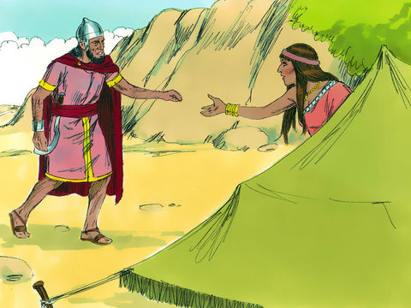
Barak chased them all the way to Harosheth-haggoyim, killing all of Sisera’s warriors. However Sisera fled towards Zaanannim where Heber the Kenite had pitched his tent. He was on friendly terms with King Jabin of Hazor. Heber’s wife was called Jael.
Jael went out to meet Sisera and said, ‘Hide in my tent, sir. Don’t be afraid.’ So he went into her tent. She gave him milk to quench his thirst and then hid him under a blanket. ‘Stand at the door of the tent,’ he told her. ‘If anybody comes say there is no-one here.’

Slide 9
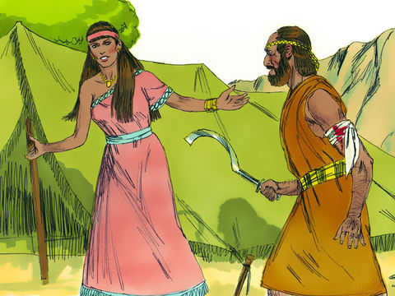
But when Sisera fell asleep from exhaustion, Jael quietly crept up to him with a hammer and tent peg in her hand. She drove the tent peg through the side of his head (temple) and killed him.
When Barak came looking for Sisera, Jael went out to meet him. ‘Come, and I will show you the man you are looking for,’ she said. Barak followed her into the tent and found Sisera lying there dead.

Slide 10
Who Are The Two Important Persons In That Story?
Deborah who is judge and prophetess – We could say she is a leader. She gives directions on how the war should be led.
Jael, a normal person who finishes the work by killing Sisera.

Slide 11
How Does Barak Looks like?
Barak looks scared.
He doesn’t trust in God to go into battle on his own.
He needs the help of a woman leader.
And the work is finished by another woman, a normal woman not a leader.

Slide 12
What Does A Hammer and A Nail Represent In Bible Prophecy?
The hammer and the nail are normal instruments of work, but they will be used for a difference purpose.
Joel 3:9 Proclaim ye this among the Gentiles; Prepare war, wake up the mighty men, let all the men of war draw near; let them come up:
3:10 Beat your plowshares into swords, and your pruninghooks (sickles) into spears: let the weak say, I [am] strong.
Usually, it is only the mighty men that have to go to war that transform an instrument of work into an instrument of war.
The purpose of the nail is to hold down the tent and the purpose of the hammer is to assist the nail to hold down the tent.
Jael takes these instruments and turn them into instruments of war or weapons. Although the only people that are supposed to have weapons are mighty men.
So Jael becomes a fighter, a mighty man. She is just not only a keeper of her house and a servant.

Slide 13
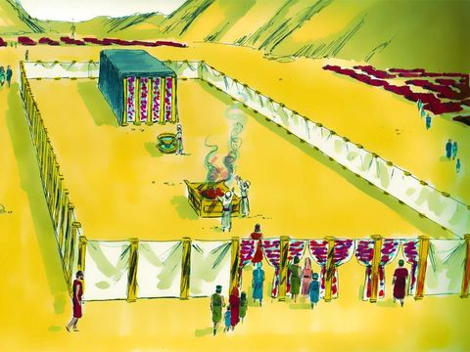
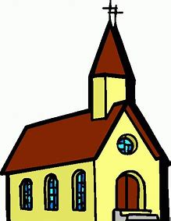
What Does The Tent Symbolize In Bible Prophecy?
A tent is a symbol of a shelter.
In our time the spiritual shelter is the church.
In the time of Moses, they had the tabernacle which is nothing less than a big tent.

Slide 14
Why The Tent Need A Nail And A Hammer?
To make sure the tent remains stable and not be destroyed by the wind, you need a nail and hammer
What keeps the church stable, when the storm comes are rules and principles or doctrines found in the Bible.
Ellen White says not a peg nor a pin can be removed.
So the pins are there to protect the church from doctrinal attacks.
So, the Nail represents the Bible or the 3rd Angel Message.

Slide 15
So, the tools that were used by men to protect the church are going to be used by a woman to do a work of destruction.
At the end of the world, when God has to free his people for them to go to war, the men who were protecting God’s church are no longer capable of doing that work on their own.
they need a female leader and a normal woman to finish it.
Before the 3rd Angel message was protecting the church. Now it is transformed into an instrument of war.

Slide 16
This Is How Equality Looks Like Before God
Men take care of the arrival of the 3rd Angel message.
Women take care of its empowerment
And its completion.

Slide 17
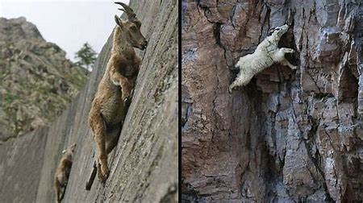
Do You know What The Name Jael Mean?
Jael means mountain goat.
A mountain goat ascends and climb mountains.
This means that women and girls must ascend to do the work in the movement. They have to teach the message.
And Barak must descend. He must be humble and not be offended to see a women takes his place as a leader and a warrior.
The work of women and girls is to become vaillant warriors and turn the 3rd Angel Message into an instrument of warfare.
This means that when people will hear the 3rd Angel Message, first in the church and then in the world, it will agitate them in a manner that will wake them up. They would have to decide whether or not they will accept it. But it is a life or death decision.
The Bible describes it this way : For the word of God [is] quick, and powerful, and sharper than any twoedged sword, piercing even to the dividing asunder of soul and spirit, and of the joints and marrow, and [is] a discerner of the thoughts and intents of the heart. Hebrew 4:12

Slide 18
What Does God Require From The Priests in the Movement?
The priests in the movement are made of men and women, boys and Girls
What qualifies you to be a priest is the fact that you can take the Bible, the 3rd Angel message and turn it into an instrument of war.
So, women are required to ascend, to become mighty warriors, to become teachers, otherwise they lose eternal life.
Men must be willing to give up their position, humble themselves and train their sisters otherwise, they would be swept away.

Slide 19
So, boys and girls are important before God and are equally require to become warriors for God and team up. Are you willing to take the challenge?

Slide 20
Who Are the two Leaders of Our Movement?
Elder Parminder Biant
A man
Elder Tess Lambert
A woman

Slide 21
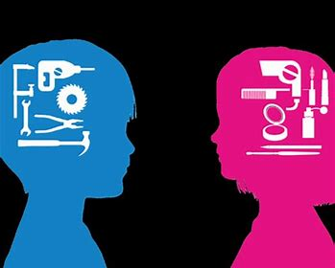
Look At The Pictures. Can You Tell If There Is Equality Or Inequality? Explain Why
Inequality!
In this picture, girls are conditioned to do a certain work and boys another work. But a girl can be skilled to do boys’ work and Boys, girls’ work.
Inequality!
The girl has done the same work as the boy, but she receives less candies
Equality!
The girl and the boy receive the same amount of candies for the same work.

Slide 22
Do You Have the Right Mindset? Discuss
It is Sabbath Preparation and Daddy asks you to clean your room and the room of your brother. On the other hand, your brother just has to wipe the kitchen table.
There is a potluck at church. After lunch only women and girls do the clean-up.
equal
Inequal
Inequal
equal

Slide 23
Do You Have the Right Mindset? Discuss
A brother and a sister got a 100% on their Math's test. The boy receives a smartwatch and the girl a kitchen playset
There is a potluck at church. The women warm up the food and the men set up the tables
equal
Inequal
Inequal
equal

Slide 24
Do You Have the Right Mindset? Discuss
We are at the end of the summer; it is the time of harvest. Your mom, picks up corns and potatoes and tomatoes in the garden. She cooks them and your dad eats the delicious meal.
Your mom is a stay-at-home mom and a homeschool mom. Your dad works for a company and receives a salary.
equal
Inequal
Inequal
equal

Slide 25
Do You Have the Right Mindset? Discuss
Your mom works a full time Job and your Dad too. They both leave the house at 7:30 am and come back home at 5:00pm. Your mom cooks dinner while your dad watches a Bible study on Equality.
Your cousin is getting married. Her family brings a lot of gifts, money and property to give her future husband.
equal
Inequal
Inequal
equal

Slide 26
Do You Have the Right Mindset? Discuss
equal
Inequal
Inequal
equal
The priests in the movement are men and women, but often moms have less time to study.
Both boys and girls are equal before GOD. How do you treat your siblings?

Slide 27
Here Are A List Of Activities You Can Do
Reconstruct the battlefield of Judges 4 with the many details.
Play the battle and explain the role of Deborah, Barak and Jael.
Compare and contrast the character of Deborah and the one of Barak as leaders.
In a large construction paper, draw 2 mighty warriors. A man and A woman and explain what it means to be priests and equal in the movement.
Write or draw what you understand about equality.
Write rules for your household that would favor equality.
Teach the story of Deborah and Jael in your fellowship and to your friends.
Practice equality every day! Work as a team; learn as a team; teach as a team; treat everybody equally.

Slide 28
Here are some nice Documentaries to watch and discuss
Watch documentaries on equality.
https://www.youtube.com/watch?v=hLr2GNRnmXM
https://www.youtube.com/watch?v=1TgCPu6QoKw
https://www.youtube.com/watch?v=hP8dLUxBfsU
https://www.youtube.com/watch?v=Mqrhn8khGLM&t=858s
Watch a videos on the mountain goat also called Ibex.
https://www.youtube.com/watch?v=RG9TMn1FJzc&pbjreload=10
https://www.youtube.com/watch?v=b_i0oKHq5Yc
https://www.youtube.com/watch?v=w3rFBxnJJoc
https://www.youtube.com/watch?v=Hu8TJKMtmtI

Slide 29
Thank you and God Bless!

