Slide 1
Kids’ Prophecy Corner
Church And State
- Part 2-

Slide 2
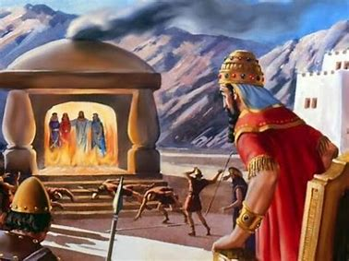
Daniel 3
In these and like words the king of Babylon endeavored to spread abroad before all the peoples of earth his conviction that the power and authority of the God of the Hebrews was worthy of supreme adoration. And God was pleased with the effort of the king to show Him reverence, and to make the royal confession of allegiance as widespread as was the Babylonian realm. {PK 510.3}
It was right for the king to make public confession, and to seek to exalt the God of heaven above all other gods; but in endeavoring to force his subjects to make a similar confession of faith and to show similar reverence, Nebuchadnezzar was exceeding his right as a temporal sovereign. He had no more rights, either civil or moral, to threaten men with death for not worshiping God, than he had to make the decree consigning to the flames all who refused to worship the golden image. God never compels the obedience of man. He leaves all free to choose whom they will serve. {PK 510.4}

Slide 3
151
Midway
July 21
1863
Ap. 19
2014
Oct 22
1861
1865
9/11
2019
R. losing
Religious Motto Suggested
National Reform Movement
Law placed on Currency
13th
“ In God We Trust”
Judgement
Judgement
USA + Churches
Slavery
Church + State
Immorality
Christian Nation
Ellen White

Slide 4
1989
Moral Majority Dissolved
Jerry Falwell
Transition Reagan/Bush Sr.

Slide 5
The Moral Majority
The Moral Majority was a prominent American political organization associated with the Christian right and Republican Party. It was founded in 1979 by Baptist minister Jerry Falwell Sr. and associates and dissolved in 1989.
This organization promotes their personal beliefs defined as Christian conception of moral law. They believed this represented the opinions of the majority of Americans (hence the movement's name).
Some of their campaigns were:
Promotion of a traditional family values (which are traditional values where the father is the breadwinner, the mother is the homemaker and the child grows in that environment)
Opposition to media outlets accused of promoting an anti-family agenda
Opposition to the Equal Rights Amendment (where man and woman can have equal rights) and Strategic Arms Limitation Talks (where arm bearing can be controlled)
Opposition to state recognition or acceptance of homosexual acts
Prohibition of abortion (ending pregnancy before the embryo or fetus can survive outside the uterus), including in cases involving incest or rape
Support for Christian prayers in schools
Proselytizing to Jews and other non-Christians for conversion to Christianity (force Jews and non-Christians to accept Christianity)

Slide 6
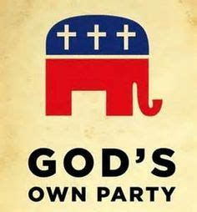
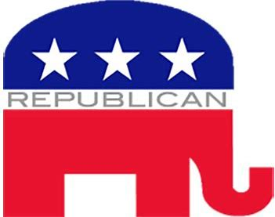

Slide 7
1979
1989
Moral Majority Formed
Moral Majority Dissolved
Jerry Falwell
Transition Reagan/Bush Sr.

Slide 8
1979
1989
Moral Majority Formed
Moral Majority Dissolved
Jerry Falwell
Transition Reagan/Bush Sr.
Christian Coalition Formed
Pat Robertson

Slide 9
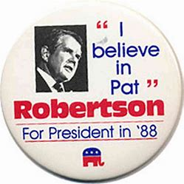
The Christian Coalition
In 1988, Pat Robertson run for the presidency of the USA. He is televangelist but the Moral Majority did not want to support him. He failed against Bush Senior.
Pat Robertson used the rest of his campaign resources to form his organization the Christian Coalition. Americans for Robertson accumulated a mailing list of several million conservative Christians interested in politics. This mailing provided the basis of the new organization.

Slide 10
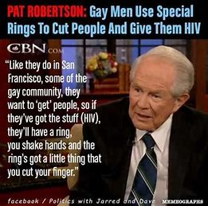
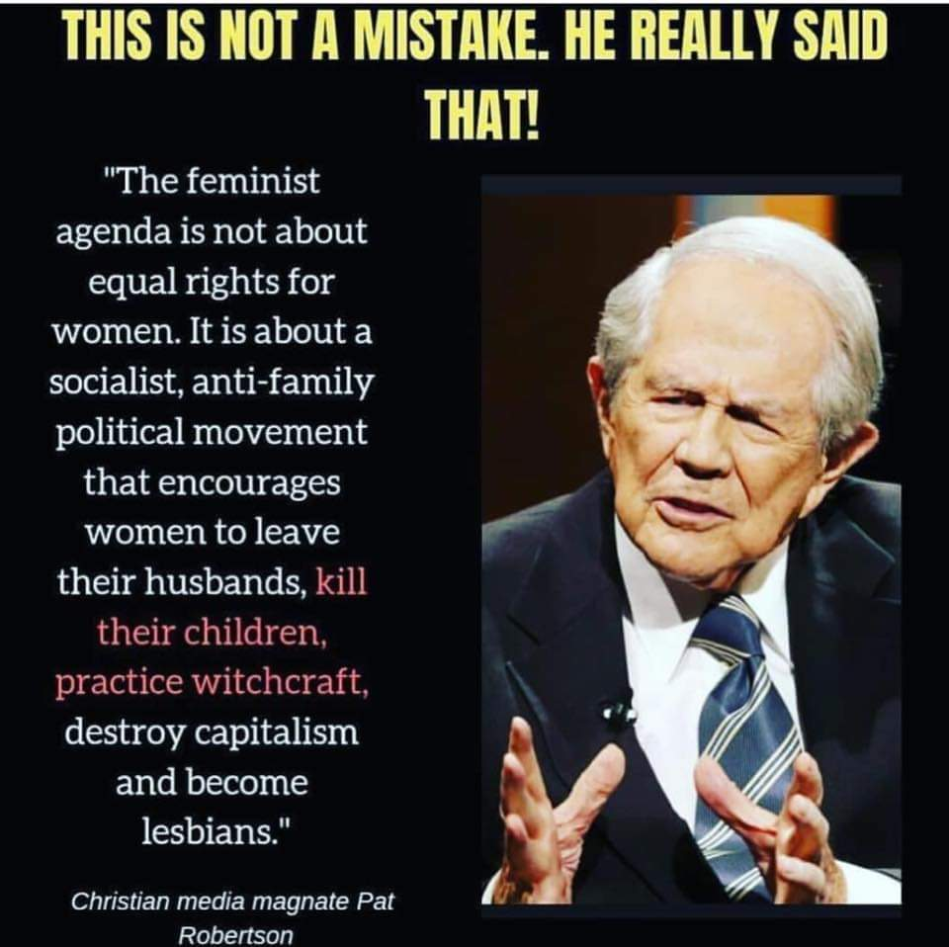
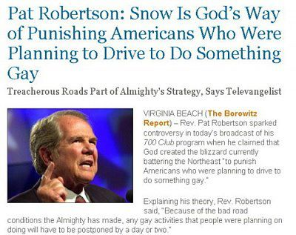

Slide 11
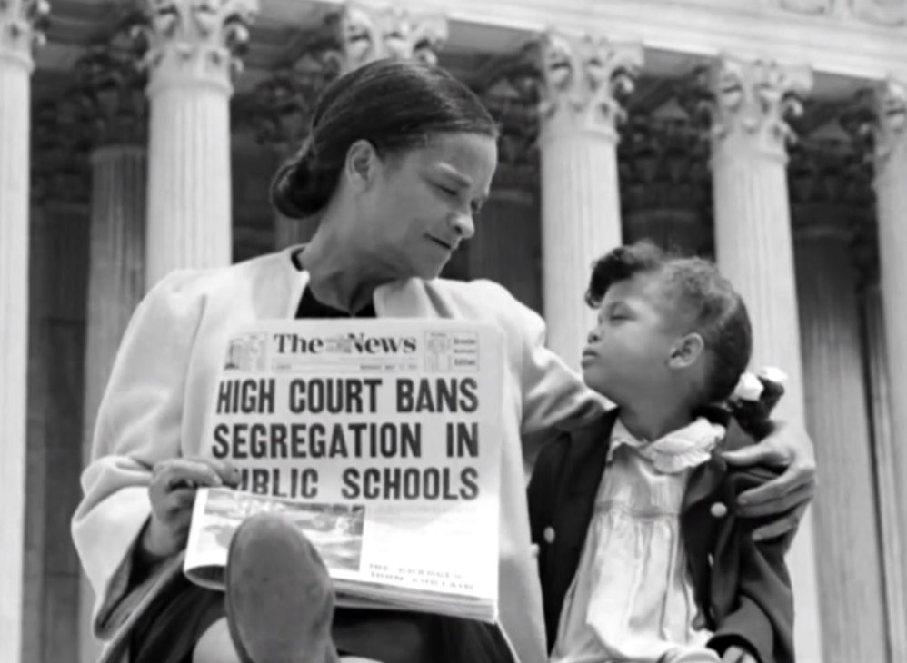
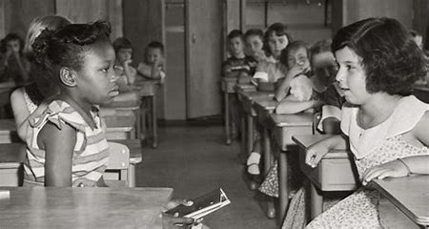

Slide 12
1979
1989
9/11
Moral Majority Formed
Moral Majority Dissolved
Jerry Falwell
Immorality
Deep State
C+S
Islam
Transition Reagan/Bush Sr.
Christian Coalition Formed
Pat Robertson

Slide 13
1979
1989
9/11
Moral Majority Formed
Moral Majority Dissolved
Jerry Falwell
Immorality
Deep State
C+S
Islam
Transition Reagan/Bush Sr.
Christian Coalition Formed
Pat Robertson
American United for the Separation of Church and State

Slide 14
1979
1989
9/11
Moral Majority Formed
Moral Majority Dissolved
Jerry Falwell
Immorality
Deep State
C+S
Islam
Transition Reagan/Bush Sr.
American United for the Separation of Church and State
Christian Coalition Formed
Pat Robertson
In God We Trust

Slide 15
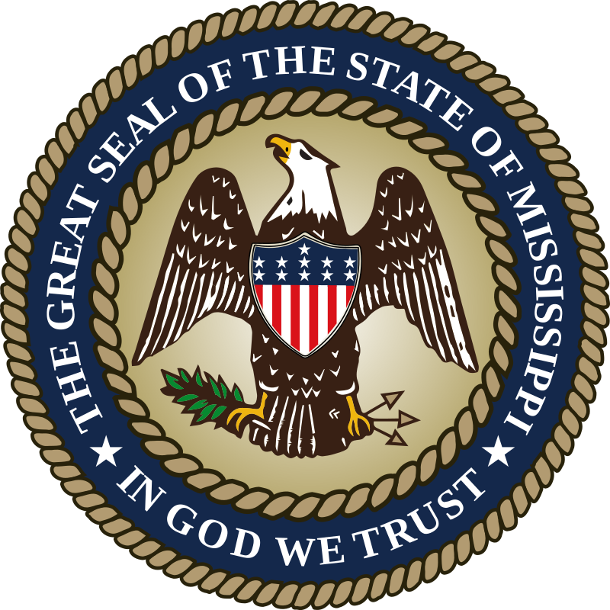
In God We Trust
In March 2001, the Governor of Mississippi Ronnie Musgrove signed a legislation where he demands that the motto "In God We Trust" to be displayed in every public-school classroom, as well as the school auditoriums and cafeterias, throughout the state.
After the September 11 attacks in 2001, many public schools across the United States posted "In God We Trust" framed posters in their "libraries, cafeterias and classrooms". The American Family Association supplied several 11-by-14-inch posters to school systems and vowed to defend any legal challenges to the displaying of the posters.
In 2006, on the 50th anniversary of its adoption, the Senate reaffirmed "In God We Trust" as the official national motto of the United States of America.
Florida adopted 'In God We Trust' as the official state motto, effective July 1, 2006.
In 2011 the House of Representatives passed an additional resolution reaffirming "In God We Trust" as the official motto of the United States.
In 2013, a federal court rejected a challenge, brought by Michael Newdow and the Freedom From Religion Foundation, to remove "In God We Trust" from American currency.
On January 31, 2014, in the name of religious freedom, the Mississippi senate voted to add the words, "In God We Trust" to the state seal and the change was made effective on July 1, 2014.

Slide 16
In God We Trust
In 2015 the county police department of Jefferson County, Illinois announced that the words "In God We Trust" will be on police squad cars.
In 2015, the Freedom from Religion Foundation demanded that local authorities remove the motto from Texas Police Department patrol vehicles. In response, Police Chief Adrian Garcia told the organization, in a written letter, to "go fly a kite.
In March 2017, Act 911, made it a mandatory by law in Arkansas for schools to display posters with the national motto ("In God We Trust").
Also, in March, the same requirement was enacted in Kentucky schools for the 2019-2020 school year requiring the slogan to be displayed "in a prominent location."
In June 2019, the Bakersfield, California City Council voted 4-2 to put an "In God We Trust" sticker on the city's police and fire vehicles.

Slide 17
1979
1989
9/11
2014
2017
2019
Moral Majority Formed
In God We Trust
Act 9/11
In God We Trust
Moral Majority Dissolved
Jerry Falwell
Immorality
Deep State
C+S
Islam
Transition Reagan/Bush Sr.
American United for the Separation of Church and State
Christian Coalition Formed
Pat Robertson
In God We Trust

Slide 18
1979
1989
9/11
2008
2012
Obama
Trump
Moral Majority Formed
Moral Majority Dissolved
Jerry Falwell
Immorality
Deep State
C+S
Islam
Transition Reagan/Bush Sr.
American United for the Separation of Church and State
Christian Coalition Formed
Pat Robertson
In God We Trust

Slide 19
1979
1989
9/11
2008
2012
Obama
Trump
Moral Majority Formed
Moral Majority Dissolved
Jerry Falwell
Immorality
Deep State
C+S
Islam
Transition Reagan/Bush Sr.
American United for the Separation of Church and State
Christian Coalition Formed
Pat Robertson
In God We Trust
Trump : Racist
Gender

Slide 20
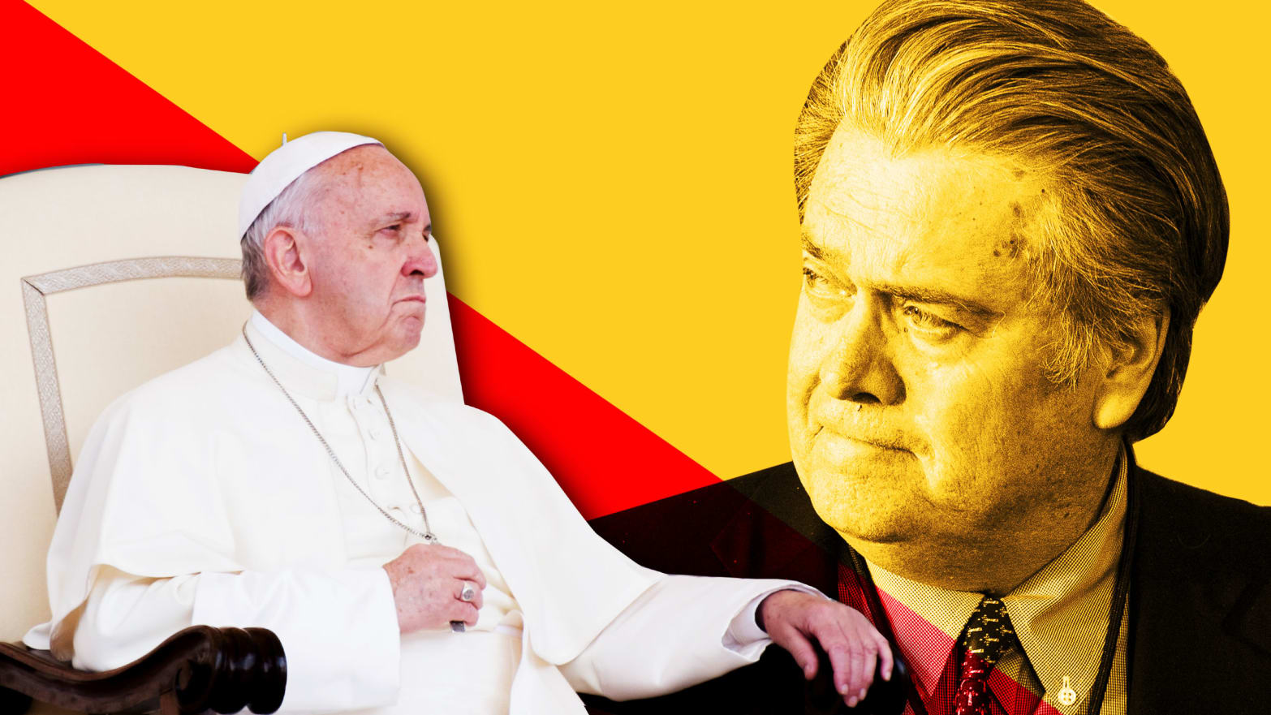
Godlessness and libertarianism have “sapped the strength of the Judeo-Christian West to defend its ideals,
We must fight for “our beliefs among other things”
https://www.vox.com/policy-and-politics/2017/1/31/14439908/steve-bannon-worldview-visa-ban

Slide 21
1979
1989
9/11
2008
2012
2014
Obama
Trump
150th Anniversary of the Gettysburg Address
Moral Majority Formed
Moral Majority Dissolved
Jerry Falwell
Immorality
Deep State
C+S
Islam
Transition Reagan/Bush Sr.
Obama :
X Under God
Out of Many One
American United for the Separation of Church and State
Christian Coalition Formed
Pat Robertson
In God We Trust
Mississippi
In God We Trust
Trump : Racist
Gender

Slide 22
1979
1989
9/11
2008
2012
2014
2015
2016
Obama
Trump
150th Anniversary of the Gettysburg Address
Gay Marriage
Presidential election
81% white Evangelicals
Moral Majority Formed
Moral Majority Dissolved
Jerry Falwell
Immorality
Deep State
C+S
Islam
Jerry Falwell
Obama :
X Under God
Out of Many One
Paula White
Pat Robertson
Jerry Falwell Jr
Transition Reagan/Bush Sr.
American United for the Separation of Church and State
Christian Coalition Formed
Pat Robertson
In God We Trust
Mississippi
In God We Trust
Trump : Racist
Gender

Slide 23
1979
1989
9/11
2008
2012
2014
2015
2016
2017
2018
Obama
Trump
150th Anniversary of the Gettysburg Address
Gay Marriage
Presidential election
81% white Evangelicals
Act 9/11
Project Blitz
Moral Majority Formed
Moral Majority Dissolved
Jerry Falwell
Immorality
Deep State
C+S
Islam
Jerry Falwell
Obama :
X Under God
Out of Many One
Paula White
Pat Robertson
Jerry Falwell Jr
Transition Reagan/Bush Sr.
American United for the Separation of Church and State
Christian Coalition Formed
Pat Robertson
In God We Trust
Mississippi
In God We Trust
Trump : Racist
Gender

Slide 24
Project Blitz
Project Blitz is an organization that wants to combine church and state.
It is a coalition of Christian groups who wants to take control of the government throw conservative voice and they want to play a role in refining religion Liberty.
It seeks to "protect the free exercise of traditional Judeo-Christian religious values and beliefs in the public square, and to reclaim and properly define the narrative which supports such beliefs."
In 2018, they are in forefront in propagating the work of Donald Trump. In their playbook they take 4 steps to redefine the religious liberty in the United States.
Its agenda includes the promotion of the Bible in public schools and religious exemptions to LGBTQ civil rights protections and women's reproductive healthcare.

Slide 25
Congressional Prayer Caucus Foundation
It was formed by the same persons who created project Blitz.
They uphold family value and religious liberty in the USA.
Their work is to go to go public squares or public parks and hold prayer meetings, prayers and Bible Studies.

Slide 26
Lea Carawan
The co-founder CEO, Lea Carawan, was interviewed in 2014 by Right Wing Watch and she declares that the separation of Church and States is a liberal plan to ruin America and will be the death knell for our nation. For her separation of church and state is that:
she said. “If the church of God, if the Christians do not engage in the public square and do not see that as their responsibility, their right and responsibility, then those that do not believe like us will absolutely fill the void.
https://www.rightwingwatch.org/post/congressional-prayer-caucus-foundation-leader-church-state-separation-the-death-knell-for-our-nation/

Slide 27
Church
State
Void

Slide 28
Christians
Church
State
Void

Slide 29
Christians
Church
State
Void
CPCF
AUSC

Slide 30
WallBuilders
WallBuilders is an organization dedicated to presenting America’s forgotten history and heroes, with an emphasis on the moral, religious, and constitutional foundation on which America was built – a foundation which, in recent years, has been seriously attacked and undermined.
They are as much active as project Blitz and the Congressional Prayer Caucus Foundation to bring church and state together.
Even Jerry Falwell and Pat Robertson are involved in this organization
In their universities, they are training young generation to be skilled in politics and other areas and who are conservatives and deeply rooted in faith.

Slide 31
2016
2017
2019/20
1979
1989
9/11
2008
2012
2014
2015
2018
Obama
Trump
150th Anniversary of the Gettysburg Address
Gay Marriage
Presidential election
81% white Evangelicals
Act 9/11
Project Blitz
Moral Majority Formed
Moral Majority Dissolved
Jerry Falwell
CPCF
Immorality
Deep State
C+S
Islam
Jerry Falwell
WallBuilders
Obama :
X Under God
Out of Many One
Paula White
Pat Robertson
Jerry Falwell Jr
Transition Reagan/Bush Sr.
American United for the Separation of Church and State (AUSC)
Christian Coalition Formed
Pat Robertson
In God We Trust
Mississippi
In God We Trust
Trump : Racist
Gender

Slide 32
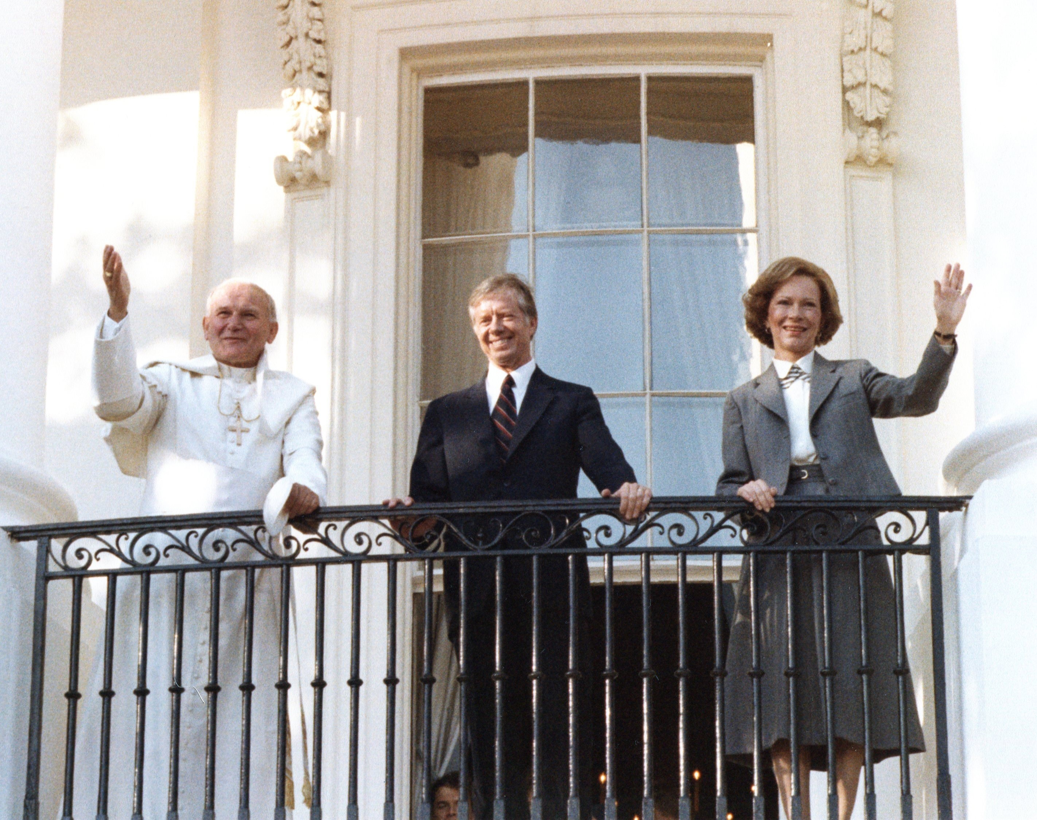
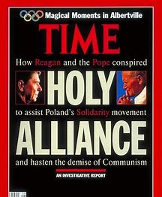
Moral Majority
1979
1989
Reagan
John Paul II in
Washington DC
John Paul II +
USA take USSR down

Slide 33
January
2013
2016
2009
2014
2018
1989
Reagan/Bush
Tea Party Movement
Meeting :
Steve Bannon
Jeff Session
Steven Miller
Eric Canton
Trump Elected with the help of Cambridge Analytica
Religious Liberty Task Force
Jeff Session

Slide 34
