Slide 1
Kids’ Prophecy Corner
Church And State
- Part 1-

Slide 2
The American Civil War
The American Civil War was fought between the southern states and the northern states. The southern states didn't want the North telling them what to do or making laws they didn't want. As a result, many southern states decided to break away and form their own country called the Confederacy. The North, however, wanted to stay as one united country; and so a war began. The Civil War, and the major events leading up to the war, lasted from 1860 to 1865. The Civil war begins on April 12, 1861 and ended on May 9, 1865.

Slide 3
151
Midway
July 21
1863
Ap. 19
2014
Oct 22
1861
1865
9/11
2019

Slide 4
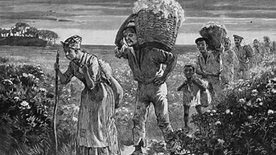
Causes of the Civil War
God is punishing this nation for the high crime of slavery. He has the destiny of the nation in his hands. He will punish the South for the sin of slavery, and the North for so long suffering its overreaching and overbearing influences. { RH August 27, 1861, Art. A, par. 1 }
All heaven beholds with indignation, human beings, the workmanship of God, reduced to the lowest depths of degradation, and placed on a level with the brute creation by their fellow-men. And professed followers of that dear Saviour whose compassion was ever moved as he witnessed human woe, heartily engage in this enormous and grievous sin, and deal in slaves and souls of men. Angels have recorded it all. It is written in the book. The tears of the pious bondmen and bondwomen, of fathers, mothers and children, brothers and sisters, are all bottled up in heaven. Agony, human agony, is carried from place to place, and bought and sold. God will restrain his anger but a little longer. His anger burns against this nation, and especially against the religious bodies who have sanctioned, and have themselves engaged in this terrible merchandise. Such injustice, such oppression, such sufferings, many professed followers of the meek and lowly Jesus can witness with heartless indifference. And many of them can inflict, with hateful satisfaction, all this indescribable agony themselves, and yet dare to worship God. It is solemn mockery, and Satan exults over it, and reproaches Jesus and his angels with such inconsistency, saying, with hellish triumph, Such are Christ’s followers! { RH August 27, 1861, Art. A, par. 2 }

Slide 5
151
Midway
July 21
1863
Ap. 19
2014
Oct 22
1861
1865
9/11
2019
Judgement
USA + Churches
Slavery
Ellen White

Slide 6
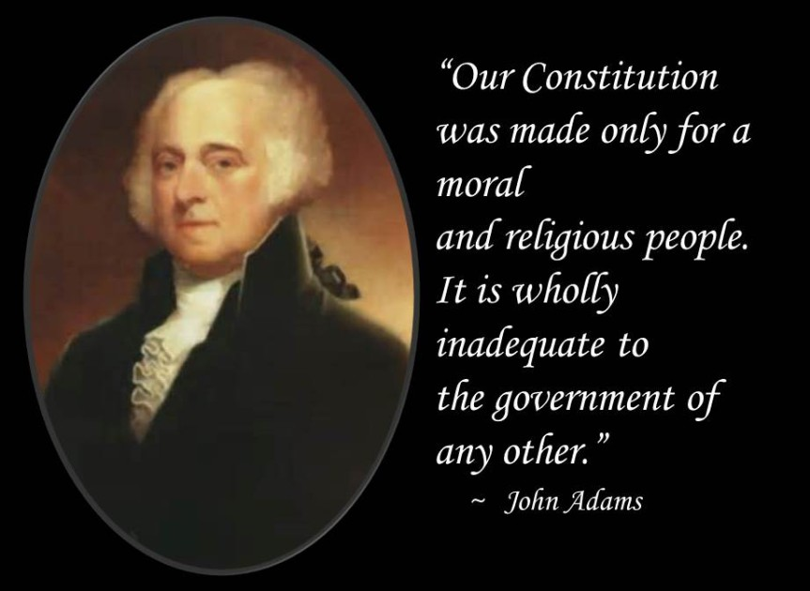
Causes of the Civil War
Early in 1863, the Civil War had not been going well for the North. Distressed over the terrible disaster his troops had suffered at Fredericksburg in December, General Ambrose Burnside had just stepped down as commander of the Army of the Potomac. Interpreting the Union defeats as a manifestation of divine wrath, clergymen representing 11 Protestant denominations met at Xenia, Ohio, on February 4, 1863, seeking ways to appease an angry God. This meeting led to the formation of the National Reform Association.
Why was God angry with the United States? According to this association’s spokesmen, the reason was the failure of its government to acknowledge the Lordship of Jesus Christ and to enforce His moral law. Even after the war was over and the North had won, they retained their conviction that Jehovah was displeased with America. National Reformers continued to warn, for at least the next three decades, that divine judgment threatened the United States. WEGW 120.1 ( from the Ellen White Website)

Slide 7
National Reform Association
The National Reform Association (NRA), formerly known as the National Association to Secure the Religious Amendment of the United States Constitution, is an organization that seeks to introduce a Christian amendment to the U.S. Constitution in order to make the United States a Christian state.
Founded in 1864, the National Reform Association included representatives from eleven Christian denominations as well as the official support of a number of Churches. It publishes a magazine called The Christian Statesman.

Slide 8
151
Midway
July 21
1863
Ap. 19
2014
Oct 22
1861
1865
9/11
2019
R. losing
Religious Motto Suggested
National Reform Movement
“ In God We Trust”
Judgement
Judgement
USA + Churches
Slavery
Church + State
Immorality
Christian Nation
Ellen White

Slide 9
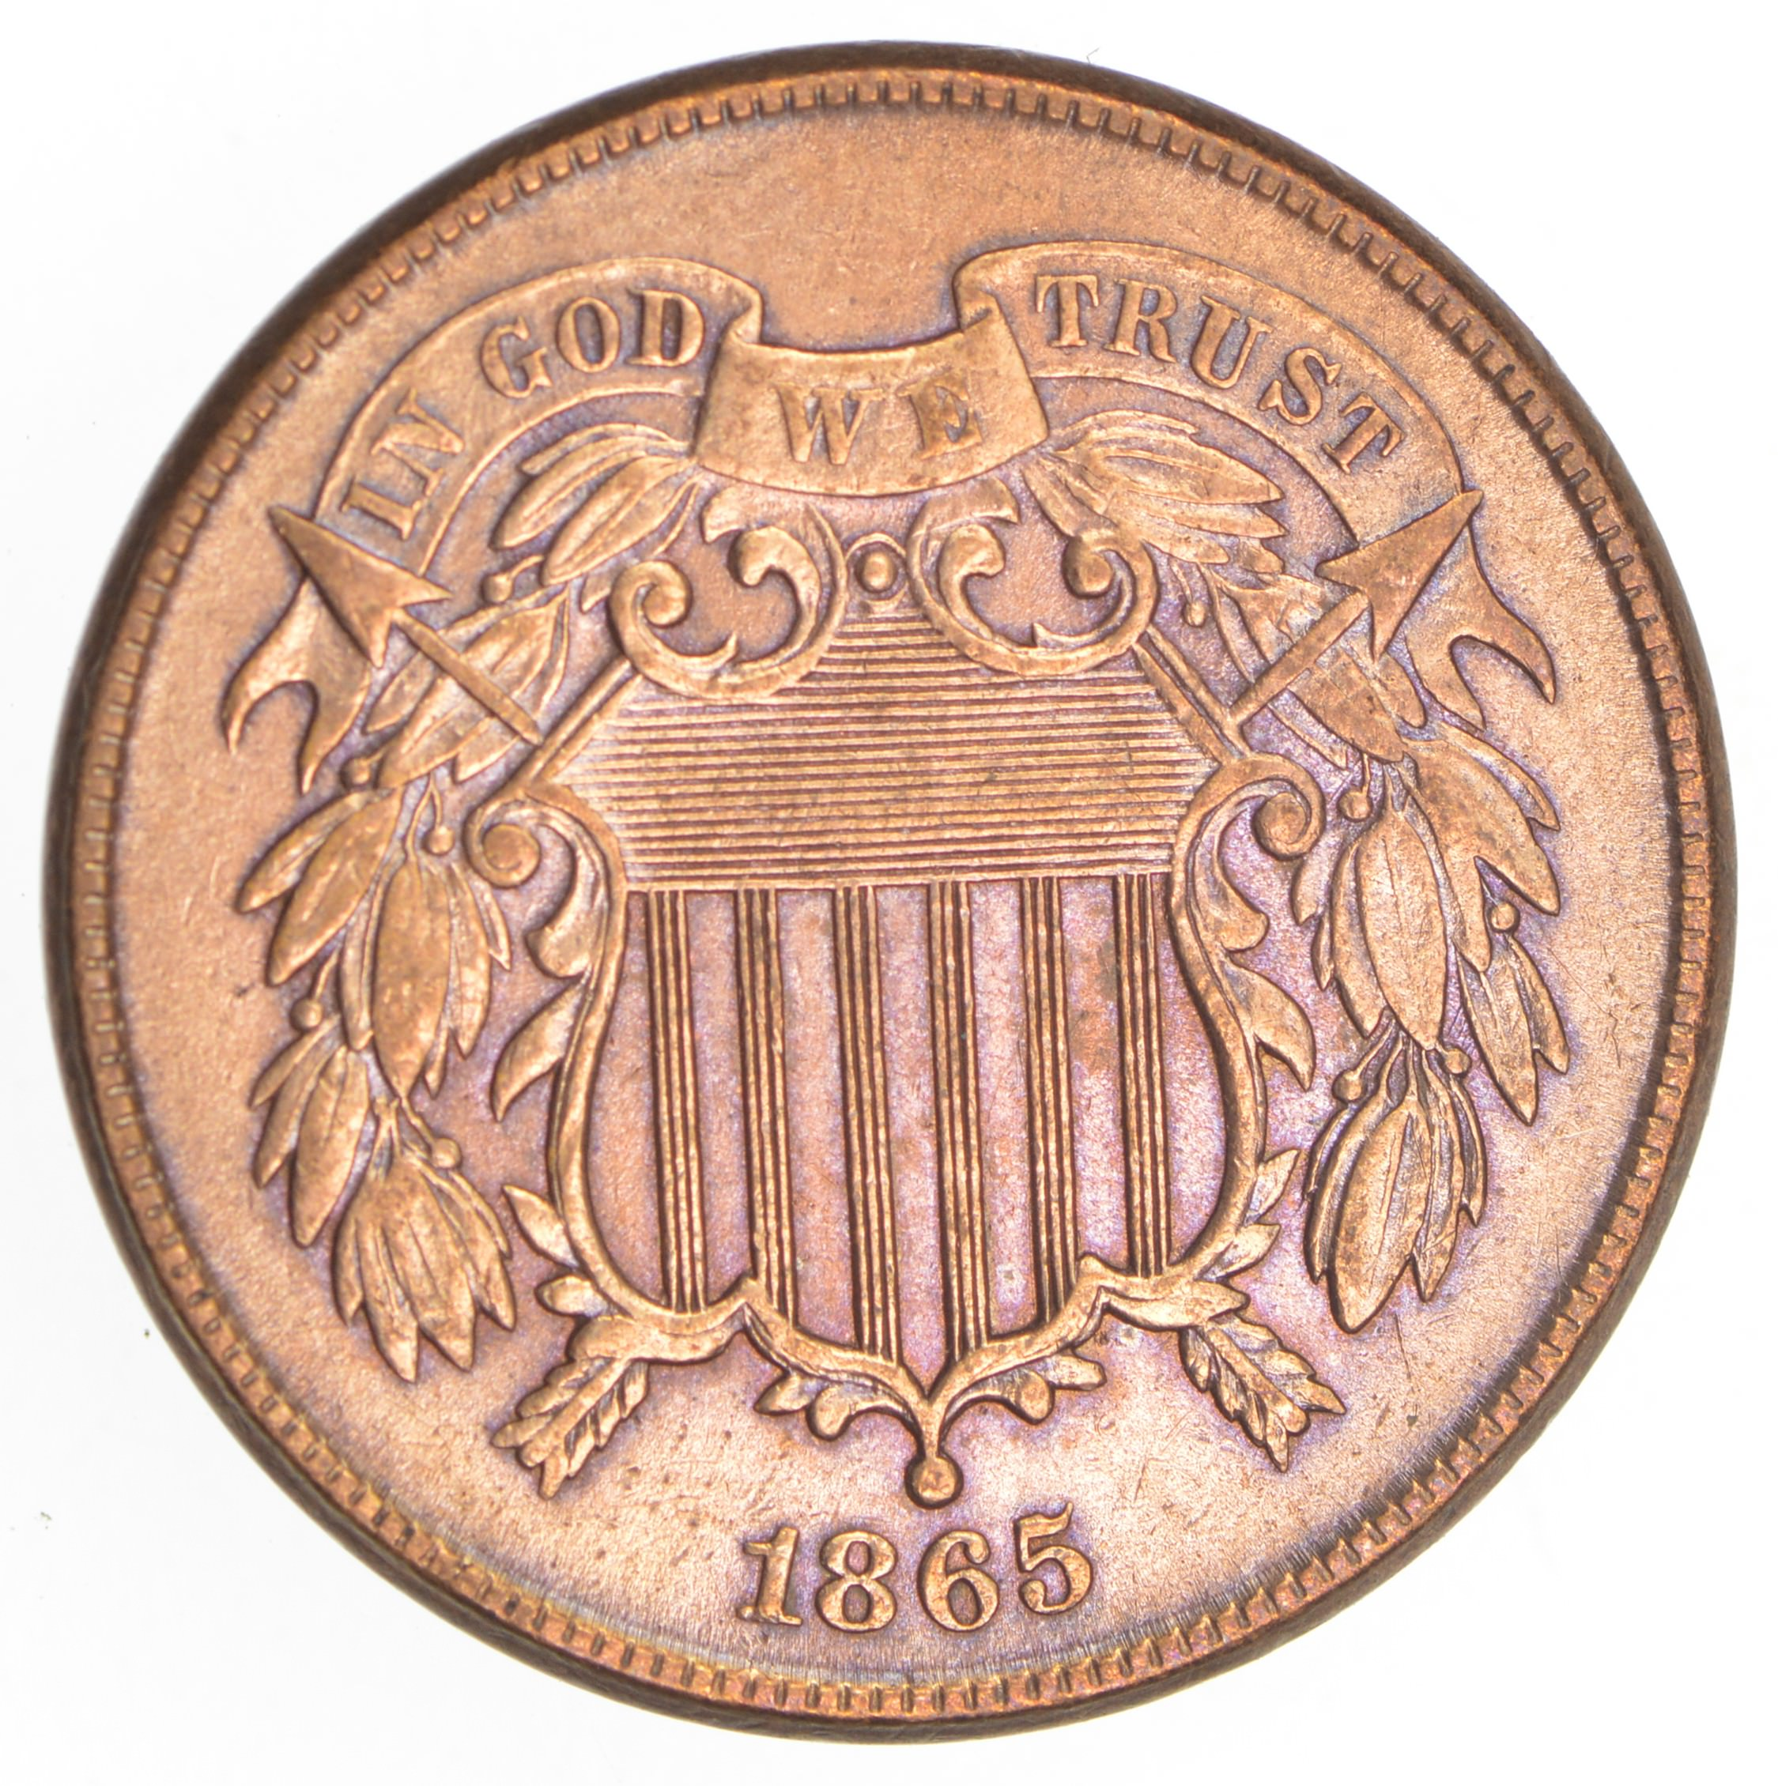
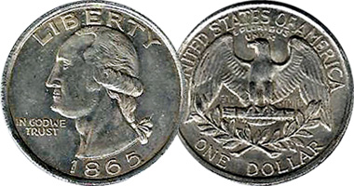
In God We Trust
Before 1861, There is a pastor who wrote to the government, to Salmon P. Chase ( Secretary of Treasury) and he says there should be a religious slogan placed on American coins. It has been rejected and resisted because it was a violation of the first amendment.
But in 1861, the North, the Republicans, are not sure of the victory. So the concept became more popular. The motto is suggested.
In 1863, the motto is decided. It is “In God we Trust”.
In 1864, the phrase is placed on coins.
In 1865, March 3, Congress passed a law, the motto to be stamped on all coins.

Slide 10
151
Midway
July 21
1863
Ap. 19
2014
Oct 22
1861
1865
9/11
2019
R. losing
Religious Motto Suggested
National Reform Movement
Law placed on Currency
“ In God We Trust”
Judgement
Judgement
USA + Churches
Slavery
Church + State
Immorality
Christian Nation
Ellen White

Slide 11
151
151
Midway
July 21
1863
Ap. 19
2014
Oct 22
1861
1865
1868
9/11
2019
R. losing
Religious Motto Suggested
National Reform Movement
Law placed on Currency
“ In God We Trust”
Judgement
Judgement
USA + Churches
Slavery
Church + State
Immorality
Christian Nation
Ellen White

Slide 12
The 14th and 15th Amendments
The Thirteenth Amendment, passed in 1865, made slavery illegal.
The Fourteenth Amendment affirmed the new rights of freed women and men in 1868. The law stated that everyone born in the United States, including former slaves, was an American citizen. No state could pass a law that took away their rights to “life, liberty, or property.”
The Fourteenth Amendment also added the first mention of gender into the Constitution. It declared that all male citizens over twenty-one years old should be able to vote. In 1870, the Fifteenth Amendment affirmed that the right to vote “shall not be denied…on account of race.”
In 1870, the Fifteenth Amendment affirmed that the right to vote “shall not be denied…on account of race.”

Slide 13
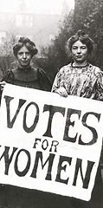
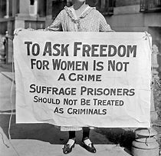
The Women’s Suffrage
Women's suffrage is the right of women to vote and to hold an elected office.
In the United States women were not allowed to vote until the passage of the 19th amendment in June 4,1919. That’s a 100 years ago!
The text says : The right of citizens of the United States to vote shall not be denied or abridged by the United States or by any State on account of sex.

Slide 14
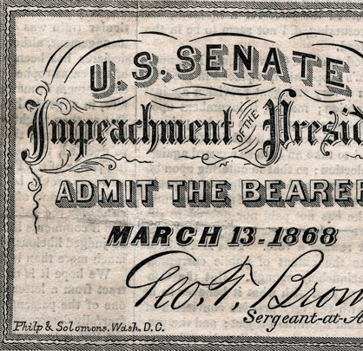
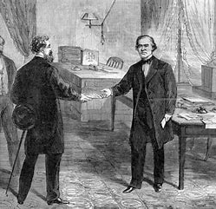
Andrew Johnson
Was charged for firing his secretary of war Edwin Stanton.
It happens after the civil war ( 1861-1865) and during the reconstruction
Johnson was not removed by one vote. 64.8% voted for.

Slide 15
Obama Vs Trump
Obama : more immigration, better rights between black and white, better health care with the Obamacare, liberty of conscience by authorising gay marriage, equal pay between men and woman.
Trump : Restraining immigration, deporting families, separating children from their parents, working with the moral majority - the white evangelicals, upholding white privileges etc.

Slide 16
151
151
Midway
July 21
1863
Ap. 19
2014
Oct 22
1861
1865
1868
9/11
2019
R. losing
Religious Motto Suggested
National Reform Movement
Law placed on Currency
14th + 15th
^{Amendment}
Gender
“ In God We Trust”
1st President Impeached
Judgement
Judgement
USA + Churches
Slavery
Church + State
Immorality
Christian Nation
Ellen White

Slide 17
151
151
Midway
63
July 21
1863
Cold War
1951
2014
Oct 22
Ap. 19
1861
1865
1868
1948
1954
9/11
2019
R. losing
Religious Motto Suggested
National Reform Movement
Law placed on Currency
14th + 15th
^{Amendment}
Gender
“ In God We Trust”
1st President Impeached
Judgement
Judgement
USA + Churches
Slavery
Church + State
Immorality
Christian Nation
Ellen White

Slide 18
151
151
Midway
63
July 21
1863
Cold War
1951
2014
Oct 22
Ap. 19
1861
1865
1868
1948
1954
9/11
2019
R. losing
Religious Motto Suggested
National Reform Movement
Law placed on Currency
14th + 15th
^{Amendment}
Gender
“ Under God”
“ In God We Trust”
1st President Impeached
Judgement
Judgement
USA + Churches
Slavery
Church + State
Immorality
Christian Nation
Ellen White

Slide 20
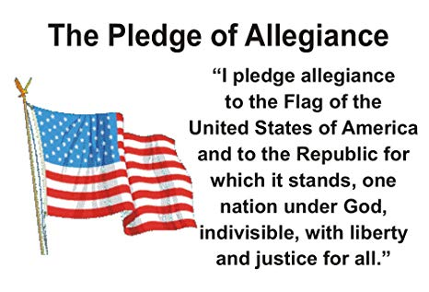
“Under God”
In 1951, one of the largest catholic association, the knights of Columbus, started to introduce “ Under God” in the pledge of allegiance at the beginning of all of their meetings.
In 1954 “ Under God” is officially added to the Pledge of Allegiance.

Slide 21
151
151
Midway
63
July 21
1863
Cold War
1951
2014
Oct 22
Ap. 19
1861
1865
1868
1948
1954
9/11
2019
R. losing
Religious Motto Suggested
National Reform Movement
Law placed on Currency
14th + 15th
^{Amendment}
Gender
“ Under God”
Knights of Columbus
“ Under God”
Introduce “ Under God”
Pledge of Allegiance
Introduce “ Under God”
“ In God We Trust”
Gettysburg Address
1st President Impeached
Judgement
Judgement
USA + Churches
Slavery
Church + State
Immorality
Christian Nation
Ellen White

Slide 22
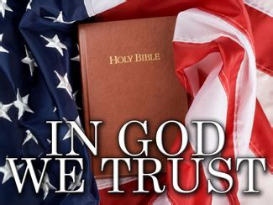
“ In God We Trust”
" In God We Trust ", also written as " In God we trust ", is the official motto of the United States of America.
It was adopted by the U.S. Congress in 1956, replacing E pluribus unum ( Out of many one), in use since the initial 1776 design of the Great Seal of the United States.

Slide 23
151
151
Midway
63
July 21
Cold War
1951
63
1863
Ap. 19
2014
Oct 22
1861
1865
1868
1948
1954
1956
9/11
2019
R. losing
Religious Motto Suggested
National Reform Movement
Law placed on Currency
14th + 15th
^{Amendment}
Gender
“ Under God”
Knights of Columbus
“ Under God”
“ In God We Trust”
Introduce “ Under God”
Pledge of Allegiance
Official Motto
Introduce “ Under God”
“ In God We Trust”
Gettysburg Address
1st President Impeached
Judgement
Judgement
USA + Churches
Slavery
Church + State
Immorality
Christian Nation
Ellen White

Slide 24
151
151
Midway
63
July 21
Cold War
1951
63
1863
Ap. 19
2014
Oct 22
1861
1865
1868
1948
1954
1956
9/11
2019
R. losing
Religious Motto Suggested
National Reform Movement
Law placed on Currency
14th + 15th
^{Amendment}
Gender
“ Under God”
Knights of Columbus
“ Under God”
“ In God We Trust”
Introduce “ Under God”
Pledge of Allegiance
Official Motto
Introduce “ Under God”
“ In God We Trust”
Gettysburg Address
1st President Impeached
Judgement
Judgement
Judgement
USA + Churches
Slavery
Church + State
Immorality
Christian Nation
Immorality
Ellen White

Slide 25
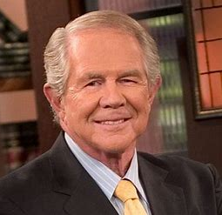
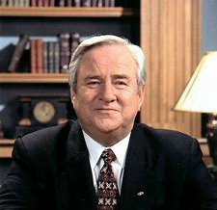
September 11, 2001
People like Jerry Falwell, Pat Robertson, Anne Graham Lotz claim that the 911 attack succeeded because of homosexuality, abortion, secular schools and courts.
Jerry Falwell said America has become so sinful; we should fear God’s judgement.

Slide 26
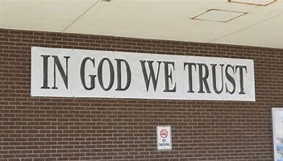
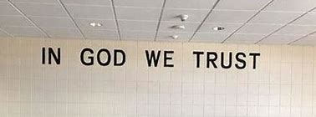

Slide 27
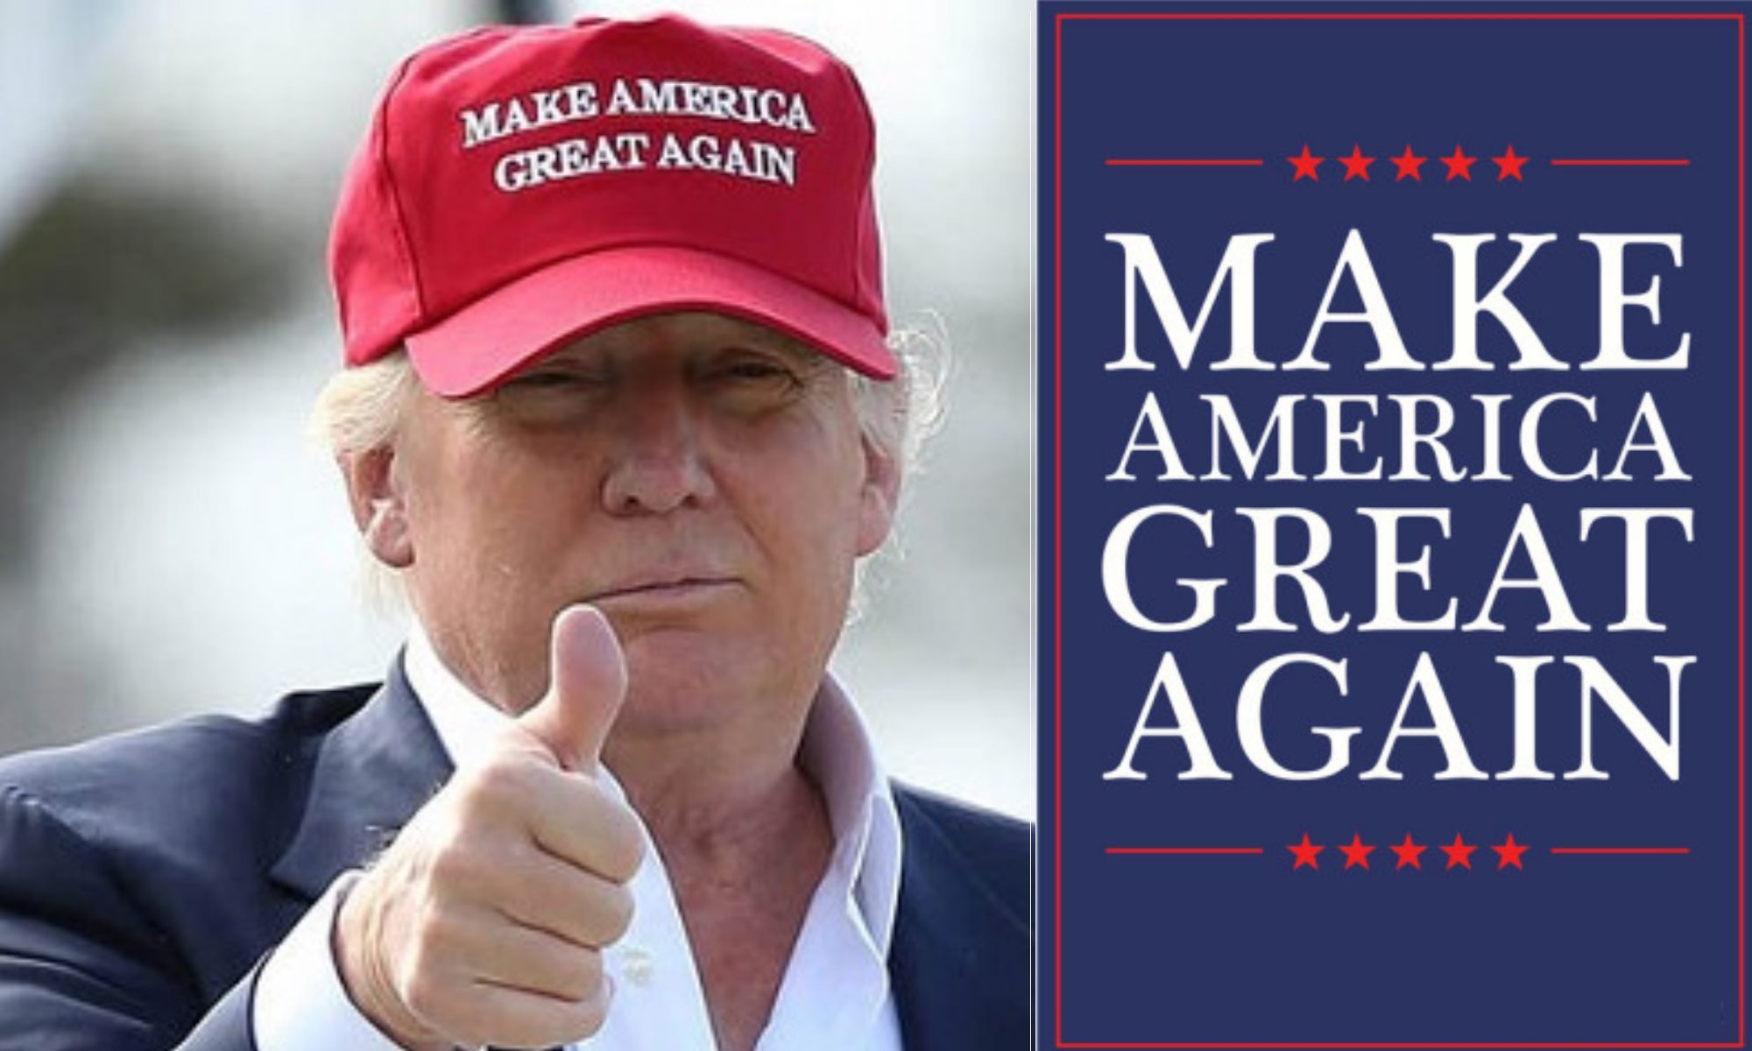

Slide 28
151
151
Midway
63
July 21
Cold War
1951
63
1863
Ap. 19
2014
Oct 22
1861
1865
1868
1948
1954
1956
9/11
2019
R. losing
R. Losing
Obama
Religious Motto Suggested
National Reform Movement
Law placed on Currency
14th + 15th
^{Amendment}
Gender
“ Under God”
Knights of Columbus
“ Under God”
“ In God We Trust”
2017
Arkansas Acts 911
Introduce “ Under God”
Pledge of Allegiance
Official Motto
Introduce “ Under God”
Cambridge Analytica
“ In God We Trust”
Gettysburg Address
1st President Impeached
Judgement
Judgement
Judgement
Make America Great Again
USA + Churches
Slavery
Church + State
Immorality
Christian Nation
Immorality
Church and State
“ In God We Trust”
Public School
. Re-form
. Nationalism
National Reform Movement
Ellen White

Slide 29
Project Blitz
In 2016, Project Blitz is created.
It is an organization that wants to combine church and state.
It seeks to "protect the free exercise of traditional Judeo-Christian religious values and beliefs in the public square, and to reclaim and properly define the narrative which supports such beliefs."
Its agenda includes the promotion of the Bible in public schools and religious exemptions to LGBTQ civil rights protections and women's reproductive healthcare.

Slide 30
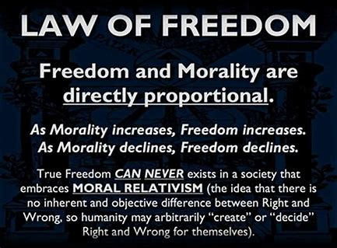

Slide 31
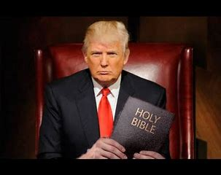
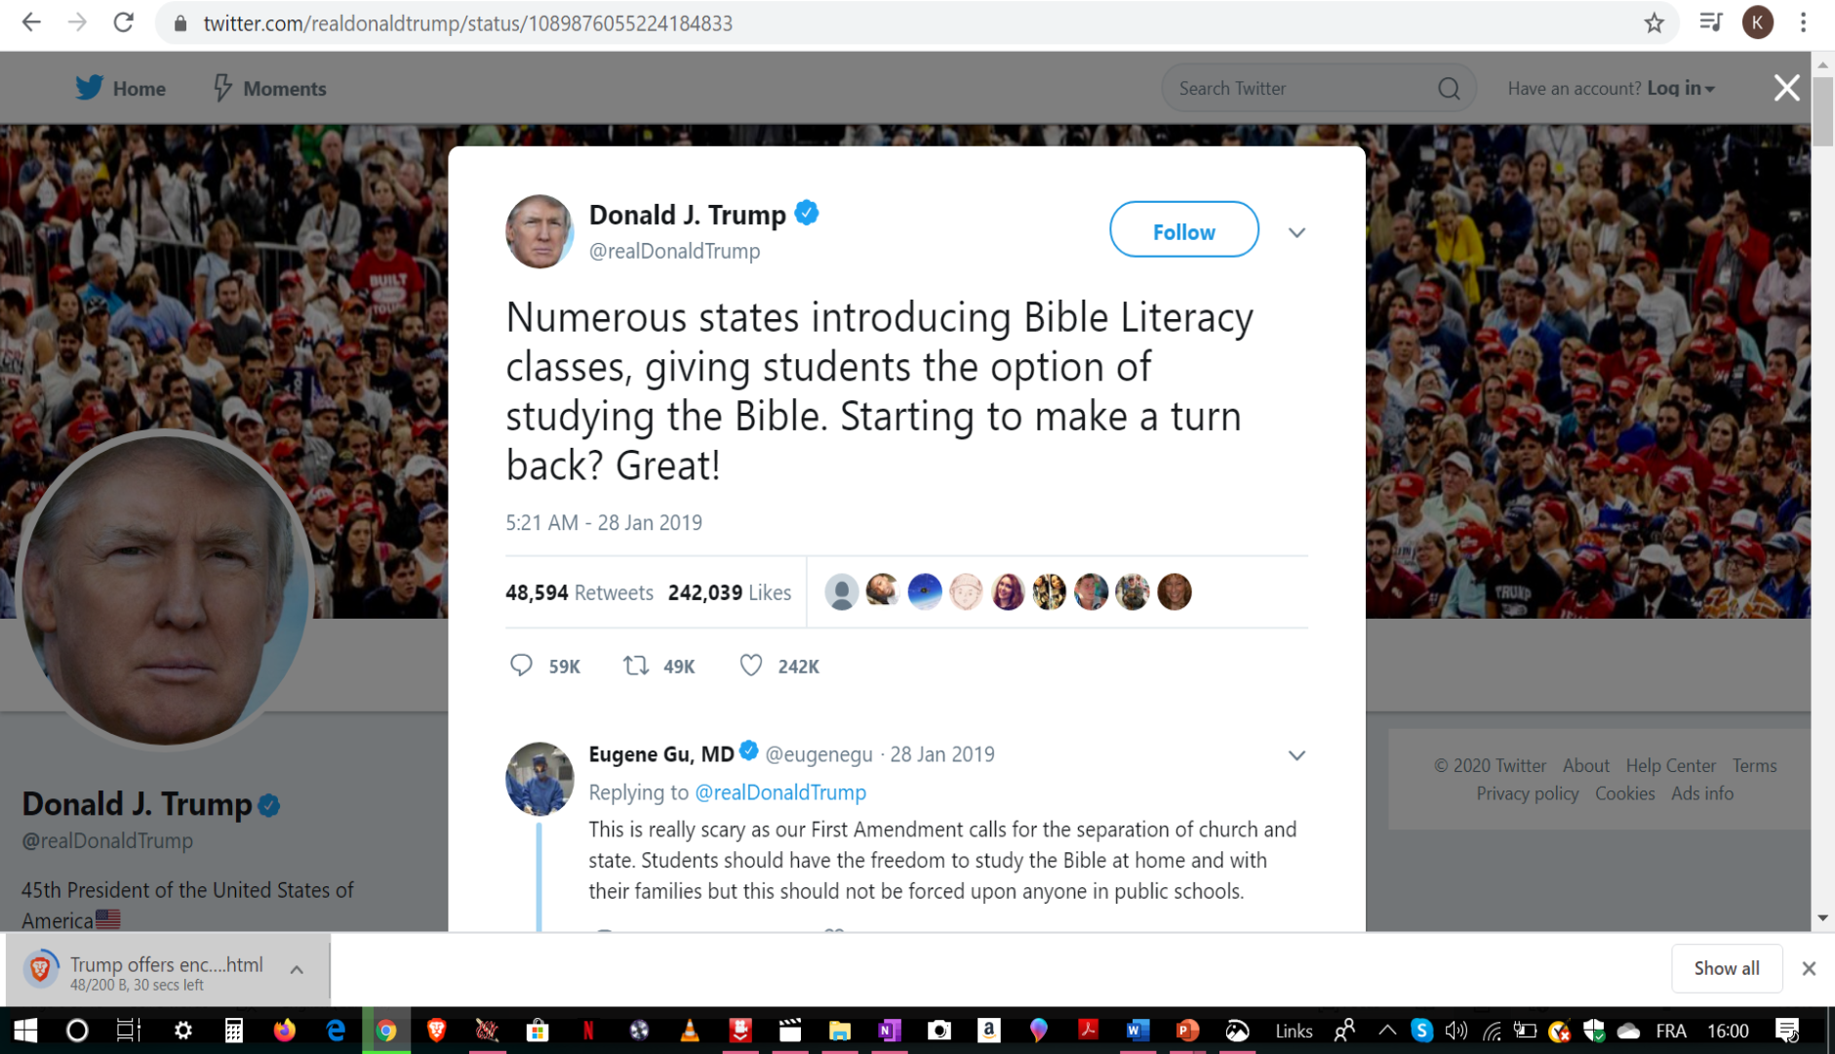

Slide 32
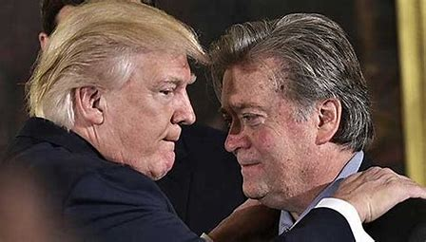
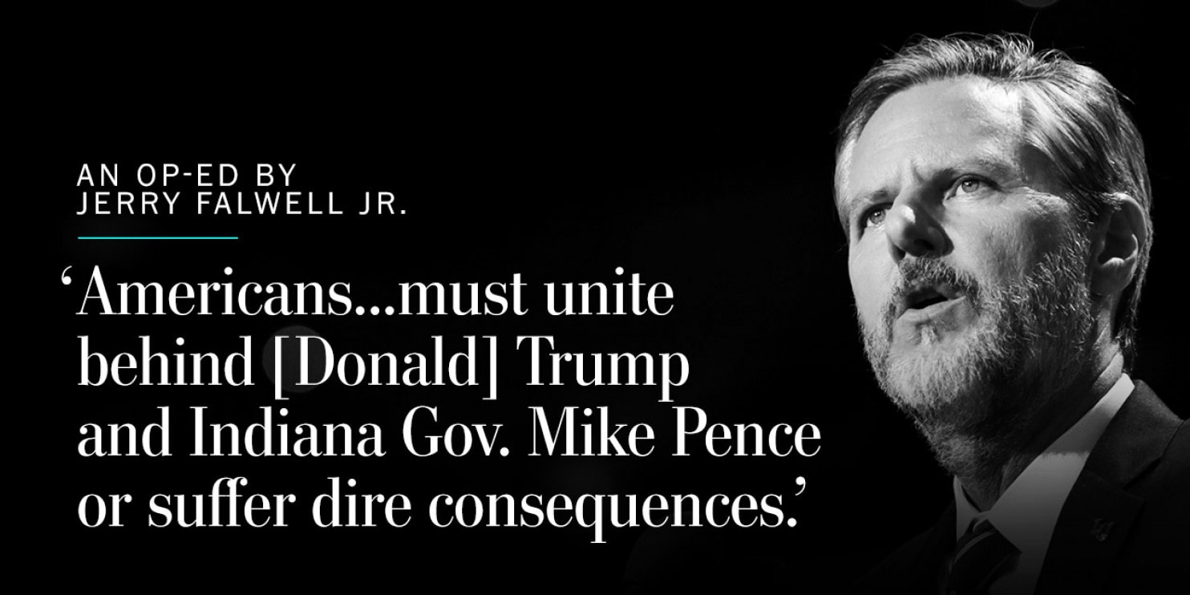
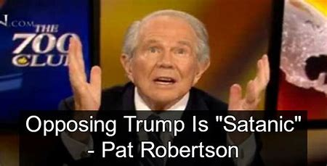

Slide 33
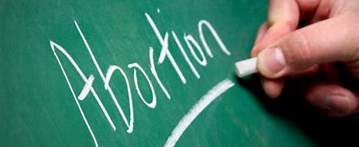
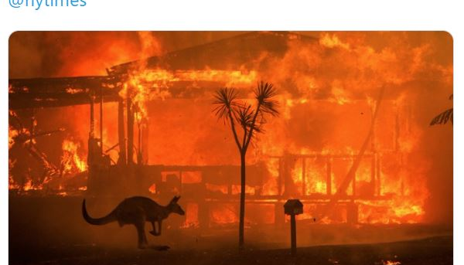
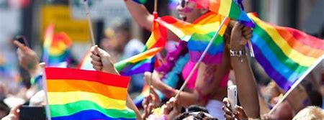

Slide 34
